Slide 1

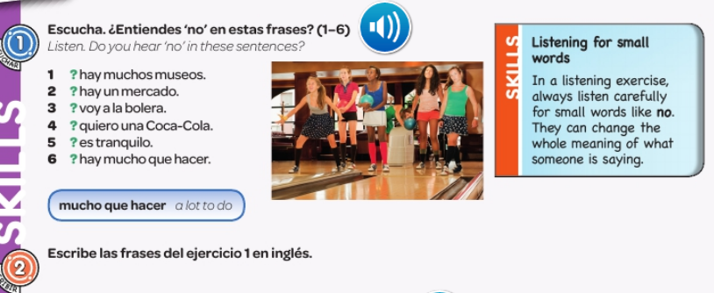

Spanish yr8. Work through as many of the activities as you can.
Tasks 1 and 2 –This week the tasks are based on the vocab you have been learning recently so use the notes in your orange book to help you. You will be doing listening and reading practice.
Task 1. Listen to the track. Do you hear ‘no’ in the sentences?
Task 2. Write what the phrases in exercise 1 mean in English

Slide 2
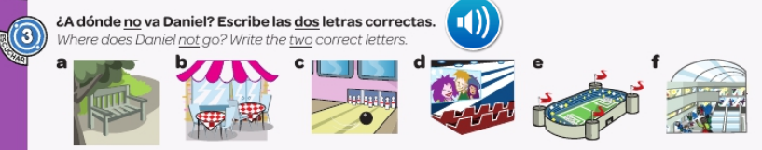
Task 3. Listen to the track and follow the instructions below.

Slide 3
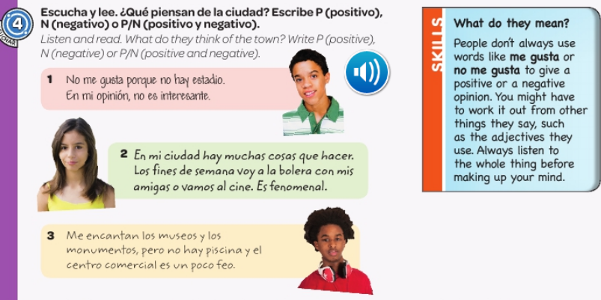

TASKS 4 + 5– Listen to the track and follow the instructions below

Slide 4
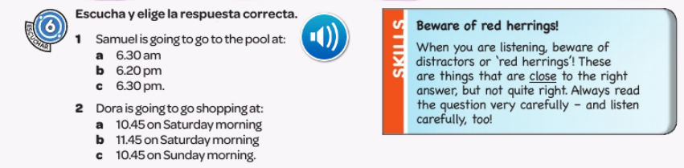
TASK 6. Listen to the track and choose the correct answer.

Slide 5
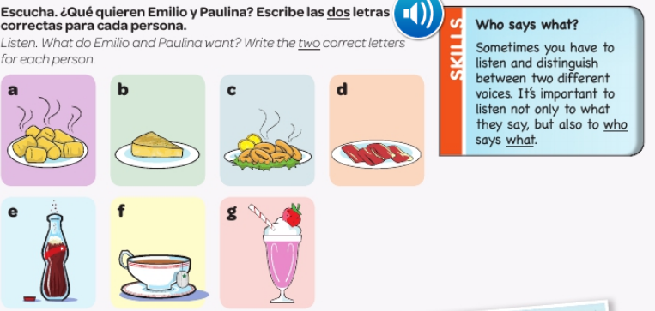
TASK 7 – Listen to the track and follow the instructions below.

