Slide 1
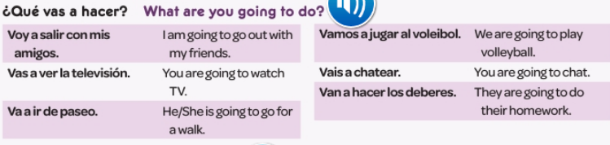
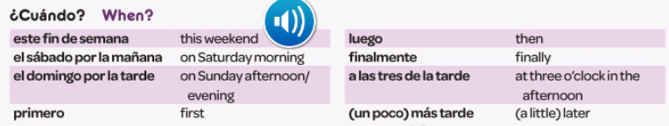
Spanish yr8. Work through as many of the activities as you can.
Task 1 -Read through this week’s vocab. Try and learn it.

Slide 2
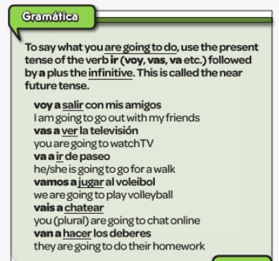
Task 2. Read this grammar information about the near future tense. Copy it in to your orange book.

Slide 3
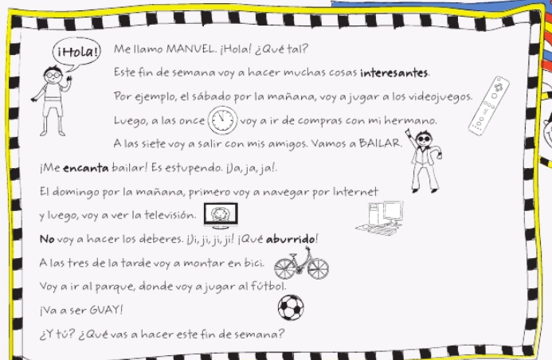

Task 3. Read the text. Look up any new words you don’t know in a dictionary and add them to your orange books. Then make bullet points in English of things you understand in the text.

Slide 4
Task 4. Read the text again. Find thirteen examples of the immediate future tense. Translate them in to English.
Example: 1 voy a hacer = I am going to

Slide 5

Task 5 Find these 6 phrases in the text below. Write them in Spanish and English in your orange book.

Slide 6

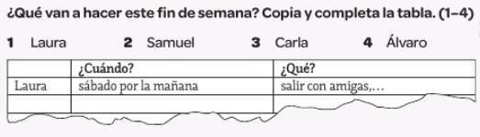
TASK 6 – Listen to the track. Copy the table and fill it in. What are they going to do this weekend? In column 1 write their name. In column 2 write when they are going to do the activity, In column 3 write what they are going to do.

