Slide 1
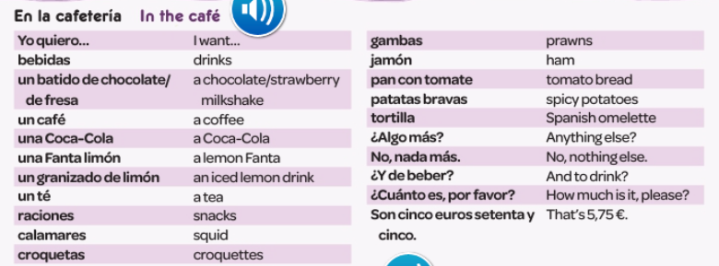
Spanish yr8. Work through as many of the activities as you can.
Task 1 -Read through this week’s vocab. Try and learn the food phrases

Slide 2
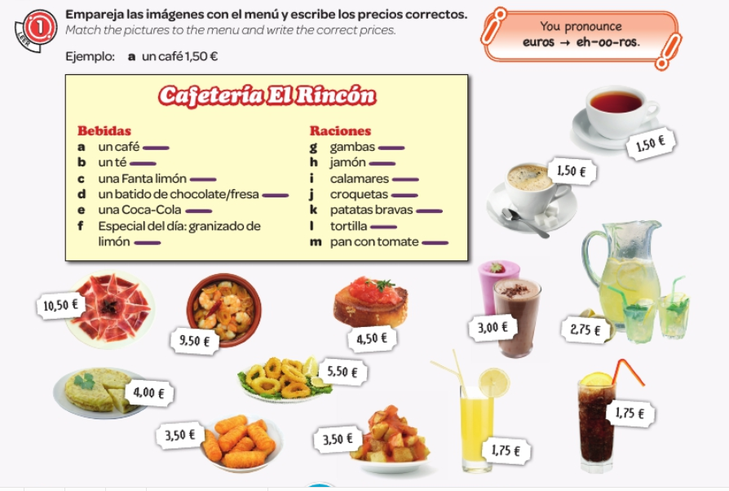
Task 2. Match up the pictures to the menu descriptions and write the prices

Slide 3

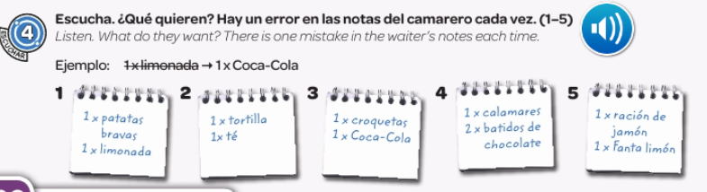
Task 3. Write down 1-5 in the back of your book. What do they order? There is a mistake in each order. Try and correct it.

Slide 4
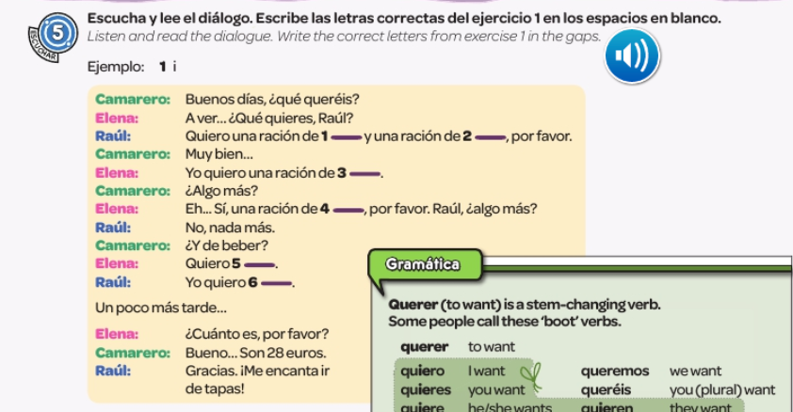
Task 4. Listen to the dialogue and fill in the gaps

Slide 5
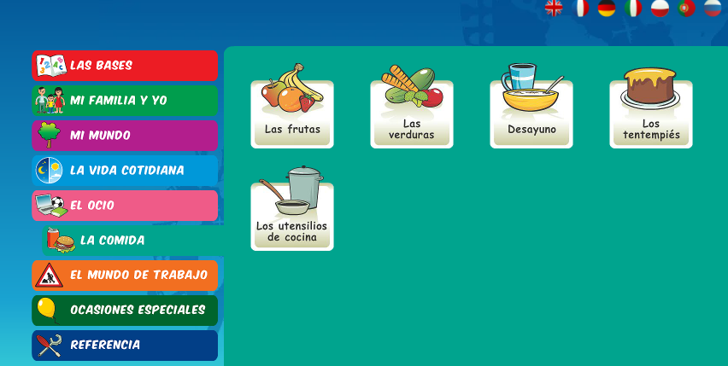
Log in to Linguascope. Username is Kingshill Password is bonjour123
Practise the vocab for food in the beginner section.

