Slide 1
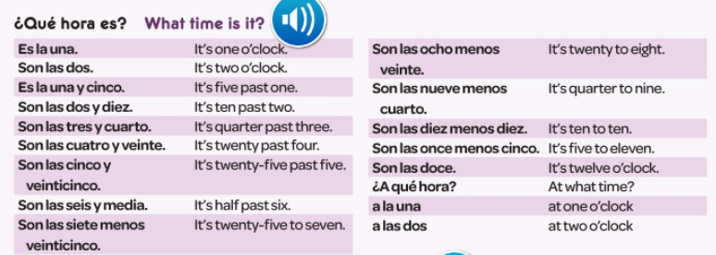
Spanish yr8. Work through as many of the activities as you can.
Task 1 -Read through this week’s vocab. Try and learn how to tell the time. There is more vocab on the next page

Slide 2
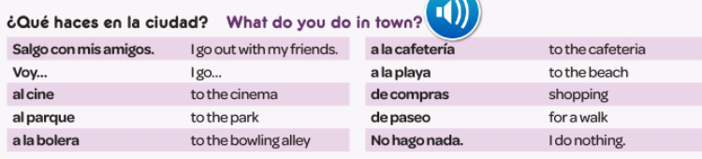
Task 2 -Read through this vocab. Try and learn the phrases.

Slide 3
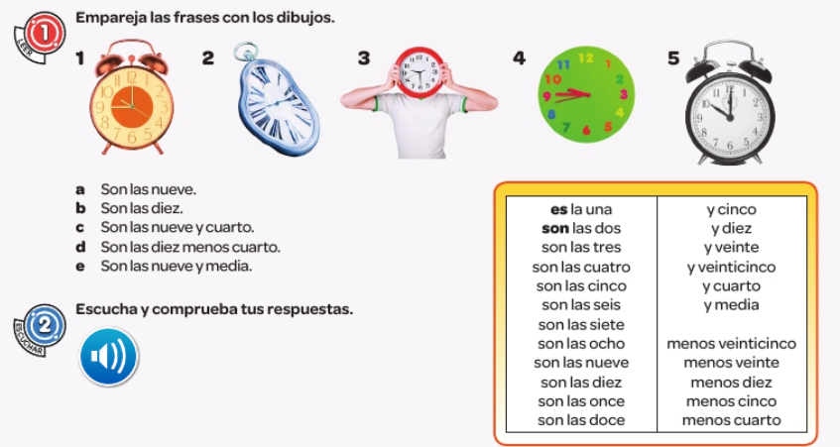
TASK 3 – Match the clocks with the times

Slide 4

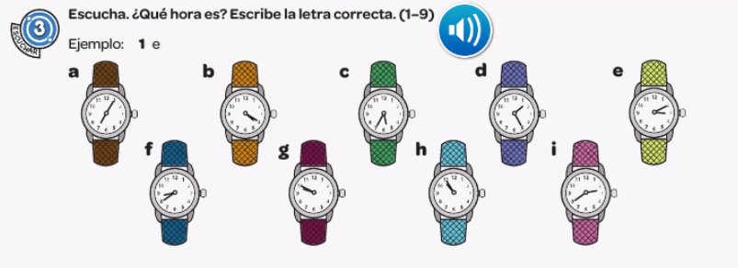
TASK 4. Write down 1-9. Listen to the track. Which time is it? Find the right watch.

Slide 5
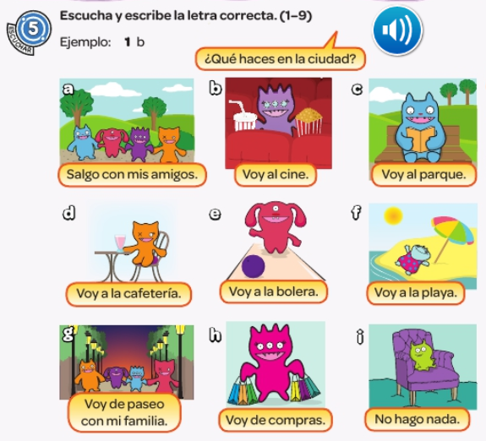
TASK 5. Write down 1-9. Listen to the track. Which phrase do you hear?

Slide 6
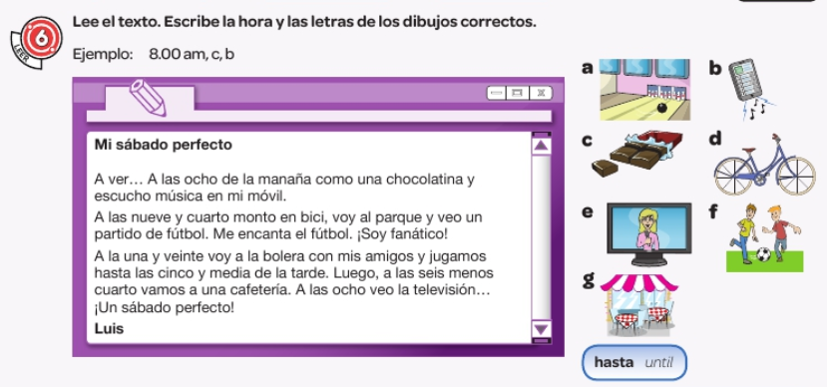
TASK 6. Read the text. Write down the times it mentions and find the picture it talks about

