Slide 1
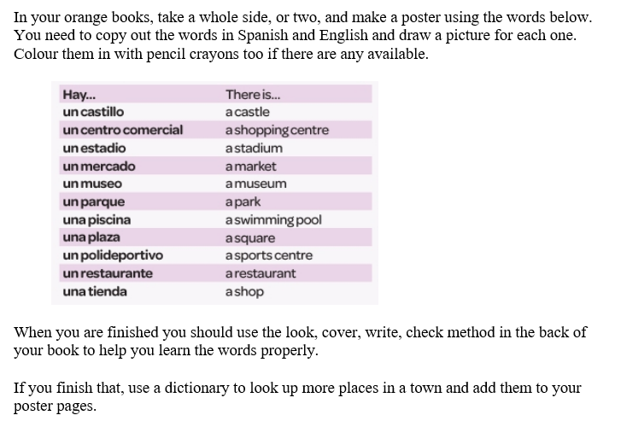
Spanish yr8. Work through as many of the activities as you can.

Slide 2
Learn the following phrases

Slide 3
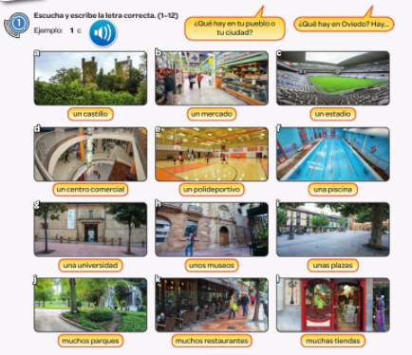
Write down 1-12 in the back of your book. Listen to the track. What is in their towns and villages?

Slide 4
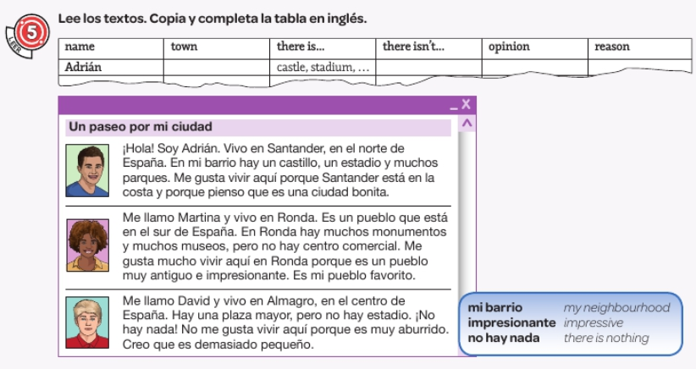
Read the texts and complete the table

Slide 5
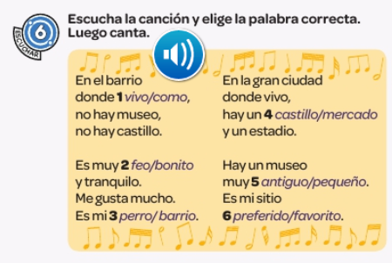
Listen to the song. Choose the correct word.

