Slide 1
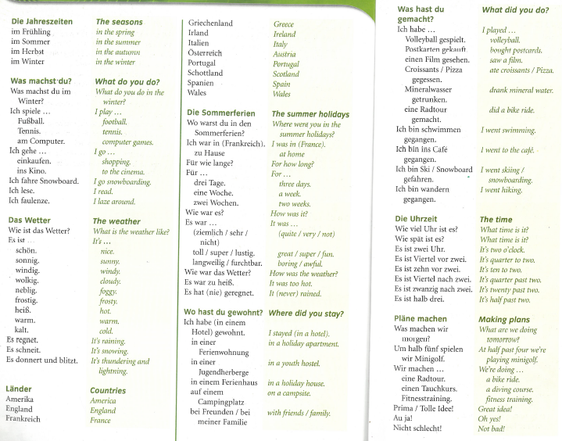
German yr8. This week is assessment week so spend time revising the vocabulary we have learned this term.
The vocabulary for the whole unit is saved in the pupil area too. Please go through it. It looks like the picture below.
Contact your MFL teacher for the assessment papers if you know you will be away for the lesson when the tests are taking place.

Slide 2
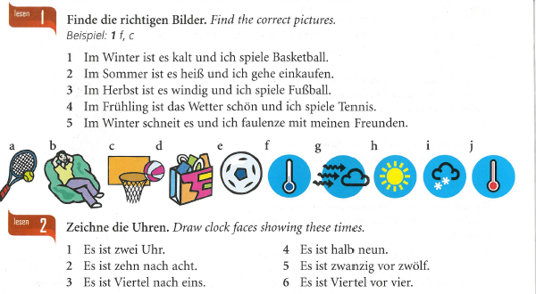
Revision tasks

Slide 3
