Slide 1
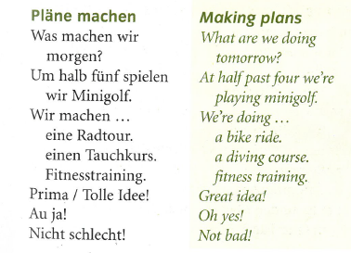
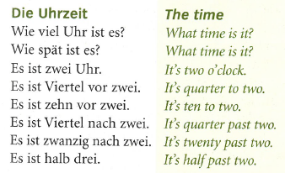
German yr8. Work through as many of the activities as you can.
Task 1 -Read through this week’s vocab. Try and learn how to tell the time and the making plans phrases
Note – in German we say ‘half to’ not ‘half past’!

Slide 2
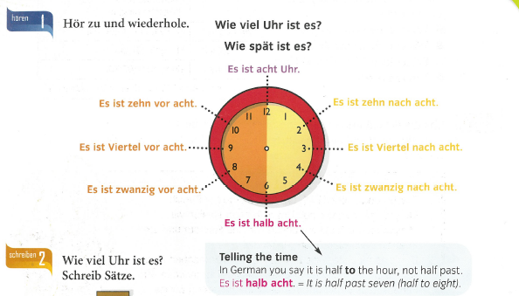

Task 2. Listen and repeat the clock times

Slide 3
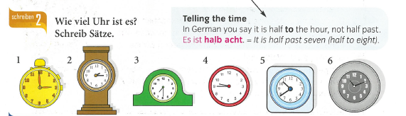
TASK 3 – Write down what time each clock is showing
Example – 1 Es ist drei Uhr (It is 3 o’clock)

Slide 4
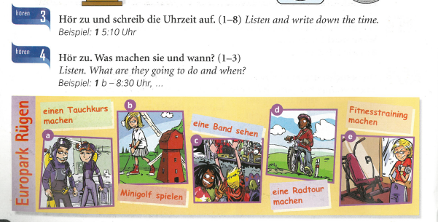
4.
5.
TASKS 4 + 5. Listen to the tracks. Follow the instructions below.

Slide 5
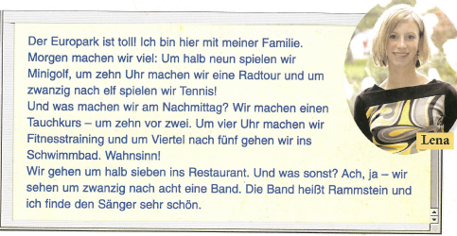
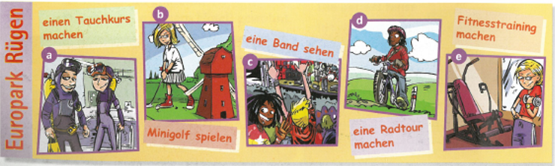
TASK 6 – Read the text. Put the pictures below (the ones from task 5) in the correct order they took place. Example b,…

