Slide 1
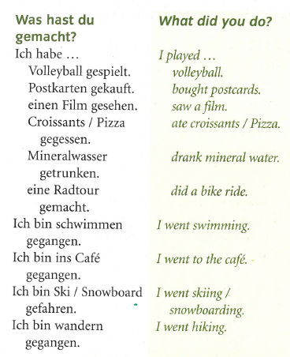
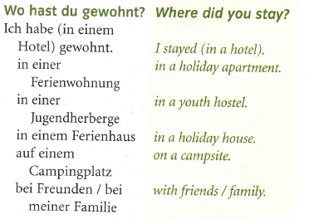
German yr8. Work through as many of the activities as you can.
Task 1 -Read through this week’s vocab. Try and learn the types of accommodation and the past tense phrases

Slide 2
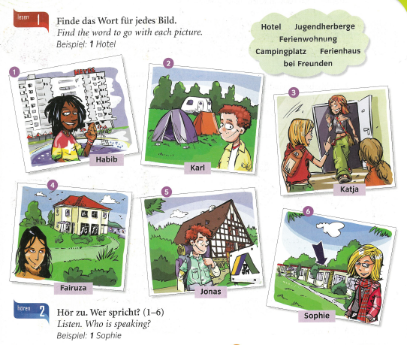
Task 2. Match the pictures with the types of accommodation in the cloud

Slide 3
Task 3. Write down 1-6 in the back of your book. Listen to the track. Who is talking? Example, 1= Sophie

Slide 4
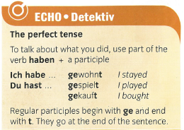
TASK 4 – Read the grammar information showing you how to use the past tense. Copy it in to your books.

Slide 5
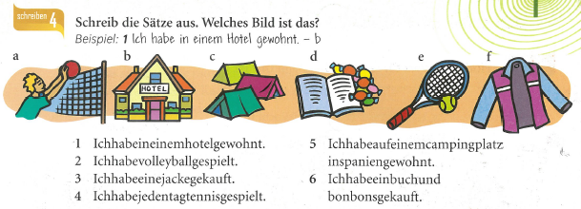
TASK 5. Write out the 6 spaces properly by adding in the spaces. Then match them with the pictures. Look back at the first slide of vocab to help you. Example (Beispiel) below

Slide 6
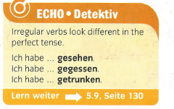
TASK 6 – Copy out this grammar information. Some verbs are irregular (i.e. they don’t follow the normal pattern of how the past tense is formed).
I saw
I ate
I drank

Slide 7
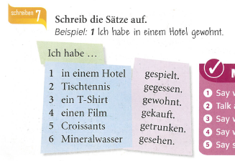
TASK 7 – Write out the sentences by choosing the correct word to complete each sentence

