Slide 1
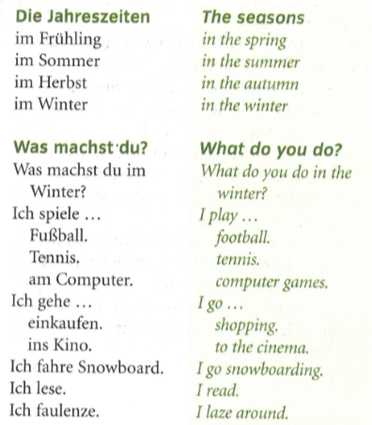
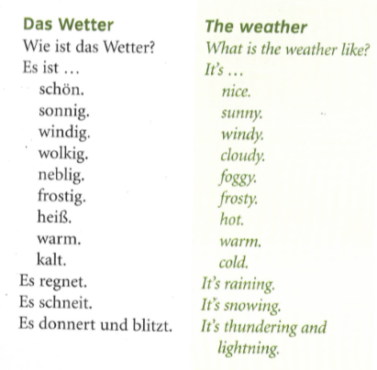
German yr8. Work through as many of the activities as you can.
Task 1 -Read through this week’s vocab. Try and learn the seasons and weather phrases

Slide 2
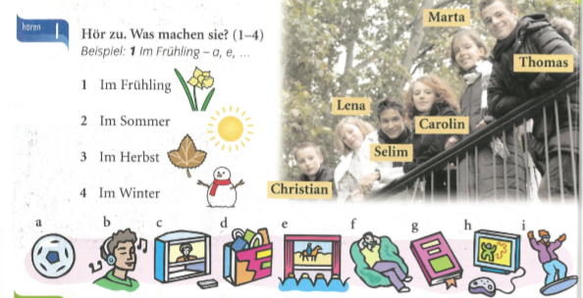
Task 2. Write down 1-4 in the back of your book. Listen to the track. Which activities do they do in each season?

Slide 3
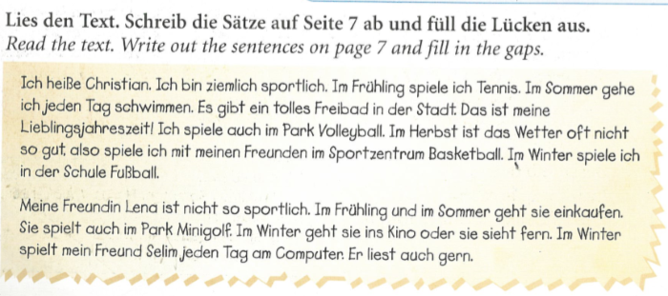
TASK 3 –
Read through the text. Write out some information in English about that you have understood. Just key information and bullet points are fine.

Slide 4
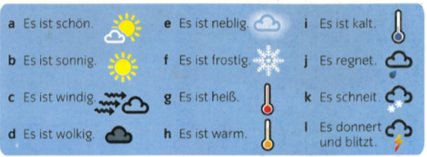
TASK 4. Make a poster of the weather phrases in your book. Try and learn them.

Slide 5
TASK 5 – Listen to the track. Which town do they mention and what is the weather like there?

Slide 6
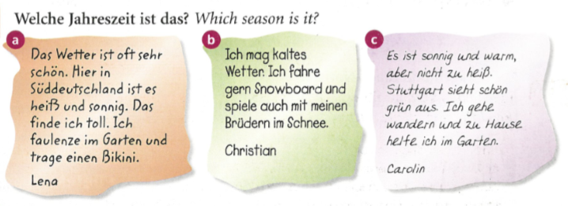
TASK 6 – Read the texts and say, in German, which season it is

Slide 7
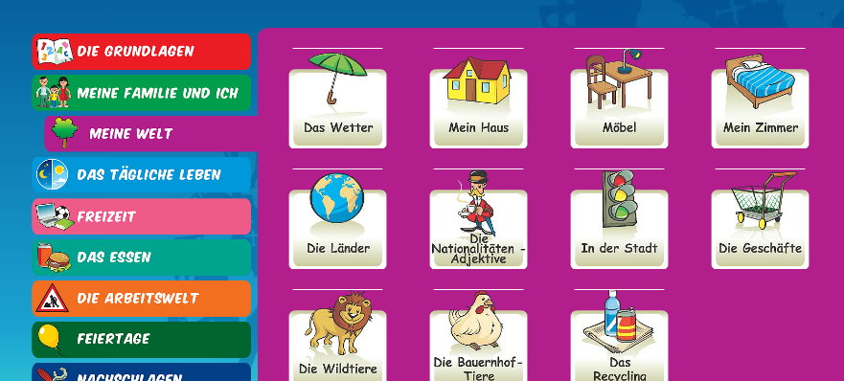
Log in to Linguascope. Username is Kingshill Password is bonjour123
Practise the weather vocab in the beginner section.

