Slide 1
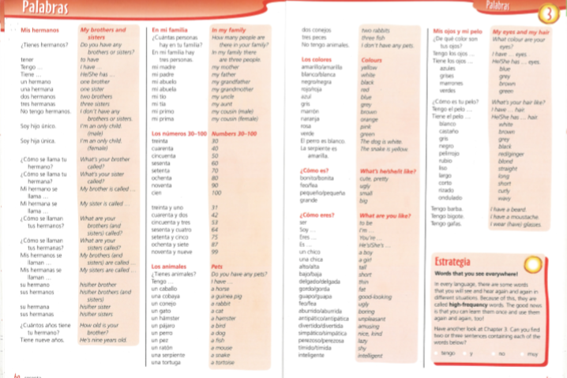
Spanish yr7. This week is assessment week so spend time revising the vocabulary we have learned this term.
The vocabulary for the whole unit is saved in the pupil area too. Please go through it. It looks like the picture below.
Contact your MFL teacher for the assessment papers if you know you will be away for the lesson when the tests are taking place.

Slide 2
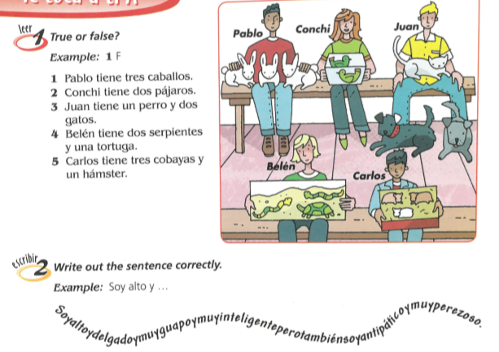
Revision tasks
exercise 1-Look at the pictures and say if the phrases are true or false
exercise 2 – Put gaps in to the word snake so that you make proper sentences. Example, Soy alto y …
exercise 3 – Write the opposite of these adjectives, ie alto-bajo

Slide 3
Exercise 4

