Slide 1
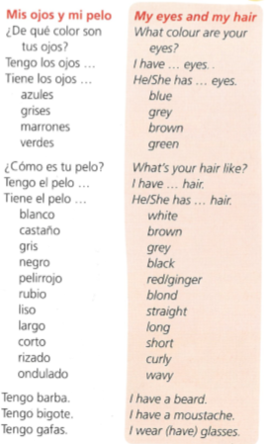
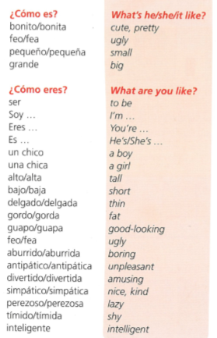
Spanish yr7. Work through as many of the activities as you can.
Task 1 –This week the tasks are based on the vocab you have been learning recently. Please read through the vocab on here as revision

Slide 2
Task 2. Copy the table. Listen to the track and fill in the descriptions of the people – in the 1st column you need to put a description of their appearance ie, height or weight, in the 2nd column you describe their eyes and in the 3rd column you describe their hair.

Slide 3
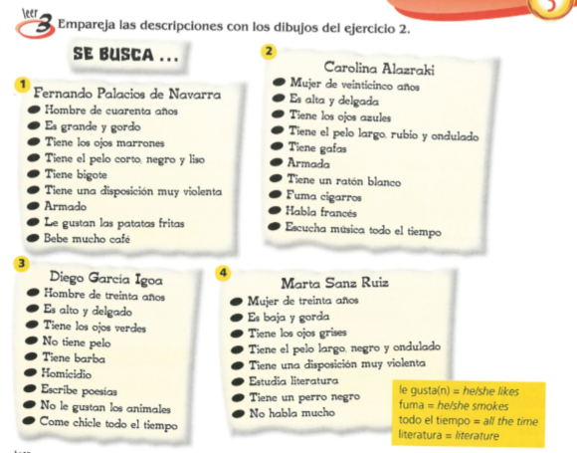
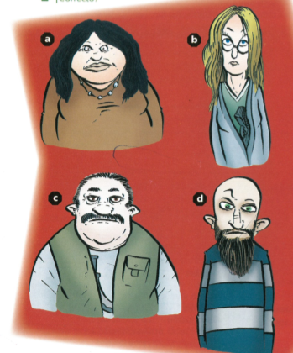
TASK 3 – Read the 4 descriptions and then match them up with the pictures a-d

Slide 4
TASK 4. Read the descriptions again and then find the 6 phrases below in Spanish in the texts.

Slide 5
TASK 5 – Using the picture below and the texts on the previous slide for ideas, design a wanted poster. Draw a picture of the wanted person and write a short description.
You are going to invent a WANTED poster using descriptions to describe your wanted person…

