Slide 1
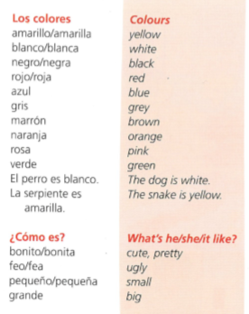
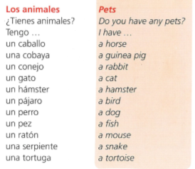
Spanish yr7. Work through as many of the activities as you can.
Task 1 -Read through this week’s vocab. Try and learn the animals and colours

Slide 2
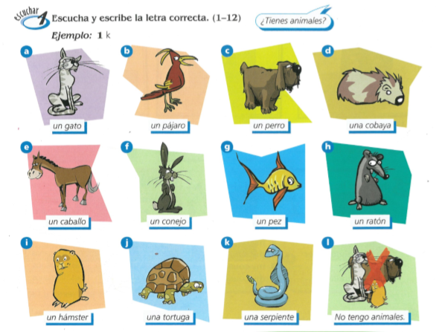
Task 2. Write down 1-12 in the back of your book. Listen to the track. What pet do they have? Write a-l for the answers

Slide 3
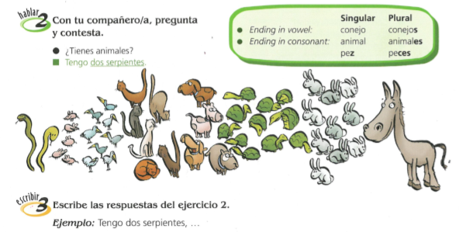
TASK 3 – Read through the grammar about plurals and copy it in to your books. Then pretend these are your pets. Make a list of what you have. Tengo dos serpientes…

Slide 4
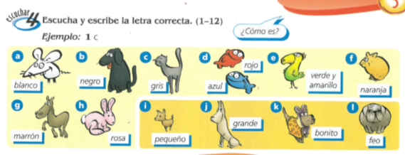
TASK 4. Write down 1-12 in the back of your book. Listen to the track. What do they look like? Write down the correct adjective a-l

Slide 5
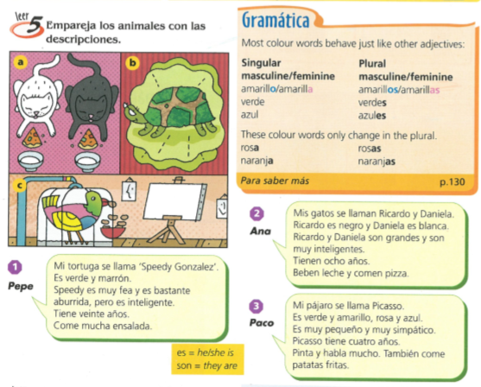
TASK 5 – Look at the grammar about how colour words behave and copy it in to your books. Then read the three texts and match up the texts with the pictures of the pets.

Slide 6
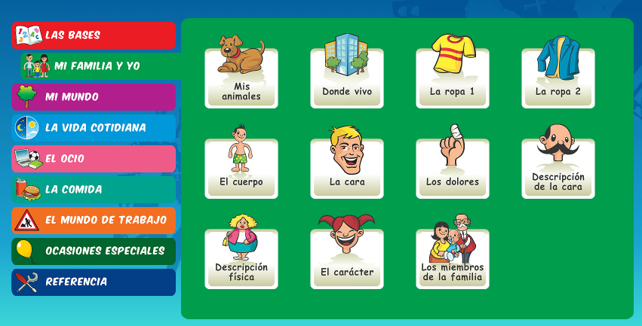
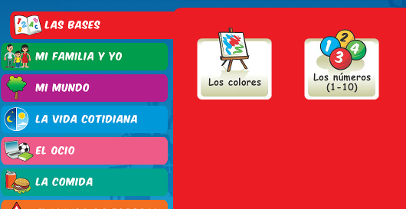
Log in to Linguascope. Username is Kingshill Password is bonjour123
Practise the vocab for the animals and the colours in the beginner section.

