Slide 1
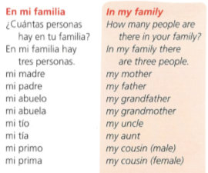
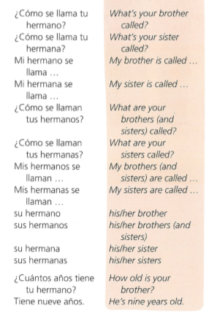
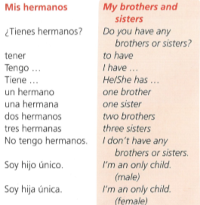
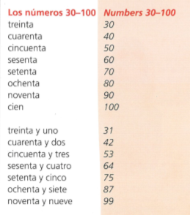
Spanish yr7. Work through as many of the activities as you can.
Task 1 -Read through this week’s vocab. Try and learn the family members

Slide 2
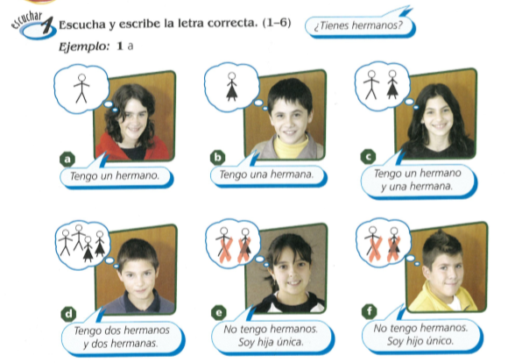
Task 2. Write down 1-6 in the back of your book. Listen to the track. What do you hear? A, b, c, d, e, or f?

Slide 3
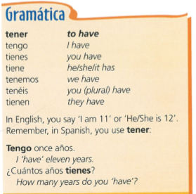
TASK 3 –
Read through the grammar and copy it in to your books

Slide 4
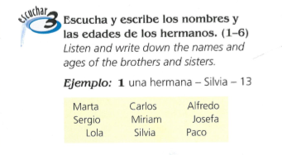
TASK 4. Write down 1-6 in the back of your book. Listen to the track. Do they have brothers or sisters? What are their names and ages?

Slide 5
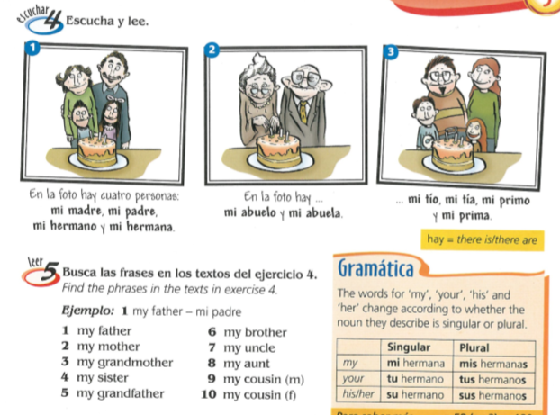
TASK 5 – Look at the pictures and read the texts. Then find the Spanish phrases for the English phrases below. Example – my father- mi padre

Slide 6
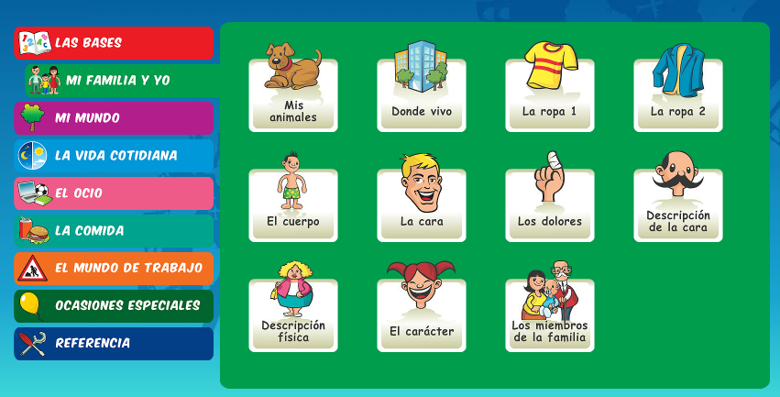
Log in to Linguascope. Username is Kingshill Password is bonjour123
Practise the vocab for the family members in the beginner section.

