Slide 1
CHRISTIANITY
Beliefs

Slide 2
CHRISTIANITY - KEY WORDS
CREED | INCARNATE | ATONEMENT | THE FALL
GOSPELS | MESSIAH | EVANGELISM | ASCENSION
SALVATION | GRACE | REDEMPTION | ESCHATON

Slide 3
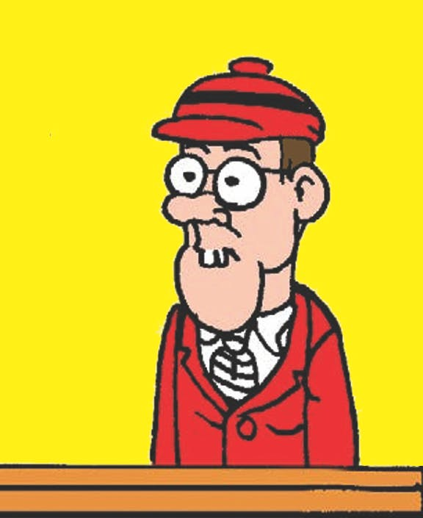
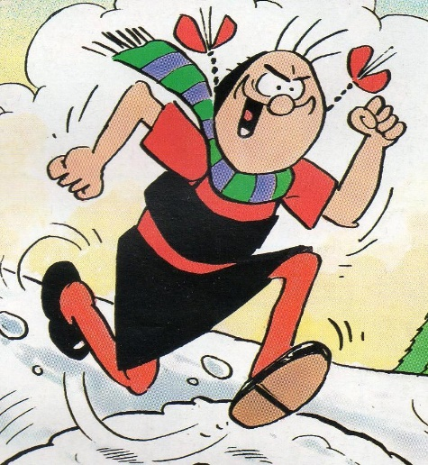
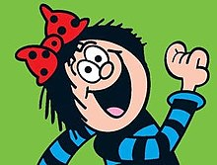
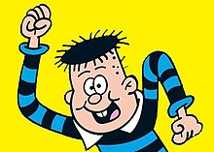
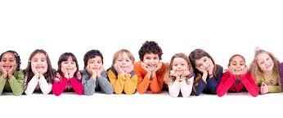
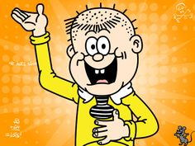
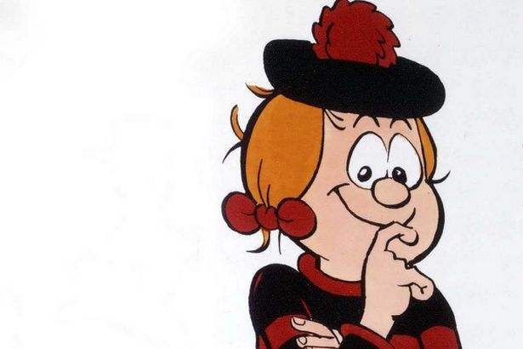
Some Basic Beliefs About
God
https://kidstalkaboutgod.org/interviews/tv-interviews/

Slide 4
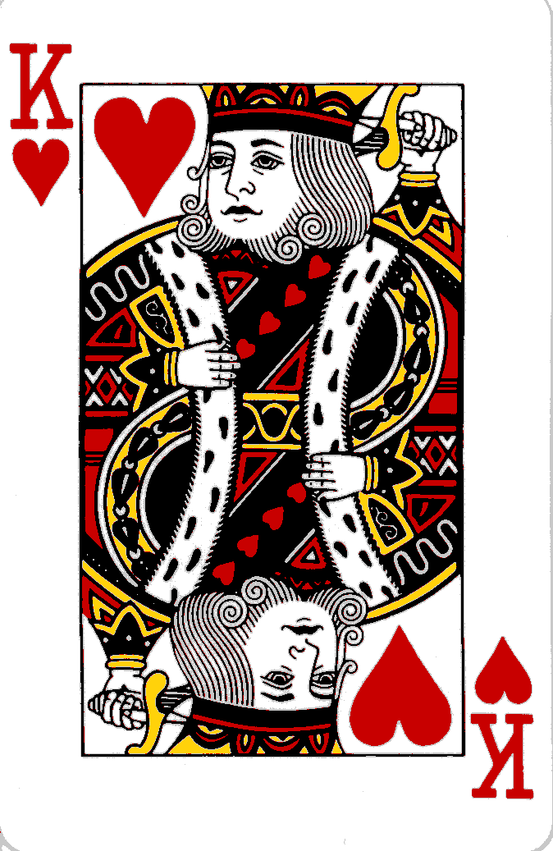
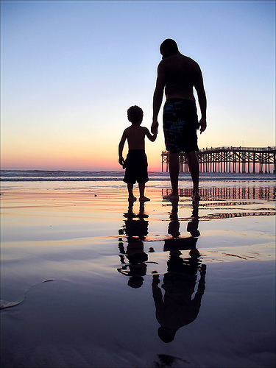
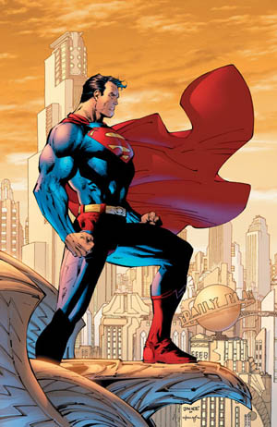
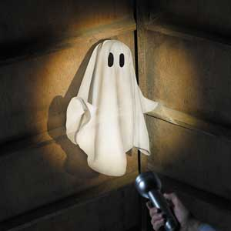
HOW DO CHRISTIANS VIEW GOD?
+
CREATOR?
WIZARD?
SAVIOUR?

Slide 5
The official definition of
God
GOD IS…
__________________ which means ____________________________
__________________ which means ____________________________
__________________ which means____________________________
__________________ which means ____________________________
__________________ which means ____________________________
?

Slide 6
The answers…

Slide 7
GOD IS…
Omnipotent which means all-powerful.
Omnisicent which means all –knowing.
Omni-benevolent which means all – loving.
Eternal which means everlasting (no beginning and no end).
Perfect which means faultless.

Slide 8
Christianity is known as a _______________ religion because it teaches that there is only _______________ God. They believe God is _______________ and exists outside _____________. The word for this is ______________. Time is part of the ____________ that God ______________. He is in control of both ____________ and ____________. God is able to see the ____________, the ______________ and the _____________. Existing outside space and time means he is ______________ and above all created things.
one
atemporal
time
time
lard
space
created
transcendent
present
world
future
eternal
past
monotheistic

Slide 9
Christianity also teaches that God is _______________, meaning He is ____________ with the __________ and human____________. By acting in this way God shows His ______________ (love and ___________ towards __________) and His ______________. In the Bible, God is often shown to have relationships with ____________ through __________, ___________ and the presence of the ____________ ____________. So Christianity understands Him to be a ______________ God.
benevolence
people
visions
Spirit
involved
immanent
world
Holy
humans
sandwich
beings
judgement
kindness
prayers
personal

Slide 10
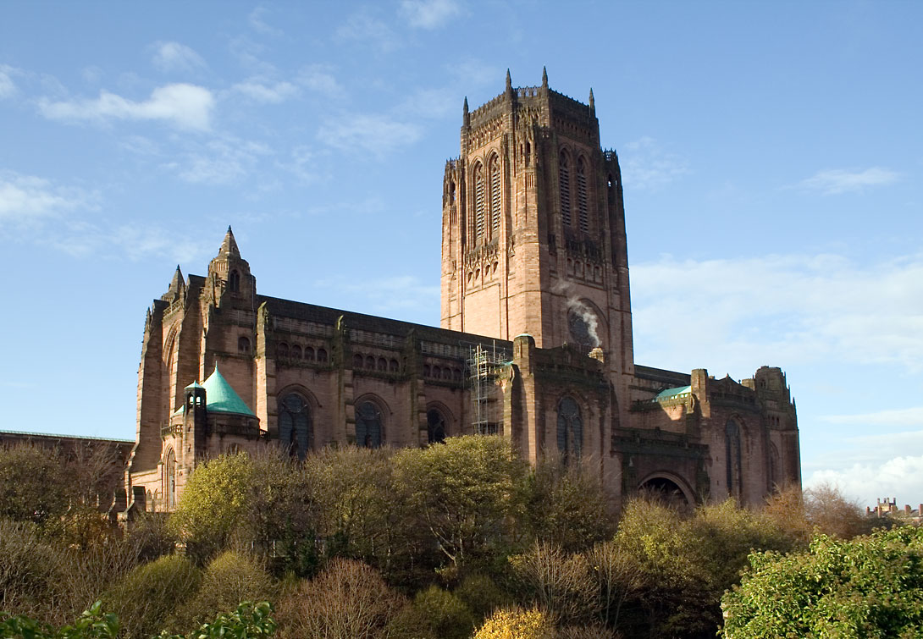
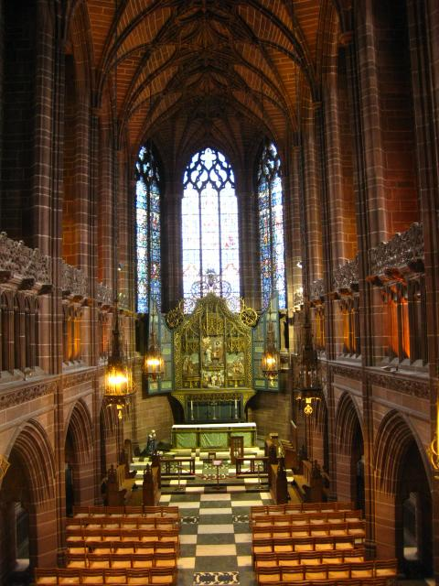

Slide 11
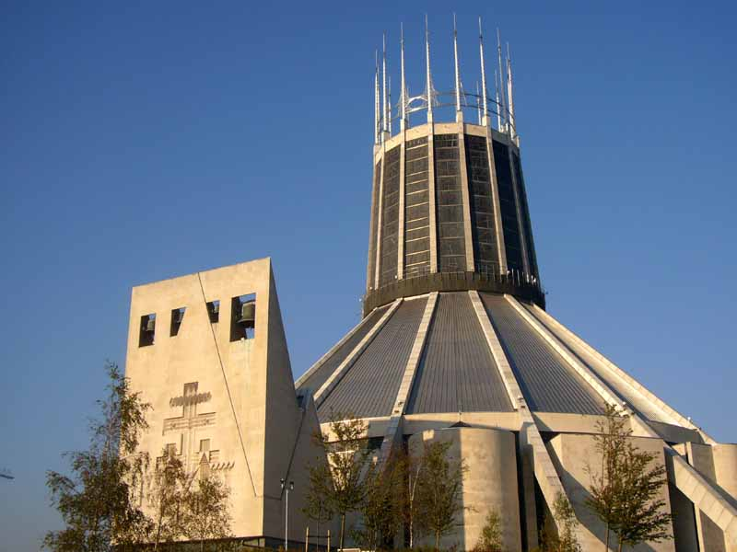
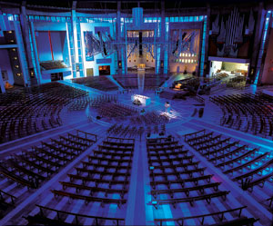

Slide 12
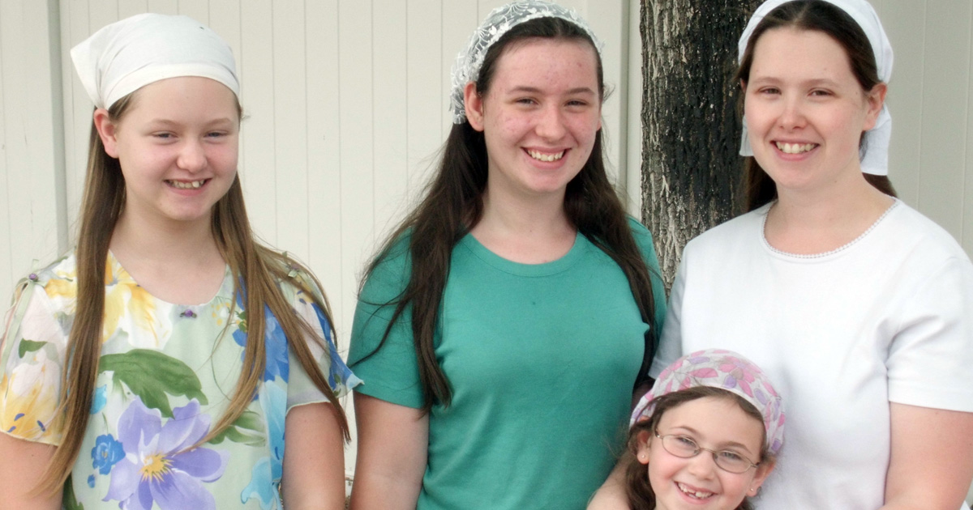
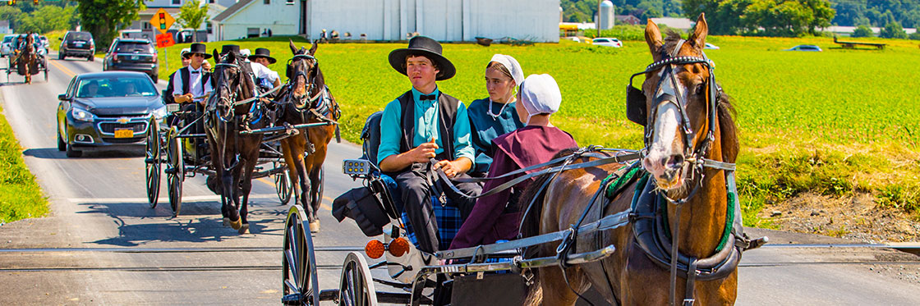
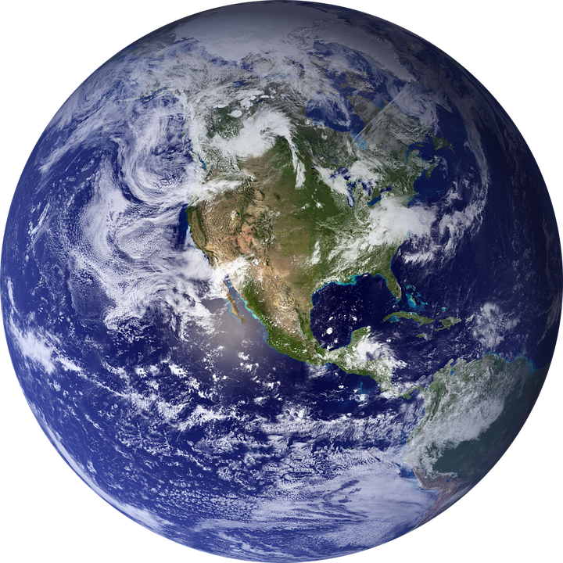
-l-m-u-h B-e-h-e-
A-i-h
What are your thoughts about these pictures?
Holy
Pure
Do not love the world or anything in the world. If anyone loves the world, love for the Father is not in them…the world and its desires pass away, but whoever does the will of God lives forever.

Slide 13
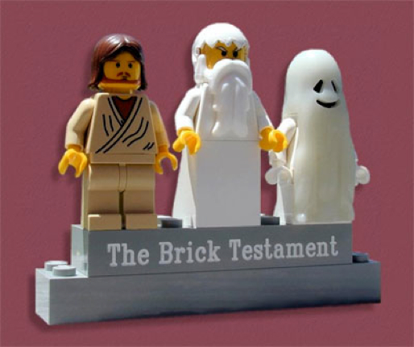
THE HOLY TRINITY
FATHER
SON
HOLY SPIRIT

Slide 14
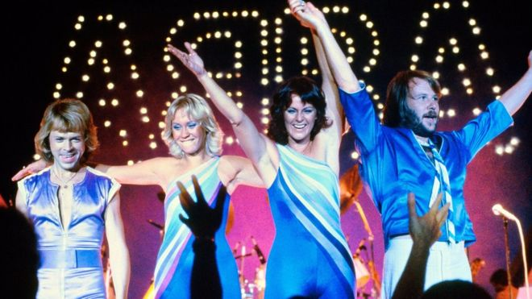
GOD THE FATHER
loving
creator - makes things
protector
discipline
("wait till your father gets home!")

Slide 15
GOD THE SON
Jesus is called the “Son Of God.” He represents God coming to earth as a man. He showed people how to behave. He took the blame for the sins of humanity and died on the cross.
understands humans
vulnerable
selfless
forgiving
tempted

Slide 16

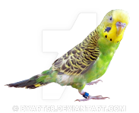
GOD THE HOLY SPIRIT
BEYOND DEATH
PEACE
LIVING WITHIN HUMANS
SUPERNATURAL
PARACLETE.
(Not parakeet!)

Slide 17
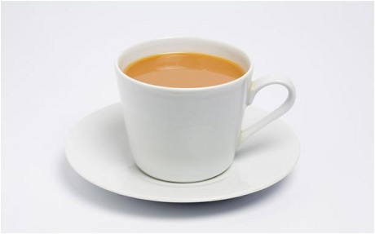

Slide 18
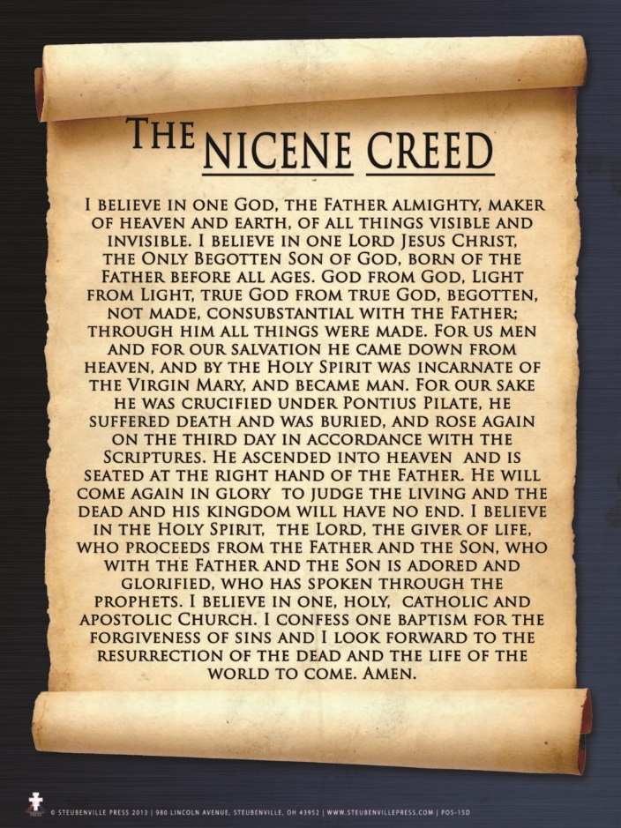

Slide 19
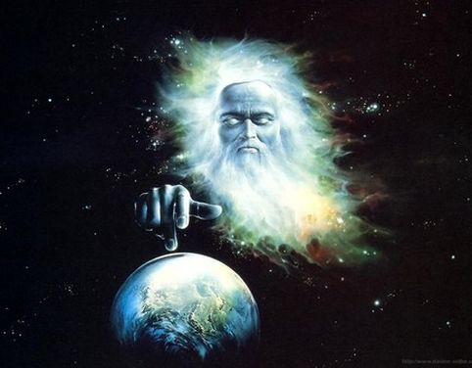
The Biblical Creation
Story
IES!

Slide 20
What do you already know about the Creation story in the bible?
Two Stories
Hebrews
Nomadic
Identity
Priests
Notes:
Discuss the background to the six day story of creation. Explain that it is (chronologically) the second creation story in the bible, even though it appears first.

Slide 21
1

Slide 22






Notes:
Students should read through the seven day creation story in the bibles. They should draw pictures of the events of each of the six days in their books, writing in what was created in the spaces below.

Slide 23
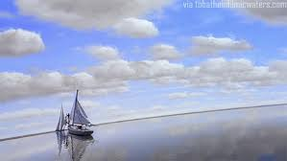
IMPORTANT POINTS
Existing beliefs about the world:
- it was flat
- the sky was a solid dome
- the land was at the centre of the world
- humans were the most important thing in the world

Slide 24
IMPORTANT POINTS
God created the world
God was in total control.
Everything was GOOD – (God cannot do bad).
God created “out of nothing”.
Humans were created last
Humans are the most important creation
The 7th day set aside for meeting and prayer.
At the time...
The Hebrews were worried about their “out of control” existence.
Scared that bad things were happening.
Felt unimportant.
Needed to be brought together regularly.

Slide 25
2

Slide 26
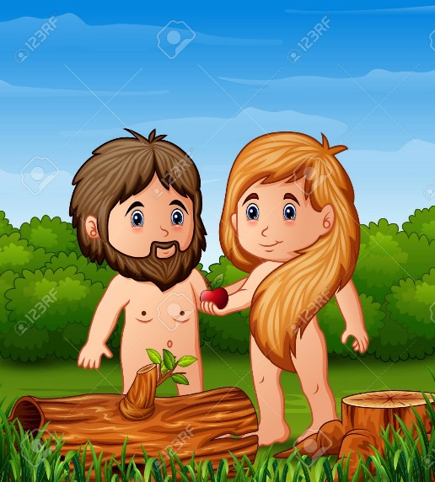
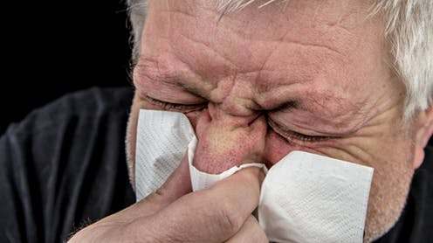
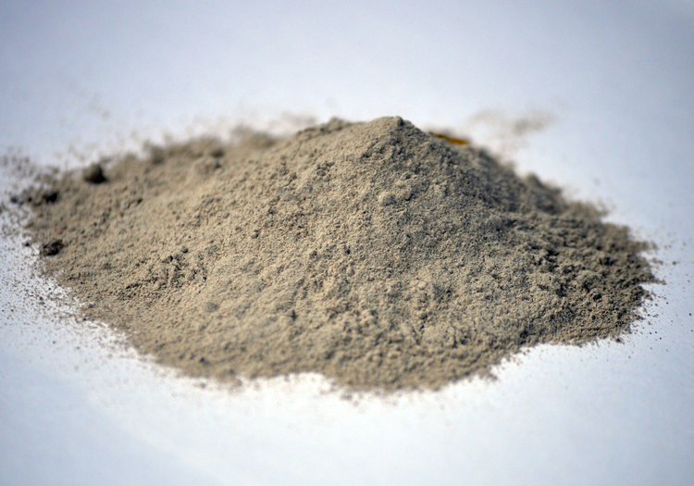
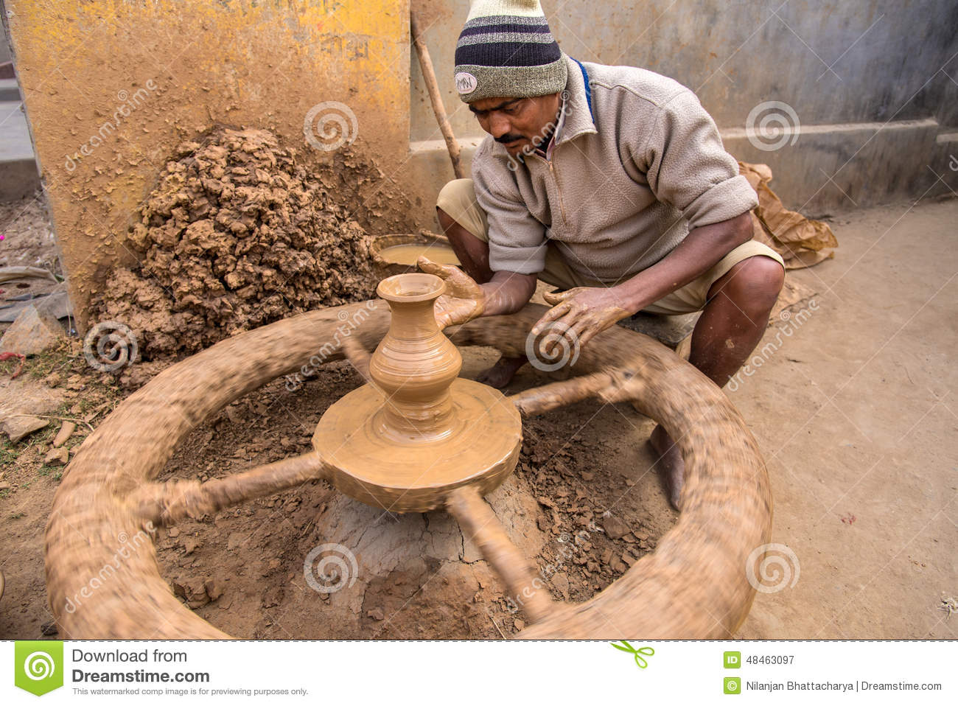
Adam = Humanity
Eve = Beginning

Slide 27
3(ish)

Slide 28

Ho
Logos
Jesus
Christ
JOHN CHAPTER 1

Slide 29
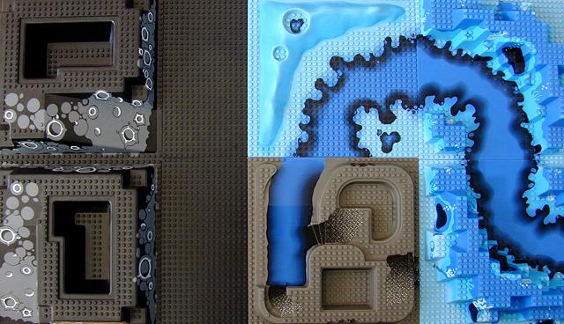
Genesis 1:1, 2:4-6
In the beginning, God created the heavens and earth. No plant or shrub had yet sprung up, for Yahweh God had not sent rain upon the earth, and there was no one to till the soil. Moisture would well up from the earth and water the surface of the ground

Slide 30
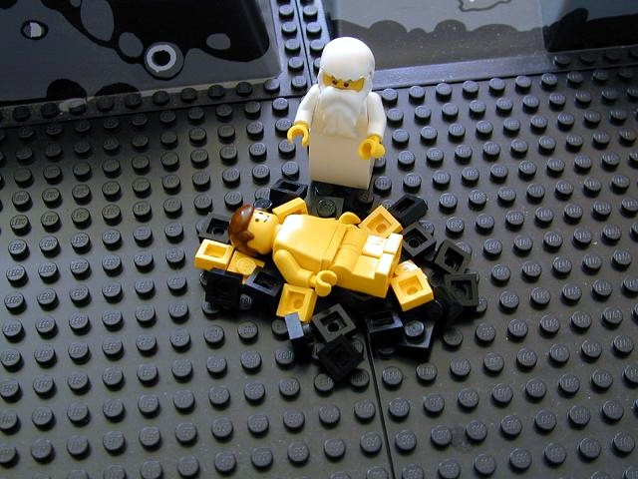
Genesis 2:7
Yahweh God formed man from the soil of the ground

Slide 31
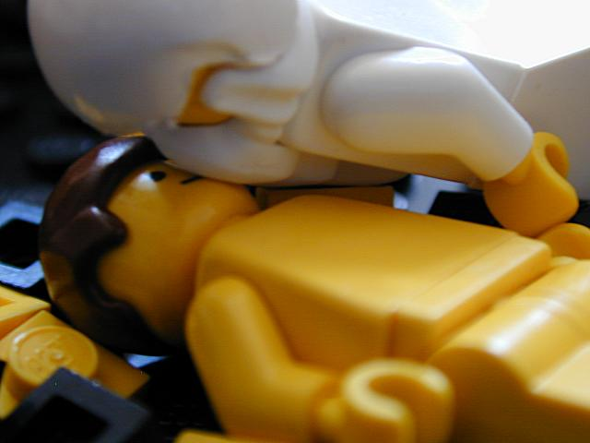
Genesis 2:7
And breathed into his nostrils the breath of life

Slide 32
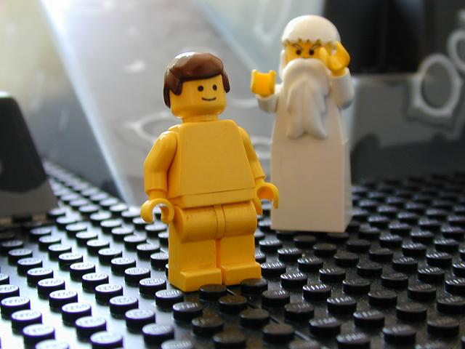
Genesis 2:7
And man became a living creature.

Slide 33
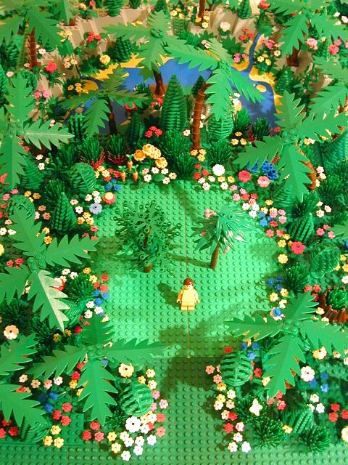
Genesis 2:8-9
Yahweh God planted a garden in Eden, and there he put the man he had formed. Yahweh God caused to sprout every tree that is pleasing to look at and good for food, with the tree of life in the middle of the garden and the tree of knowledge of good and evil

Slide 34
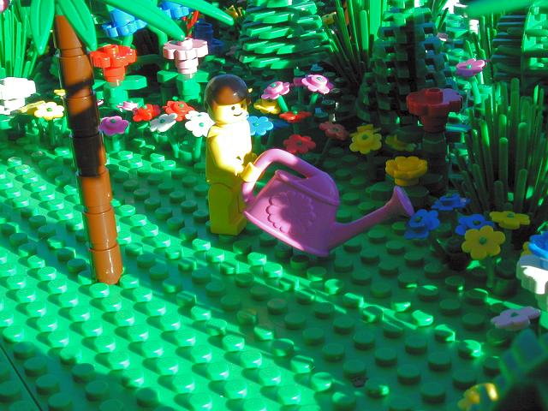
Genesis 2:15
Yahweh God took the man, and put him in the garden of Eden to look after and maintain it.
Genesis 2:15
Yahweh God took the man, and put him in the garden of Eden to look after and maintain it.

Slide 35
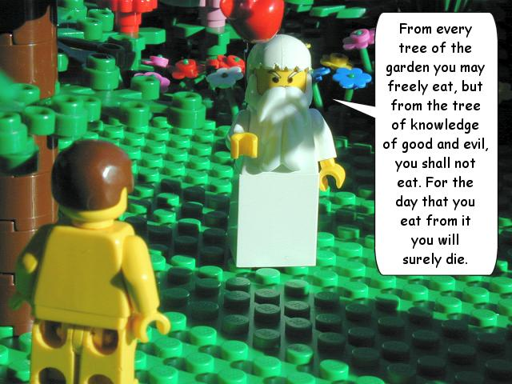
Genesis 2:16-17

Slide 36
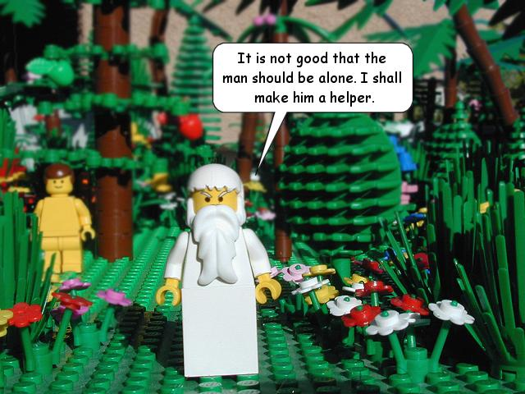
Genesis 2:18

Slide 37
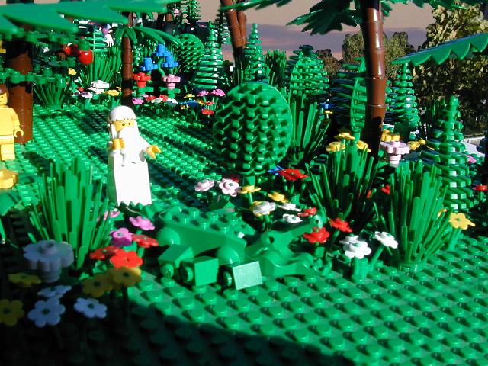
Genesis 2:19
From the ground Yahweh God formed every animal of the field and every bird of the sky.

Slide 38
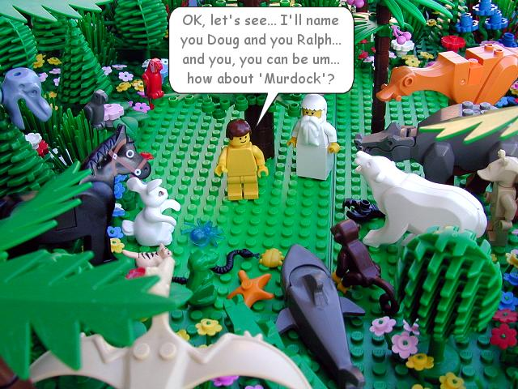
Genesis 2:19-20
He brought them to the man to see what he would call them. Whatever the man called every living creature, that was its name. The man gave names to all the cattle, every bird of the sky, and every animal of the field. But no suitable helper was found for the man

Slide 39
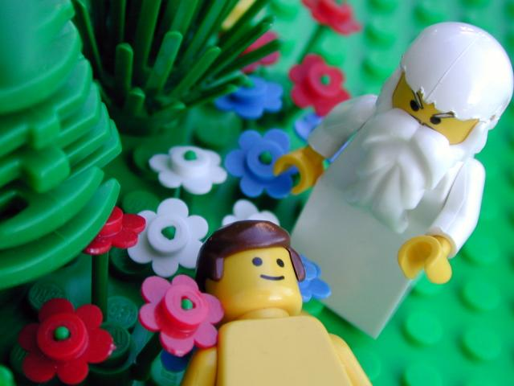
Genesis 2:21
Then Yahweh God caused a deep sleep to fall on the man

Slide 40
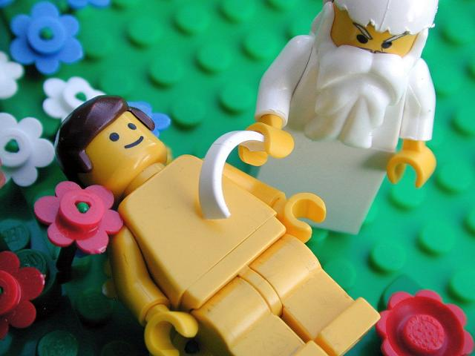
Genesis 2:21
And as he slept, Yahweh God took one of his ribs, and closed up the flesh in its place

Slide 41
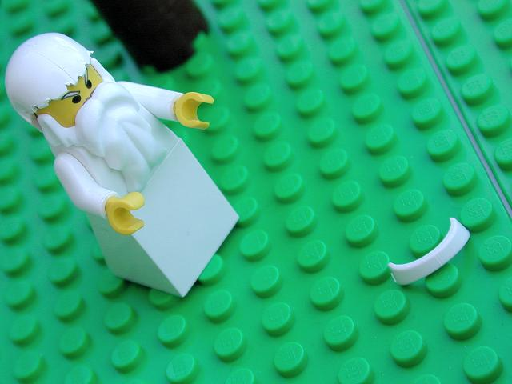
Genesis 2:22
And from the rib which Yahweh God had taken from the man…

Slide 42
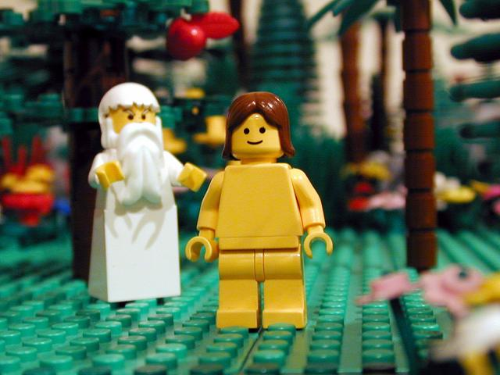
Genesis 2:22
...he made a woman, and brought her to the man

Slide 43
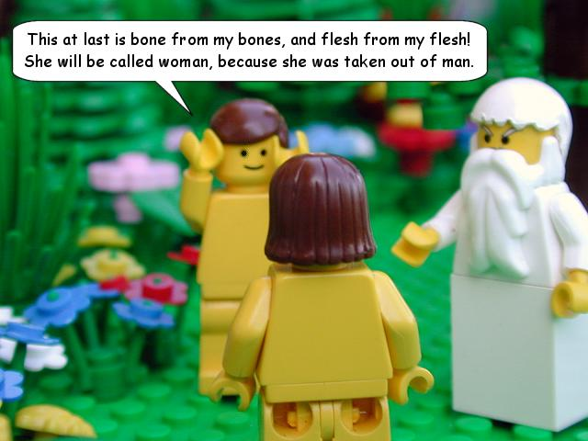
Genesis 2:23

Slide 44
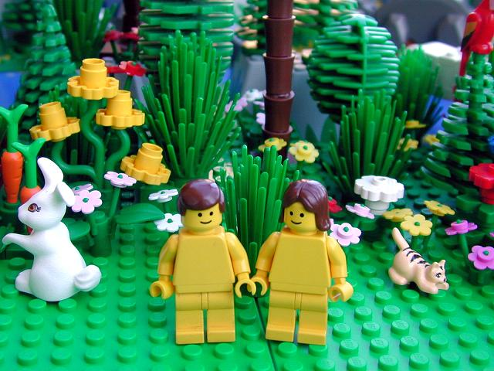
Genesis 2:25
And the man and his wife were both naked and were not ashamed
Genesis 2:25
And the man and his wife were both naked and were not ashamed

Slide 45
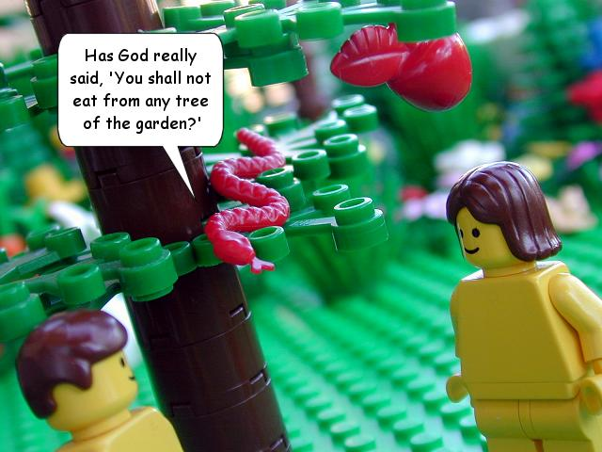
Genesis 3:1
Now the snake was the shrewdest of any animal of the field which Yahweh God had made…

Slide 46
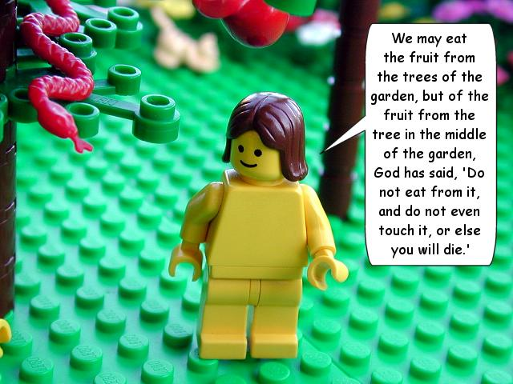
Genesis 3:2-3

Slide 47
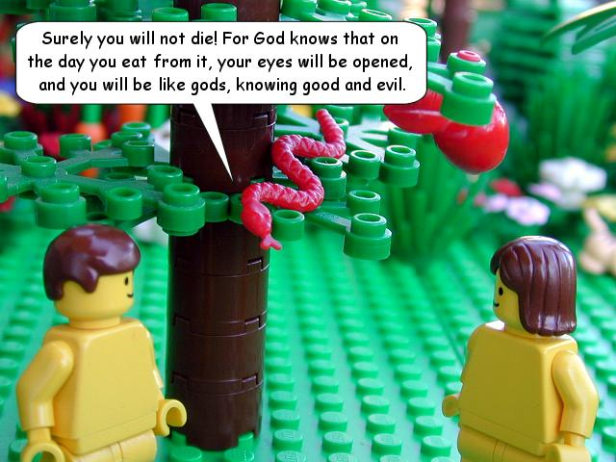
Genesis 3:4-5

Slide 48
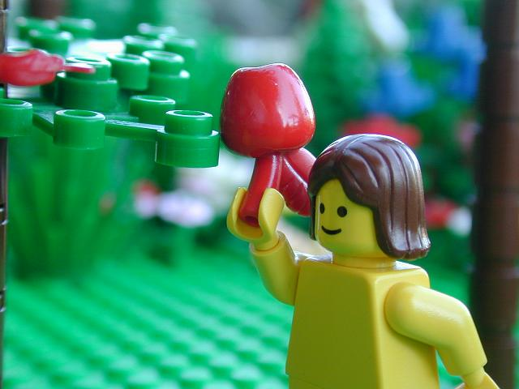
Genesis 3:6
The woman saw that the tree was good for food, pleasing to the eyes, and desirable for the knowledge it could give, and she took fruit from it…

Slide 49
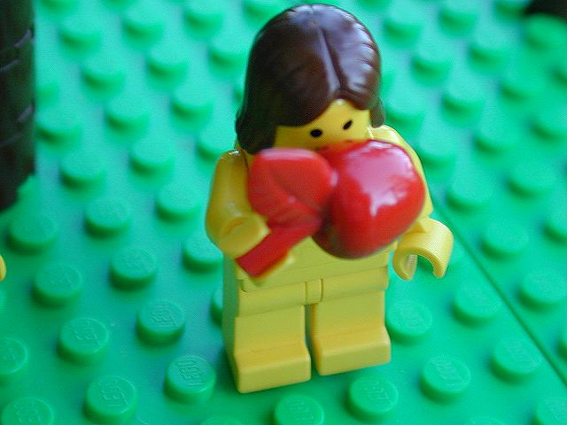
Genesis 3:6
And ate it…

Slide 50

Genesis 3:6
She gave some to her husband who was with her…

Slide 51

Genesis 3:6
And he ate it…

Slide 52

Genesis 3:7
The eyes of both them were opened, and they knew that they were naked

Slide 53

Genesis 3:7
They sewed fig leaves together, and made themselves loincloths

Slide 54

Genesis 3:8
They heard the voice of Yahweh God walking in the garden in the cool of the day, and the man and his wife hid themselves from Yahweh God among the trees of the garden…

Slide 55

Genesis 3:9

Slide 56

Genesis 3:10

Slide 57

Genesis 3:11

Slide 58

Genesis 3:12
Genesis 3:12

Slide 59

Genesis 3:13

Slide 60

Genesis 3:13

Slide 61

Genesis 3:14-15

Slide 62

Genesis 3:16

Slide 63

Genesis 3:17-19

Slide 64

Genesis 3:21
Yahweh God made leather garments for the man and his wife, and clothed them

Slide 65

Genesis 3:22-23
Yahweh God sent him away from the garden of Eden, to till the ground from which he was taken

Slide 66

Genesis 3:24
He drove the man away and stationed cherubs at the east of the garden of Eden, and a flaming sword which turned every way, to guard the way to the tree of life

Slide 67
What Sort Of World Are
We Living In?
Notes:
Pupils have a couple of minutes to answer this question. Write their responses on the board.

Slide 68

Notes:
Hurricane Harvey

Slide 69

Notes:
North Korea nuclear missile tests.

Slide 70

Notes:
Charlottesville riots

Slide 71

Notes:
Fatal M1 crash

Slide 72

Notes:
Brucie is dead.

Slide 73

Notes:
UK prisons now overcroded

Slide 74

Notes:
1 in 4 children in the UK are now living in poverty – figure is much higher globally.

Slide 75

Notes:
East Sussex beach-goers overwhelmed by noxious chemical fumes

Slide 76
GOOD THINGS THAT HAPPENED TO ME OVER THE WEEK | BAD THINGS THAT HAPPENED TO ME OVER THE WEEK
Notes:
Individual work – pupils to create lists of good and bad things that happened to them over the summer (they do not have to share if they don’t want to). Once pupils have finished this work ask them to decide whether, on balance, their summer was good or bad. They should take into account number of good v bad events and also their duration, long-term effect, how happy or sad they were made to feel etc. Once they have done this, ask those who think the summer was bad to stand on one side of the room, and those who think that the summer was good to stand on the other side. Explain that there can be no middle ground – they must choose one side or the other.

Slide 77
GROUP WORK
In small groups you must come up with a simple argument to say whether you think the world is good or bad. You must have a completed, agreed answer. You must have reasons behind your answer. You must examples from real life to back up your reasons.
Notes:
Try to create groups containing mixes of pupils from both sides of the room. Groups should be no more than four pupils and no fewer than three. Give them five to ten minutes to come up with their answers. Then listen to each group’s feedback.

Slide 78

R
E

Slide 79





?

Slide 80
So what exactly is “EVIL”?
Evil is…

Slide 81


MORAL | NATURAL

Slide 82
The Problem Of Evil & Suffering
Life is nasty!

Slide 83

Omni-benevolent
God is….
Omniscient
Eternal
Omnipotent

Slide 84
Evil exists
The Inconsistent Triad
God is
omnipotent
God is
omnibenevolent

Slide 85

This proves there cannot be a god!
I’ve obviously done something to upset god.
God must be testing me, I’d better love Him even more!
Which is the best response?

Slide 86

Who Was St Augustine
Of Hippo?
A very influential bishop from North Africa.
Lived from 13th November 354 to 28th August 430
Completely changed the course of the Christian religion and is responsible for much of the Roman Catholic dogma – eg Original Sin
Had some issues with sex.
Created a theodicy to suggest that evil and suffering is the result of god giving humans free will.

Slide 87


Slide 88

Theodicy Corner
A “theodicy” is a response to The Problem Of Evil And Suffering.
God made a perfect creation that had no evil in it. Evil is, in fact, the absence of goodness. It is when something good goes wrong. When Adam and Eve made a bad use of their free will by eating the forbidden fruit, evil entered God’s perfect creation.

Slide 89

Augustine’s theodicy
Augustine starts from the assumption that god is wholly, completely and utterly good. He also created a world completely free from defects. Suffering and evil where unknown.
Therefore it is not possible for god to be responsible for evil. It wasn’t Him.
Instead, evil refers to what is lacking in a thing – it is a “privation of good”. Augustine used the analogy of blindness which is not a thing in itself but an absence of sight.
goddy
If god cannot have created evil, Augustine traced its origin to those areas within the world that have free will; namely angels and humans. Not cows or geese. These fellows abused god’s gift of freedom and wilfully turned their attentions away from god.

Slide 90


He argued that the desire for power was too much for Adam and Eve, who were tempted by Satan – a fallen angel, to break god’s command and eat the forbidden fruit.
Naughty!
He went on to show that all suffering is a fully deserved consequence of human sin. Natural evil occurs as a result of the loss of order within nature following The Fall. This destroyed the delicate balance of the world. Pain and death entered the world. Thanks, Eve.
Both Natural and Moral Evil are seen as punishments for sin. ALL HUMANS must suffer because we were all seminally present in Adam’s loins, apparently.
Which makes us all Fall Fans. So it probably serves us right.

Slide 91

Don’t worry, though.
We’ve all got GOD’S GRACE to save us – God sent his son, Jesus, to die for our sins and to save us from evil. (If god was simply just he wouldn’t bother doing this. Fortunately for us, he is just AND loving AND full of grace.)
All we have to do to be saved by God is to make every effort to turn towards him and to be dutiful Christians. We don’t have to do this – its up to us, but it would probably be better if we did.
This is a soul-deciding theodicy!

Slide 92
Its good because…
Evil isn’t a substance.
It relies upon free will – a choice – so that means when we decide to be good we really are being good. This makes the existence of evil a necessary evil.
It accounts for moral and natural evil.

Slide 93
criticisms
It has been argued that Augustine’s Theodicy contains:
Logical errors
Scientific errors
Moral errors

Slide 94
LOGICAL PROBLEMS:
F.E.D. Schleiermacher (1768-1834)
Why would a perfectly created world go all wonky and evil?
Has evil created itself out of nowt? This is surely logically impossible!
Whether or not evil is a deprivation, it is still a real feature of the world. It happens.
So either the world has gone wrong, or god enabled it to go wrong.
AND ANOTHER THING…
Its all very well Augustine invoking the “FREE WILL” defence, but in a world where everything is perfect and the occupants have no knowledge of good and evil. How could they possibly be free to make decisions about good and evil? They can’t freely choose to disobey god if they don’t know that good, bad and even disobedience exist.

Slide 95
SCIENTIFIC PROBLEMS:
Just how was the world created again, Augustine?
The Biblical account of creation and the fall are scientifically controversial to say the least.
Evolutionary theory tells us that humans are getting better, not that they started perfect and then got worse. Besides, it shows that we need our selfish desires to help us survive, so they must have been present from the outset. Does this mean that god is responsible for introducing moral evil?
Also, I don’t remember being seminally present in Adams loins. I don’t even remember being seminally present in my dad’s loins. The biology here is very unsound.

Slide 96
MORAL PROBLEMS:
Did god anticipate hell?
It seems to be part of the design plan, which must mean he anticipated things getting screwed up well in advance – and accepted it!
Some people get to go to Heaven and others don’t. Even though we have this wonderful gift of free will. If we exercise it the way god wants us to, then we’re fine. But if we don’t we’re damned. Is this really free will?

Slide 97

God allows evil and suffering to exist. The world was deliberately created with both good and bad in it so that humans could choose and learn what is right and good. It is all about soul-making because giving humans responsibility allows them to develop. We learn from our suffering. That is why God gave us free will.

Slide 98
IRENAEUS’ THEODICY
God’s aim when he created the world was to make humans flawless, in His likeness.
Genuine human perfection cannot be ready-made, but must develop through free choice.
Since God had to give us free choice, He had to give us the potential to disobey Him.
There would be no such potential is there were never any possibility of evil. If humans were made ready-perfected, and if God policed His world continually, there would be no free will.
Therefore, natural order had to be designed with the possibility of causing harm, humans had to be imperfect and God had to stand back from his creation.
Humans used their freedom to disobey God, causing suffering.
God cannot compromise our freedom by removing evil.
Eventually, however, evil and suffering will be overcome and everyone will develop into God’s likeness, living in glory in Heaven. This justifies temporary evil.

Slide 99
The strengths
John Hick – goodness that has been developed by free choice is infinitely better than goodness that is readily programmed into us like robots. If we were created to be perfect and automatically love god, then our love for god would be valueless. God must keep an EPISTEMIC DISTANCE
Peter Vardy – The King and the peasant girl.
If you are free to choose, and you choose to do evil but god always intervenes and prevents harm coming from evil acts, how would you change or improve? Would you like to live in such a world? Imagine that wherever you drove in your car, the Chief of Police always sat in the car with you. Are you really free to break the speed limit?
Only a reward in Heaven can justify the magnitude of suffering that we go through in this life.

Slide 100
The weaknesses
The concept of Heaven seems unjust. Whatever happened to good old fashioned punishment for naughty people? Why go out of our way to improve if Heaven is a universal reward?
Although soul-building cannot take place in a perfect world, the amount of suffering that goes on in this world does seem unfair. Why do some have to suffer so much more than others? Whats that all about?
How can suffering be an expression of God’s perfect love? D.Z. Phillips – it is never justifiable to hurt someone in order to help them.

Slide 101
In your booklets, write out the two
theodicies WITHOUT USING THE
WORDS THAT ARE IN THE SPEECH BUBBLES!

Slide 102


Slide 103
Watch the video on the life of Jesus. Make notes on the key events.

Slide 104
What Were The Main Events In
The Life Of Jesus?

Slide 105














MAIN EVENTS IN JESUS’ LIFE
Sermon On The Mount
Arrest in Gethsemane
Lazarus
Jerusalem Entry
Water into wine
Feeding 5000
Birth
Resurrection & Ascension
Last Supper
Trial
Cleansing Temple
Crucixion
Transfiguration
Baptism

Slide 106

The Life Of Jesus
The betrayal in Gethsemane
The crucifixion
The Last supper
Choosing the twelve disciples
The birth of Jesus
The cleansing of the Temple
The Resurrection
Jesus’ trial and Peter’s denial.
The baptism of Jesus
Jesus visits the Temple as a boy
The Sermon on The Mount
The Temptation of Jesus.
PUT THEM IN THE RIGHT ORDER!

Slide 107
The Life Of Jesus
(in the correct order).
*
The birth of Jesus
Jesus visits the Temple as a boy
The baptism of Jesus
The Temptation of Jesus
Choosing the twelve disciples
The Sermon on The Mount
The cleansing of the Temple
The Last Supper
The betrayal in Gethsemane
Jesus’ trial and Peter’s denial.
The crucifixion
The Resurrection
How many did you get right?

Slide 108

_ _ _ _ _ _ _
_ _ _ _
How do we know?
_ _ _ _
_ _ _ _

Slide 109


In what ways was Jesus rebellious?

Slide 110



Slide 111
The Sermon On The
Mount
https://www.youtube.com/watch?v=YP2KDUiBI-E
Part One: The Beatitudes.

Slide 112
In the first three Beatitudes, Jesus shows that by being aware of their own issues and needs, it makes his followers better, truer people.
This makes them more open to God.
Then they are more able to share God’s love through their actions by caring for others who also have issues and needs.

Slide 113

Blessed are the poor in spirit,
For theirs is the Kingdom of Heaven

Slide 114

Blessed are they who mourn,
For they shall be comforted

Slide 115

Blessed are the meek,
For they shall inherit the world

Slide 116
In Beatitudes 4 - 7, the focus is on searching for God, truth and righteousness. This means trying to be “pure in heart” – focused on God in all that you do and avoiding distractions and temptations.

Slide 117

Blessed are those who thirst for righteousness,
For they shall have their fill

Slide 118

Blessed are the merciful,
For they shall be shown mercy.

Slide 119


Blessed are the pure of heart,
For they shall know God.

Slide 120

Blessed are the peacemakers,
For they will be called children of God.

Slide 121
The final Beatitudes focus on suffering as a result of doing what is right in the eyes of God.
If a Christian suffers because they are being faithful to God, they are still “happy” because they are being true to themselves.
Its not easy but they will get rewarded in Heaven.

Slide 122

Blessed are those who are persecuted…
Blessed are you when people insult you and falsely say all kinds of evil against you….
REJOICE!

Slide 123




How Beatitudiful Are You?

Slide 124

The Sermon On The
Mount
Part Two: The Law.

Slide 125


Slide 126
THE TEN COMMANDMENTS
1
2
3
4
5
6
7
8
9
10
Heart and Head and Deeds
You shall have no other Gods before me.
Do not make false idols.
Lust is as unacceptable as adultery.
Hate is as unacceptable as murder.
Do not misuse the name of the Lord.
Keep the Sabbath Day holy.
Honour your parents.
Don’t swear oaths, just say yes or no.
Do not kill.
Re-marrying after divorce is adultery.
Do not commit adultery.
Do not steal.
Do not tell lies.
Love your…ENEMIES!.
Do not covet your neighbour’s ass..

Slide 127

The Sermon On The
Mount
DON’T BE SHOWY!
KEEP IT PRIVATE!
Part Three: True Discipleship.

Slide 128
The Lord’s Prayer
Challenge

Slide 129



Slide 130

The Sermon On The
Mount
Part Four: True Righteousness.

Slide 131








Slide 132




+
&

Slide 133


Slide 134

The Sermon On The
Mount
https://www.youtube.com/watch?v=0ZFgw9J7tks
Part Five: The Narrow Gateway.

Slide 135
The Sermon On The
Mount
https://www.youtube.com/watch?v=Eu5bBDRpzPM
https://www.youtube.com/watch?v=zAjEjxX-DhA
Part Six: Building On Solid
Foundations

Slide 136

1) The Beatitudes
2) The Law
3) True Discipleship
4) True Righteousness
5) The Narrow Gateway
6) Solid Foundations

Slide 137
GOD THE SON
Jesus is called the “Son Of God.” He represents God coming to earth as a man. He showed people how to behave. He took the blame for the sins of humanity and died on the cross.
understands humans
vulnerable
selfless
forgiving
tempted
ABLE TO SUFFER

Slide 138
The Passion
https://www.youtube.com/watch?v=mFbQDhkZq3M
Make notes on the key events, themes and ideas.

Slide 139


Slide 140
Christians believe that because Adam and ______ sinned in The _______, the human ___________ with God had been broken. Something had to be done to ____________ the relationship.
Humans have to be saved from their __________. The Christian message is that this saving process, or ___________ was done by ______ Himself. He did it by becoming _____________ as Jesus (the ______________) and died as a _____________ in the place of humans. This is known as the _____________ (something that makes amends or pays for having done something _________).
human
God
relationship
SALVATION
Fall
INCARNATION
fish
wrong
sin
repair
ATONEMENT
Eve
sacrifice

Slide 141


Slide 142

Atonement –
bad news for
goats

Slide 143


Slide 144



COVENANT
Original Sin

Slide 145


Slide 146


Slide 147

https://www.youtube.com/watch?v=f-EsQHr2TQ8
https://www.youtube.com/watch?v=Br_RhjvZIrU

Slide 148


Slide 149



Slide 150


Slide 151

RESURRECTION OF THE BODY
How does resurrection of the body take place if the body has gone all mouldy, decayed or been cremated? If survival for a materialist must include both body and soul, then life after death would have to be in a form similar to to the one in this world.

Slide 152
“So it will be with the resurrection of the dead….The body that is sown is perishable, it is raised imperishable…it is sown a natural body, it is raised a spiritual body.”
1 Corinthians 15: 42, 44

Slide 153

Evidence for the existence of a soul
FLOATING
OBSERVING WHAT IS HAPPENING
HEIGHTENED AWARENESS
NO PAIN WHEN THERE SHOULD BE SOME PAIN
PASSING THROUGH WALLS
BLISS OR ECSTASTY & PEACE
A TUNNEL WITH A LIGHT
DEAD FRIENDS AND RELATIVES WAITING AT THE END
THE PRESENCE OF A DIVINE BEING
AWARENESS OF HOW YOUR ACTIONS HAVE AFFECTED OTHERS
BEING ABLE TO JUDGE YOURSELF OBJECTIVELY
THE IMPORTANCE OF LOVE
BEING TOLD ITS NOT “YOUR TIME” YET
Near Death Experiences
More people who are declared “clinically dead” are resuscitated. Their descriptions of what happened to them while dead are so similar that Dr Ray Moody reckons its more than just coincidence. Generally speaking, they include…

Slide 154

https://www.youtube.com/watch?v=txErSEZoTo8

Slide 155


PURGATORY

