Slide 1
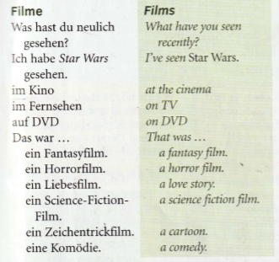
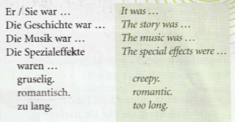
Year 9 German term 5 week 4
Spend some time learning the vocab for this week.

Slide 2
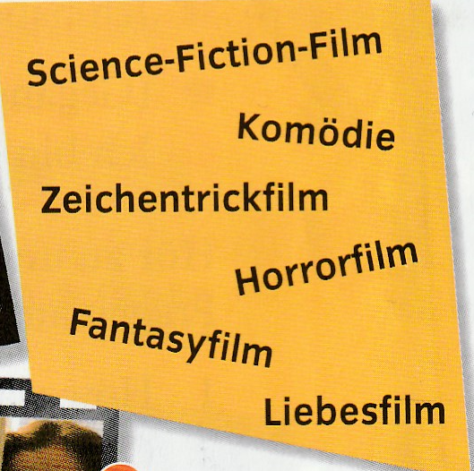
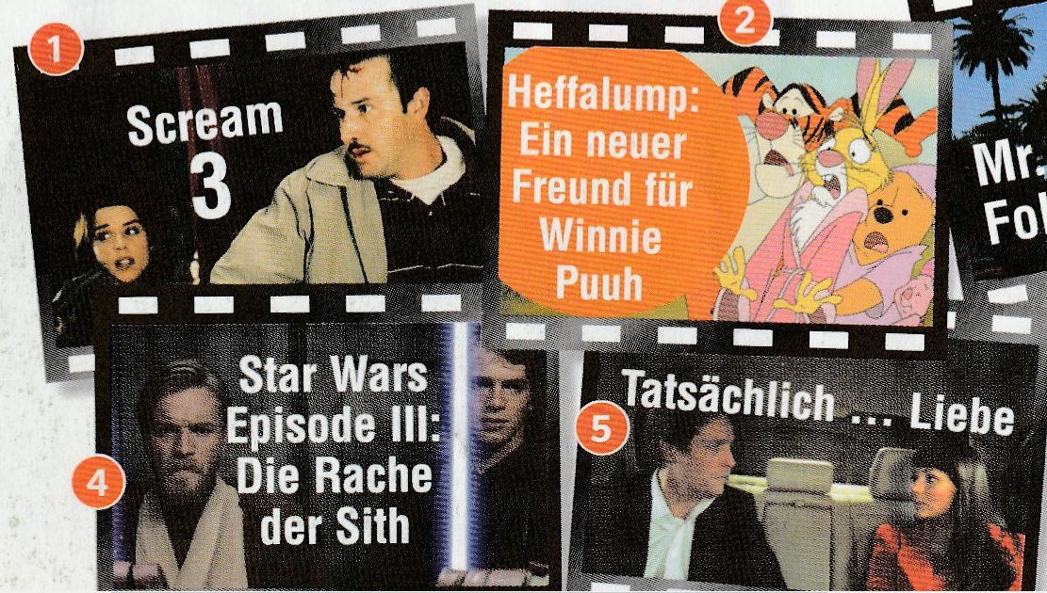
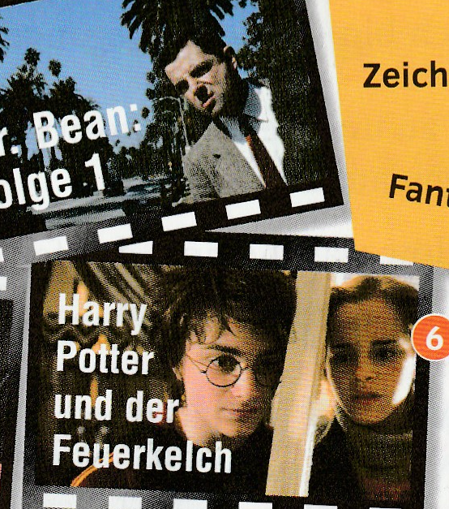
Match up the type of film in German on the right with the pictures of the films below.

Slide 3
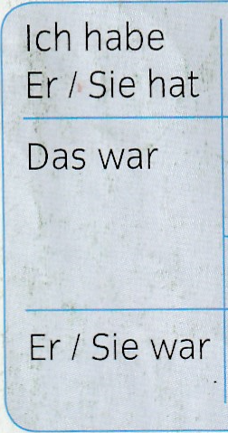
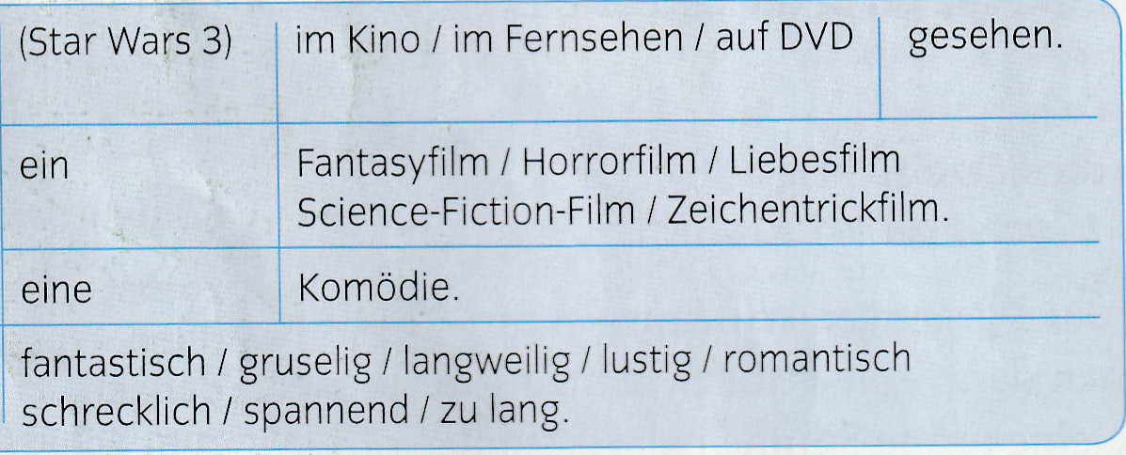
Listen to the track. Write down 1-6 in the back of your book. What type of film was it and how was it? Answer in German (the table below should help)
Example: 1 Horrorfilm-gruselig

Slide 4
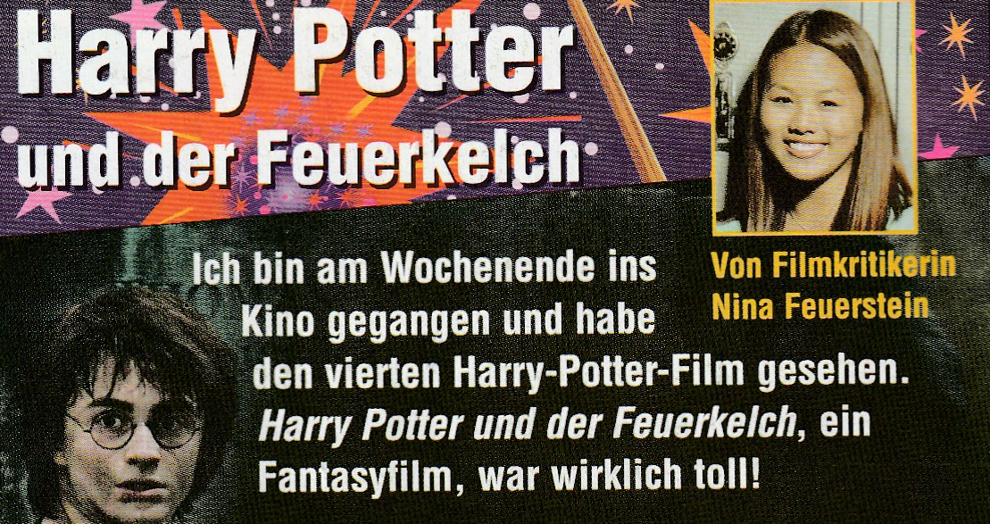
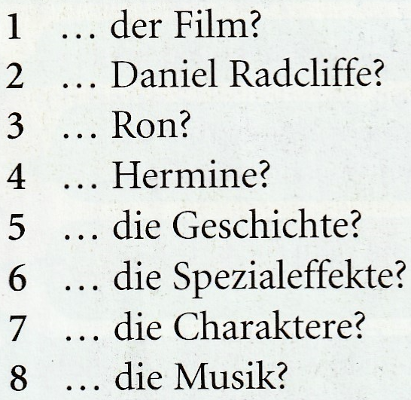
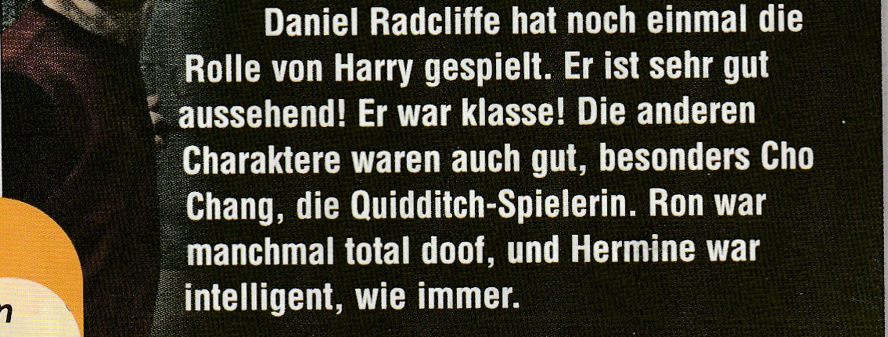
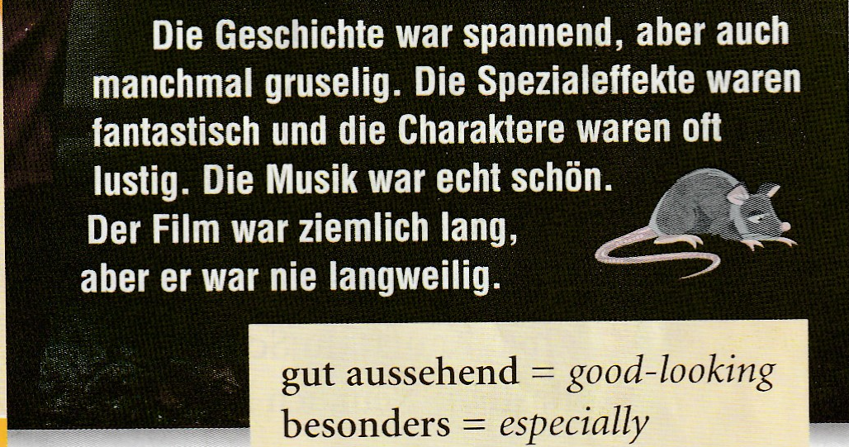
Read the article and then say how the 8 things
below were.
The first one is done for you.

Slide 5
Listen to the track. Copy out the table and fill it in.

Slide 6
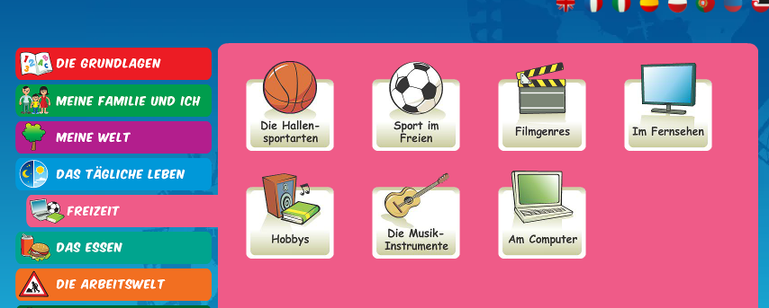
Have a go on Linguascope in the filmgenres section. It’s in the beginner area.
Username – kingshill password – bonjour123

