Slide 1




Year 7 Graphics
Coat of Arms
Week 4

Slide 2

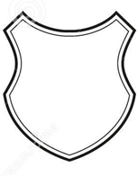

Recap…
Last lesson we looked at the shape of shields and banners.
Next you identified a family motto
Finally you should have produced a research page on your chosen animal standing up
Love
Honesty and
Trust

Slide 3
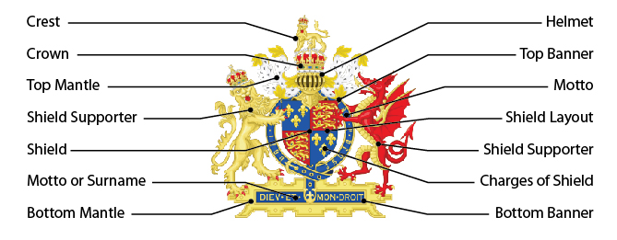
Today we are going to focus on the shape of shields and a family motto

Slide 4
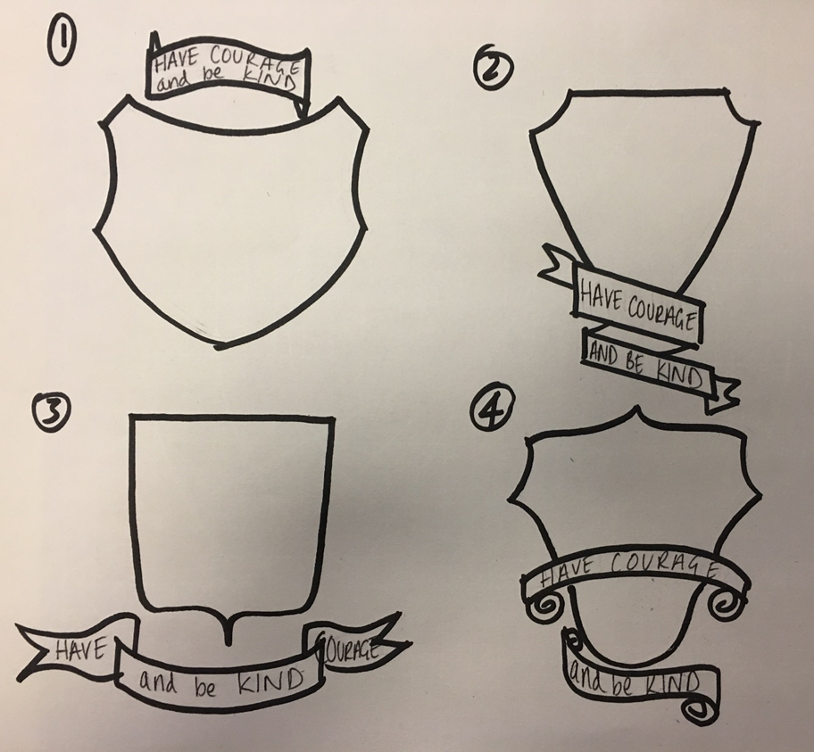
Task 1 – select one of your 4 designs from last lesson….
Divide up your shield into sections – each section will be for a motif (your likes / hobbies / interests)
Therefore you might split the shield in half, or into 3 or even 4 sections.

Slide 5

Task 1 – Remember those colours you chose to represent your personality? Well now you will use them to identify the background colours of your shield.
Trustworthy
Interesting
Hard
Working

Slide 6





Task 1 - Motifs
Use your research that you did on your hobbies and interests.
You want to draw them so that they fit onto your shield.
You may need to simplify the design as remember it will need to fit on your shield.

Slide 7


Task 1 – At this stage you can present your shield like the one below, no need to fill in all the colour. We are just working out the best composition.
Trustworthy
Interesting
Hard
Working

Slide 8


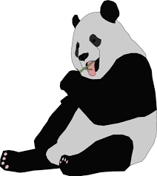
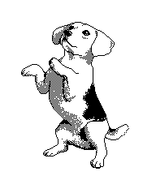
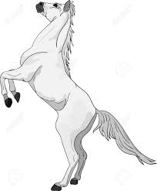
Task 2 – Now its time to add the shield supports (your animal)

Slide 9

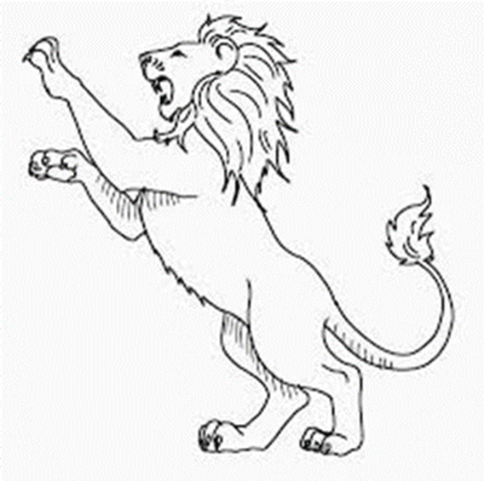
Task 2 – again no need to colour at this stage.

Slide 10
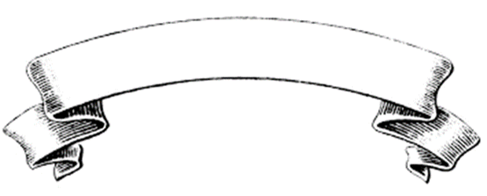

Task 2 – adding your banners for the family name and motto.

Slide 11


Task 2 – additional embellishment……

Slide 12




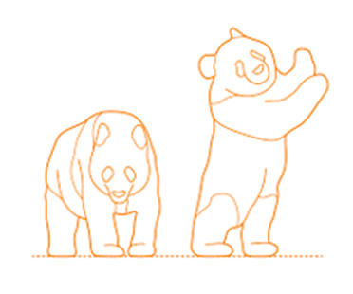
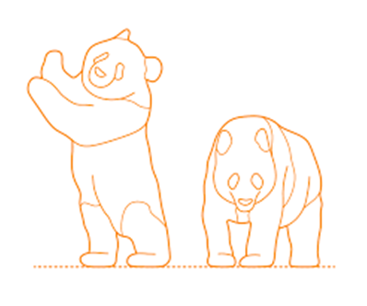

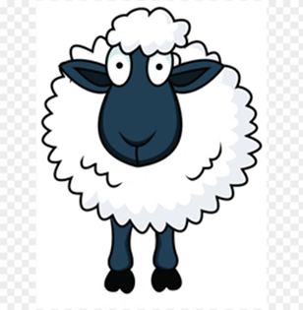



Pupil Outcome
There are 5 pandas because there a 5 members in my family.
Task 2
Johnson
Love is the main ingredient

Slide 13
Task 3 - Specification for a Coat of Arms
My Coat of Arms will use this shape shield
The shield will be divided up into …… different colours, these colours are………to represent trustworthy, ………to represent interesting and …….. to represent hard working.
On each section of the shield I will have a motif to represent my likes, interests and hobbies, these will be………… ……….. and …………
The shield supporter will be a …………
The banner beneath my shield will hold the motto……………………………
In a banner above the shield will be my family name………………..
Additional embellishment will be of a …………………….flower as I am Welsh and this is the national flower of Wales

Slide 14
Specification - Coat of Arms
My Coat of Arms will use this shape shield
The shield will be divided up into three different colours, these colours are Blue to represent trustworthy, Purple to represent interesting and Red to represent hard working.
On each section of the shield I will have a motif to represent my likes, interests and hobbies, these will be a camera on a tripod, a horse shoe and a cupcake.
It’s shield supporter will be of a Lion
The banner beneath my shield will hold the motto ‘Love, Honesty & Trust’
In a banner above the shield will be my family name Richards
Additional embellishment will be of a daffodil flower as I am Welsh and this is the national flower of Wales

Slide 15

Hand Drawn Design.
(this should take you up to lunch 12.25)

Slide 16
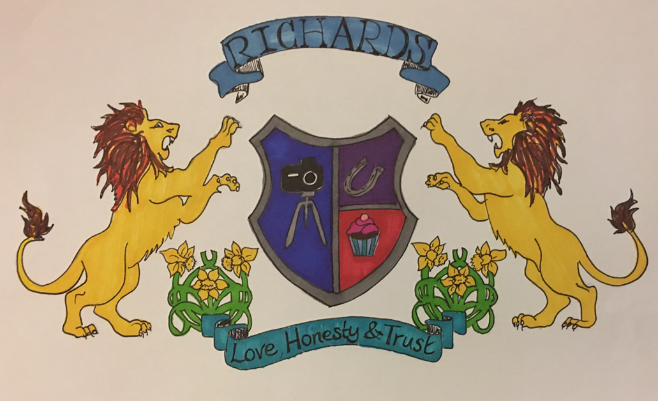
Final presentation - full colour hand drawn design

Slide 17
Next week
In preparation for making your Coat of Arms I would like you to collect any available corrugated card / thin card.
You will also need some strong glue or double sided tape.
A craft knife or Stanley knife would be desirable (if you are allowed to use one at home)
White emulsion paint /colour paint

Slide 18






Slide 19


