Slide 1
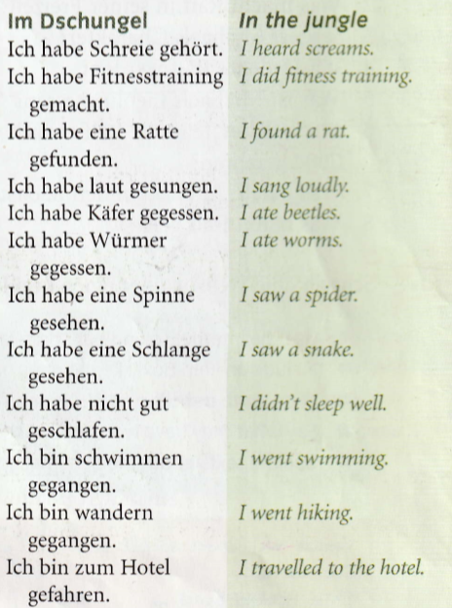
Year 9 German term 5 week 3
Spend some time learning the vocab for this week.

Slide 2
Read the 7 words below and try and guess what they mean in English.
Clue -This page in the text book is about a reality show set in the jungle.

Slide 3
Read this grammar note to remind yourself about how the perfect tense (past tense) works

Slide 4
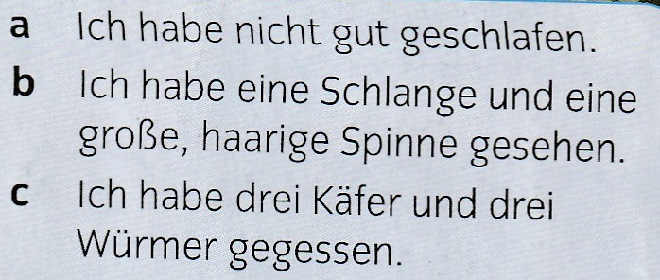
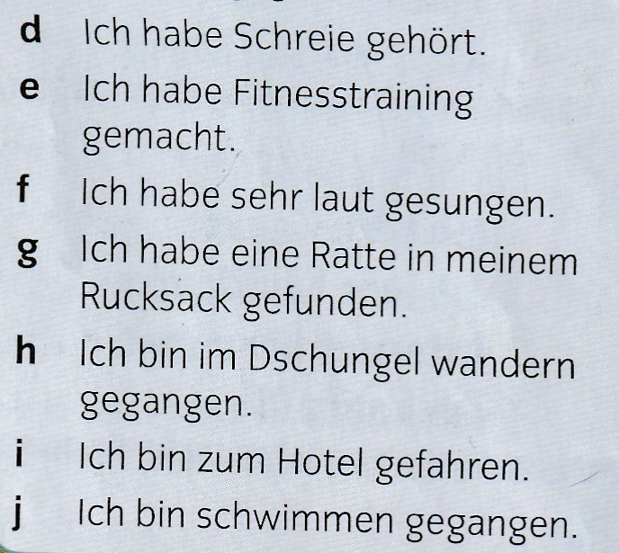
There are 4 celebrities in the jungle. Marco, Selina, Jens and Kathrin. Listen to the track. Which of them said the things a-j?
Example, Marco – c,…

Slide 5
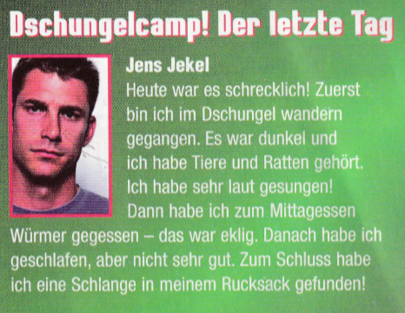
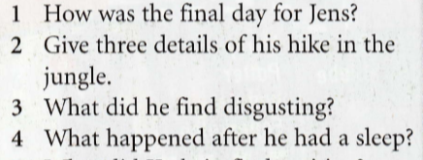
Read about Jens’s time in the jungle. Look up any words you don’t know and add them to your orange book. Then answer the questions.

Slide 6
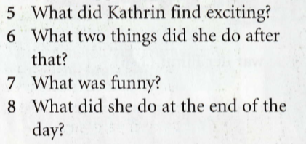
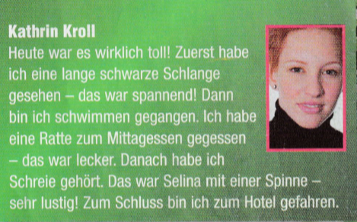
Read about Kathrin’s time in the jungle. Look up any words you don’t know and add them to your orange book. Then answer the questions.

Slide 7
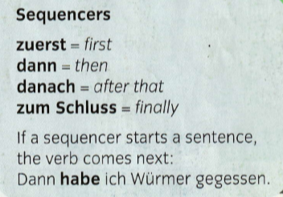
Copy down these new phrases in to your orange book and learn them.

