Slide 1
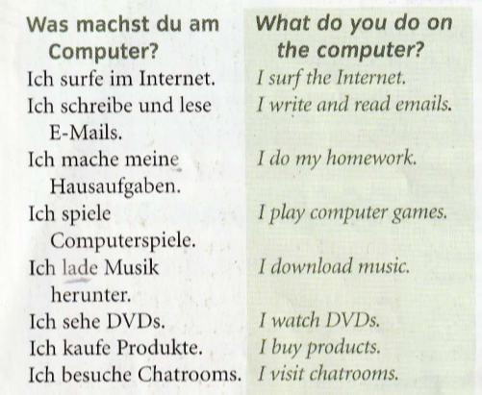
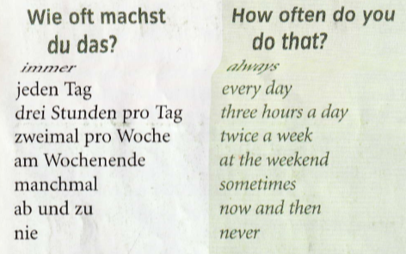
Year 9 German term 5 week 1
Spend some time learning the vocab for this week.
There is more on the next slide too.

Slide 2
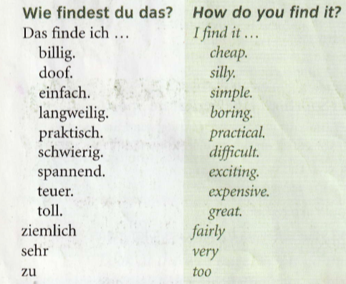

Slide 3
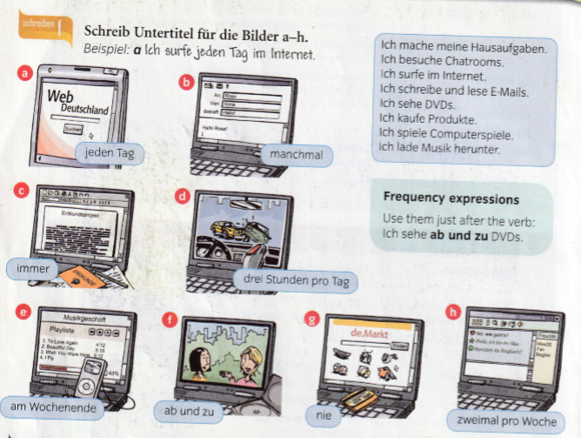
Write a sentence for each picture. Use the expressions at the right hand side and add in the time phrase in each picture. Remember the time phrase goes straight after the verb. Look at the example to help you.

Slide 4
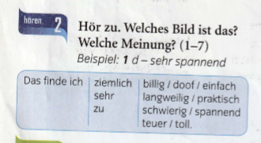
Write 1-7 in the back of your book and the listening symbol. Listen to the track. Which picture are they referring to from the last activity and what is their opinion. There is an example below to help you.

Slide 5
Write 8 sentences in German like the ones below saying what you do, how often and your opinion. Use the vocab slides to help you.

Slide 6
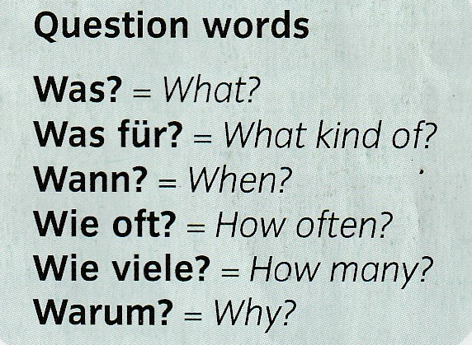
Copy these in to your orange book and learn them

