Slide 1
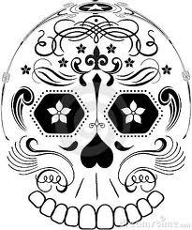
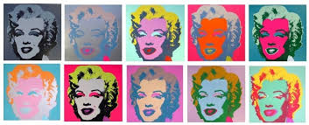
Yr 8 Cover Lesson
Day of the Dead meets Andy Warhol

Slide 2
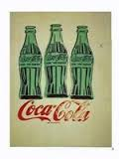
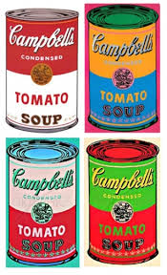
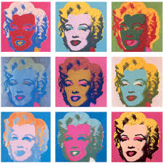
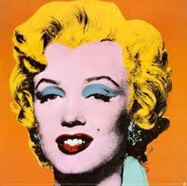
Andy Warhol was an US painter, film-maker and author, and a leading figure in the Pop Art movement.
In the early 1960s, he began to experiment with reproductions based on advertisements, newspaper headlines and other mass-produced images from American popular culture such as Campbell's soup tins and Coca Cola bottles. In 1962, he began his series portraits of Marilyn Monroe.

Slide 3
Task
Select one of the A3 sheets with Day of the Dead designs on.
In the style of Andy Warhol decorate each of the 4 images on your sheet.
You need to use bright colours as this is the theme of Day of the Dead.
Use felt pen or coloured pencil.

