Slide 1


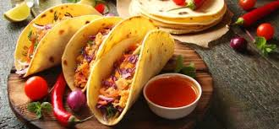

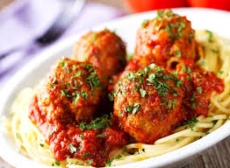

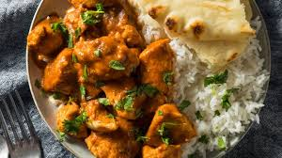

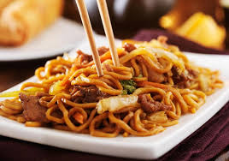
Year 9: Focus on Cultural Food
Name:
Pathway:
Class:

Slide 2
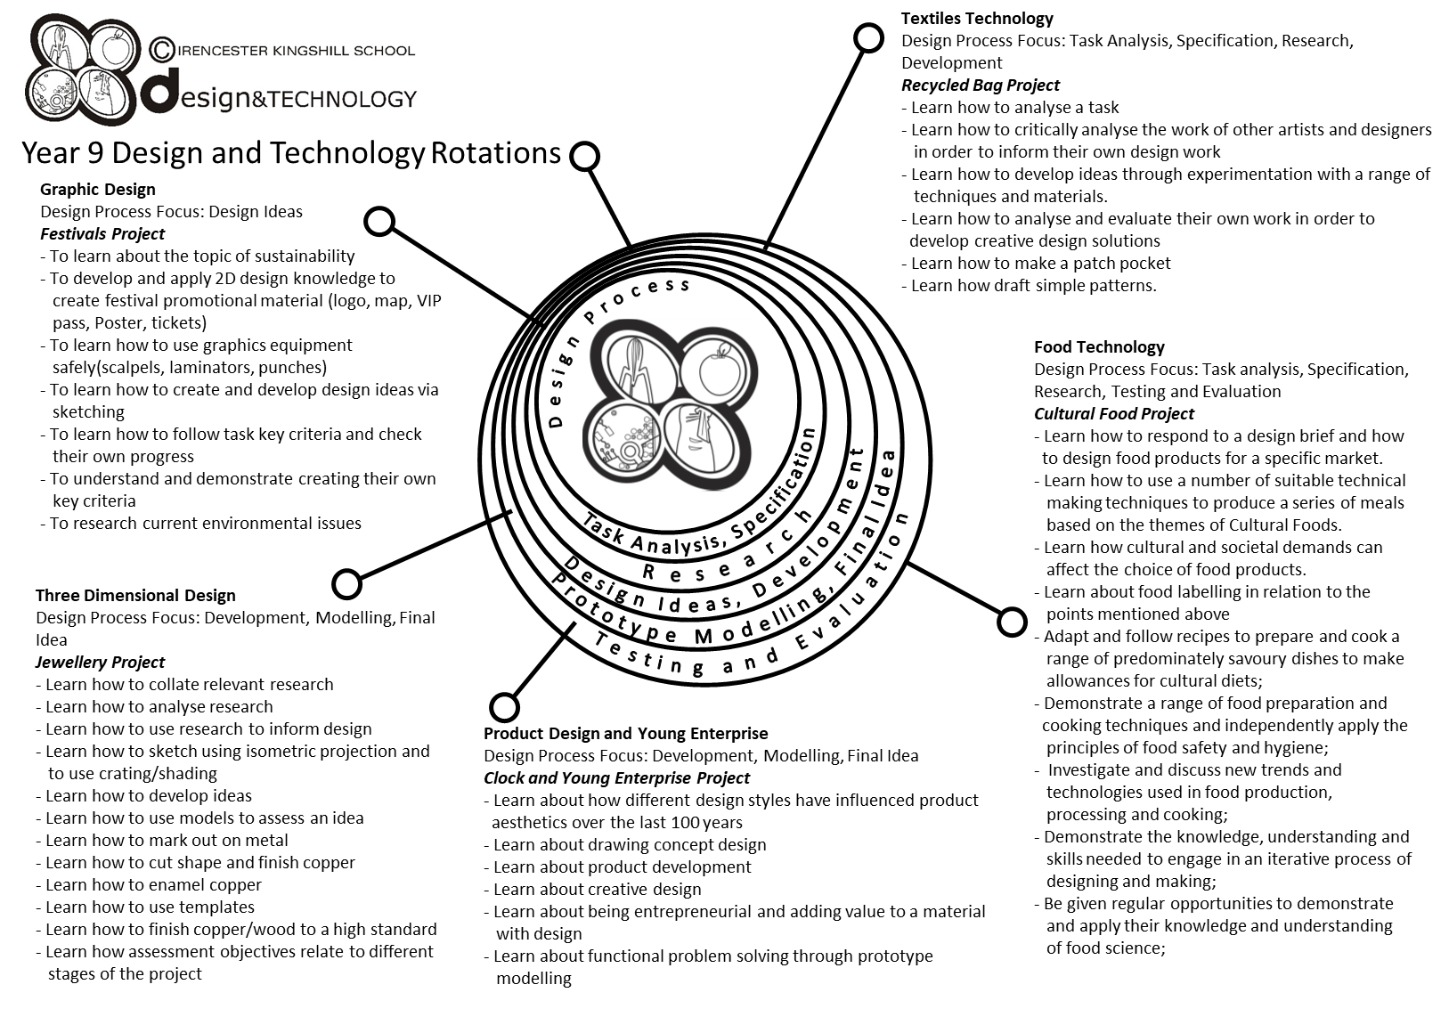

Slide 3
Year 9 pathways criteria – written work
Year 9 Foundation | Year 9 Secure | Year 9 Confident | Year 9 Exceptional
A title page showing the following from your chosen country: a flag, a map, main language spoken and famous people/chefs from that country. | All criteria met from the previous pathway, plus the population and main religions of that country. | All criteria met from previous pathway, with a discussion on at least three areas (e.g. religion, staple foods etc.) | All criteria met from previous pathway, with a discussion on at least five areas (e.g. religion, staple foods etc.)
A map of your chosen country stating the capital and three famous dishes from that country. | A map of your chosen country stating the capital and three famous dishes from that country, names of famous cities and landmarks. | A map of your chosen country stating the capital and three famous dishes from that country, names of famous cities, landmarks, and staple foods grown and produced in that country. | All criteria met from the previous pathway with a discussion on the sustainability on staple foods grown and produced in that country.
You have chosen your dish and have adapted a recipe from the book stating what new flavours you are choosing from your chosen country. | All criteria met from the previous pathway with one alternative dish you have also adapted that is influenced from your chosen country. | All criteria met from the previous pathway with two alternative dish you have also adapted that is influenced from your chosen country. | All criteria has been achieved with reference made to Social, Moral and Ethical issues (cost, religious influences etc.)
You have written your plan of making showing a start and finish time. | You have written your plan of making showing a start and finish time and some timings throughout. | You have written your plan of making showing a start and finish time, and some timings throughout. You have made reference to at least three control points. | You have written your plan of making showing a start and finish time, and some timings throughout. You have detailed control points.

Slide 4
Year 9 pathways criteria – practical work
Year 9 Foundation | Year 9 Secure | Year 9 Confident | Year 9 Exceptional
Some ingredients and equipment handled with reasonable control. | Most ingredients and equipment handled with co-ordination. | Most ingredients and equipment handled with excellent competence and co-ordination. | All ingredients and equipment handled with excellent competence and co-ordination.
Needed a little assistance. | Mostly independent – a little assistance. | Completely independent. Demonstrating good organisation. | Completely independent. Demonstrating a high level of organisation.
Mostly worked in a hygienic and safe manner. | Worked in a hygienic and safe manner. | Consistently worked in a hygienic and safe manner. | Consistently worked in a hygienic and safe manner.
Finished practical dish. | Finished on time. Sink and equipment cleaned and finished product packed away. | Finished well within the time limit. All equipment cleaned and finished product packed away, and extension work completed. | Finished well within the time limit. All equipment cleaned and finished product packed away, and extension work completed to a high standard.
Acceptable finish on end product. | Good finish to end product. | High quality product with excellent finish. | High quality product with excellent finish. Demonstrating good garnishing/decorating skills to finished product.

Slide 5


Food Technology – essential information
What to bring to school:
For each Food Technology lesson, you will need:
Your pencil case
Your planner
You work booklet
When you have your practical lessons, you must also bring:
Your ingredients – weighed and measured
A lidded container to take your food home in, clearly marked with your name
For some practical lessons you may also need a dish/tin to cook the food in.
If you do not bring in ingredients – you will NOT cook
When you get to school
On the days that you have practical lessons, you must take your ingredients to the food room BEFORE registration.
Place your high-risk ingredients (meat, dairy, fish) in the fridge and your dry ingredients in the Cool Room.
After your practical lesson you must leave your food in the cool room and collect after afternoon registration.
Think about the environment. Try not to use too many plastic bags for your ingredients Try to reuse
plastic pots and bags. Use old margarine tubs/sweet tins instead.
It is essential that you leave your unit drawers and cupboards CLEAN and TIDY, ready for the next class.
Please sign to show that you have read and understood the essential information set out below.
Name………………………………………………… Signature………………………………………….. Date…………………………….

Slide 6
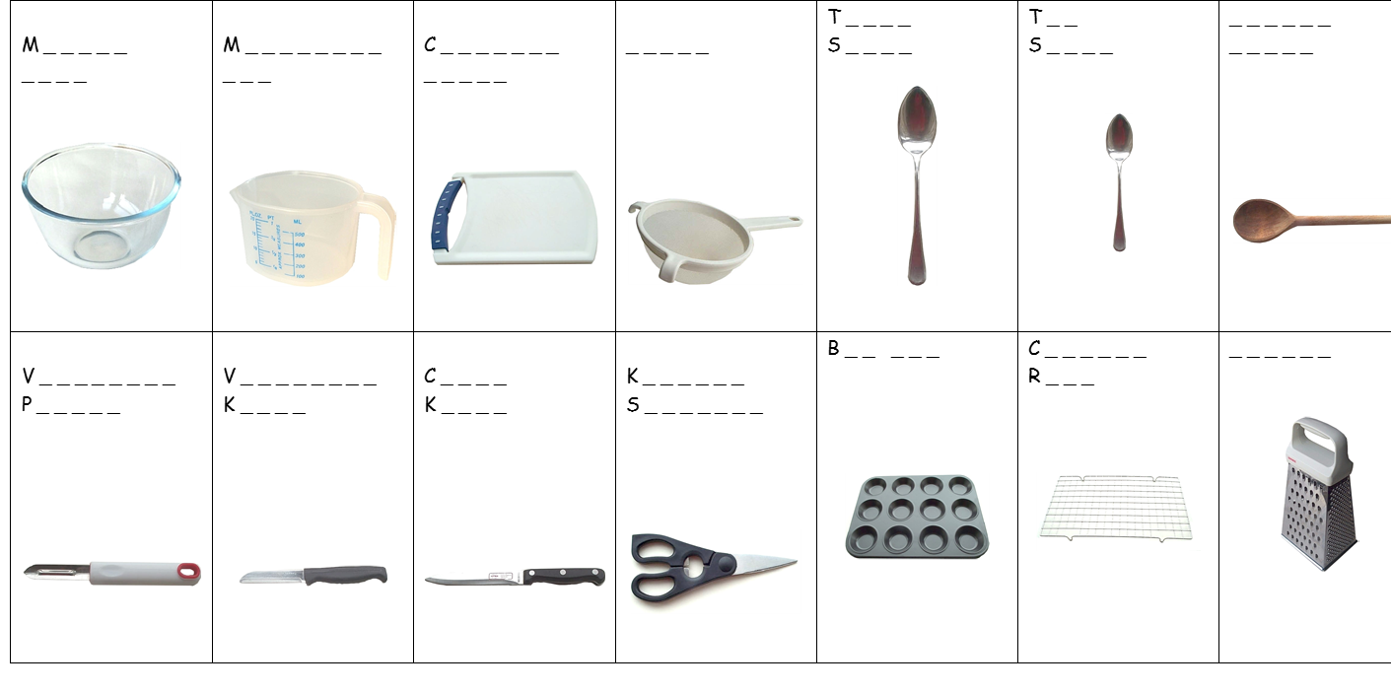
FOOD EQUIPMENT - SPELLING TEST
Identify the following pieces of equipment.

Slide 7
Health and Safety in the kitchen
The Food Technology classroom is one of the most dangerous rooms in the school. During the practical lessons, you will be using a range of equipment, such as sharp knives, ovens, hobs and electrical equipment. It is therefore really important that you follow strict health, safety and hygiene rules to reduce the risk of accidents and injuries.
Write down 10 Food Room Rules and give a brief explanation of why they are important.
1.
2.
3.
4.
5.
6.
7.
8.
9.
10.

Slide 8
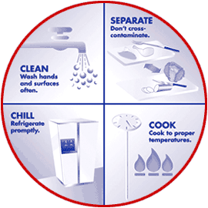
Food Safety Quiz
Use your knowledge of Food Hygiene to answer the following questions. The following keywords will help you.
No | Diarrhoea | Warmth | Chilling | 5° - 63° | Cooking | Moisture | 75°
Food | Acidic | 72°+ | Nausea | Time | Salty | Vomiting | Bacteria
Red | Cleaning | 0° - 5° | Sugary | Once | Stomach cramps | -18° | Cross-contamination
 | Question | Answer
1. | What is the main cause of food poisoning? | Bacteria
2. | Can bacteria be seen without a microscope? | No
3. | State 4 symptoms of food poisoning. | 1 Stomach cramps 2 Nausea 3 Diarrhoea 4 Vomiting
4 | What conditions do bacteria need to multiply? | 1 Warmth Time 3 Moisture 4 Food
5 | Name 3 conditions in which bacteria find it difficult to multiply. | S A L T Y S U G A R Y A C I D I C
6 | What temperatures constitute the danger zone? Explain why. | 5° - 63° C – because that’s the optimum temperature range for bacteria to grow.
7 | When cooked, what should the core temperature of food be? | 75°C
8 | What temperature are most bacteria destroyed? | 72°
9 | What temperature should your fridge be kept at? | 0 - 5°
10 | What colour board should be used for raw meat? Explain why? | Red – it’s the colour of raw meat plus it also signals danger.
11 | What are the 4 C’s of Food Hygiene? | 1 Cleaning 2 Cooking 3 Chilling 4 Cross-contamination
12 | How many times can you reheat food? | Once
13 | What temperature should your freezer be? | -18°C
Notes:
Click on picture to view Bacteria Bites video 8.07 mins.

Slide 9
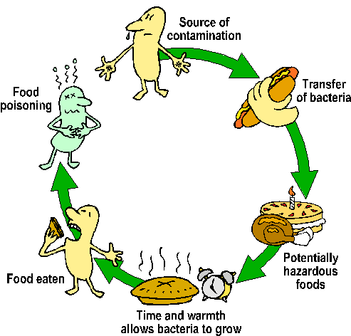
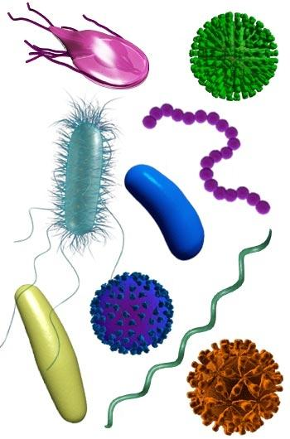
Food Contamination
FOOD SAFETY is the protection of consumer health and well being by safeguarding
food from anything that could cause harm
Food companies have a legal duty to produce food that is “safe to eat”.
Food should be protected from “Field to Fork”. FOOD CONTAMINATION is the
presence in food of any harmful or objectionable substance or object.
Hazards in food are anything that could cause illness, injury or discomfort.
There are 3 types of hazard
  Physical 2. Chemical 3. Biological
Place these contaminants under the correct heading
Plaster Viruses Fly spray Salmonella fungi
Sanitiser E.coli String Hair finger nail
Metal Bolt Yeast Pesticides Bleach soil
Physical | Chemical | Biological
Plaster | Sanitiser | Fungi
Metal bolt | Fly spray | Viruses
Soil | Pesticides | E.coli & Salmonella
String, hair, finger nail | Bleach | Yeast

Slide 10
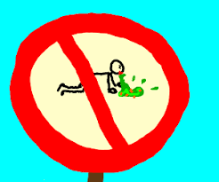
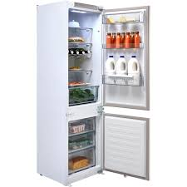
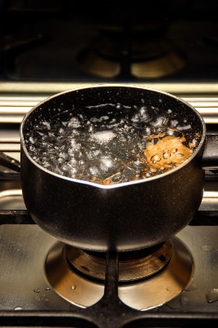
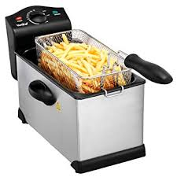
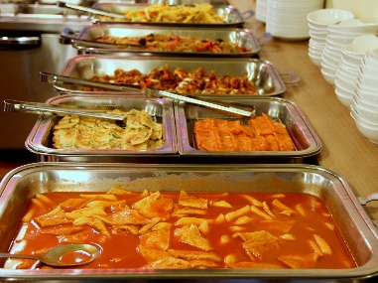
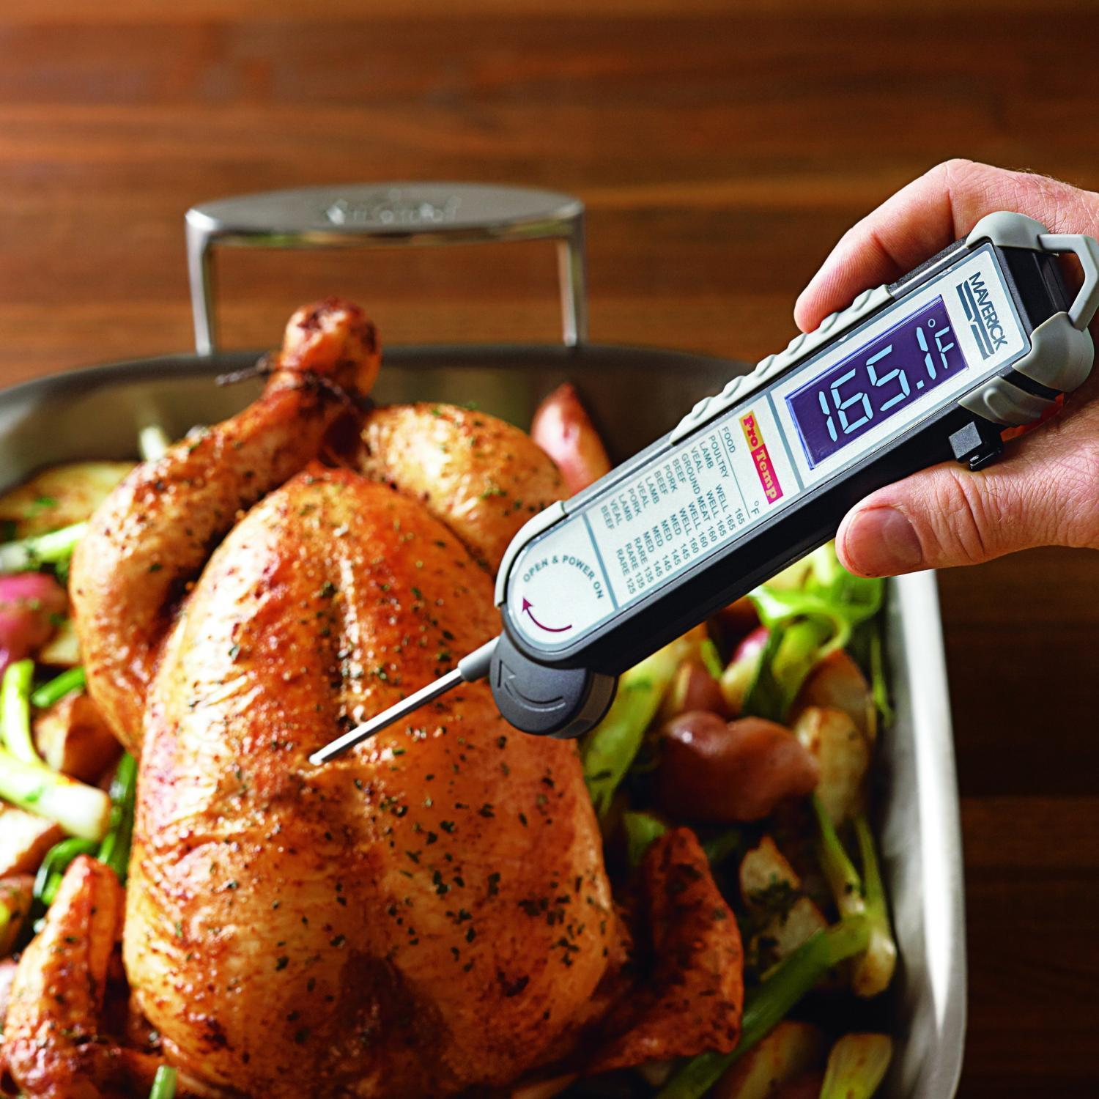
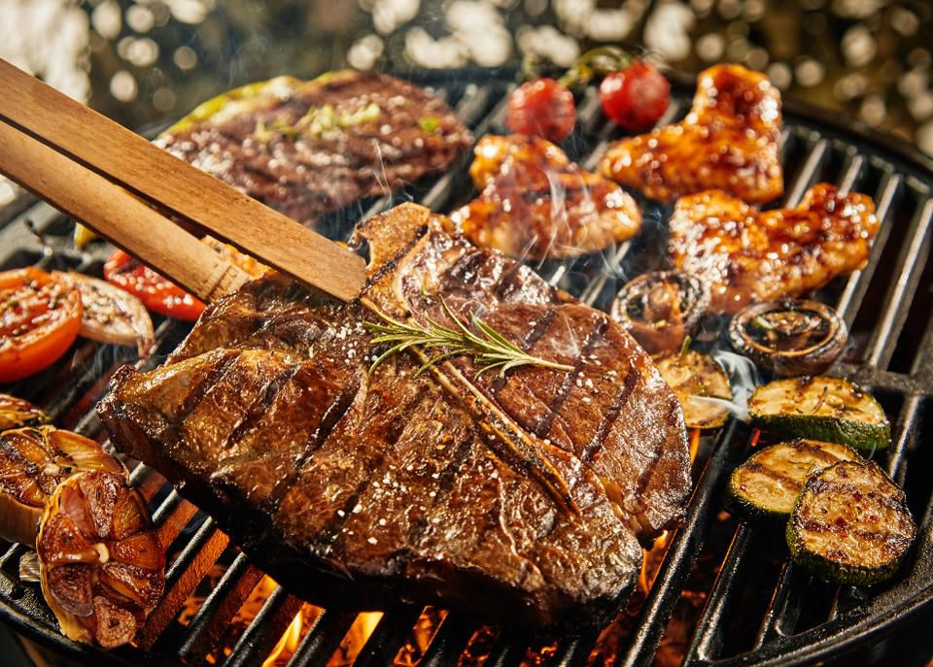
Fridge temperature should be:
0°C - 5°C
The temperature of boiling water is:
100°C
water is…..
Important food temperatures
Temperature of oil in a deep fat fryer should be:
170 - 190°C
Freezer temperature should be:
-18°C
The Danger Zone where bacteria multiply is between
The holding temperature and the temperature that cooked should be served at is:
66°C
0°C
5°C
The core temperature of cooked food should be:
75°C
To check the internal temperature of foods use a:
Food Probe
The core temperature of reheated food should be:
72°C

Slide 11
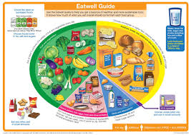
Implementing Dietary Goals
To improve the health of the nation, the government has set a range of dietary guidelines. We know that it is what we eat over a period of time rather than on any particular day that will affect our future health. To avoid illness and try to improve our general state of health we should follow the guidelines below
To reduce Fat, especially animal fat.
To reduce Sugary Foods
To reduce Salt
To increase Dietary Fibre.
As a nation we suffer from a range of Dietary Related Diseases.
Obesity, Heart Disease, Strokes, Tooth Decay, Gum Disease, Diabetes, High Blood Pressure, Constipation, Diverticular Disease, Cancer of Colon.
Use the above words to link the health problem with the dietary goal.
Too much Fat especially saturated fat causes | Obesity, heart disease, high blood pressure , diabetes
Too much Sugar causes | Tooth decay, gum disease, diabetes
Too much Salt causes | High blood pressure, strokes
Not enough Dietary Fibre, fruit and vegetables causes | Diverticular disease, Cancer of the colon, constipation

Slide 12
Nutrition – nourishment or energy obtained from food
A balanced diet has all the essential nutrients found in our food in the correct amounts
Nutrient | Types | Source of nutrient | Function
Protein | Animal | Meat, fish, eggs, milk & cheese | Growth and repair
 | Plant | Peas, bean, nuts & pulses
Carbohydrate | Starches | Bread, pasta, rice & potatoes | Energy
 | Sugars | Fruit, sugar, sweets, cakes & biscuits
Fats | Animal | Butter, lard, dripping | Essential source of fat soluble vitamins (A,D, E and K). Warmth Protects internal organs
 | Plant | Olive oil, sunflower oil
Vitamins | Vitamin A | Liver, egg yolks & green vegetables | Healthy eyesight, general good health
 | Vitamin B | Cereals, green vegetables, dairy | Healthy nervous system, blood clotting, digestion
 | Vitamin C | Citrus fruits, peppers, new potatoes, tomatoes | Fight against infection, healthy gums and skin
 | Vitamin D | Dairy, oils & oily fish | Strong bones & teeth
Minerals | Iron | Spinach, liver, chickpeas & lentils | Formation of red blood cells
 | Calcium | Milk, cheese, yoghurt, tofu, leafy green vegetables | Healthy bones & teeth
Notes:
Click on underlined word for videos

Slide 13
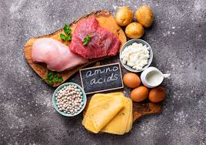
Macro & Micro Nutrients
Protein
Protein is a ‘Macronutrient’ – which means it is needed by the body in large amounts.
1. Complete the word gap task
Animal Pulses Nuts Repair Growth
Proteins assist with __growth______ and ___repair__ of the body.
Proteins are found in ______animal______ products like meat, fish, cheese, milk and eggs. Vegetable sources include soya bean products, _____nuts______ and ____pulses_____.
2. a) What do protein-rich foods have to contain to make them High Biological Value (HBV)?______essential amino acids_________________________________
b) Which types of protein are typically HBV? ___animal proteins and soya_________
Notes:
Click on picture for video on amino acids 1.47

Slide 14

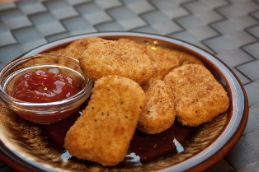
3. Complete the table. There are some foods listed below to give you some help. Classify them as ‘animal’ or ‘plant’ protein.
Animal (high biological value HBV) | Plant (low biological value)
Beef Pork Eggs Cheese Poultry Cod Dairy) | Nuts Tofu Grains Kidney beans Cereal
Nuts Beef Eggs Grains Poultry
Cod Soya Kidney Beans Tofu
Dairy Cereal Pork Cheese
Extension task
What is Quorn?
It is a Mycoprotein made from a fungi called fusarium venenatum. Quorn was first produced in the 1980’s. It has been developed into more than 90 products and is available worldwide.
What are the benefits of eating Quorn instead of meat?
It is an excellent source of high quality protein and contains all the essential amino acids.
It is high in dietary fibre, unlike meat which contains no dietary fibre.
It is low in fat and sodium and contains no cholesterol or trans fats.
Notes:
Click on Quorn picture for short video 1.04 mins.
Click on nuggets for Peter Andre cooking nuggets!

Slide 15
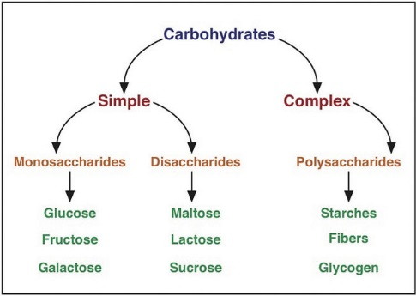
Carbohydrates are also classed as ‘Macronutrients’ – what does this mean?
________It is needed by the body in large amounts________________________
Complete the word gap task:
Starch Cereals Sugar Energy Fruit
Carbohydrates are needed to give the body _energy______. There are two types of
Carbohydrate - __starch_____ and _______sugar__.
Starch is found in ____cereals________, cornflour, potatoes, pasta and flour.
Sugar is found in ___fruit__________, vegetables, honey, milk and processed foods.
2. When might the body need fast release (sugary) carbohydrates?
______after exercise________________________________________________
3. When might the body need slow release (starchy) carbohydrates?
Gives you energy over an extended time – good for breakfast to stop you snacking.
Notes:
Click on picture for Ted Talk video on Carbs 5.10 mins.

Slide 16

4. Complete the table using the list of foods below. Classify them as fast or slow release carbohydrates.
Fast release (sugary ) carbohydrates | Slow release (starchy) carbohydrates
Fruit Rice | Vegetables
Jam | Oats
Sugary cereal | Lentils
Honey | Peas
Potatoes
Energy drinks
Fruit jam vegetables sugary cereal oats lentils Honey potatoes peas
energy drinks rice
Extension task
Which type of foods contain gluten?
Gluten is a protein mainly found in wheat flour. It can also be found in: rye, barley, bulgur, and cous cous.
If you were gluten intolerant (coeliac) which foods could you get your carbohydrates from?
Gluten-free products, rice, potatoes, millet, corn & quinoa.
Notes:
Click on ‘carbs’ for video 3.20

Slide 17
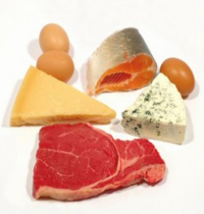
Fats are also ‘Macronutrients’.
Complete the word gap task:
butter insulate saturated energy plant
Fats help to provide concentrated sources of _energy__ and help to _insulate______ the body in cold weather. There are two main types:
__saturated_____________ fats are usually obtained from animal sources, for example _____butter__ and lard. Unsaturated fats come from ____plant___ sources, such as sunflower oil.
2. Complete the table using the lists of foods below. Classify them as saturated or unsaturated fats.
Saturated Fats | Unsaturated Fats
Meat Nuts | Olive oil
Eggs | Vegetable oil
Butter | Oily fish (Omega – 3)
Cream
Meat Olive Oil Eggs Butter Oily fish Vegetable Oil Cream
Nuts
Notes:
Click on picture to view The science behind fats video 5.13 mins.

Slide 18
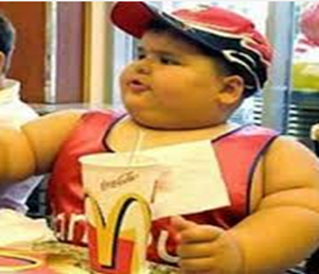
Extension task
Write your answers here:
Health risks:
Obesity, diabetes, risk of strokes
Changes to diet:
Exchange saturated fat foods for unsaturated fats.
No processed foods, foods cooked at home so that you know what they contain.
Reduce the amount of food eaten.
More fruit and vegetables and more exercise.
What health risks does this boy face?
If you were his parent, how would you change his diet?

Slide 19
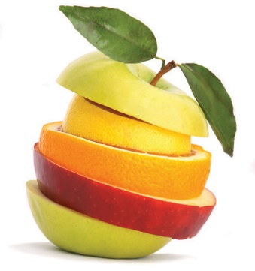
Vitamins are needed in very small amounts for growth and health therefore they are
Micronutrients. The main vitamins are vitamin A, the B complex of vitamins (including thiamine and folic acid), vitamin C, vitamin D, vitamin E & vitamin K.
Match the vitamins to their function (job role in the body).
Give 3 examples of foods you would find each vitamin in.
A B C D E K
Fat Soluble | Function | Food Sources
e.g. Vitamin A | I’m important for growth, healthy skin and hair and I can help you see better at night. | Yellow peppers, carrots, dairy e.g. milk
Vitamin D | You need me for healthy bones and teeth. | Oily fish, eggs, fortified margarines
Vitamin E | I help protect cells. I also help your immune system and repair DNA! | Plant oils, soya, nuts, seeds, egg yolk, olive oil
Vitamin K | I help to clot your blood. | Leafy green vegetables, liver, bacon, cereals, vegetable oils
Water soluble | Function | Food Sources
Vitamin B group | We help with cell repair, digestion and energy release from carbohydrates. | Red meat, yeast, dairy, egg, mushrooms, nuts & seeds
Vitamin C | I help you repair wounds and absorb iron to carry oxygenated red blood cells. | Fruits especially citrus, dark green vegetables, potatoes
Notes:
Click on picture to view the difference between water and fat soluble vitamins 2.40

Slide 20
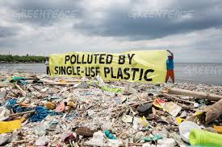
Environmental issues within the food industry
Looking after the environment is really important to prevent global warming. The food industry and consumers have a large part to play in protecting the environment.
Remember the 3 ‘R’s - Reduce
Reuse
Recycle
How can we reduce the amount of waste within our homes?
Use products with less packaging
Use up food left overs in other meals
Compost food /vegetable peelings etc.
Recycling glass, tins, cardboard and paper.
Plan meals carefully to prevent waste – make a shopping list
Don’t be tempted by offers such as ‘Buy one get one free’
Packaging:
We use packaging for food to:
Protect the contents
Hold the contents
Keep it fresh
Reduce waste – keeping it safe to eat for longer
Make food easier to handle, transport and serve.
Improve hygiene – protects from bacterial contamination
Make contents look more attractive
Give information to consumer on the contents, storage etc.
Notes:
Click on photo for Ted Talks video on plastic bottles. 4.06 mins

Slide 21
Packaging | Advantages | Disadvantages
Paper and card | Easily printed Can be recycled Strong when dry Lightweight | Crushes easily Weak when wet Recycled paper & card cannot be used for food.
Glass | Easily printed Strong Reusable Can carry liquids | Brittle Easily broken
Metal | Easily printed Recyclable Strong Rigid | Must be coated inside or reacts with food Cannot microwave Uses valuable energy to extract from the ground
Plastic and polystyrene | Easily printed Strong Flexible Does not react with food | Causes litter problems Limited resource Not easily recycled
Packaging
Looking after the environment is really important to prevent global warming. Remember the 3 ‘R’s R_ _ _ _ _, R_ _ _ _ & R_ _ _ _ _ .
How can we reduce the amount of waste within the home?

Slide 22
Why do we package food? List as many reason as you can think of.
Protect the contents
Hold the contents
Keep it fresh
Reduce waste – keeping it safe to eat for longer
Make food easier to handle, transport & serve
Improve hygiene – protects from bacterial contamination
Make contents look more attractive
Give information to consumer on the contents, storage etc.
Make a list of 5 foods that are suitable for composting?
1. Fruit & vegetable peelings/scraps
2. Tea bags and coffee grounds
3. Egg shells
4. Meats
5. Dairy

Slide 23
Understanding recycling symbols
14
8
3
6
5
13
1
15
12
2
10
4
11
9
7
1 | Organic | 4 | Irradiation | 7 | Freezer | 10 | Vegetarian | 13 | Microwave
2 | British Farm Standards | 5 | Traffic Light Labelling | 8 | Barcode | 11 | Compostable packaging | 14 | 5 a Day
3 | Fairtrade | 6 | Litterman | 9 | Gluten Free | 12 | Freedom Food | 15 | Recyclable

Slide 24
Produce a poster to promote recycling in the home
Make your work eye-catching – use bold designs, bright colours, a slogan and a border

Slide 25
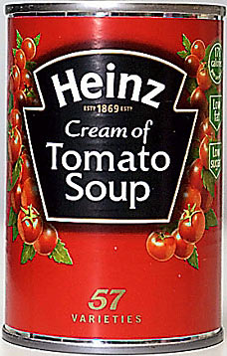
What does the label tell us?
Food labelling has to follow strict guidelines. This is a legal requirement and helps to protect the consumer and allows them to make informed choices.
Look at the label and find the following information. This information has to be visible on the label by law.
1 | Name of product | Cream of tomato soup
2 | Name and address of manufacturer | H.J. Heinz Foods UK Ltd., Hayes, Middx, UB4 8AL
3 | List of ingredients | Tomatoes (89%), water, modified corn flour, sugar, rapeseed oil, dried skimmed milk, salt, cream, milk proteins, acidity regulator – citric acid, spice extracts, herb extract.
4 | Weight of product | 400g
5 | Date marking | On top of tin
6 | Storage instructions | Empty unused soup into a covered container and put into the fridge.
7 | Instructions for use | Hob: empty soup into a pan and stir gently while heating. Do not boil. Microwave: Empty soup into a microwaveable dish and cover. Heat on full power for 2 minutes.
8 | Place of origin | Made in England
9 | Food Allergy information | Milk

Slide 26
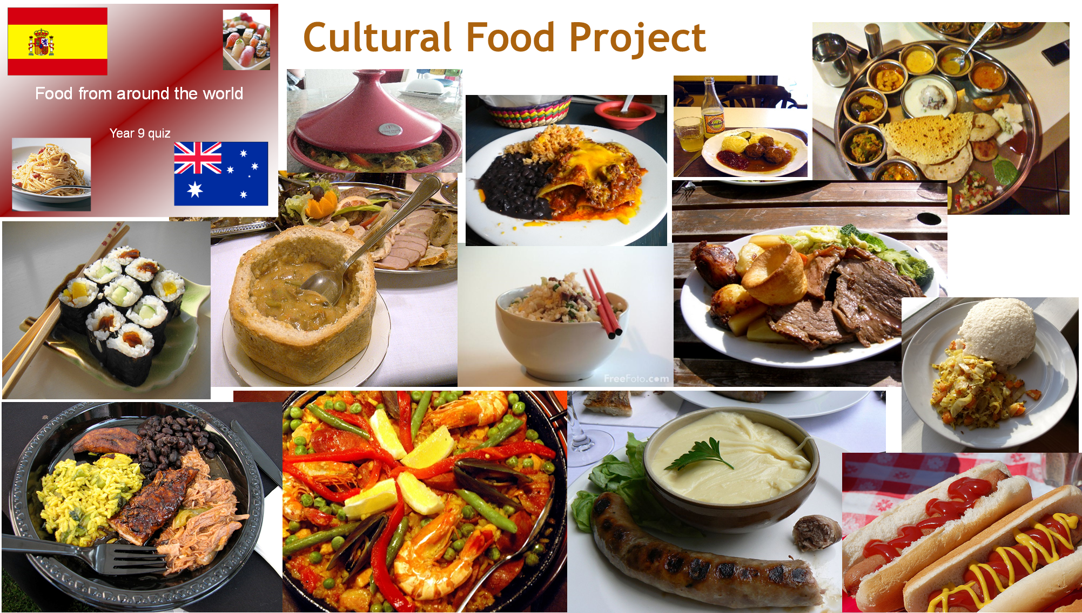
Your project during Year 9 is to research, plan and cook a dish based on a particular chosen country. You will use the influences of your chosen country to develop a recipe that you may have previously used.
Your project can be produced as a Word document, a PowerPoint or hand-written. As well as cooking the dish, you will be expected to evaluate your cooked dish and project against a set criteria, complete a sensory analysis profile and suggest ways in which you could improve your dish if you were to cook it again.
Use the following codes to check the criteria against your pathway – F S C E
Your project needs to contain the following. Tick the check box to show you have completed the task.

Slide 27
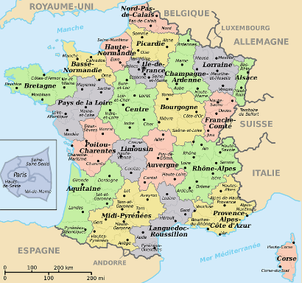
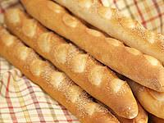
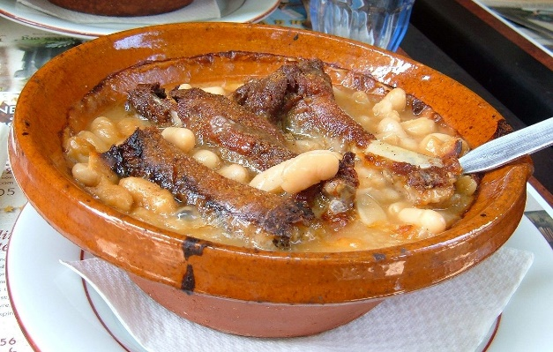
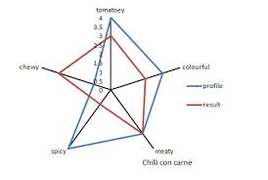
Cultural Food Project
Task | P/W | 
A title page which sets out which country you will be researching, complete with appropriate pictures. | F S C E
Facts about the country – i.e. Language spoken, population, religion, famous people and any interesting facts and figures. | F S C E
A map of the country showing important landmarks, cities and geographical features. | F S C E
What ‘staple foods’ are grown and produced in that country | C E
Traditional and famous dishes. | C E
Describe the dishes you have chosen to cook and explain why you have chosen them. | S C E
Write an evaluation explaining how you cooked them and how they turned out. What could you have done to improve the dish? | S C E
Complete a Nutritional Analysis of each dish. (www.explore food. Calculate a recipe). | E
Draw or create a star profile analysing your product. (By hand or in Excel) | F S C E
Include an annotated photo of dish 1 | C E
A traditional bread from France is a baguette
Cassoulet – a traditional dish of mid and southern France
A sensory profile showing the attributes of the dish.

Slide 28
Plan of work
Product Name:
Time | Order of work
Equipment I will need: 1
Ingredients I will need:
Health & safety checks:

Slide 29
Star Profile
Product name: Chosen Country:
Your product score:
Perfect product score:
40
What does the star profile tell you?
Time management
Taste
Appearance
1
2 3 4 5
Country
Aroma
Skills
Colour
Texture
Notes:
Click on ‘star profile’ for video on sensory perception 3.40

Slide 30
Evaluation of your chosen dish – Cultural Food Project
Comments on planning and organisation
Comments on making and following recipe/instructions
Comments on clearing up
Tester | Comment | Score /5
1
2
3

Slide 31
Conclusion
Comment on how your product met the design brief.
My product met the design brief because …….
To improve my product if I were to make it again, I would…
1
2
3
4

Slide 32
No ingredients?
In your books or on lined paper, write out the question and then write your answer, use full sentences.
What is the practical today?
List the equipment/utensils & functions of what is being used today
What skills are being used to make this dish?
What are the hygiene and safety hazards in the recipe? How can these be prevented/controlled?
What should a 'good' example of this dish look, smell and taste like? (Describe in detail with sensory language)
What are the common mistakes that may occur with this recipe? How can they be prevented or put right?
What key advice/tips would you give to someone making this recipe?
What nutrients are present in this dish? What nutrients are in excess (lots of) / deficient (missing) in the dish?
How could the dish be made healthier? Suggest at least 3 ways.
How can the dish be adapted to be suitable for: a. Gluten free? b. Lactose intolerance? c. Vegans?
Explain how you will be more organised with bringing your ingredients next lesson.

