Slide 1
Year 9 Drama
Private Peaceful – Lesson 1

Slide 2
Objectives
To know what an effective still image is
To understand the characters of Private Peaceful
To be able to role play a drama scene using dialogue, facial expressions and body language

Slide 3

Starter: Listening (& thinking) task
Find a space in the room and close your eyes
Listen carefully to the music…
Thinking task:
How does it make you feel?
Where/when would it be played?

Slide 4
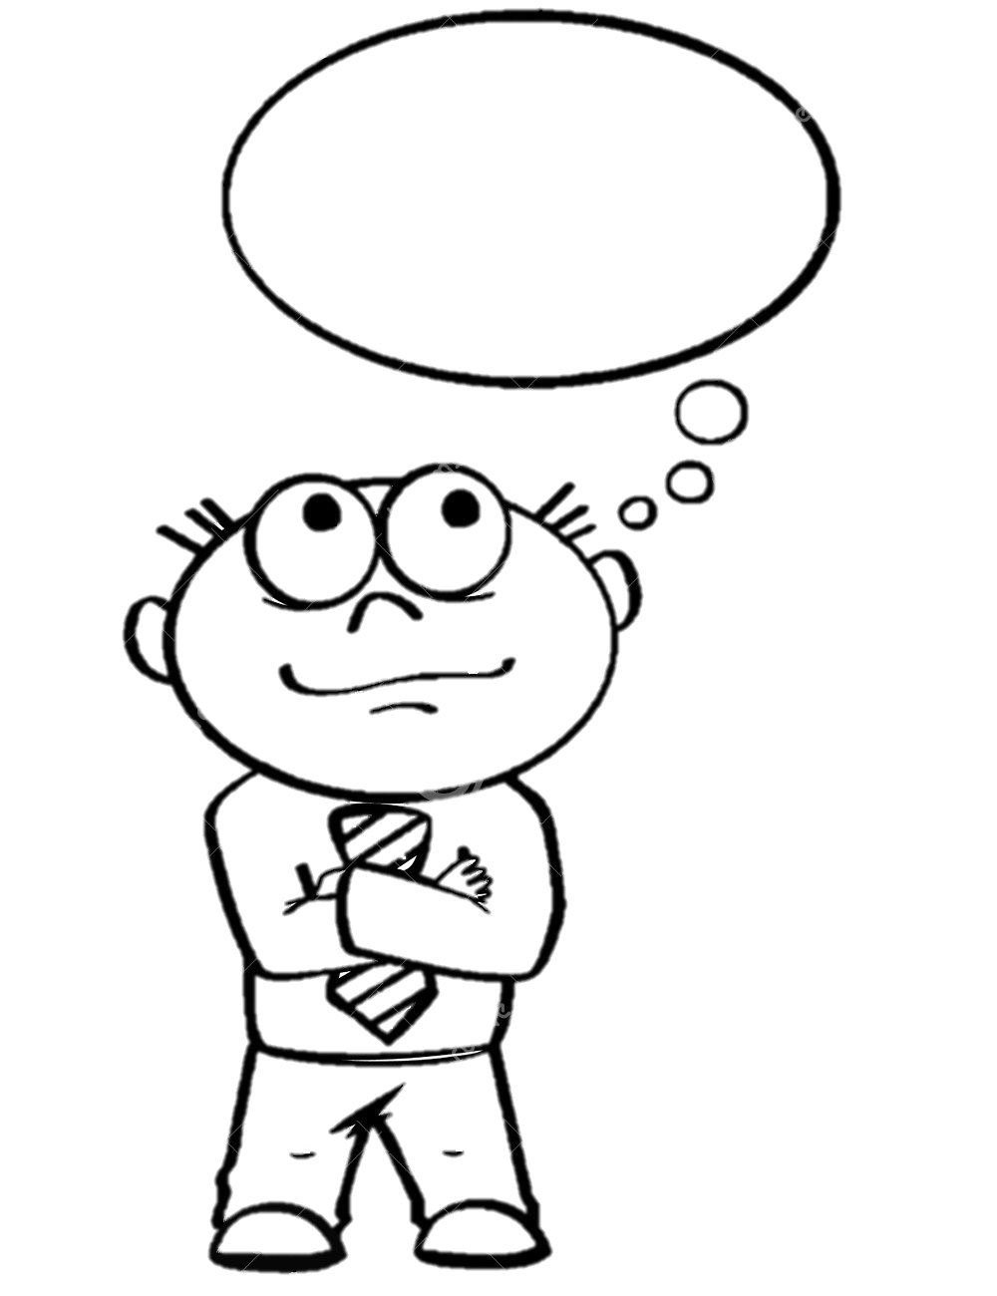
Task 1: Still images
Just like a photograph, a still image can be examined closely, and the audience can note body language, facial expressions or proxemics to give clues as to the situation or the people within the situation at that moment.
In groups of 4, create the following still images;
A family
Signing up to the war
Leaving home for war
The trenches
Writing letters home to your family
Coming home
What makes a good still image?
Extension task: Add transitions to link the still images together to create a moving story

Slide 5

Task 2: Scene 2
Read as a whole class
Who’s the story about?
What do we know about him/them?

Slide 6
Task 3: Role play
In groups of 4, use role play to act out Scene 2
Decide who will play each character and how you will stage the scene
Remember to include;
Facial expressions
Movement
Loud, clear voices to communicate the dialogue

Slide 7
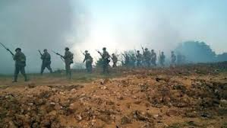
Audience rules
Sit quietly and listen respectfully to the performers
Be prepared to give feedback on what you have observed
Anyone who talks will have a break time detention next week

Slide 8
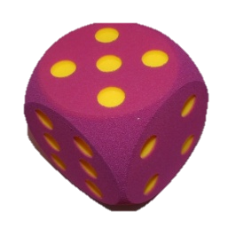
Peer Feedback - Dice
How were Tommo’s emotions portrayed?
What did you enjoy about the performance?
What could be improved?
How did Mr Munnings show his authority?
How did the group use voice and facial expressions to show their characters?
Describe the use of movement and the effects

Slide 9
Objectives
To know what an effective still image is
To understand the characters of Private Peaceful
To be able to role play a drama scene using dialogue, facial expressions and body language

Slide 10
Starter: Listening task
https://www.youtube.com/watch?v=FsynSgeo_Uo&list=PL1mZeR4wTBoxiM86th4lOXhMQN8wDWYAt
During your lesson break, listen carefully to the music
How is it different to the first track we listened to? How does it make you feel? Where would you hear it?

Slide 11
Task 1: What happens next?
Improvise – To create and perform spontaneously or without preparation
In groups of 4, you have 5 minutes to improvise a scene of what happens next, following Scene 2
Show Tommo going home and telling his mum and Big Joe (older brother) about school
Include how Tommo feels and who he met
Performance and feedback

Slide 12
Task 2: Set the scene
Now go back into your groups and work on improving and setting your What happens next scene, based on your improvisation
You may use ideas that you have seen from other groups performances
Every group will perform at the end of the lesson

Slide 13
Performance and Peer Feedback - Dice
What did you like about the performance and why?
What could the group do to improve their performance?
What drama strategies did the group use? (still images, mime, narration etc)
If you could, what would you like to ‘steal’ to use in your performance?
How did the performers use voice, facial expression and body language?
In what ways did the performers show character?

Slide 14
Drama
Private Peaceful – Lesson 3
https://www.youtube.com/watch?v=d5aeClRY4kA

Slide 15
Objectives
To know how to improvise an alternative ending to a scene
To understand the skills required to ‘set’ a scene
To be able to work positively with other students and to perform confidently

Slide 16

Starter: Still images
In pairs, use still images to reflect the first scene;
Remember to use levels to show authority, body language and facial expressions to show characters!
Charlie ‘dragging’ Tommo to school
Tommo meeting Mr Munnings for the first time
Miss McAllister and Tommo meeting
Mollie helping Tommo with his shoe laces

Slide 17
Task 1: What happens next?
Improvise – To create and perform spontaneously or without preparation
In groups of 4, you have 5 minutes to improvise a scene of what happens next, following Scene 2
Show Tommo going home and telling his mum and Big Joe (older brother) about school
Include how Tommo feels and who he met
Performance and feedback

Slide 18
Task 2: Set the scene
Now go back into your groups and work on improving and setting your What happens next scene, based on your improvisation
You may use ideas that you have seen from other groups performances
Every group will perform at the end of the lesson

Slide 19
Performance and Peer Feedback - Dice
What did you like about the performance and why?
What could the group do to improve their performance?
What drama strategies did the group use? (still images, mime, narration etc)
If you could, what would you like to ‘steal’ to use in your performance?
How did the performers use voice, facial expression and body language?
In what ways did the performers show character?

Slide 20
Objectives
To know how to use drama strategies to role play a scene
To understand why these strategies are important
To be able to role play scene 30 demonstrating key strategies like marking the moment and freeze frames

Slide 21
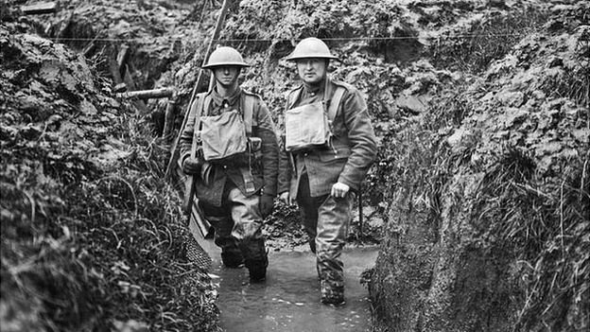
Task 1: Scene 30
As a class, read through Scene 30
Where are Charlie and Tommo now?
What happens in the scene?
How do you think they are feeling?

Slide 22
Task 2: Role play scene 30
In groups of 5, role play the action of scene 30
Include;
Marking the moment
Still images
Facial expressions
Body language

Slide 23
Audience rules
Sit quietly and listen respectfully to the performers
Be prepared to give feedback on what you have observed
Anyone who talks will have a break time detention next week

Slide 24
Performance and Peer Feedback - Dice
What did you like about the performance and why?
What could the group do to improve their performance?
What drama strategies did the group use? (still images, mime, narration etc)
If you could, what would you like to ‘steal’ to use in your performance?
How did the performers use voice, facial expression and body language?
In what ways did the performers show character?

Slide 25
Objectives
To know how to use drama strategies to role play a scene
To understand why these strategies are important
To be able to role play scene 35 demonstrating key strategies like marking the moment and freeze frames

Slide 26
Starter…
Still images;
March
Attention
At ease
Single file
Halt

Slide 27
Task 1: Scene 35
As a class, read through Scene 35
Where are Charlie and Tommo now?
What happens in the scene?
How do you think they are feeling?

Slide 28
Task 2: Role play scene 35
In groups of 5, role play the action of scene 35
Include;
Marking the moment
Still images
Facial expressions
Body language

Slide 29
Audience rules
Sit quietly and listen respectfully to the performers
Be prepared to give feedback on what you have observed
Anyone who talks will have a break time detention next week

Slide 30
Performance and Peer Feedback - Dice
What did you like about the performance and why?
What could the group do to improve their performance?
What drama strategies did the group use? (still images, mime, narration etc)
If you could, what would you like to ‘steal’ to use in your performance?
How did the performers use voice, facial expression and body language?
In what ways did the performers show character?

Slide 31
Starter…
Still images;
March
Attention
At ease
Single file
Halt

Slide 32
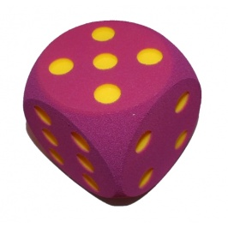
Performance and Peer Feedback - Dice
What did you like about the performance and why?
What could the group do to improve their performance?
What drama strategies did the group use? (still images, mime, narration etc)
If you could, what would you like to ‘steal’ to use in your performance?
How did the performers use voice, facial expression and body language?
In what ways did the performers show character?

Slide 33
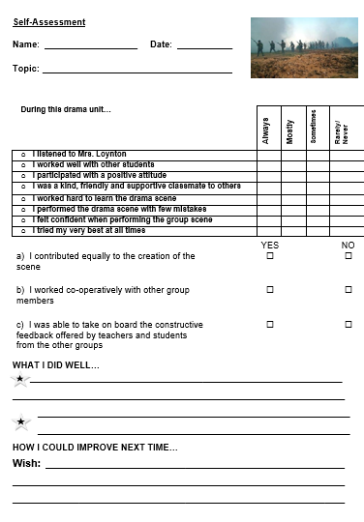

Self assessment
We are now going to watch the performances back and complete the self assessment sheets.
Remember to be honest…
What did you do well?
What could you do to improve your performance next term?

Slide 34
Game time!!!
Circle games
Spaghetti
Cross the circle
Zombies
Throw the dice (memory game)
Splat
Zip, Zap, Bong
1-10
Energy circle (clap)
Heads down, heads up
1 duck, 2 legs, Quack!
Centre games
Mirroring
10 seconds to make (in 4s)
Bubbles
Line up
Sleeping lions
Chicken in a hen house
!!!!!

