Slide 1
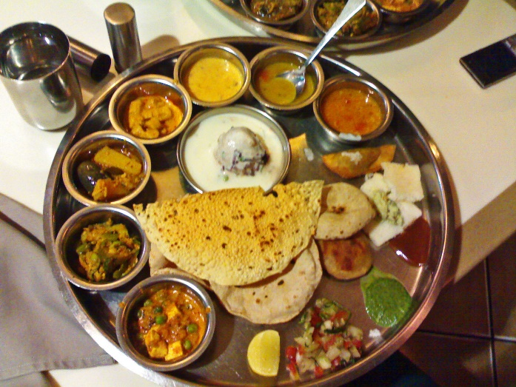
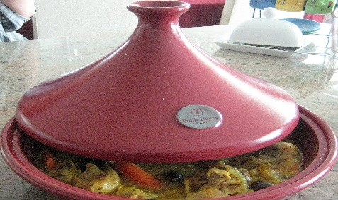
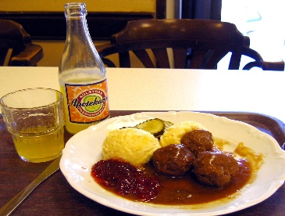
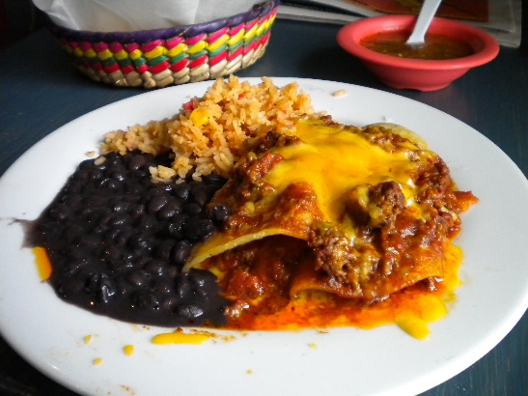
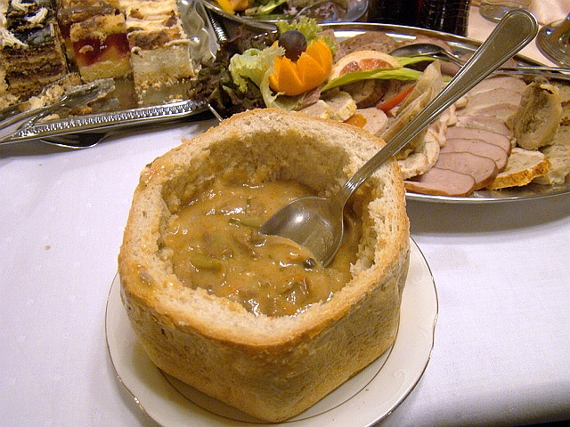
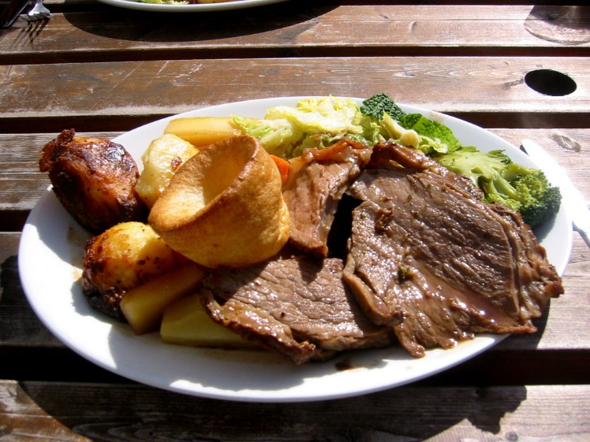
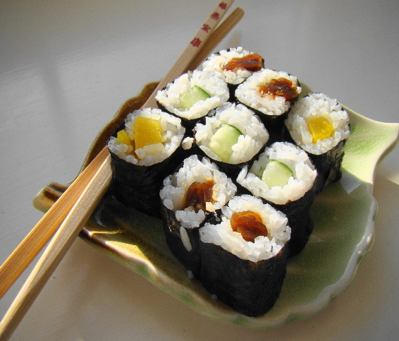
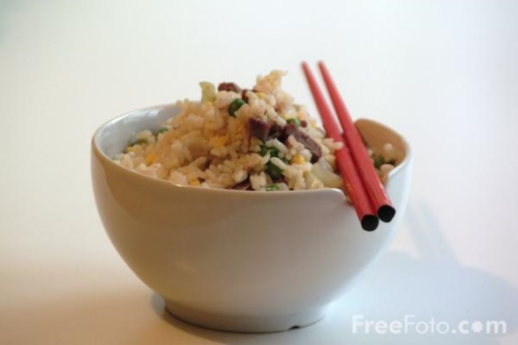
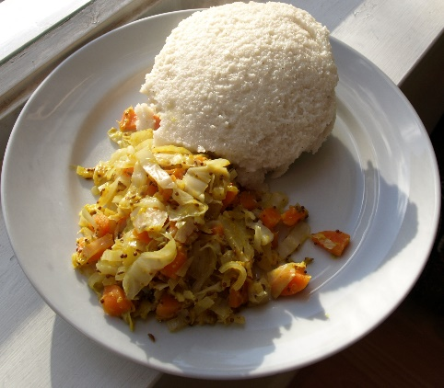
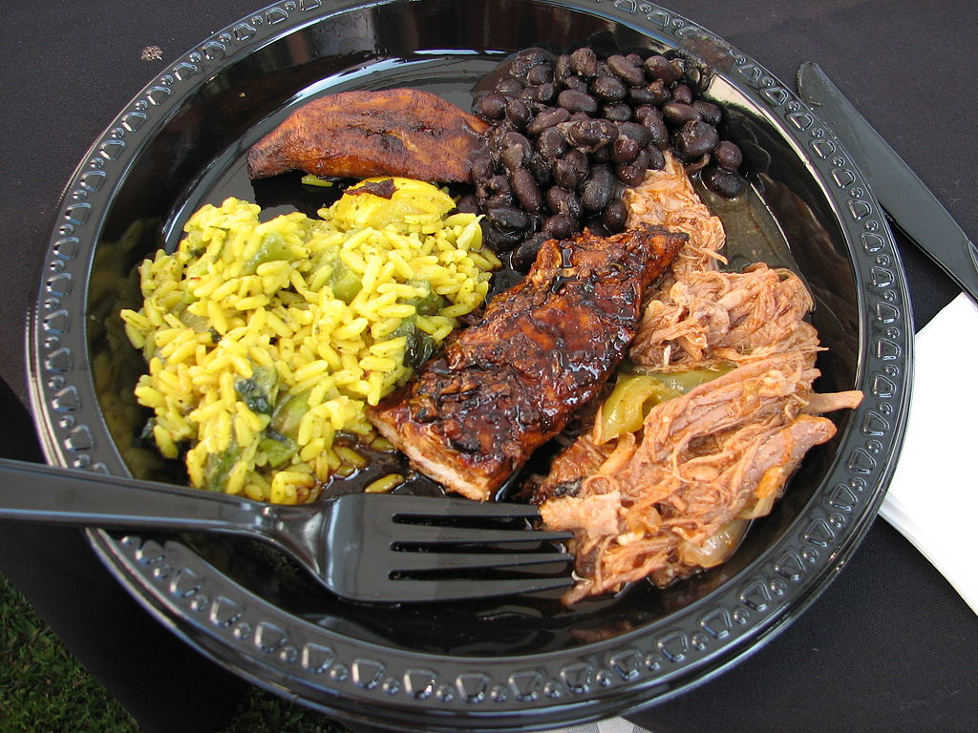
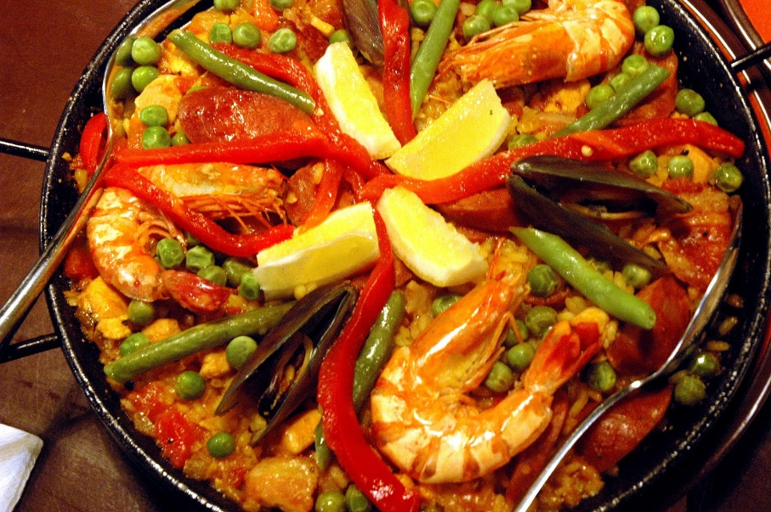
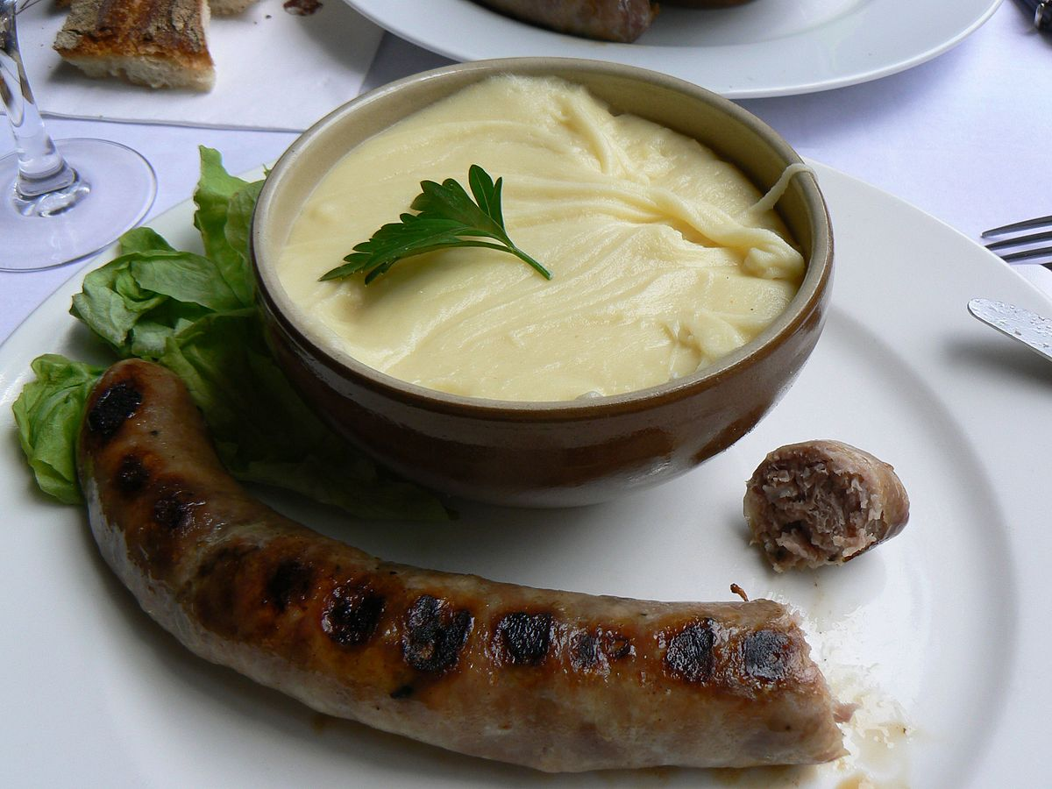
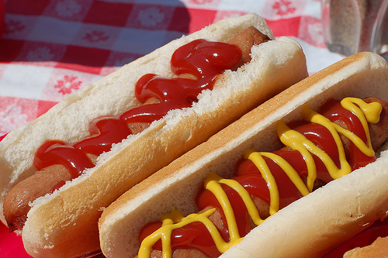
Cultural Food Project
Notes:
Click on tagine for link to Euroclub quiz

Slide 2
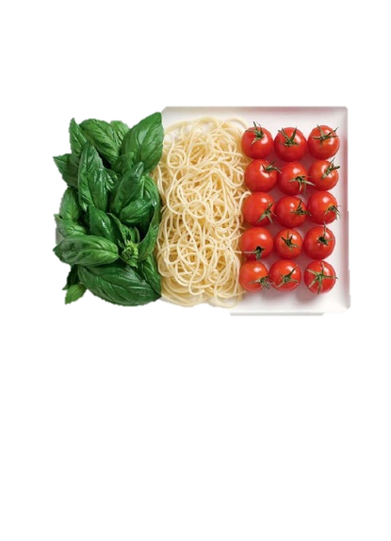
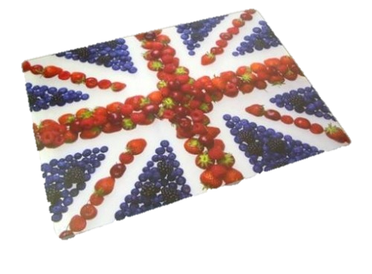
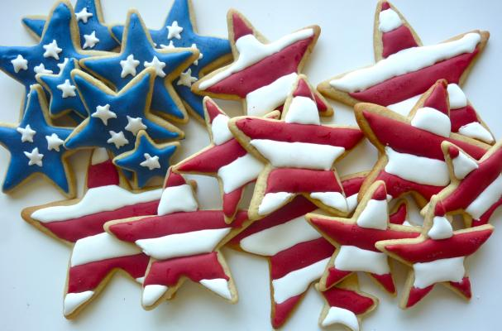
Cultural Project Requirements
Your project for the next couple of weeks is to research and cook 2 dishes based on a particular country.
Your project needs to be produced as a PowerPoint presentation and will need to contain the following points;
A title page which sets out which country you will be researching, complete with appropriate pictures.
Facts about the country – i.e. Language spoken, population, religion, famous people and any interesting facts and figures.

Slide 3
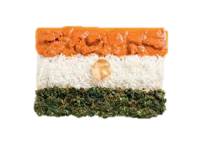
A map of the country showing important
landmarks, cities and geographical features.
What ‘staple foods’ are grown and produced in that country.
Traditional and famous dishes.
Describe the dishes you have chosen to cook and explain why you have chosen them.
Write an evaluation explaining how you cooked them and how they turned out.
Complete a Nutritional Analysis of each dish. (explore food. Calculate a recipe). I will show you how to do this next week.
Draw or create a star profile showing your
sensory analysis of your dish.
And finally – include annotated photo’s of dishes that
you will make at home.

Slide 4
Your Time Plan
Thursday 21st June – planning/writing in DT6
Friday 22nd June – Cooking your developed recipe.
Thursday 28th June – planning/writing DT6. Print out recipe
Friday 29th June – You will be cooking your chosen 1st dish.
Thursday 5th July – Evaluating dish no1 and planning recipe
2 in DT6.
Friday 6TH July – Practical dish 2 - evaluate dish no.2. Sensory & nutritional profile.
Thursday 12th July – Project to be handed in BEFORE this date. Awards day.

