Slide 1
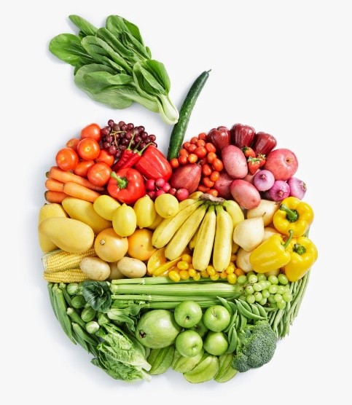
Food Technology
Year 8
Name:
Pathway:
Class:
Focus on Practical Skills and Healthy Eating

Slide 2
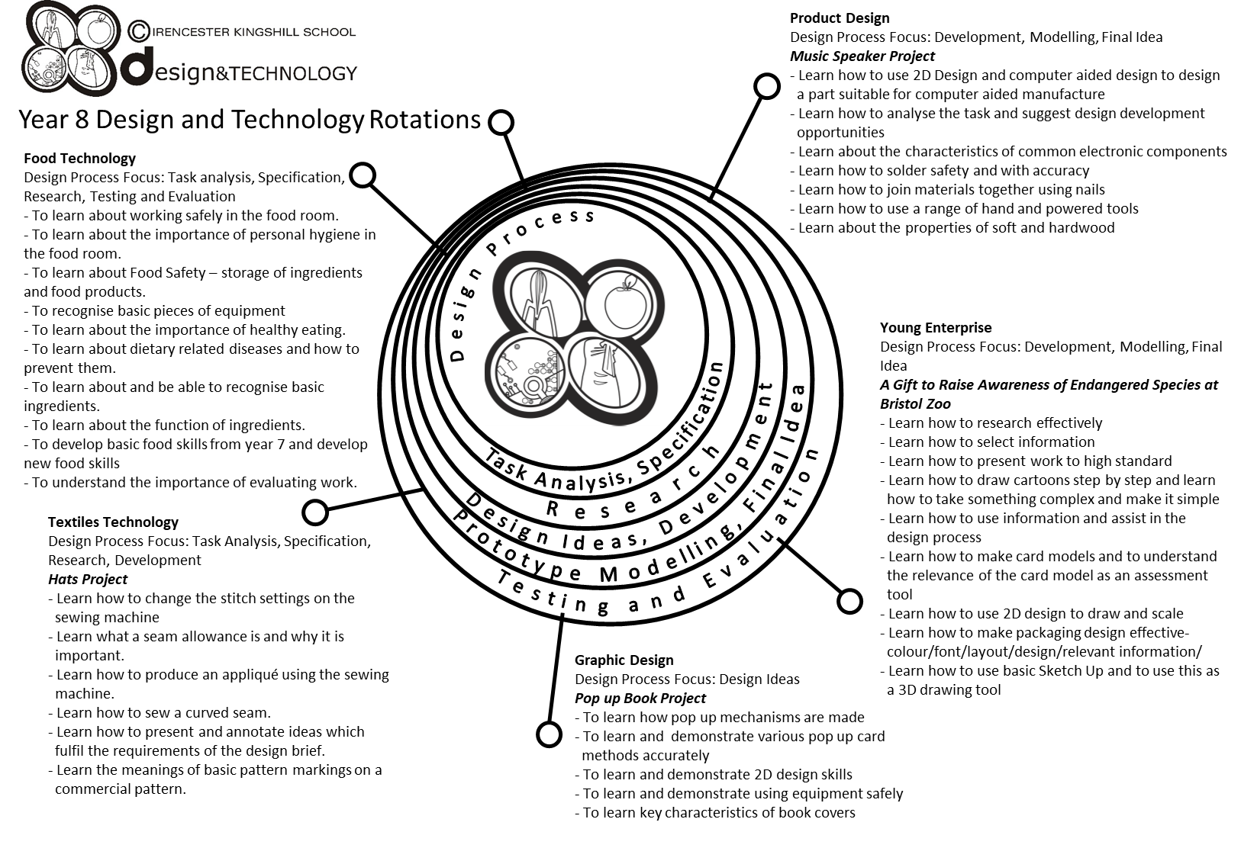

Slide 3
Year 8 pathways criteria
Year 8 Foundation | Year 8 Secure | Year 8 Confident | Year 8 Excellent
Four initial design ideas, completed and rendered. | Four initial design ideas, completed and rendered with accuracy. | All criteria from previous pathway has been completed to a high standard. | All criteria from previous pathway has been achieved to an exceptional standard.
At least two annotations made on each design. | Four annotations made on each design. | Six annotations made on each design. | Eight plus annotations made on each design.
One view of design ideas. | You have drawn some of your design ideas in 3D. | You have drawn all of your design ideas in 3D. | You have drawn all of your design ideas in 3D, showing some designs with different views e.g. cross-section.
You have named your chosen target market. | You have identified why your design is suitable for your chosen target market. | All criteria from previous pathway has been achieved with reference made to the design specification. | All criteria from previous pathway has been achieved with reference made to the design specification and a detailed design proposal has been completed.
You have a written plan of making. | You have written your plan of making showing a start and finish time. | You have written your plan of making with some timings. | You have written a detailed plan of making with timings and some control points.
Some ingredients and equipment handled with reasonable control. | Most ingredients and equipment handled with co-ordination. | Most ingredients and equipment handled with excellent competence and co-ordination. | All ingredients and equipment handled with excellent competence and co-ordination.
Practical sessions - needed a little assistance. | Practical session - mostly independent – a little assistance. | Practical sessions - completely independent. Demonstrating good organisation. | Practical sessions - Completely independent. Demonstrating a high level of organisation.
Mostly worked in a hygienic and safe manner. | Worked in a hygienic and safe manner. | Consistently worked in a hygienic and safe manner. | Consistently worked in a hygienic and safe manner.
Finished practical dish. | Finished on time. Sink and equipment cleaned and finished product packed away. | Finished well within the time limit. All equipment cleaned and finished product packed away, and extension work completed. | Finished well within the time limit. All equipment cleaned and finished product packed away, and extension work completed to a high standard.
Acceptable finish on end product. | Good finish to end product. | High quality product with excellent finish. | High quality product with excellent finish. Demonstrating good garnishing/decorating skills to finished product.

Slide 4


Food Technology – essential information
What to bring to school:
For each Food Technology lesson, you will need:
Your pencil case
Your planner
You work booklet
When you have your practical lessons, you must also bring:
Your ingredients – weighed and measured
A lidded container to take your food home in, clearly marked with your name
For some practical lessons you may also need a dish/tin to cook the food in.
If you do not bring in ingredients – you will NOT cook
When you get to school
On the days that you have practical lessons, you must take your ingredients to the food room BEFORE registration.
Place your high-risk ingredients (meat, dairy, fish) in the fridge and your dry ingredients in the Cool Room.
After your practical lesson you must leave your food in the cool room and collect after afternoon registration.
Think about the environment. Try not to use too many plastic bags for your ingredients Try to reuse
plastic pots and bags. Use old margarine tubs/sweet tins instead.
It is essential that you leave your unit drawers and cupboards CLEAN and TIDY, ready for the next class.
Please sign to show that you have read and understood the essential information set out below.
Name………………………………………………… Signature………………………………………….. Date…………………………….

Slide 5
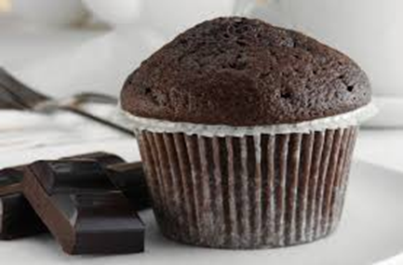
Chocolate Muffins
Ingredients
6 paper Muffin cases
125g Self raising flour, ½ tsp bicarbonate of soda
75g Chocolate chips, 50g Caster Sugar
1 Egg
75 mls. Yogurt - any flavour.
50g Butter or margarine
Method
Heat oven 180 C / Gas 6. Place muffin cases in the muffin tin.
Sift the flour with the bicarbonate of soda ( measure this accurately) in a large bowl. Stir in the chocolate chips and sugar.
Beat eggs in a jug. Melt the butter.
Add the beaten eggs, melted butter and yogurt to dry ingredients.
Stir to combine all ingredients. The mixture SHOULD LOOK LUMPY. Do not overmix this would make your muffins tough.
Fill the paper cases evenly and bake for 20-25 mins until risen and golden brown. Transfer to rack to cool.

Slide 6
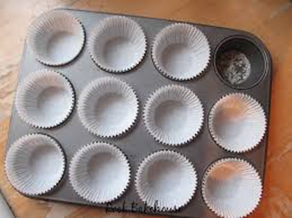
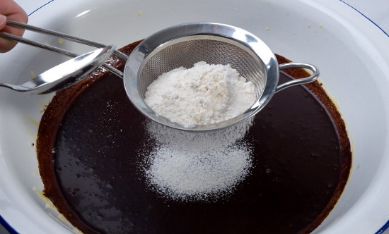
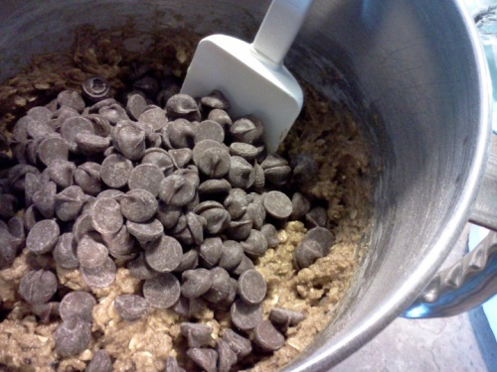
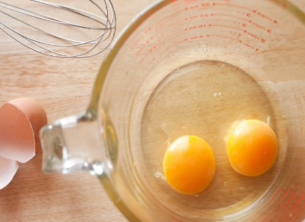
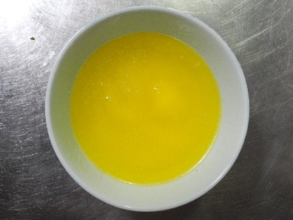
Chocolate muffins
Preheat oven to 180˚ C/gas 6. Place muffin cases in tin. | 2. Sift flour and bicarbonate of soda into the bowl.
3. Stir in chocolate chips and sugar. | 4. Beat eggs in jug. Melt the butter in the microwave.

Slide 7
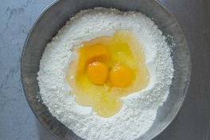
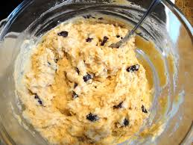

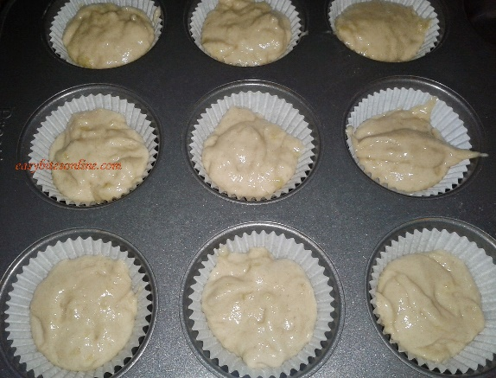
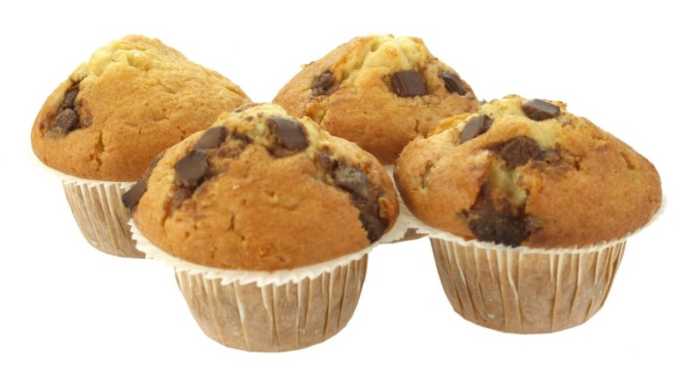
Chocolate muffins
5. Add the beaten eggs, melted butter and yogurt to dry ingredients. | 6. Stir to combine all ingredients. The mixture SHOULD LOOK LUMPY. Do not overmix.
7. Fill the paper cases evenly and bake for 20 -25 minutes until the risen and golden brown. | 8. When cooked, transfer to a wire rack to cool.

Slide 8
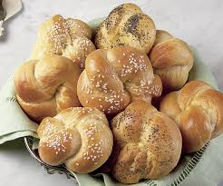
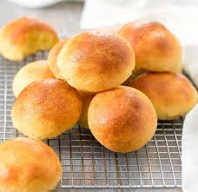
Bread Rolls
Ingredients
225g strong bread flour
1 tsp salt
1 packet (7g) fast action dried yeast
150 mls (approx.) warm water, cling film to cover
Optional: dust with extra flour, oats, poppy seeds or glaze with beaten egg
Method
1. Set oven to 220˚C/gas 8. Grease baking tray
2. Mix the bread flour, add salt and the packet of dried yeast to mixing bowl.
3. Collect 150mls warm water and add to the above ingredients. Mix with a round bladed knife until dough comes together.
4. Place on a floured surface and knead the dough for 10 minutes until smooth and stretchy.
5. Divide the dough into 6 even sized pieces. Shape appropriately. Place on baking tray.
6. Cover loosely with cling film and place in a warm place until the rolls have doubled in size. ( 10 minutes ).
7. Remove the cling film. Glaze with beaten egg or milk and add finishes.
8. Place in the oven and cook for 10-12 mins until the base sounds hollow when tapped and rolls are golden brown.
Notes:
Click on both pictures to watch videos – bigger picture is making the dough, smaller picture is shaping the dough into rolls.

Slide 9
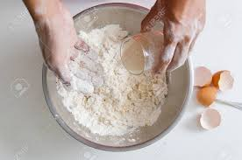
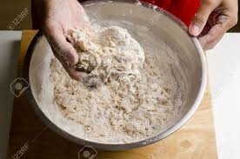
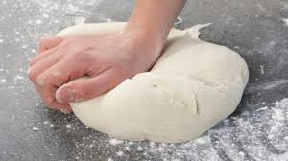

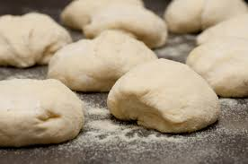
Bread rolls
1. Preheat oven to 220˚C/ gas 8. Grease or line the baking tray. Mix flour, salt & yeast in mixing bowl. | 2. Add approx. 150mls warm water to dry ingredients. Mix with a round-bladed knife until dough comes together.
3. Knead on a floured worktop for 10 minutes until smooth & stretchy. | 4. Divide into 6 pieces and shape.

Slide 10
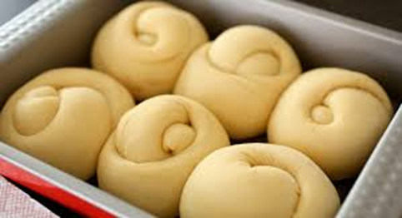
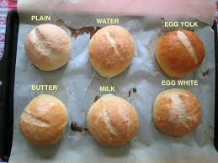
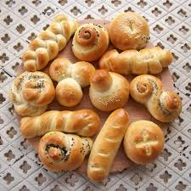
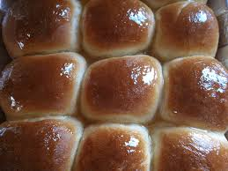
Bread rolls
5. Loosely cover with cling film or a damp tea towel, and leave to prove until they have doubled in size. | 6. Remove cling film and glaze with a beaten egg, or milk and add toppings if using.
7. Bake for 10-12 minutes until golden brown and sound hollow when tapped on the bottom. | 8. Remove from tray and place on cooling rack.

Slide 11
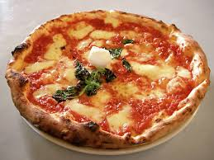
Pizza
Ingredients
150g Strong bread flour
½ teaspoon salt
½ packet fast action dried yeast
Approx. 120ml warm water
Toppings: 4 tbsp. pizza sauce, 1 ball Mozzarella, 150g grated cheese, ham, peppers,
Pepperoni, cooked bacon etc.
Method
1. Set oven to 220˚C/gas 8. Grease baking tray.
2. Put flour, yeast and salt in mixing bowl and mix in approx. 120 mls. warm water.
3. Place on a floured surface and knead for 10 mins. until smooth and stretchy. Place in a bowl and cover with Clingfilm and leave until doubled in size (at least 10 mins).
4. Prepare toppings. Knead dough until smooth. Press or roll out into a circle on the baking tray.
5. Use the back of a spoon to spread the pizza sauce onto the base.
6. Add the toppings – cheese goes on last.
7. Place in oven and cook for 15-20 minutes until the cheese is golden and bubbling.
Notes:
Click on picture for ‘how to make’ video 6.35 minutes

Slide 12
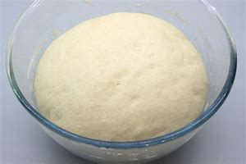
Pizza
1. Preheat oven to 220˚C/ gas 8. Grease or line the baking tray. Mix flour, salt & yeast in mixing bowl. | 2. Add approx. 120mls warm water to dry ingredients. Mix with a round-bladed knife until dough comes together.
3. Knead on a floured worktop for 10 minutes until smooth & stretchy. | 4. Place in a bowl and cover with cling film, and leave until doubled in size.
Notes:
Click on band at top for Dominoes pizza 3.06 minutes

Slide 13
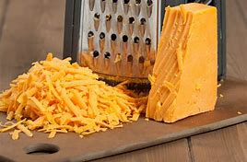
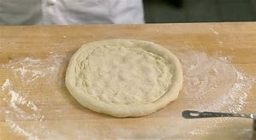

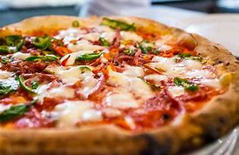
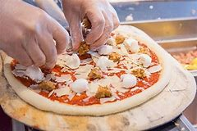
Pizza
5. Prepare toppings. | 6. Remove cling film. Knock back the dough and shape into a circle. Place onto baking tray.
7. Place tomato sauce onto pizza base and add other toppings. Cheese goes on last. | 8. Bake for 10 – 15 minutes until base is cooked and cheese is golden and bubbly.

Slide 14
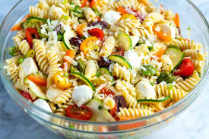
Pasta salad
Ingredients
150g/6oz dried pasta
4cm cucumber, 10 cherry tomatoes
1 red/green/yellow pepper, 2 spring onions / 1 red onion
Optional – green beans, mange tout, cooked chicken, ham, fish.
For the dressing :-4 tablespoons mayonnaise; 4 tablespoons milk; salt, black pepper; 4 fresh chives
Method
1. Fill a large saucepan with water and put onto boil.
2. If using fresh beans, cut in half.
3. Add pasta to the pan and cook for 10 – 12 minutes.
4. Prepare all of your vegetables. In a small bowl mix together the mayonnaise and the milk.
5. Five minutes before the pasta is ready, add the green beans.
6. When cooked, drain the pasta and beans – cool.
7. Add the vegetables to the pasta. Stir in the dressing and the chopped chives.
8. Add any meat, fish etc.

Slide 15
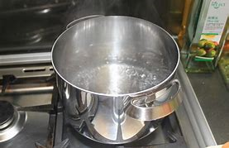
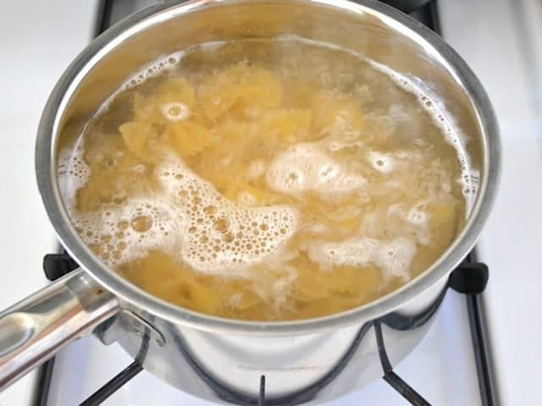
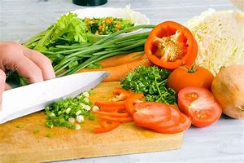
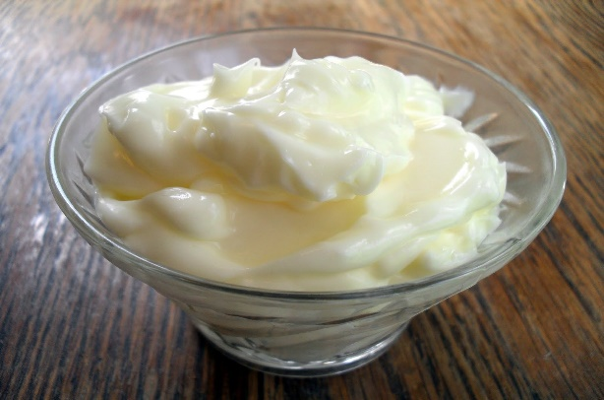
Pasta salad
1. ¾ fill a large saucepan with water and put onto boil. If using fresh beans, wash and cut in half. | 2. Add pasta to pan and cook according to instructions – boil for 10 – 12 minutes.
3. Prepare your salad vegetables. | 4. In a mixing bowl, stir mayonnaise and milk together. Add salt and pepper.

Slide 16
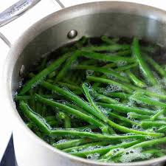
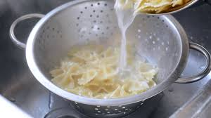

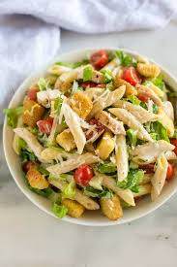
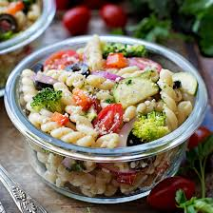
Pasta salad
5. Five minutes before the pasta is cooked, add the green beans to the pan. | 6. When cooked, drain the pasta and beans in a colander. Leave to cook.
7. Add the prepared vegetables to the pasta. Carefully stir in the dressing and the chives, if using. | 8. Add any meat, fish or cheese when you get home.

Slide 17
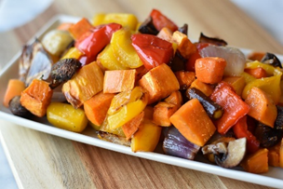
Roasted Vegetables
Ingredients
1 courgette
1 pepper ( any colour)
200g Cherry Tomatoes
1 Onion ( red or white), other vegetables you could use are: aubergine, sweet potato, Broccoli, butternut squash etc.
1 garlic clove
2 tbsp. oil, fresh or dried herbs (thyme, basil, parsley)
Method
Pre heat oven – Electric 180 C / Gas 6
Prepare all vegetable. Cut into bite sized pieces.
Place on a baking tray with the thyme, oil and salt and pepper. Mix ingredients together until all vegetables are covered in oil.
Place in a hot oven for 30 minutes, turning the vegetables after about 15 minutes. Cook until tender and starting to go brown.
Pre heat oven – Electric 180 C / Gas 6
Prepare all vegetable. Cut into bite sized pieces.
Place on a baking tray with the thyme, oil and salt and pepper. Mix ingredients together until all vegetables are covered in oil.
Notes:
Click on video for Jamie Oliver video 3.24

Slide 18
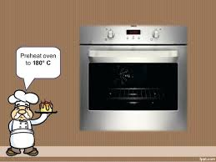
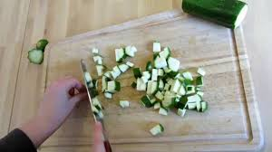

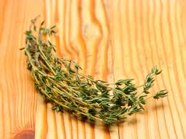
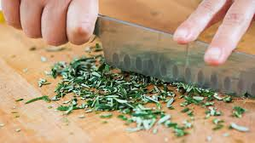
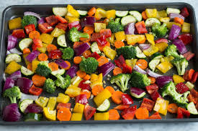
Roasted vegetables
1. Preheat oven to 180°C/ gas 6. | 2. Prepare all vegetables. Peel and cut into bite-size pieces.
3. Place vegetables on a baking tray with the thyme, oil, salt & pepper. Mix them all together. | 4. Place in the oven for 30 minutes, turning the vegetables after 15 minutes. Cook until tender and starting to turn brown (the Maillard reaction).

Slide 19
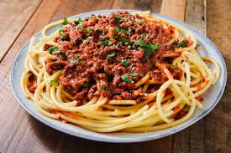
Bolognese sauce
Ingredients
450g minced beef
1 tin (400g) chopped tomatoes, 1 clove garlic
1 onion, 1 carrot (you could also add peppers, mushrooms, celery)
2 tbsp. tomato purée
1 beef stock cube, 1 bay leaf
1 tsp. mixed herbs (fresh or dried) preferably basil
Method
1. Prepare the vegetables – dice the onion, carrot & celery. Slice or crush the garlic.
2. Heat oil in a saucepan over a medium heat. Add the vegetables and cook for 5 mins.
3. Add the meat and break up with a wooden spoon. Cook until meat turns brown.
4. Dissolve the stock cube in 300ml boiling water and add to the meat.
5. Add the purée, herbs and bay leaf and stir well.
6. Bring the mixture to the boil and then reduce the heat and let the sauce simmer for 20-30 minutes. Leave the lid on the pan at an angle to allow the sauce to reduce and thicken.
7. When the vegetables are soft, the sauce is ready. Serve with pasta.

Slide 20
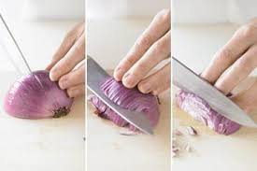
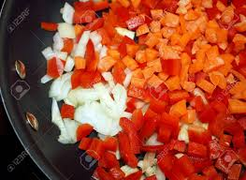

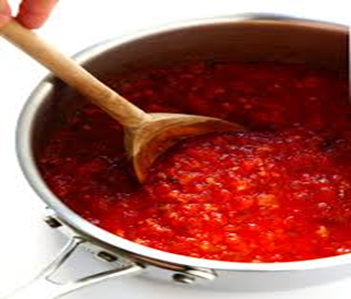
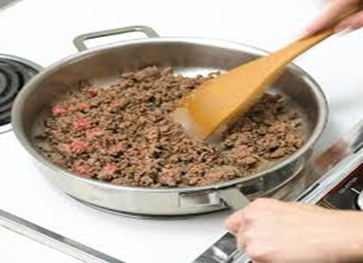
Bolognese sauce
1. Prepare your vegetables – peel and chop the onion, carrot & garlic. Wipe and chop the mushrooms, celery & peppers. | 2. Heat oil in saucepan over a medium heat. Add the vegetables and cook until soft.
3. Add minced beef and break up lumps with a wooden spoon. Cook for 6 – 8 minutes until meat is brown. | 4. Pour in can of tomatoes and ½ can of water. Stir well.

Slide 21
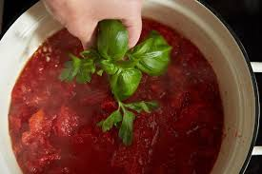
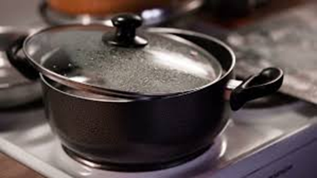


Bolognese sauce
5. Add stock cube, tomato puree, herbs and bay leaves and stir well. | 6. Bring sauce to the boil, reduce heat and simmer gently for 20 – 30 minutes, with the lid at an angle.
7. As the sauce is ‘reducing’ (i.e. getting thicker from losing water vapour). Stir occasionally to prevent burning. | 8. The sauce is cooked when the vegetables are tender. Serve with pasta.

Slide 22
Banana Bread
Ingredients
135g soft light brown sugar
1 egg
100g bananas, mashed (the older, the better!)
140g plain flour
½ tsp baking powder + ½ tsp Bicarbonate of soda + ½ tsp each ginger and cinnamon
120g butter/margarine, melted
Method
Preheat oven to 170°/gas 4. Line a 1lb loaf tin.
In a mixing bowl, beat the eggs and sugar together. Beat in bananas.
Add the flour, Bicarbonate of soda, baking powder and spices.
Mix thoroughly until all the ingredients are entirely incorporated.
Pour in the meted butter and mix well.
Pour into the tin and bake for 20 – 30 minutes or until firm to touch and a skewer inserted comes out clean.
Leave cake to cool slightly in the tin before turning out
8. Slice and serve with a cup of tea!

Slide 23

Tomato and lentil soup
Ingredients | Changes you could make
1 tablespoon of oil | You could add any other vegetables: 50g mushrooms, 1 parsnip, swede, turnip. Broccoli, celery, fresh tomatoes.
2 rashers of bacon ( optional)
1 Carrot
1 Potato
1 Onion
100g red Lentils
1 tbsp. tomato puree
14oz can tomatoes
1 chicken stock cube + 375mls water | vegetable or Ham stock cube
Fresh parsley
PLAN OF WORK | CONTROLS
1. Prepare vegetables – peel and dice. Dice bacon. | Dispose of all waste and peelings carefully.
2. Heat oil and add chopped onion. Cook until soft not brown.
3. Add potato and carrot and put the lid on. Sweat vegetables for a few minutes on a low heat. Take care not to burn them. | Make sure all vegetables are clean and good quality.
4. Add the diced bacon and sauté. | Take care when using sharp knives.
5. Wash the lentils using a sieve and drain. | Place pan handles inwards and not over the heat.
6. Add the lentils, tin of tomatoes, tomato puree and half of the parsley. | Take care when using the hob.
7. Simmer for 15-20 mins. Season. | Stir to prevent sticking and water to prevent soup drying out.
8. Blitz the cooked soup in a blender or leave chunky. Add remaining parsley. | Take care when using electric blender.

Slide 24




Halloween cupcakes
1. Preheat oven to 180 C/Gas 5.Cream your butter and sugar together with a wooden spoon until soft and fluffy. | 2. Add one egg and beat thoroughly. Add the second egg, and any flavourings and colouring.
3. Sieve the flour and baking powder into the mixture and fold in using a metal spoon. | 4. Spoon the mixture evenly into the paper cases and bake for 12 – 15 minutes until golden brown.

Slide 25






Halloween cupcakes
Once your cakes are totally cool, you can decorate them.

Slide 26

Victoria Sandwich Cake
Ingredients | Changes you could make
125g Self raising flour | 50 g wholemeal self-raising flour and 75 g white self-raising flour.
125 g margarine | Sunflower spread ( margarine )
125 g caster sugar | Golden caster sugar
2 Eggs | Columbus eggs-rich on omega 3
2-3 tablespoons jam or lemon curd
1 tablespoon icing sugar for dusting top.
PLAN OF WORK | CONTROLS
Oven Gas 4. Electric 180 C. Grease and line a 16cm round cake tins with greaseproof paper. Cream together the margarine and sugar in a mixing bowl with a wooden spoon until light and fluffy. Beat the eggs in a small bowl with a fork and gradually mix into the creamed mixture using your wooden spoon. Sieve the flour and fold into the above mixture with a metal spoon. Divide the mixture evenly between the two cake tins and carefully spread out. Bake for 20 mins until golden brown and well risen. It should spring back to touch/ clean skewer test. Take cakes out of tins and leave to cool. Spread jam on one of the sponges and sandwich sponges together. Dust the top with icing sugar | Check oven is at correct temp. Correct size tins . Cream using a wooden spoon. Check there is no shell in the eggs. Use a metal spoon for folding. Check oven temp and cooking time. Is the cake golden brown and risen? Is the cake cool?

Slide 27




Victoria Sandwich Cake
1. Preheat oven to 180 C/Gas 5.Cream your butter and sugar together with a wooden spoon until soft and fluffy. | 2. Add one egg and beat thoroughly. Add the second egg, and any flavourings and colouring.
3. Sieve the flour and baking powder into the mixture and fold in using a metal spoon. | 4. Spoon the mixture evenly into the prepared tins and bake for approx. 20 minutes until risen and golden brown.

Slide 28




Recognising Equipment
Key words | Teaspoon | Palette knife | Dessert spoon | Kitchen Knife | Tablespoon
Can you name the equipment? Use the box above to help you.
A | B | C | D | E
In recipes what do the following abbreviations stand for?
tsp | dsp | tbsp.
A
B
C
D
E
Name the following pieces of equipment and their uses:
Name: P | Name: G | Name: Z
Use: | Use: | Use:

Slide 29

Kitchen and Personal Hygiene
1. A cooked chicken is left on the window sill. This could fall into the washing-up bowl and also attract pests.
2. There are large piles of washing-up either side of the sink. These could fall and smash. Also they are attracting pests.
3. There is an open bottle of kitchen cleaner net to the taps. This could be toxic and could contaminate anything it comes into contact with.
4. A cooked meal on a plate has been left on the side. This is perfect for bacteria to multiply on and make you ill. It should be covered.
5. The fridge door is left open which means that the temperature in the fridge will be rising, plus pests can enter.
6. Uncovered raw meat is on the top shelf which means it juices which could contain bacteria are dripping onto food below.
7. A dirty mop has been left which is a trip hazard.
8. A dirt bucket of water has been left out – another trip hazard and unhygienic.
9. There is rubbish around the bin.
10. The lady is feeding the dog from the table.
Notes:
Click on picture for Bacteria Bites video 8.06 mins

Slide 30
Between 5 - 63°
Cover it up. Put it in the fridge
Above 60°
0° - 5°
To destroy the bacteria.
To stop it falling into your food.
To prevent bacteria from your clothes getting into your food.
If the plaster falls off, it can be seen.
You will infect the food with your bacteria.
The bacteria lives in your saliva.
If they are damp, the bacteria will multiply
You could spread the bacteria through the food.

Slide 31









Safety & Hygiene in Food Technology
Each year many thousands of people are injured through accidents in the home. You can help to prevent accidents by thinking carefully about how you and your team work safely in the Food Room.
Read through the following rules. Why are they important when working in the food room?
Identify the main possible danger areas in the Food Room:
A food processor
The blades are very sharp so you could cut yourself.
Saucepans
Make sure the handles are facing inwards so you cannot knock them off
1. Make sure all bags and stools are out of the way.
You could trip over them
2. Walk; don’t run in the food room.
2. You could fall/slip over
Gas hobs
Naked flames could burn or set tea towels etc. on fire
Cables
Ensure cables are tucked out of he way so you cannot trip over them. Keep them away from water.
3. Beware of any spilt food.
3. You could slip in it.
4. Don’t leave pan handles sticking out over edge of a cooker or work surface.
4. You could knock the pans off the cooker.
Cookers
Always use DRY oven gloves when using the oven.
Knives
Take great care when using knives. Never put them in the washing-up bowl
5. Always use dry oven gloves.
5. Wet gloves conduct heat.
6. Take care when using and washing sharp knives.
6. Always hold knives when washing them up.
Notes:
Bacteria bites video click on Danger icon / minutes. Intro to basic hygiene – click on germs picture 2.15

Slide 32

Design an informative Safety poster for the Food Room.

Slide 33

Nutrient | Function | Where it’s found
Carbohydrates
Proteins
Fats
Vitamins and minerals
Fibre
Energy
Wheat, bread, potatoes, pasta, rice & cereals
Growth & repair
Meat, fish, eggs, cheese, milk, peas, beans, nuts & lentils
Warmth, energy, protect internal organs
Butter, cream, vegetable oil, margarine, lard.
Resistance against infections, general good health
Fruits and vegetables, dairy products, cereals
Improve elimination of waste products from the body. Makes you feel full.
Whole-wheat cereals, wholemeal bread, brown pasta & rice, fruits and vegetables.
Notes:
Click on picture for Basic Nutrients video 6.41 mins.

Slide 34

The Eatwell Guide
Carbohydrates Bread, other cereals and potatoes.
This should make up 1/3rd of your days food intake
Fruits and vegetables.
This should make up 1/3rd of your days food intake.
Foods and drinks high in fat and/or sugar.
Eat and drink these foods occasionally and in small amounts
Proteins
Meat, fish and vegetarian alternatives.
2-3 portions a day.
Milk and dairy Foods.
2-3 portions a day.
Notes:
Click on picture for a video on The Eatwell Guide 2.15 minutes

Slide 35
Implementing Dietary Goals
For a healthy life we need to eat well. We know that the food we eat over a period of time rather than on any one particular day will affect our future health. As a nation we suffer from many diseases that are dietary related
Implementing these DIETARY GOALS: We can easily make the following changes to our diet to help implement these goals.
Gum Disease
Obesity
Strokes
Cancer of the Colon
High Blood Pressure
Tooth Decay
Constipation
Diabetes
Heart Disease
Diverticular Disease
REDUCE FAT | REDUCE SUGAR
REDUCE SALT | INCREASE DIETARY FIBRE
Too much FAT
Too much SUGAR
Too much SALT
Too little DIETARY FIBRE ( NSP)
Dietary Goals:
In order to avoid illness and to try to improve our state of health the government have set us targets in the form of dietary goals. These are:-
To reduce F _ _
To reduce S _ _ _ _
To reduce S _ _ _*----------------------
To increase D _ _ _ _ _ _ F _ _ _ _ (NSP)

Slide 36

Ingredient Function
The function of ingredients – why do we use some ingredients and not others? What do the ingredients ‘do’ in the recipe?
Flour
Butter/margarine
Sugar
Eggs
Milk
Flavourings/seasonings
Adds bulk, creates the structure of the dish.
Self-raising flour contains a raising agent that raises the product.
Adds flavour and colour
Important for the ‘shortness’ of the product
Improves shelf life
Adds sweetness and colour
Improves shelf life
Binds the product
Sets the product (coagulation)
Aerates and adds colour and moisture
Binds mixture together and adds moisture
Adds flavour, texture and colour
Notes:
Click on picture for video of the science of cookies. 4.29 minutes

Slide 37
Homework Task – Research 3 different types of Bread. You must include an image of the bread –country of origin – description of the bread. Complete the following table.
 | 1 | 2 | 3
NAME OF BREAD
IMAGE OF BREAD
COUNTRY OF ORIGIN
DESCRIPTION

Slide 38






Making Bread Rolls
Knead for 10 minutes
Glaze and add any finishes.
Divide into 6 even
sized pieces
Put all the ingredients into bowl. Add enough warm water to make a dough.
Cover with cling film and leave to prove in top oven for 10 minutes until double in size.
Knead each roll until smooth and then shape. Place on baking sheet.
Bake for 10-12 minutes until golden brown
38

Slide 39
Bread Making Checklist
 | Question | Answer
1 | Name the type of flour we need to use in Bread making? | Strong white flour
2 | What is the substance found in the flour that makes the dough stretchy? | Gluten
3 | Wheat is high in Gluten. If someone cannot eat gluten it means they have what condition? | Coeliac disease
4 | What is the raising agent used in Bread making? | Yeast
5 | What conditions does Yeast need to be active? | 1. Warmth/food 2.Time/moisture
6 | What gas is produced by yeast when the above conditions are present? | Carbon Dioxide
7 | What is the scientific abbreviation for this gas? | (CO₂ )
8 | What is the chemical reaction called when yeast produces carbon dioxide? | Fermentation
9 | Put the following bread making processes in the correct order. Proving – kneading – glazing mixing – shaping -baking | Mixing, kneading, proving, shaping, glazing and baking.
10 | How could we add more Fibre to our bread mixture? | 1. Use whole-wheat flour 2. Use granary flour or add nuts etc. To the dough
11 | Suggest 3 finishes that we could put on top of our rolls | 1. Egg – for a golden brown colour 2. Poppy Seeds 3. Oats
KEY WORDS | Strong Plain Bread Flour | Warmth | Coeliac
CO₂ | Moisture | Gluten | Carbon Dioxide

Slide 40






Design a pizza brief
Tesco have asked you to design and make a new pizza aimed at teenagers promoting healthy eating.
Your task is to design, draw and annotate 4 pizza designs that would fit the brief. Please think about the appearance, flavours, textures and use of healthy ingredients for the pizza.
Consider your 4 designs and choose the one you feel will be most successful.
40

Slide 41

Homework – Designing a Pizza
The word pizza is Italian for pie.
A Margherita Pizza is the most popular pizza followed closely by a Pepperoni Pizza.
Produce 4 different design ideas.
Key words: to help you to check your spelling: tomato, mozzarella, basil, pepperoni, pineapple,
Remember to sketch with a pencil, render and annotate your sketches in detail.
Design 1 | Design 2
Design 3 | Design 4

Slide 42

Design Sheet
Product Name: | Product Design:
Product specification Be a bread based product Healthy – includes healthy ingredients Looks attractive Taste good Golden crust Good shape Base is thin and crisp. Appeal to target market.
Why my product meet design brief? Use the product specification above to help you. | Ingredients I have chosen to add to the basic recipe:
 | Skills I will use

Slide 43
Design Specification for ……….
 | Specification | Design 1 | Design 2 | Design 3 | Design 4
1 | Based on the bread recipe
2 | Healthy – include healthy ingredients
3 | Look attractive
4 | Tastes good
5 | Golden Crust
6 | Good shape
7 | Base is thin and crispy
8 | Appeal to chosen target market
 | TOTALS for each design
Design Proposal
I have chosen to make design number …… because
I am not making design number …… because
I am not making design number …… because
Words/ideas to help for choosing
Got the highest score; most attractive; healthy: can make it healthy but still attractive; have skills to make; easily get the ingredients; challenging; different.
Words/ideas to help for not choosing
Did not score very many marks; difficult to make in the time; unhealthy; flavour may not be as popular; decoration too tricky; not easy to package without getting in a mess; would have to make a template so shapes may not be as accurate; not very original.

Slide 44

Evaluation
Made safely and hygienically
Complete all the following questions in full sentences.
1 | Did you meet the criteria of your design brief?
2 | Were you well organised? Explain.
3 | Did you find anything difficult?
4 | Could you of done anything differently or better?
5 | Did you learn any new skills?
6 | Underline the practical skills you used: | Kneading - Shaping - Rolling - Glazing - Grating Chopping – Slicing.
7 | Were you pleased with your final result? Why?
Time management
Skills
Shape
Appeal to
Colour
Appearance
Texture
KEY:
My product –
Perfect product-

Slide 45
Homework – Produce a fact file on Pasta. Your fact file should include a title - 10 interesting facts – images and a border.
(You can do your work on this page or print off and stick work into your booklet)

Slide 46

Pasta Quiz
What is pasta made from? Durum wheat
Which country has pasta as one of it’s staple foods? Italy
What does the term ‘al dente’ mean when talking about pasta? ’To the tooth’
In what form can you buy pasta? Fresh or dried
There are over 100 shapes of pasta. Can you name 5?
  Spaghetti
  Tagliatelli
  Farfalle
  Conchiglie
  Rigatoni
Name 4 dishes that use pasta.
  Spaghetti Bolognese
  Ravioli
  Lasagne
  Macaroni cheese
Some pasta’s come in different colours. What is used to colour them?
Beetroot Tomato puree Spinach Squid Ink
What type of pasta is known as ‘pillow pasta’?
Ravioli

Slide 47
How to cook pasta successfully
Cook the pasta for about 12 minutes until ‘al dente’.
Drain into a colander and serve.
Add a teaspoon of salt and bring it to the boil.
Fill a saucepan ¾ with cold water.
Carefully pour the dry pasta into the boiling water.

Slide 48







PASTA SALAD
It is important that we eat at least 5 portions of fruit and vegetables a day. We should try to eat a variety of different coloured fruit and vegetables to ensure we get a full range of vitamins and minerals in our diet.
Vitamins and minerals are important to maintain good health.
Design Brief:
You have been asked by a leading food manufacturer to design and make a healthy and attractive pasta salad. The salad should supply a good range of vitamins and minerals.
Notes:
Click on title for how to make pasta video 5.53
Click on pictutr of pasta – top right – for video on how pasta is made in the factory 5.48

Slide 49






PASTA SALAD DESIGN
Points I will need to consider when choosing a container
Include a suitable pasta shape – it holds the dressing
Include a dressing
Safe to eat
Attractive
Can be eaten
easily
with a fork
Healthy
Colourful – using a range of
Different fruits and vegetables.
Range of textures

Slide 50
PASTA SALAD DESIGN
Food Group | Examples
Vegetables | Tomatoes, lettuce, cucumber, spring onions, grated carrot,
Fruit | Fresh or tinned - Pineapple, peach, Dried fruits - raisins
Animal protein – This needs to be cooked and chilled. | Meat: ham , chicken, sausages, bacon, hot dogs Fish: smoked salmon, tinned Tuna/salmon
Vegetable protein | Kidney beans, butter beans, cooked lentils, chick peas, edamame beans Nuts: almonds/walnuts/ pine nuts
Carbohydrates – This needs to be cooked and chilled | Pasta shapes – shells, spirals, tubes
Dressing | Mayonnaise, vinaigrette using oil and vinegar ( red/white wine/balsamic vinegar or lemon juice.

Slide 51
PASTA SALAD
Make your choices - think about colours, flavours and textures that complement each other. What Pasta shape will you use.
Consider what is in your fridge and needs eating up☺
Food Group | Examples
Vegetables
Fruit
Animal protein – cooked and chilled.
Vegetable protein
Carbohydrates – cooked and chilled
Dressing

Slide 52


Name of Product
Description of Product
Draw your design idea for the pasta salad above … Make sure that you have annotated how you have included:
Vegetables/Fruit *Dairy or alternatives *Protein (Veg or meat) *Grains / Complex carbohydrates
Label the functions of the ingredients in your salad (Sensory & nutritional)

Slide 53
PASTA SALAD PLANNING
Ingredients Required
Preparation
Equipment Needed
Cooking
Equipment Needed
Serving
Equipment Needed
Success Criteria … what will make my Pasta Salad the best product in the room …
I must demonstrate that …
The product must show …
I will have challenged myself by…

Slide 54


PASTA SALAD PROCESS
PROCESS
Complete this flow chart outlining the main steps to make your design. Include the safety & hygiene.
END

Slide 55
Checklist – Pasta Salad
 | Question | Answers
A | How do you know when the water is hot enough to cook the pasta?
B | Always keep the lid off the saucepan when boiling the pasta. True / False
C | How long do we cook the pasta for?
D | How can we check when the pasta is cooked?
E | Why should we allow the pasta to cool before making the Salad?
F | Why should we use separate chopping boards for vegetables and meat?
G | Give two safety points when using sharp knives | 1. 2.
H | Why should we include a range of different vegetables?
I | What high risk foods could we consider to use in our pasta salads?
K | How and where should we store the Pasta Salad?
L | How would you modify your recipe for Pasta Salad if it was for a Vegetarian?
M | Give 2 examples of dressings that could be put on the pasta Salad? | 1. 2.

Slide 56



PASTA SALAD EVALUATION
Photo 1: Photo of my design idea
Write the 8 adjectives to describe your ultimate Pasta salad and complete the star chart & evaluation.
What went really well today…
Would have been better if…
Environmental Impact Statement …
Think about sourcing of ingredients, packaging, air miles, carbon foot print, chemicals used …

Slide 57


Looking at Fruit and Vegetables
Complete the chart below listing as many different coloured fruits and vegetables that you can think of in the correct columns.
Colour | Fruit | Vegetables
Orange/yellow/white
Red/Purple
Green

Slide 60
Using Fruit and Vegetables – Checklist. Write your answers in the space below.
Question | Question | Answer
1 | The Government are encouraging us to eat more fruit and vegetables a day. How many portions a day do they recommend?
2 | Can we include a glass of fruit juice as one of our portions?
3 | True or False? We can include portions of dried, frozen and canned fruit and vegetables as well as fresh.
4 | Why should we eat a ‘rainbow’ of fruit and vegetables?
5 | True or False? Potatoes can be included as one of our portions.
6 | Name a fruit and a vegetable beginning with the letter: A | A
7 | Name a fruit and a vegetable beginning with the letter: B | B
8 | Name a fruit and a vegetable beginning with the letter: C | C
9 | Eating too many snacks and junk foods may lead to health related diseases. Name 2 common diseases | 1. 2.
10 | Snack foods are often high in sugar, salt and fat. Suggest alternative snacks using fruit and vegetables. | 1. 2. 3.

Slide 61
PASTA SALAD EVALUATION
Photo 1: Photo of my design idea
Write the 8 adjectives to describe your ultimate Pasta salad and complete the star chart & evaluation.
What went really well today…
Would have been better if…
Environmental Impact Statement …
Think about sourcing of ingredients, packaging, air miles, carbon foot print, chemicals used …

Slide 62




HOMEWORK TASK – Storing Food
 | Question | Answer
1 | What temperature should your fridge be?
2 | Name five high risk foods | 1. 2. 3. 4. 5.
3 | Where should high risk foods be stored in your fridge? | 1. 2.
4 | Name two raw foods that should be stored at the bottom of the fridge? | 1. 2.
5 | Name two raw foods that should be stored at the bottom of the fridge? | 1. 2.
6. | Suggests two hazards that could occur in your fridge? | 1. 2.
7. | Why should you cover all foods when storing them in the fridge?
8 | Suggest two checks you could make to ensure the food in your fridge is safe to eat.
9 | Why are ‘date marks’ on food important?
10 | Why should we store cooked foods above raw foods in the fridge?

Slide 64



Love Food. Hate Waste.
In England we throw away 7.1m tonnes of food every year from our homes.
A tonne of waste is the weight of a small car!

Slide 65



This is enough to fill up Wembley stadium 48 times over.
...more than half of this is food that could have been eaten.
We bin 2 million slices of ham a day.
65

Slide 66


...or a family of 4 we could save around £800 a year.
What would you buy with £800?
Wasted food also lets off harmful gases in landfill...
When we waste food we waste all the energy and natural resources that go into producing it…
...this is bad for our environment

Slide 67

If we saved all the avoidable food waste from the bin in England..
...it would have the same positive environmental impact as taking approximately 1 in 4 cars off the road

Slide 68
Design a poster that will encourage households to reduce food waste and help save the planet

