Slide 1
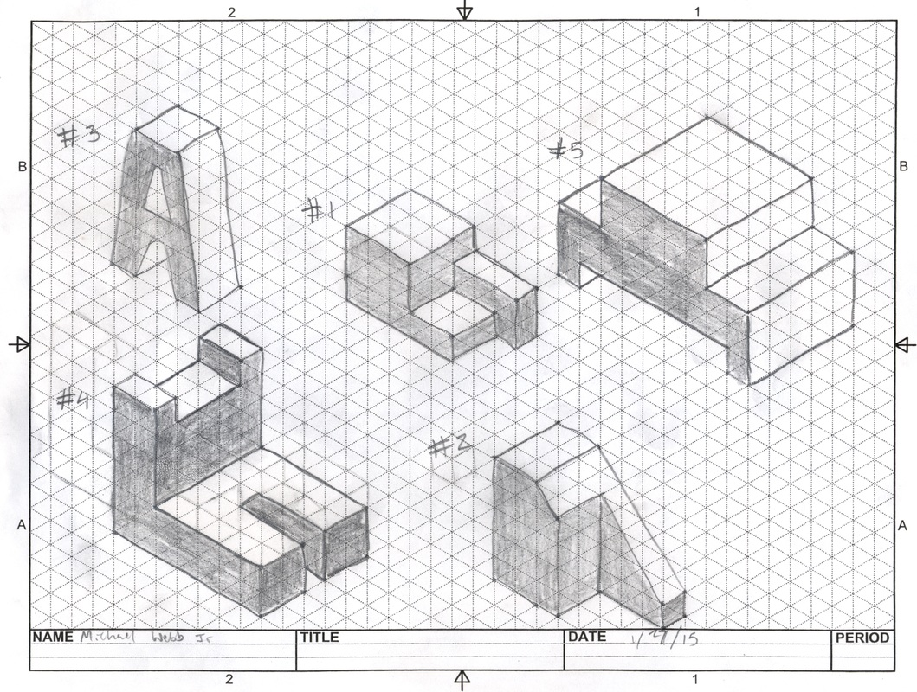
Year 7 shadow curriculum Week 1-Drawing styles You will need-plain paper (preferably), pencil, ruler, rubber, sharpener
Week 1 task- Isometric Drawing is a way of drawing things in 3 dimensions. This week is a drawing task where you will follow a You Tube tutorial
Copy and paste the link below and follow the instructions. You will need to print the next slide so you have a copy of the isometric paper to do the task. If you unable to print the isometric paper you can do task on plain paper. Follow the video carefully and use pause frequently to complete the task.
Extension-If you finish the task within lesson time practice drawing more shapes. On the next slide I have attached a picture of various geometric shapes that you can copy
https://www.youtube.com/watch?v=LY5OqKhEP9k
Isometric drawing example

Slide 2
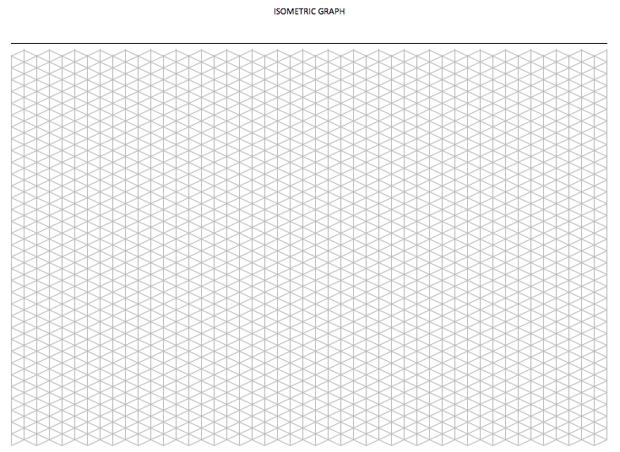
Week 1
Isometric Paper-print this

Slide 3
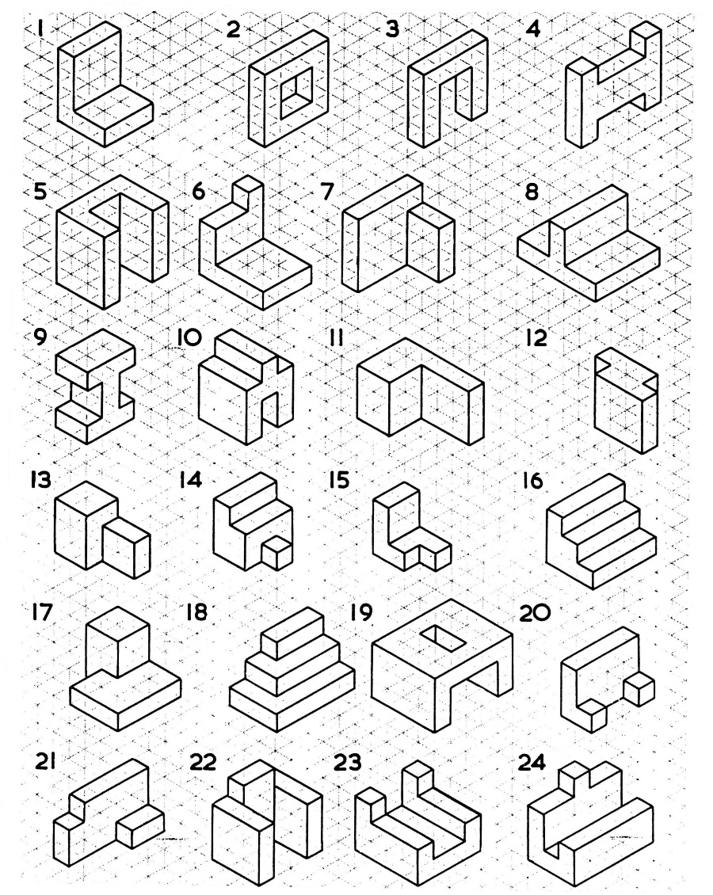
Week 1-Extension task

Slide 4
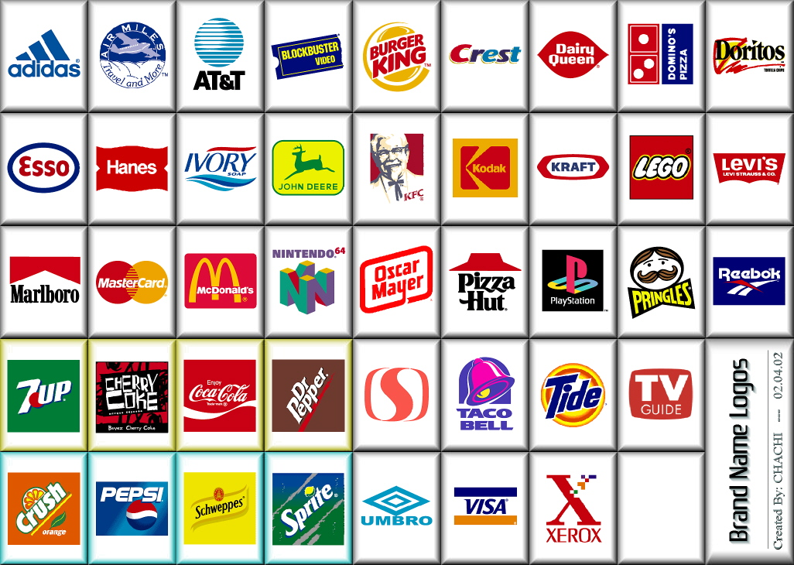
Week 2 Task: 1) Know what a brand name/logo is and to be able to design a variety of brand names for sweet shop/bakery. 2) Know what a brand name/logo is and to be able to design brand name for sweet shop or bakery.
Brand names & logo mood board

Slide 5
Week 2 Brand name and logo
Some brand names and logo’s are so well known that they become part of our culture or to put it another way, part of our life. The logos below are good examples of this. All these brands are widely used all around the world and are instantly recognisable. They are also really well designed. Companies spend lots of money making sure their image is right. Having a well designed logo is a big part of that.
If you study the logos below you will notice that they all use two colours and they are very simple designs that are easy to read.

Slide 6
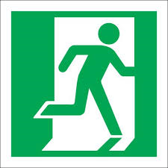
Week 2 - Signs and information
The signs below are all health and safety signs that you will find in a Design & Technology workshop. All the signs are simple in design and only use two colours much like the famous logo designs on the preceding slide.
Wear a face mask
Wear safety glasses
Wheelchair access
Fire escape
Fire extinguisher

Slide 7
Week 2 Bad logo?
Some logo designs are not as successful as others. Take this example for the London Olympics which was not very popular. The other examples are not as successful either. The pest control logo is difficult to read and the logo with the dog has too much information and becomes confusing.
Good presentation is important and part of this is using good font and drawing.

Slide 8
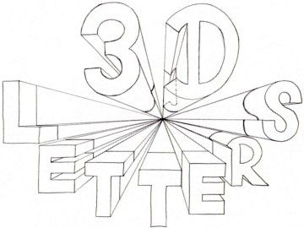
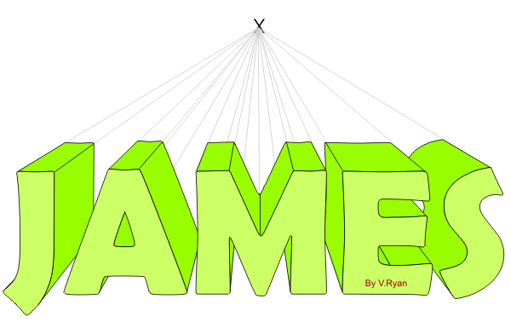
Week 2 task-One point perspective drawing
Copy and paste the following link. This is a video tutorial for one point perspective drawing. Make sure you follow the instructions carefully. Pause the video when necessary and take your time.
As an extension to this task you could try drawing your name or initials.
https://www.youtube.com/watch?v=cleMc9hNwIU

Slide 9
Week 3 Word Association Brainstorm
Task:
This task is to think of a name for a sweet shop or bakery which you are going to design a logo for.
To do this you need to think of words associated with bakery and sweet shops. To help do this use the list below but add some words of your own to it. Then use a combination of the words to come up with a name. Eg The Cookie Café, The Cake Emporium, The Luscious Pastries Supermarket
Write a list of possible names and choose your favourite
Write your sweet shop or bakery name in one point perspective
Sweet- syrup, chocolate, sugar, honey, luscious, delicious, candy
Bakery- cake, savoury, dough, flour, icing, confectionary, cookie, pastry
Shop- hut, shack, emporium, boutique, table, café, supermarket, bakehouse, patisserie,
Sensory words- smell, taste, touch, appetizing, buttery, comfort, bitter, fresh, sumptuous, yummy, spicy, salty, mouth watering, scrumptious

Slide 10
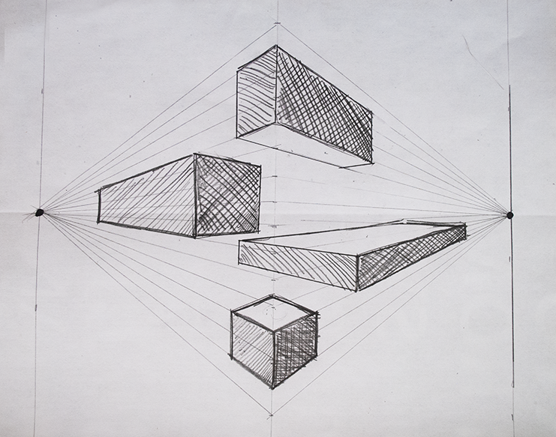
Week 4 task- Two point perspective shapes
Copy and paste the following link to do an exercise on 2 point perspective drawing of shapes. When you have completed the video practice drawing simple geometric shapes on your own and use shade to enhance the perspective.
https://www.youtube.com/watch?v=IXlpsRQDTcI

Slide 11
Week five- task This week’s task is to draw a simple building in 2 point perspective. The video for the link below follows on from last week where you drew simple geometric shapes. Copy and paste the link and follow the video. Make sure you are patient and use pause to stop the video and work at your own pace. https://www.youtube.com/watch?v=w_LbQviO1K4
The most difficult part of the video is when drawing the steps. Make sure you keep the line of the steps parallel with the building.

Slide 12
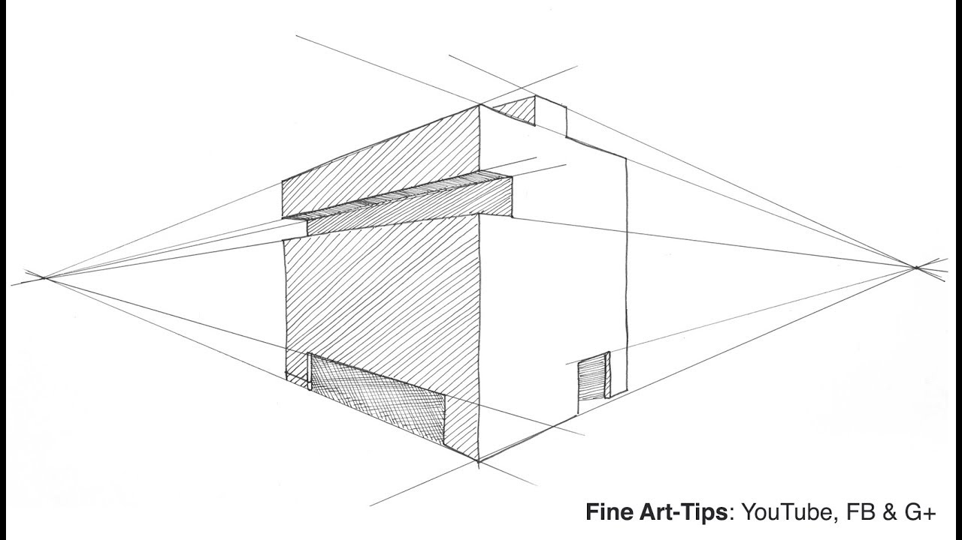
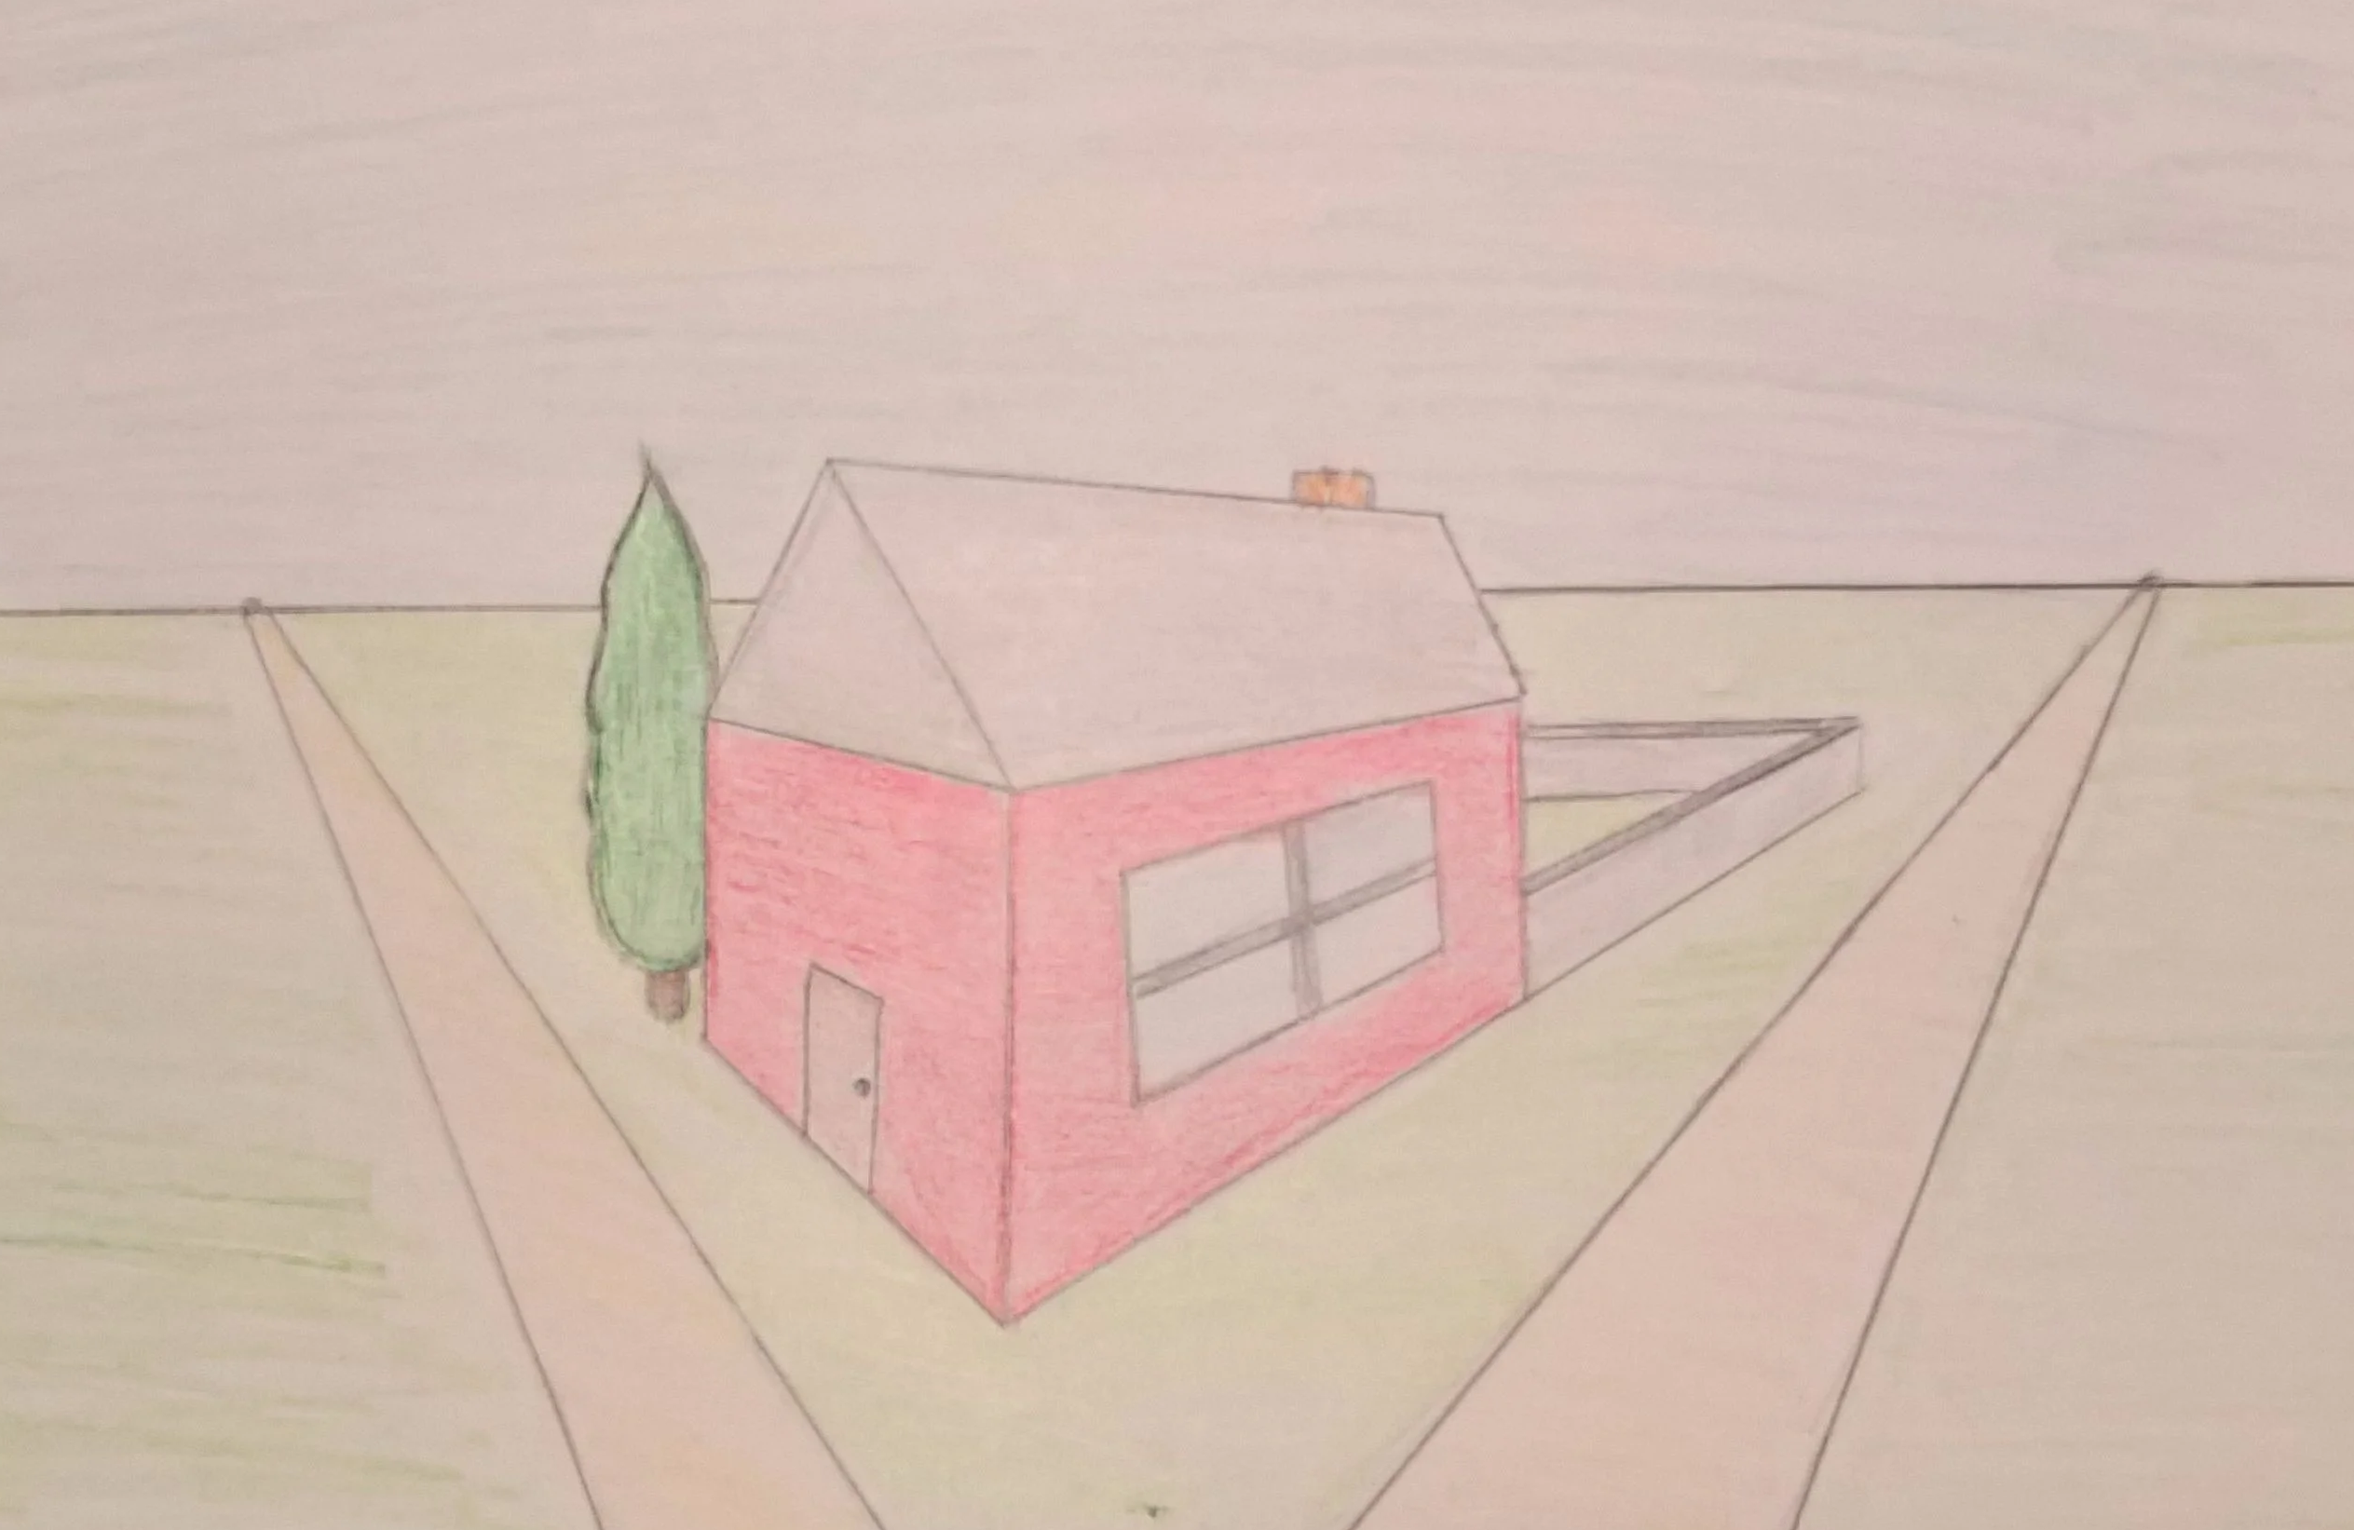
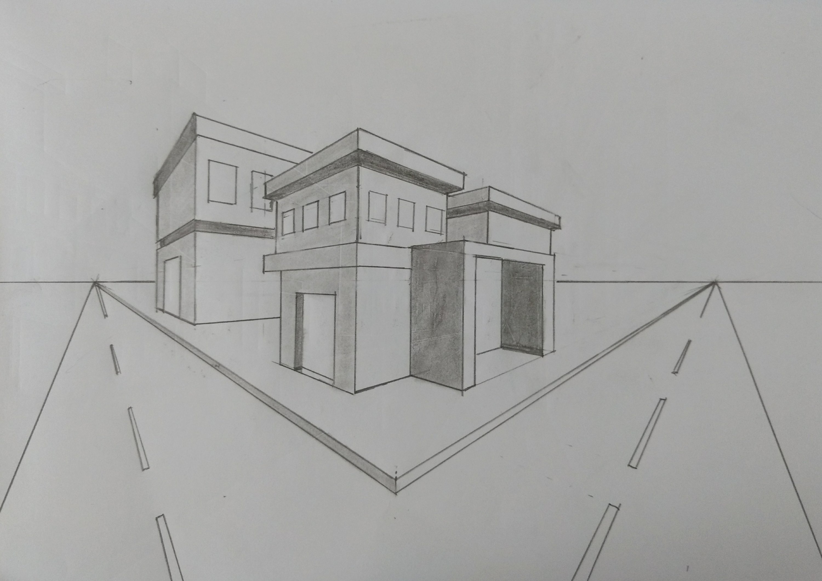
Week 6 task Using your knowledge of 2 point perspective and isometric drawing draw a shop front. It should look something like this which is basically a cuboid.
Think about you can add things like a pitched roof or a flat roof and doorways and windows.

Slide 13
Week 7 task – 2 point perspective letters When you have drawn your building you now need to add your bakery or sweet shop name to the front of your building. To do this you one final drawing video to follow which is on drawing letters in 2 point perspective. Copy and paste the following link: https://www.youtube.com/watch?v=dpWoX7OgWdQ Carefully follow the instructions and you will produce this!

Slide 14
Week 8 task Your final task is to combine the drawing of your shop with your shop name The example below is to show what this could look like.
When you have finished save your work and email it to your teacher.

Slide 15
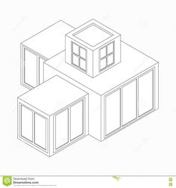
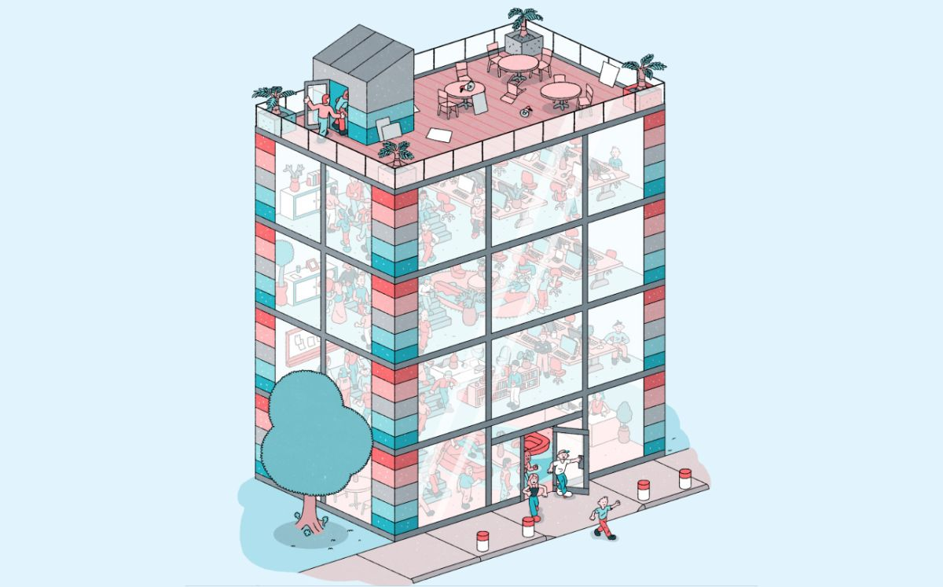
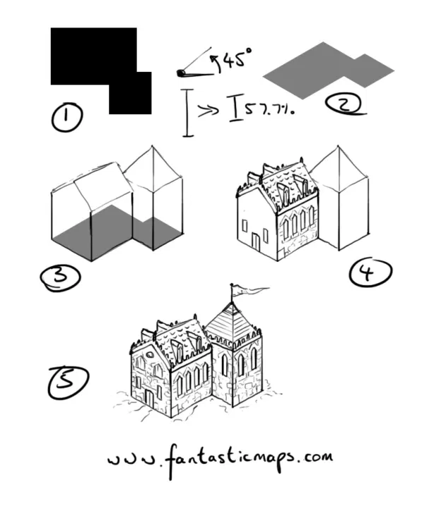
Week 9 & 10 extension task Using isometric projection draw a picture of your dream house. You can include anything you want such as a swimming pool, tennis court, helicopter pad. Try your best and use the skills you have gained from the tutorials to produce a drawing that uses 3 dimensional shapes, shading and perspective. Examples of possible outcomes are shown below

