Slide 1
Personal Hygiene
I will know what important hygiene routines are.
I will know the consequences of poor hygiene.
I will work well with others.

Slide 2
What have your hands touched today?!
Write a list of everything you have touched.
Think about door handles, books, bus seats…

Slide 6
https://www.youtube.com/watch?v=jQ2e0KH5WrI&safe=true
https://study.com/academy/lesson/the-importance-of-personal-hygiene.html
https://www.youtube.com/watch?v=AyZ6LjDLe14&safe=true

Slide 7
‘A Child In England Has A Tooth Removed In Hospital Every 10 Minutes Due To Preventable Decay’

Slide 8
Oral Hygiene
To know how to keep my gums and teeth healthy
To know why it is important to keep gums and teeth healthy

Slide 9
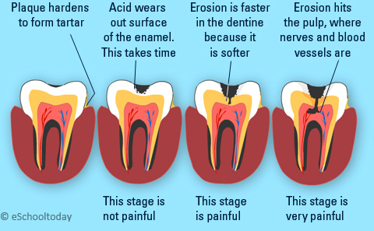
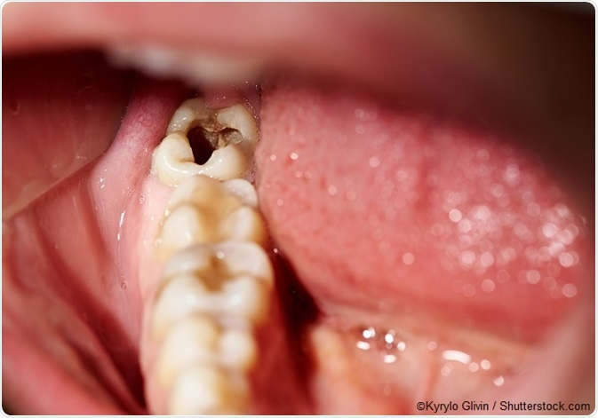
What is tooth decay?

Slide 10
Group Work
Using the information sheet you should create a short infomercial for the NHS.
It should teach people why and how they should brush their teeth.

Slide 11
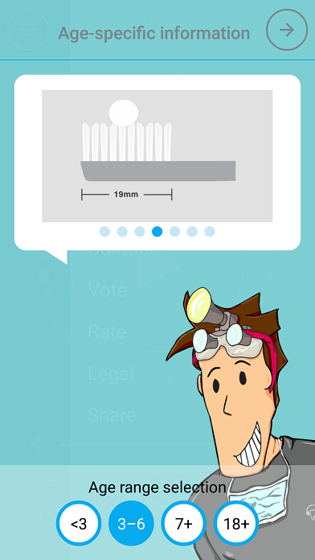
Brush DJ
Brush DJ plays two minutes of your music so you brush your teeth for the right amount of time. The app has short videos on how to brush your teeth and how to clean in between them using an interdental brush or floss.

Slide 12
A Balanced Diet
To know what a balanced diet looks like.
To know what the benefits of a healthy diet are.
To know how to make changes to my own diet.

Slide 13
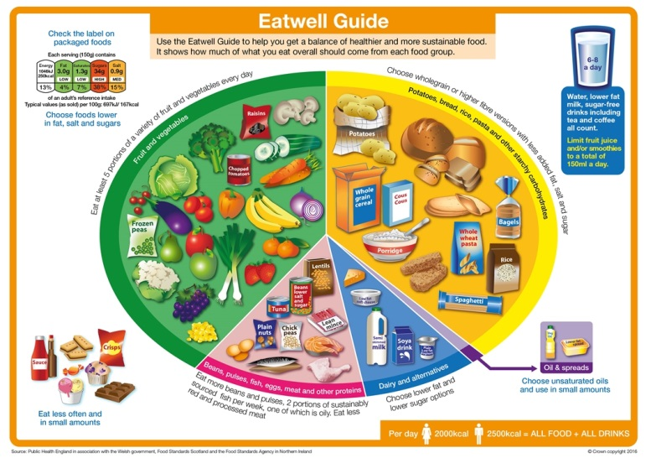

Slide 14
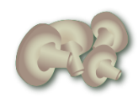
Fruit and vegetables
Fruit and vegetables should make up just over a third of the food we eat each day.
Aim to eat at least five portions of a variety of fruit and vegetables each day.
Choose from fresh, frozen, canned, dried or juiced.
A portion is 80g or any of these:
1 apple, banana, pear, orange or other similar-size fruit;
3 heaped tablespoons of vegetables;
a dessert bowl of salad;
30g of dried fruit (counts as a maximum of one portion a day);
150ml glass of fruit juice or smoothie (counts as a maximum of one portion a day).

Slide 15
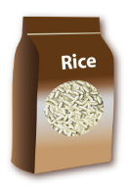
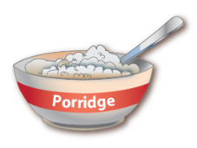
Potatoes, bread, rice, pasta and other starchy carbohydrates
Starchy food should make up just over a third of the food we eat.
Choose higher-fibre, wholegrain varieties when you can by purchasing wholewheat pasta, brown rice, or simply leaving the skins on potatoes.
Base your meals around starchy carbohydrate foods:
• start the day with a wholegrain breakfast cereal - choose one lower in salt and sugars;
• have a sandwich for lunch;
• round off the day with potatoes, pasta or rice as a base for your evening meal.

Slide 16
Potatoes, bread, rice, pasta and other starchy carbohydrates
Why choose wholegrain?
Wholegrain food contains more fibre than white or refined starchy food,
and often more of other nutrients. We also digest wholegrain food more
slowly so it can help us feel full for longer.
Wholegrain food includes:
wholemeal and wholegrain bread, pitta and chapatti;
wholewheat pasta;
brown rice;
wholegrain breakfast cereals and whole oats.
Remember, you can also purchase high fibre
white versions of bread and pasta which will help to increase your fibre intake.

Slide 17
Beans, pulses, fish, eggs, meat and other proteins
These foods are sources of protein, vitamins and minerals, so it is important to eat some foods from this group.
Beans, peas and lentils (which are all types of pulses, sometimes called ‘legumes’) are good alternatives to meat because they’re naturally very low in fat, and they’re high in fibre, protein and vitamins and minerals. Other vegetable-based sources of protein include tofu, bean curd and mycoprotein.
Aim for at least two portions (2 x 140g) of fish a week, including a portion of oily fish. Most people should be eating more fish, but there are recommended limits for oily fish, crab and some types of white fish.*
*Please see www.nhs.uk/Livewell/Goodfood/Pages/fish-shellfish.aspx Also www.msc.org/ for more guidance on sustainably sourced fish.

Slide 18
Beans, pulses, fish, eggs, meat and other proteins
Some types of meat are high in fat, particularly saturated fat. So when you’re buying meat, remember that the type of cut or meat product you choose, and how you cook it, can make a big difference.
To cut down on fat:
choose lean cuts of meat and go for leaner mince;
cut the fat off of meat and the skin off of chicken;
try to grill meat and fish instead of frying;
have a boiled or poached egg instead of fried.
If you eat more than 90g of red or processed meat per day, try to cut down to no more than 70g per day. The term processed meat includes sausages, bacon, cured meats and reformed meat products.

Slide 19
Dairy and alternatives
Try to have some milk and dairy food (or dairy alternatives) such as cheese, yoghurt and fromage frais.
These are good sources of protein and vitamins, and they’re also an important source of calcium, which helps to keep our bones strong.
Some dairy food can be high in fat and saturated fat, but there are plenty of lower-fat options to choose from.
Go for lower fat and lower sugar products where possible. For example, try:
- 1% fat milk which contains about half the fat of semi-skimmed milk without a noticeable change in taste or texture;
- reduced fat cheese which is also widely available;
- have a smaller amount of the full-fat varieties less often;
- going for unsweetened, calcium-fortified versions when buying dairy alternatives.

Slide 20
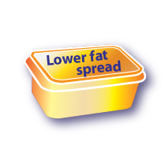
Oils and spreads
Although some fat in the diet is essential, generally we are eating too much saturated fat and need to reduce our consumption.
Unsaturated fats are healthier fats that are usually from plant sources and in liquid form as oil, for example vegetable oil, rapeseed oil and olive oil.
Swapping to unsaturated fats will help to reduce cholesterol in the blood, therefore it is important to get most of our fat from unsaturated oils.
Choosing lower fat spreads, as opposed to butter, is a good way to reduce your saturated fat intake.
Remember that all types of fat are high in energy and should be
limited in the diet.

Slide 21
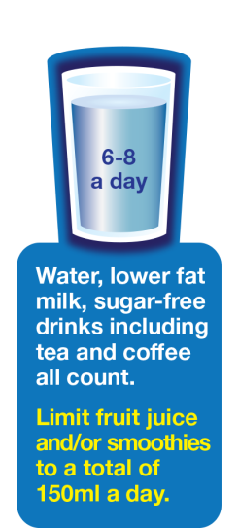
Hydration
Aim to drink 6-8 glasses of fluid every day.
Water, lower fat milk and sugar-free drinks including tea and coffee all count.
Fruit juice and smoothies also count towards your fluid consumption, although they are a source of free sugars and so you should limit consumption to no more than a combined total of 150ml per day.
Sugary drinks are one of the main contributors to excess sugar consumption amongst children and adults in the UK.
Swap sugary soft drinks for diet, sugar-free or no added sugar varieties to reduce your sugar intake
in a simple step.

Slide 22
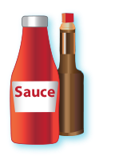
Foods high in fat, salt and sugars
This includes products such as chocolate, cakes, biscuits, full-sugar soft drinks, butter and icecream.
These foods are not needed in the diet. If they are included, have infrequently and in small amounts.
If you consume these foods and drinks often, try to limit their consumption so you have them less often and in smaller amounts. Food and drinks high in fat and sugar contain lots of energy, particularly when you have large servings.
Check the label and avoid foods which are high in fat, salt and sugar!

Slide 23
Key message summary
Eat at least 5 portions of a variety of fruit and vegetables every day.
Base meals on potatoes, bread, rice, pasta or other starchy carbohydrates; choosing wholegrain versions where possible.
Have some dairy or dairy alternatives (such as soya drinks); choosing lower fat and lower sugar options.
Eat some beans, pulses, fish, eggs, meat and other proteins (including 2 portions of fish every week, one of which should be oily).
Choose unsaturated oils and spreads and eat in small amounts.
Drink 6-8 cups/glasses of fluid a day.
If consuming foods and drinks high in fat, salt or sugar have these less often and in small amounts.

Slide 24
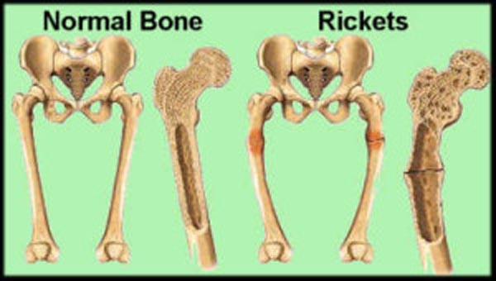
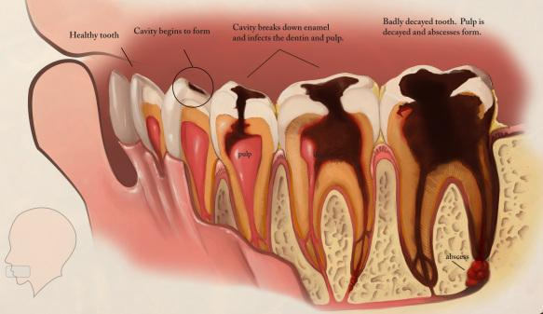
What are the side-effects of not having a balanced diet?

Slide 25
Barriers to having a healthy diet:
Your Family don’t buy healthy food
You don’t like healthy food
You don’t know what healthy food is

Slide 26
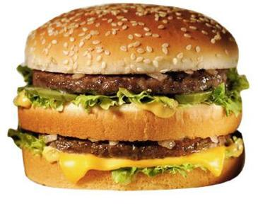
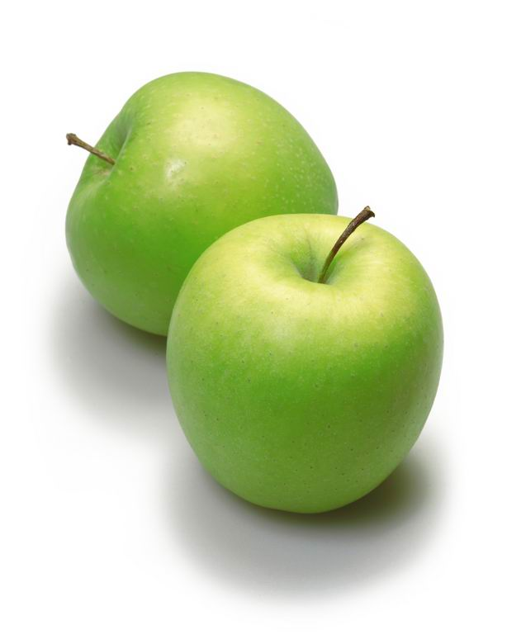
Put in order of "healthiest".

Slide 27
Healthy Living
WALT: To understand what it means to be healthy

Slide 28
Which of these foods is the Healthiest?
1
2
3
4
Put the four foods in rank order starting with the healthiest and ending with the least healthy.
For each one say why?

Slide 29
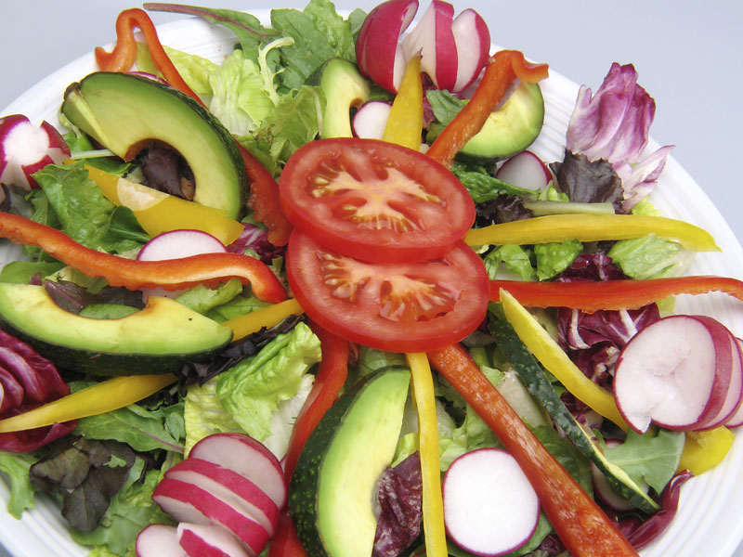
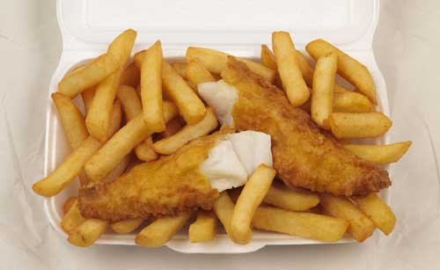
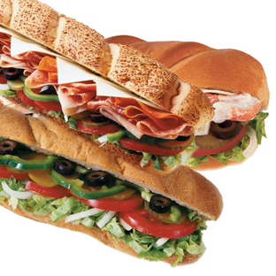
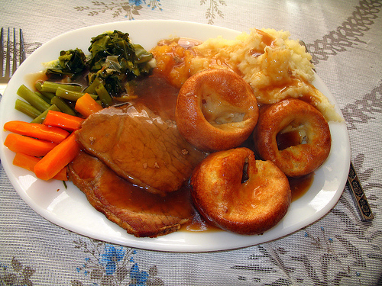
?

Slide 30
Sugar
To understand how much sugar is in the food and drinks we consume
To know how sugar can affect us
To suggest how we can stop people consuming too much sugar

Slide 31
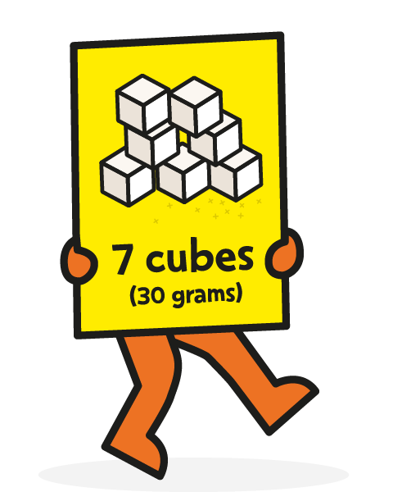
How sugar affects us
So how much should you have?
Can cause spots!
Causes tooth decay
Affects your mood
Fat around your organs
Causes weight gain
High blood sugar levels can lead to Type 2 Diabetes
For age 11+

Slide 32
The Sugar Tax
Manufacturers have to pay a levy on the high-sugar drinks they sell.
Leading brands such as Fanta, Ribena and Lucozade have cut the sugar content of drinks, but Coca-Cola has not.
The levy is being applied to manufacturers - whether they pass it on to consumers or not is up to them.
Drinks with more than 8g per 100ml will face a tax rate equivalent to 24p per litre.
Those containing 5-8g of sugar per 100ml will face a slightly lower rate of tax, of 18p per litre.
Pure fruit juices will be exempt as they do not carry added sugar, while drinks with a high milk content will also be exempt due to their calcium content.
The Treasury forecast it would raise more than £240m a year. In England that income is being invested in schools sports and breakfast clubs.
Products such as cakes, biscuits and other foods are not covered by the tax.

Slide 33
How many cubes of sugar are in these foods?
Bolognese sauce
500ml of orange juice
Mars bar
1 mango
1 white bagel
1 Starbucks hot chocolate with whipped cream
Bulmers cider
Heinz Tomato soup
Muller light yoghurt
Flavoured water
Granola
Can of coke
Apple
Put them in order, starting with the highest!

Slide 35
Task
Now using the information, create an information leaflet suitable for young people.
This should help them to understand how much sugar is healthy, and what food/drinks to avoid.
You may work in pairs
Make sure it’s colourful!

Slide 36
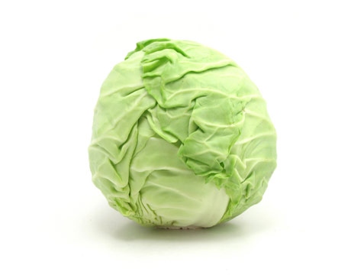

Slide 37
Design a Menu
I discuss what makes a healthy diet.
I will consider ways to promote health eating.

Slide 38
Your Task
In pairs you must design a menu.
It must be a healthy menu for a restaurant.
It must be balanced.
It must have at least 4 options for each course.

Slide 39
Why do we need exercise?
To discuss what counts as exercise.
To discuss the benefits to exercise
To discuss the barriers to exercise.

Slide 40
What do people gain from exercising?
https://youtu.be/liCRrheKIOI
https://youtu.be/s7TBB_0HTWg
https://youtu.be/G2o72-7bwSI
https://youtu.be/H0sL7BLJlz0
https://youtu.be/84-5xSUh3z0

Slide 41
My Weekend
Saturday
9 am- woke up
10 am- went on laptop
11 am- went out with family (included some walking)
3 pm- got home- watched film
6pm- played Xbox
Sunday
8am- woke up
10 am played football game
1 pm- had Sunday roast at Nan’s
3 pm- played football in garden with cousins
5pm- played Xbox

Slide 42
Individual Reflection
Write a paragraph about your exercise at the weekend and your exercise levels in general.
Was it a typical weekend?
Do you think you are active enough? Why/why not?
What benefits do you get from the exercise that you do?
What might stop you from exercising?

Slide 43
NHS Guidelines
Guidelines for 5- to 18-year-olds
To keep a basic level of health, children and young people aged 5 to 18 need to do:
at least 60 minutes of physical activity every day – this should range from moderate activity, such as cycling and playground activities, to vigorous activity, such as running and tennis
on three days a week, these activities should involve exercises for strong muscles, such as push-ups, and exercises for strong bones, such as jumping and running

Slide 45
Sleep
To know why sleep is important
To understand the effects of a lack of sleep
To think about our own sleep.

Slide 46
Reasons for Bad Sleep
Too much screen time
Not sleeping regular hours
Going to bed without winding down first
If your bedroom isn’t sleep friendly (Too noisy, bad bed or no bed, to hot or cold)

Slide 47
The NHS website says that we need at least 8 hours of sleep a night (some people may differ slightly).

Slide 48
Lack of sleep can cause…
Poor concentration
A bad temper
Falling asleep during the day
Illness
Poor growth
Obesity
Mental health issues such as depression.
A risk of heart disease

