Slide 1
Colour
Y8 Textiles

Slide 2
Colour, Pattern and Texture
The use of colour, pattern and texture are extremely important in Fashion and Textiles. They are all used by designers to make their designs stand out and appeal to the customer.
Today we are going to have a look at the colour wheel and colour theory to help you to think about how you can used colour the express different moods and feelings.

Slide 3
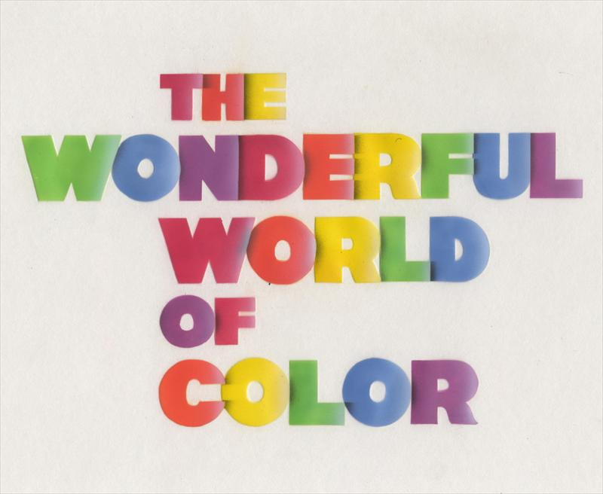

Slide 4
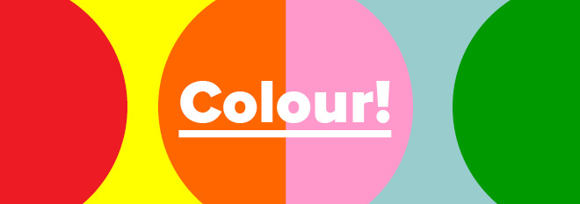
Colour is an important part of design. Colour is used to gain our attention. It creates emotions eg: happy, calm, excitement, sorrow, anger. It helps us to communicate ideas, emotions and to give instructions/ warnings without the need for words. In order to use colour effectively in your design work you need to understand a little bit about the use of colour theory. This is really useful in all aspects of art and design not just Textiles it is vitally important in Fine art, Graphics and 3D design also.
https://www.interaction-design.org/literature/topics/color-theory

Slide 5
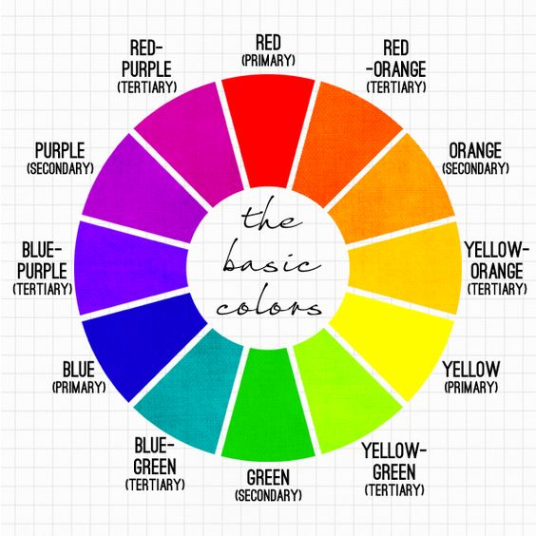
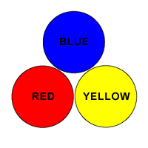
Colour Wheel
Primary Colours:

Slide 6
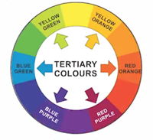
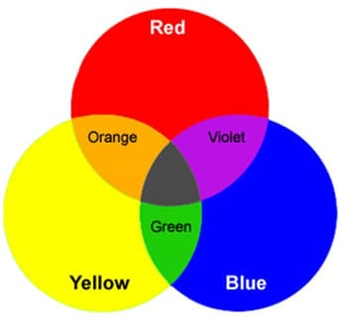
Secondary Colours:
Secondary colours can be made by mixing together 2 of the primary colours eg: yellow+ blue = green
Tertiary Colours: Are a mix of a primary and secondary colour.
Eg: Yellow + Green = Yellow green
Red + Orange = Red Orange

Slide 7
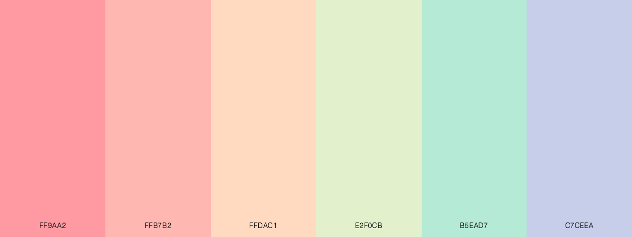
Colour Schemes
The colour wheel is a useful way of helping you to decide which colours will work together in a colour scheme. Some colours will work in harmony with one another while others will clash and not look appealing together. You will need to decide what colour scheme works best for your chosen design. One that is bold, eye catching and exciting using colours that are opposites of one another or a softer more harmonious one which is pleasing to the eye.

Slide 8
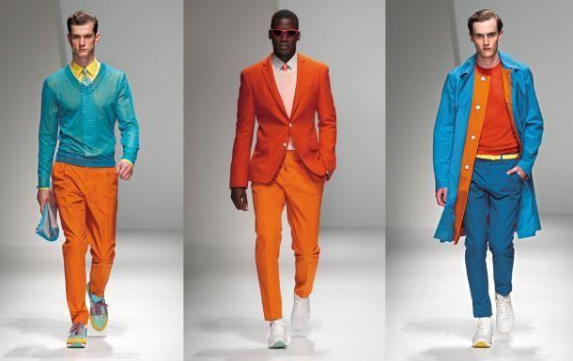
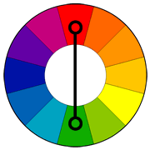
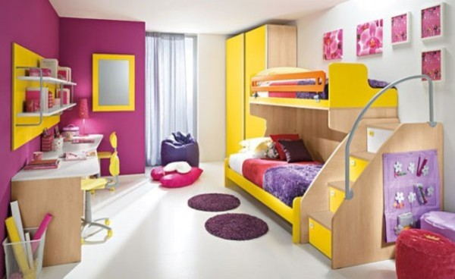

Complementary colours: can be found opposite one another on the colour wheel. Putting these colours together makes them look brighter. Complementary colour schemes are very eye catching because the colours ‘pop’ against one another.
Example: Blue and Orange
Yellow and Purple

Slide 9
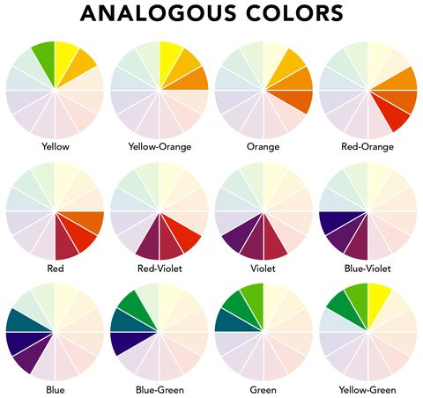
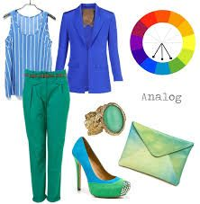
Analogous Colours: are colours that appear next to each other in the colour wheel. Analogous colour schemes are usually very harmonious and pleasing to the eye as the colours are very similar and blend together well.

Slide 10
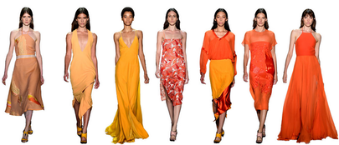
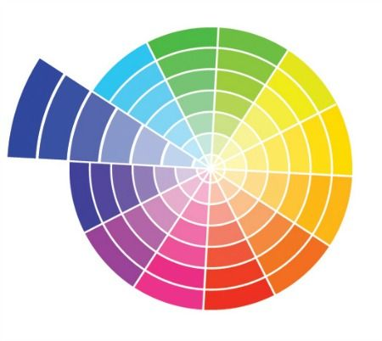
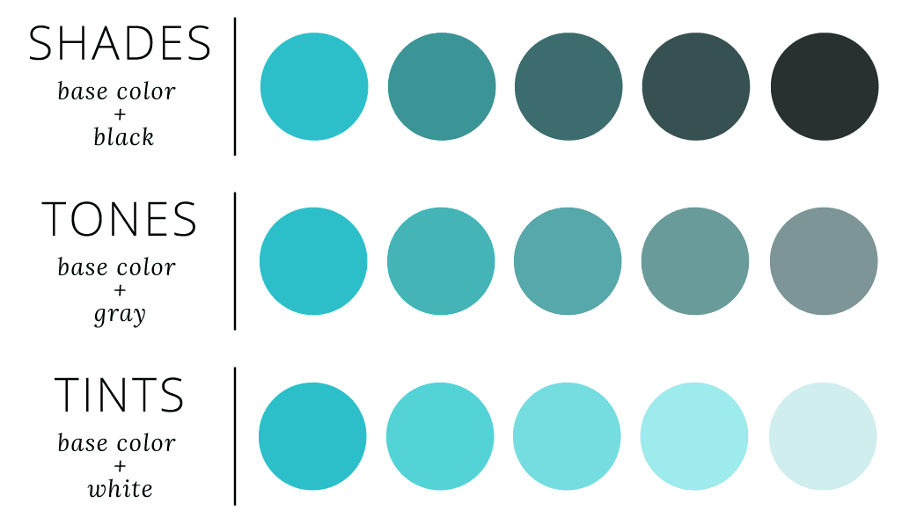
Monochromatic: A monochromatic colour scheme is based upon just one colour. The colour is extended by using different hues (shades) of that colour to make it darker/ lighter eg: by mixing in white/ black

Slide 11
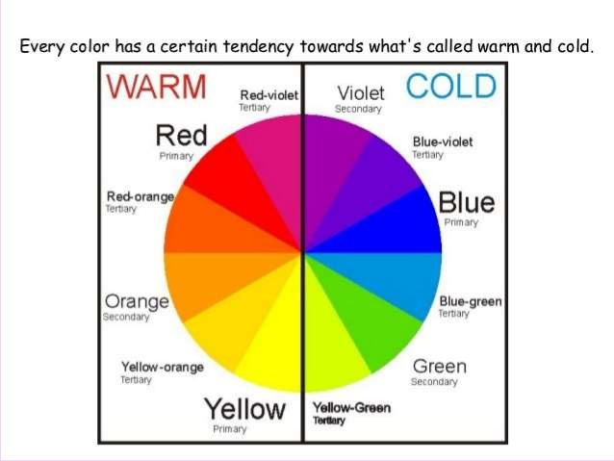
Warm colours — such as red, yellow, and orange; suggest warmth because they remind us of things like the sun or fire.
Cool colours — such as blue, green, and purple (violet); suggest a cool feeling because they remind us of things like water or grass.

Slide 12
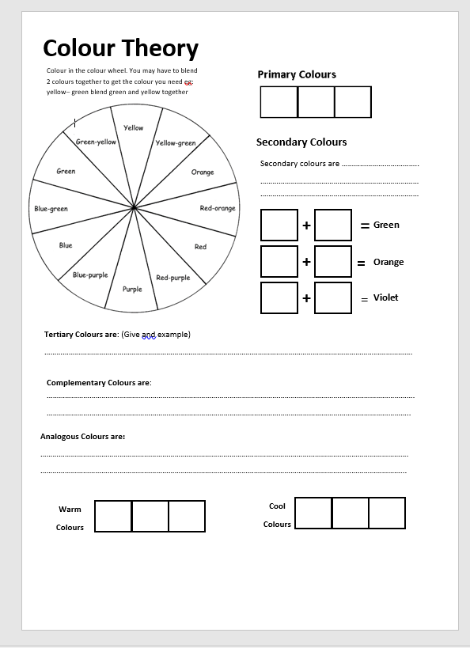
Task 1: Colour Theory Work Sheet
Use everything you have learnt about colour theory to complete the colour theory work sheet. If you don’t have a printer you can complete the work on a separate sheet of paper.#
You will need coloured pencils!

Slide 13
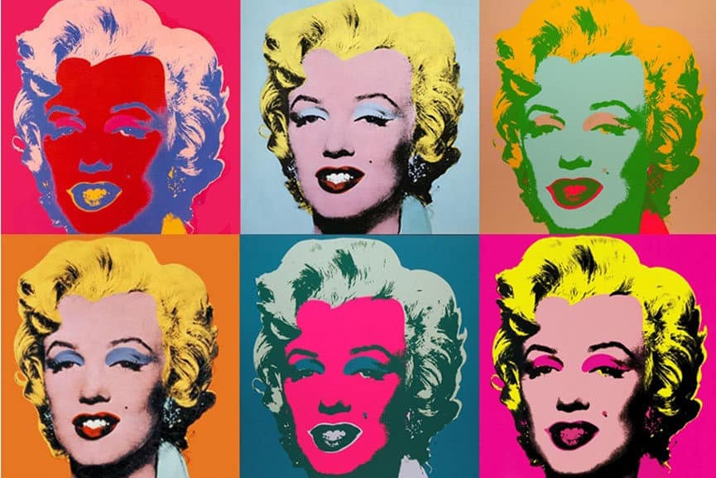
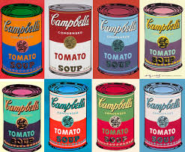
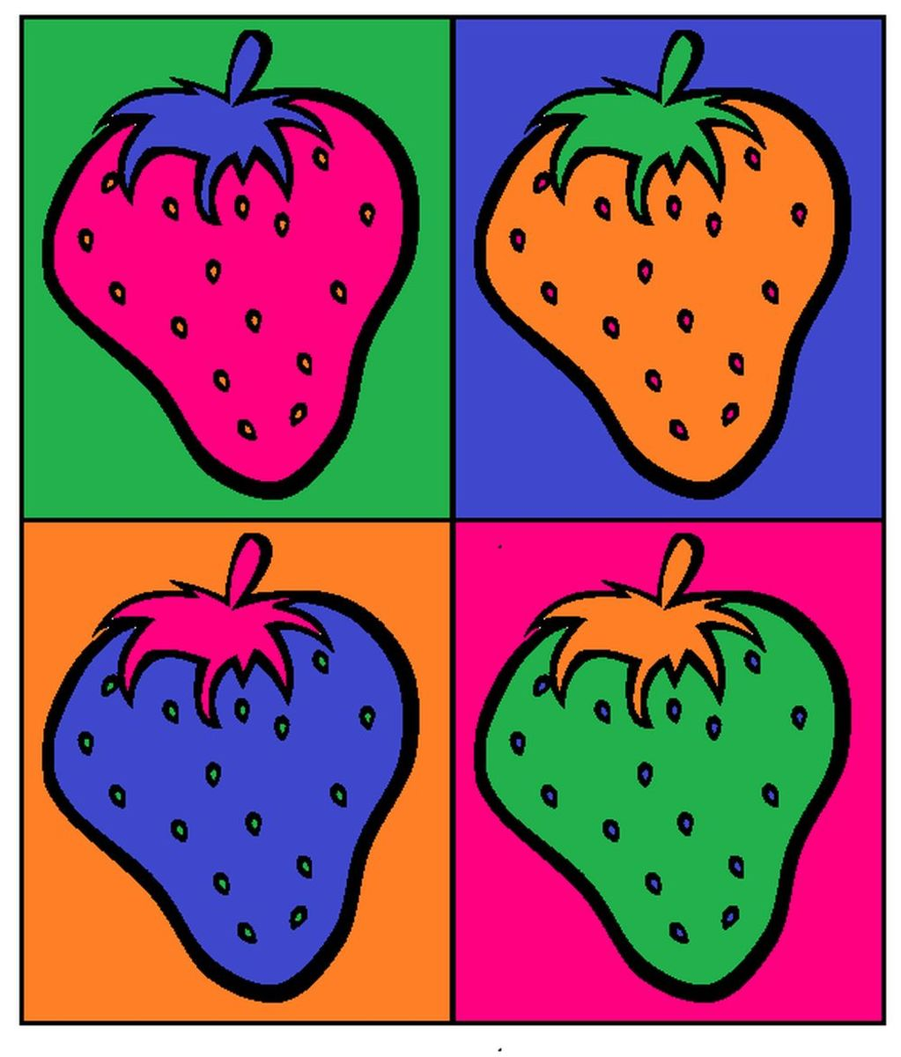
Task 2: Option 1
The American Pop artist Andy Warhol is best known for his paintings featuring objects or people with the same image repeated over and over again but coloured in different bright complementry colours.
Task: Draw an item of food in pencil. Use the tracing technique which we learnt about a few weeks ago to create a repeating design using the same shape. Colour in your design using different complementary colour schemes.

Slide 14
Task 2: Option 2
You have been asked by an Interior design company to present design ideas for a teenagers bedroom.
1. Using your knowledge of colour schemes produce a design sketch/ or moodboard to show how you would decorate the bedroom.
Explain which type of colour scheme you have chosen eg: complementary, analgous and monochrome and why.
2. Produce a design drawing for your bedroom to show your design.

Slide 15
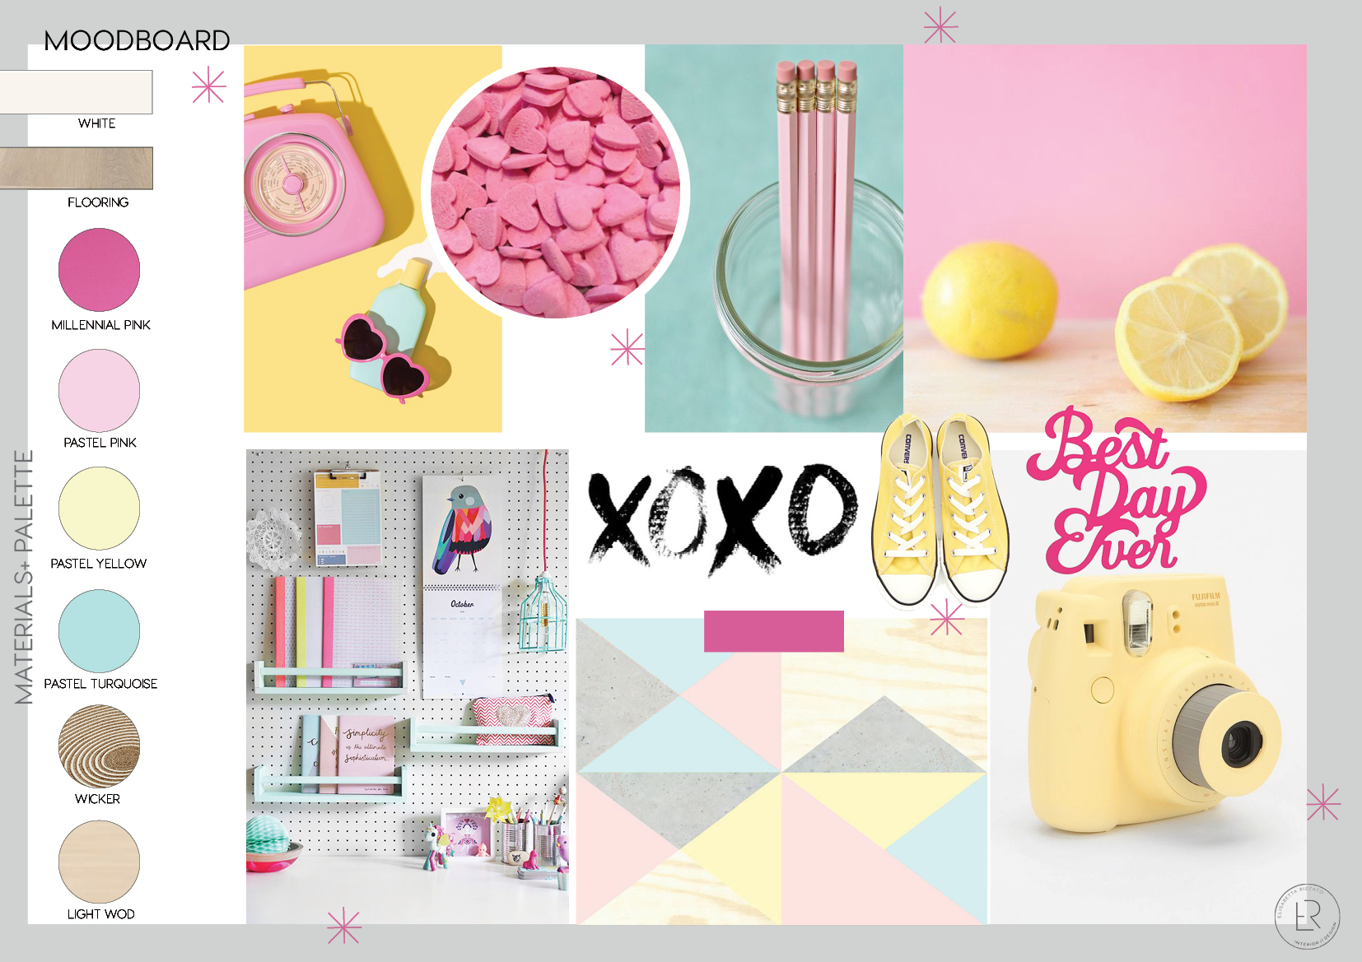

Slide 16
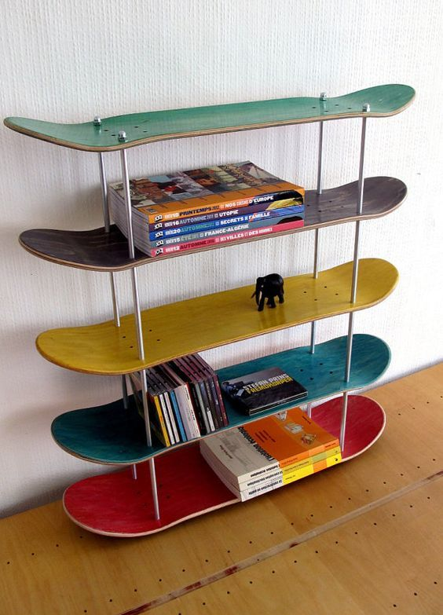


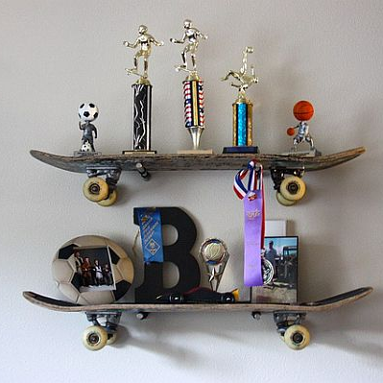
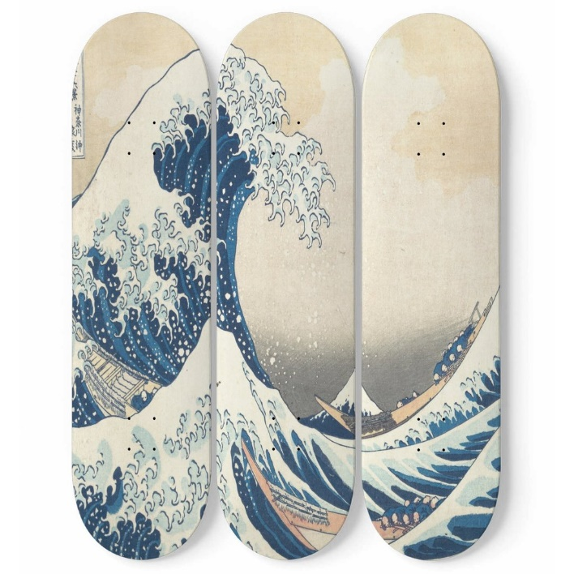

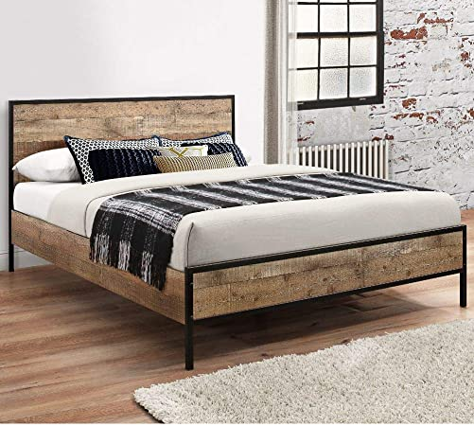
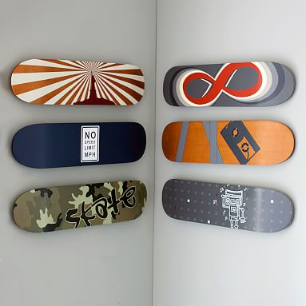
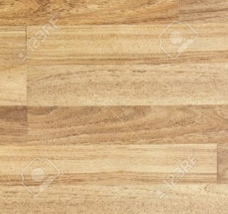
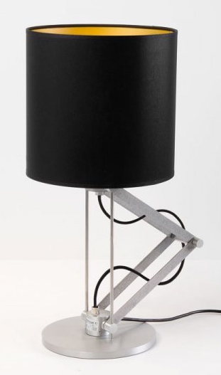

Slide 17
