Slide 1
What will kill 12000 women
and 90 men this year?

Slide 2
BREAST AND TESTICULAR
CANCER
I will know why it is important to be aware of these cancers.
I will know some facts about breast and testicular cancer in the UK.
I will know how to check my breasts/testicles.
What do you ALREADY know?

Slide 3
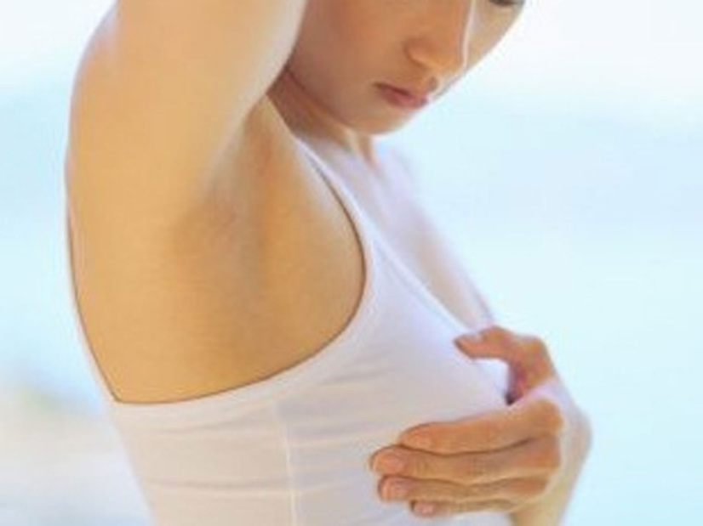
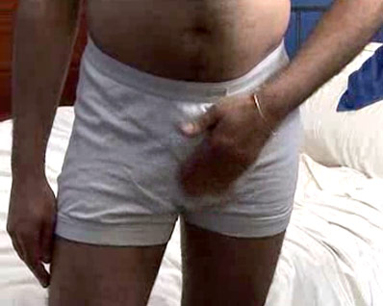
Checking for Cancer
To know how to check for breast and testicular cancer

Slide 4
Breast cancer statistics & facts
There are an estimated 550,000 people living in the UK today who have been diagnosed with breast cancer. In the UK
Breast cancer is the most common cancer
Around 47,700 women and 340 men are diagnosed with breast cancer each year
One woman in eight will be diagnosed with breast cancer in her lifetime
Around 12,000 women and 90 men will die from breast cancer each year
More people are surviving breast cancer than ever before
80% of people with breast cancer are still alive five years after diagnosis
People are surviving longer thanks to advances in research, new treatments, earlier diagnosis, breast screening and breast cancer awareness

Slide 5
Testicular Cancer
Leading cancer in young men 15-35
Higher death rate than breast cancer in this age group
One new diagnosis every hour
Very curable if detected early
Testicular cancer is a disease in which cancer develops in one or both of the testicles
Testicular cancer can metastasize, meaning that it can spread to other parts of the body.
Testicular cancer is on the rise and can affect any male from infancy to elderly. An estimated 8,290 new cases will be diagnosed in 2011. 1 out of 270 young men will be diagnosed. The highest rate of diagnoses are males between the ages of 15 to 35. Due to the lack of early detection, more than 350 deaths will occur in 2011

Slide 6
http://www.youtube.com/watch?v=soEGqOdiU_0
Breast examination video
http://www.5min.com/Video/How-to-Perform-Breast-Self-Exam-286302892
http://www.videojug.com/film/breast-cancer-awareness-2
Testicle examination video
http://www.thesite.org/audioandvideo/video/healthandwellbeing/testicularselfexamination

Slide 7
Breast Cancer in Men
http://www.youtube.com/watch?v=2tVr70IzSB0

Slide 8
The sun and our skin

Slide 9
UV sunburn and skin cancer
https://www.youtube.com/watch?v=o9oSJpomee8&safe=true

Slide 10
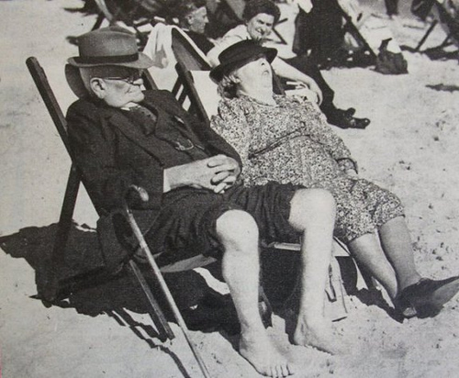
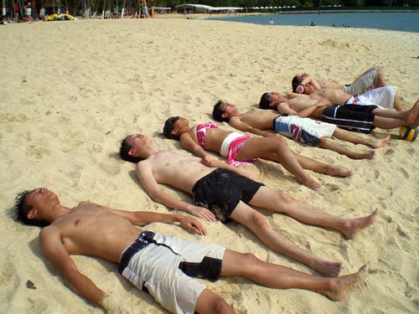
There's a famous seaside place called Blackpool, that's noted for fresh air and fun
Costa del Anywhere 2011
seaside holidays 1950

Slide 11
the surface temperature of the
Sun is about 6000°C
the Sun emits all electromagnetic
radiation except gamma rays
so we received X-rays, ultraviolet, visible light , infrared, and radio waves from the Sun
the most significant radiations are
visible light ultra violet infra red

Slide 12
these frequencies in combination provide all the colours we can see
black = no frequencies
white = a mixture of all colours
paint and ink colours – the chemicals in the dyes and inks absorb all frequencies but only emit particular combinations of frequencies

Slide 13
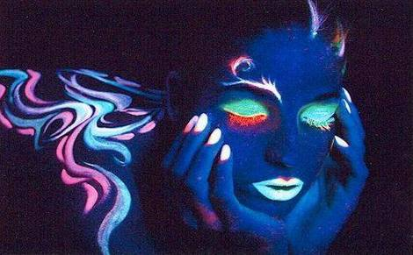
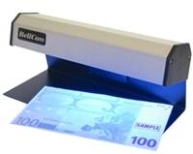
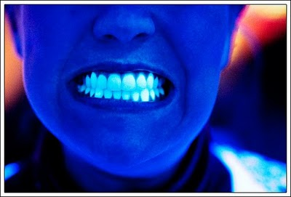
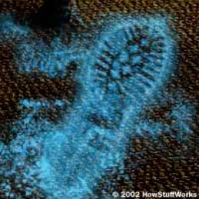
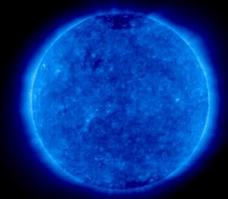
this slide is ‘coloured’ to represent ultra violet
some ways we use ultra violet radiation

Slide 14
Ultraviolet C
absorbed/reflected by atmosphere
germicidal properties
germicidal lamps.
Ultraviolet B
some is absorbed in the atmosphere
causes DNA damage
tanning, burning and aging
.
Ultraviolet A
penetrate into skin surface
damages DNA
light tanning
deep penetration can cause skin cancer
.

Slide 15
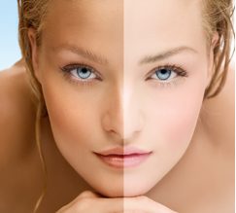
ultra violet and skin - suntan
A dark pigment called melanin is produced
skin gets a darker tone
melanin absorbs UV
protects but can cause sunburn
UVB causes direct damage to skin cell DNA

Slide 16
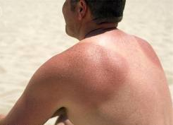
ultra violet and skin - sunburn
sunburn - aka erythema
skin cells are damaged by the absorption of energy from UV rays.
extra blood travels to the damaged skin in an attempt to repair it
this is the cause of the redness associated with sunburn.
caused by
UVA
and
UVB

Slide 17
ultra violet and skin – other effects
photo-ageing wrinkles, loosening of the skin
thinner blood vessel walls, increased bruising
thinning / thickening of skin of skin,
moles in sun exposed areas
skin bumps / keratoses

Slide 18
ultra violet and skin – skin cancer
UVA and UVB both damage DNA
genes are made from DNA
genes control cell growth
severe genetic damage can cause normal skin cells to grow and reproduce in a very uncontrolled, disorderly way
they become cancer cells.

Slide 19
skin cancer risk
basal carcinoma
most common
deep in skin
repeat sunburn or childhood over exposure to sun
fair skin and tend to freckle or burn rather than tan
squamous carcinoma
second most common
skin surface
long time over exposure to sun
fair skin
tobacco use
melanoma most deadly in melanin producing cells | high sun exposure before age 20 use of tanning beds before age 30 freckle or burn rather than tan moles present / genetic links

Slide 20
reducing the risk
naturally darker skin has more melanin
absorbs more uv
so less penetration
so less risk
reduce exposure time
use shading
use sunblock

Slide 21
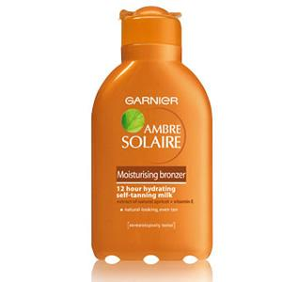
sunscreen
modern sunscreen does
delay the start of sunburn
absorb over 90% of UVA
and UVB
need replacing regularly
sunscreen does not
stop sun burn
give you a sun tan
last all day
make you better looking

Slide 22
spf - sun protection factor
A sunscreen with an SPF of 15 will delay the start of a sunburn by a factor of 15.
So a person who would normally burn after 10 minutes will not burn for 10 x 15 minutes – that’s over 2 hours.
The SPF 15 sunscreen allows a person to stay out in the sun 15 times longer before burning
but your skin type matters ………….

Slide 23
spf and skin type
What’s your skin type?
Always burns, never tan - pale skin, freckles, blond or red hair, blue or green eyes
Burns easily, tans eventually - white skin, blond hair,
blue or green eyes
3. Sometimes burns, tans slowly - white skin, usually dark hair and brown eyes
4. Occasionally burns, tans well - light brown, brown or black hair, brown eyes
5. Hardly ever burns, tans well - browner to dark skin, brown or black hair, brown eyes
6. Never burns - brown to very dark skin, brown or black hair, brown eyes

Slide 24
Match up your skin type to the SPF you should use just for normal everyday exposure to the sun
1 2 3 4 5 6
SPF 25 SPF 20 SPF 15 SPF 8 SPF 6 SPF 2
sunscreen should be applied generously before you go out in the sun
apply again after swimming or sweating
avoid sunbathing for long periods of time between 10.00 am and 3.00 pm
but remember ………….

Slide 25
and
and

Slide 26
That’s all folks!

