Slide 1
Year 8 Textiles
Shadow Curriculum Work

Slide 2
Year 8 Textiles: Fashionable Food
The Y8 Textiles project in school is based on the work of Textiles artist Lucy Sparrow who creates Textiles soft sculptures of different food products which she uses to fill the shelves of super markets.
In school we will be focusing upon making your own textiles soft sculpture which will not be possible at home. Please complete work from this powerpoint if you are working from home. I will either tell what work I would like you to do via email/ SMHW or you can email me to ask what you should complete

Slide 3
Textiles Work to Complete Based on which week of the rotation we are on
Week 1: Observational Drawing and food moodboard
Week 2: Appliqué information sheet
Week 3 onwards: Work through the following tasks choose one per week from the following.
Creating a repeat pattern using tracing
Weaving
Collage
Kawaii research and kawaii drawing
Colour theory worksheet and colour theory task

Slide 4
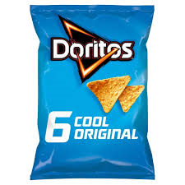
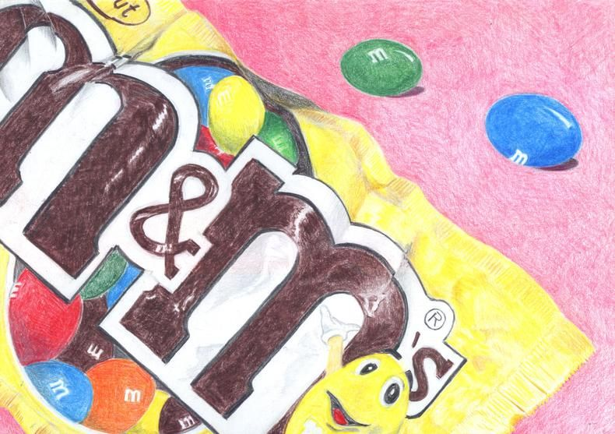
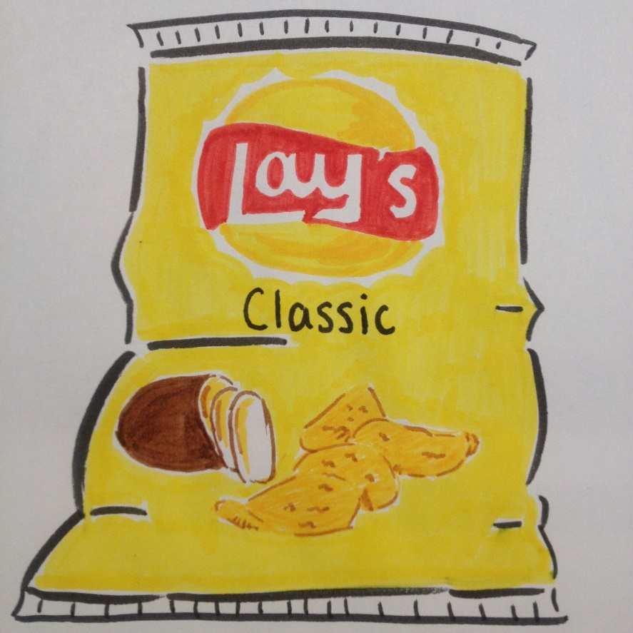
Week 1 Task 1: Observational Drawings Food Packaging
Using pencils and coloured pencils produce an observational drawing of an item of food packaging.

Slide 5
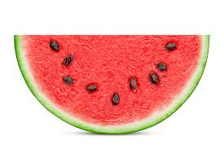
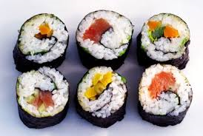
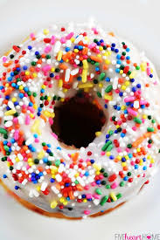
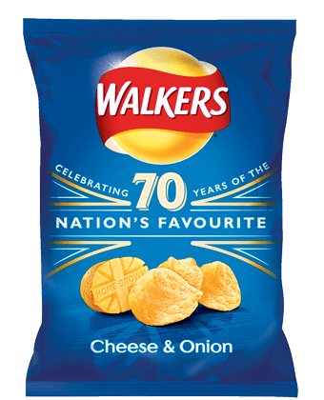
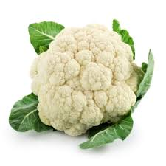
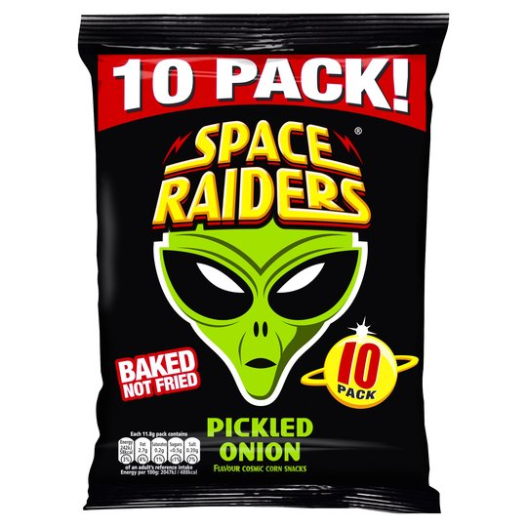
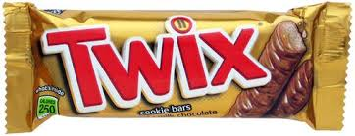
Week 1 Task 2: Moodboard
Produce a moodboard of different types of food which you could turn into designs for your final product. Choose images that have a lot of detail eg: food packaging, foods with patterns and details like a slice of water melon or pizza.
You should include:
At least 10 different images
A title
Labels to help explain your ideas.
If you don’t have a computer create a moodboard/ collage made from the packaging of different foods eg: crisps, sweets, chocolate, drinks bottles, biscuits, cereal boxes etc.

Slide 6
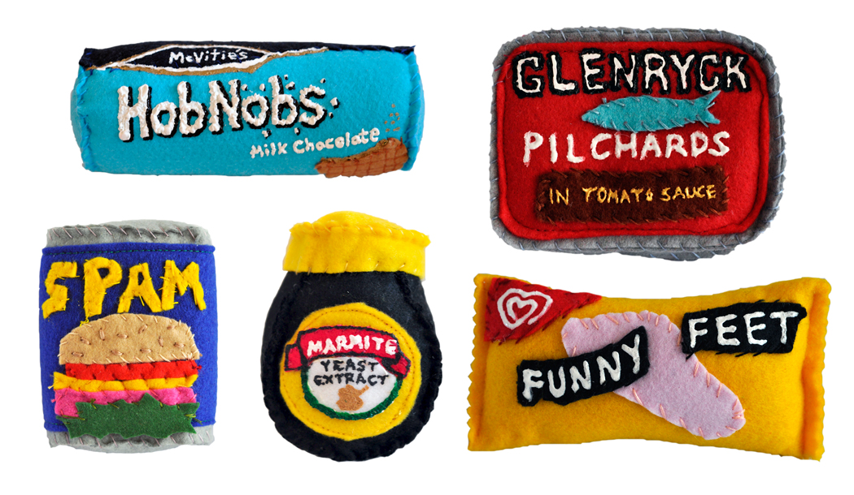
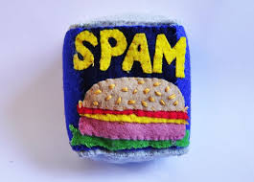
Week 2: Appliqué Information Sheet
Make a step by step plan explaining how to make an appliqué. Your instructions sheet should include:
A short piece of writing explaining what appliqué is.
An equipment list
Health and safety information for the equipment.
A numbered set of step by step instructions with a picture to go with each step.

