Slide 1
Weaving
Y8 Textiles

Slide 2
Materials
Paper: coloured paper, newspaper, magazine pages, junk mail, wrapping paper, food pacakaging …
Scissors
Glue
For a card loom (Optional)
Thick cardboard (From an old box)
Wool or string or your could use a plastic bag cut into strips
Wools, string, bits of ribbon, strips of fabric, strips of plastic bag

Slide 3
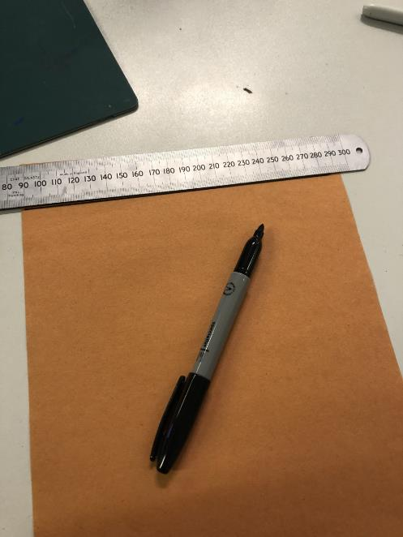
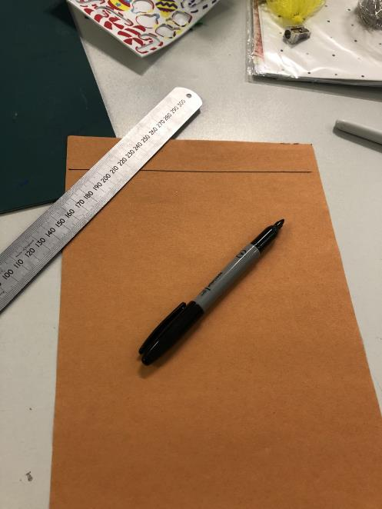
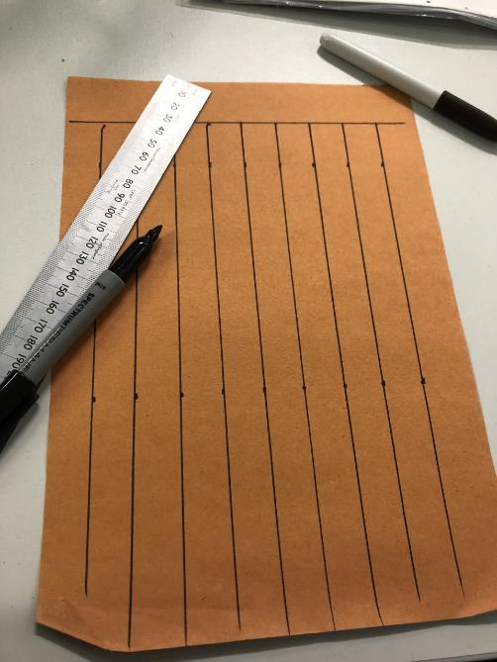
Step 1:
Place a ruler along the top edge of your paper and draw a line
Measure and draw lines going down the paper from top to bottom

Slide 4
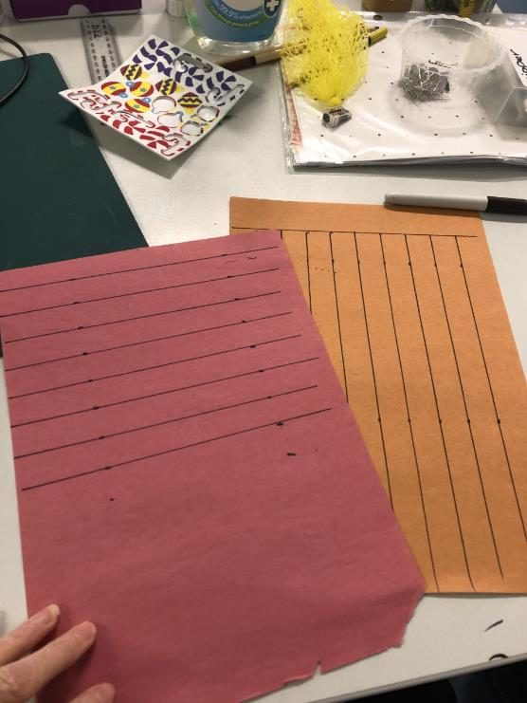
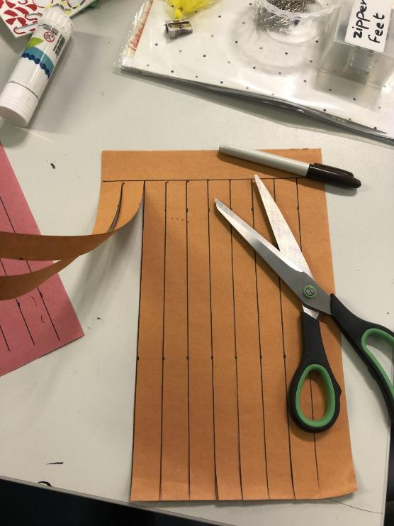
On a different sheet of paper measure and draw lines going across the page from left to right
Cut up the lines on your first sheet until you reach the line you drew across with your ruler.
With your second strip cut the strips of paper out

Slide 5
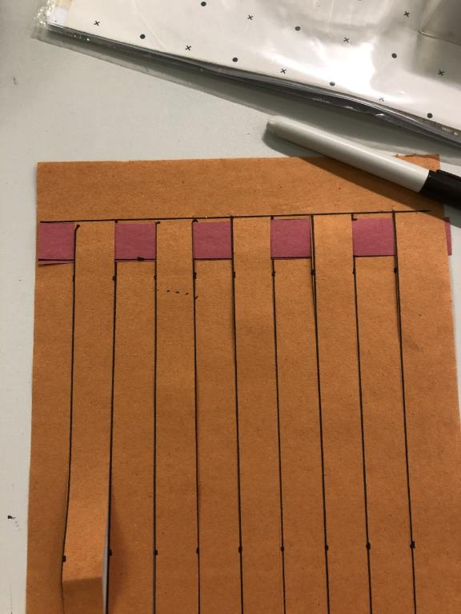
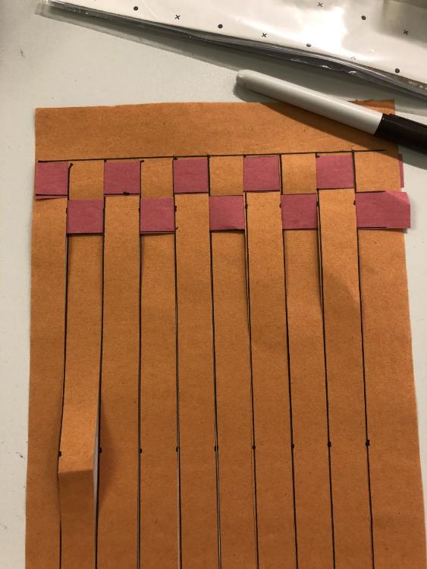
Take a strip of paper and weave it in and out of the strips that are still held together. Go over, under, over, under
Take your next strip and do the opposite to the first row.
Repeat until you have used up all of your strips

Slide 6
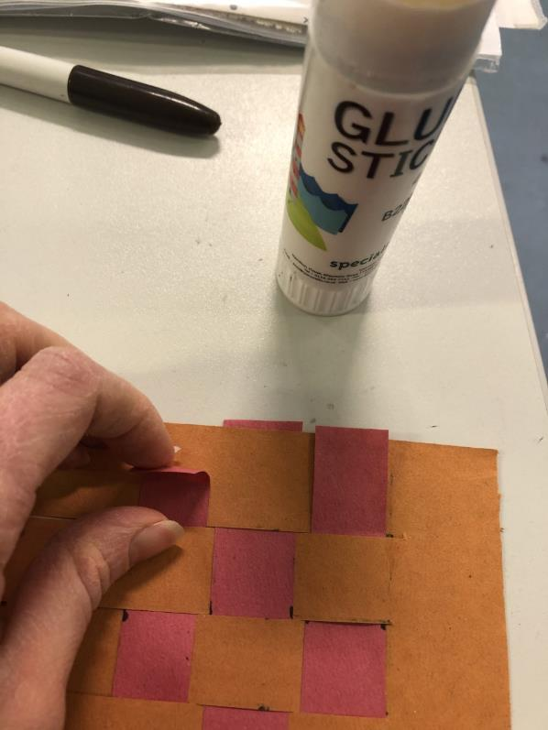
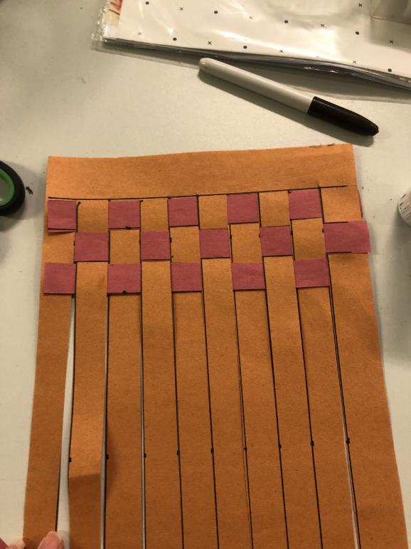
Glue your paper strips at each end to stop it all falling apart!

Slide 7
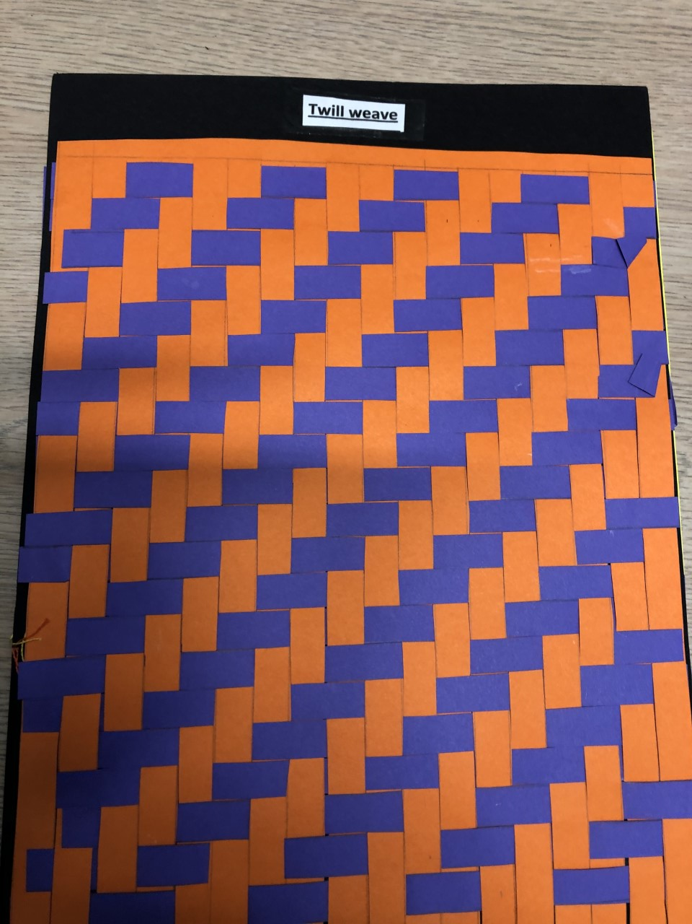
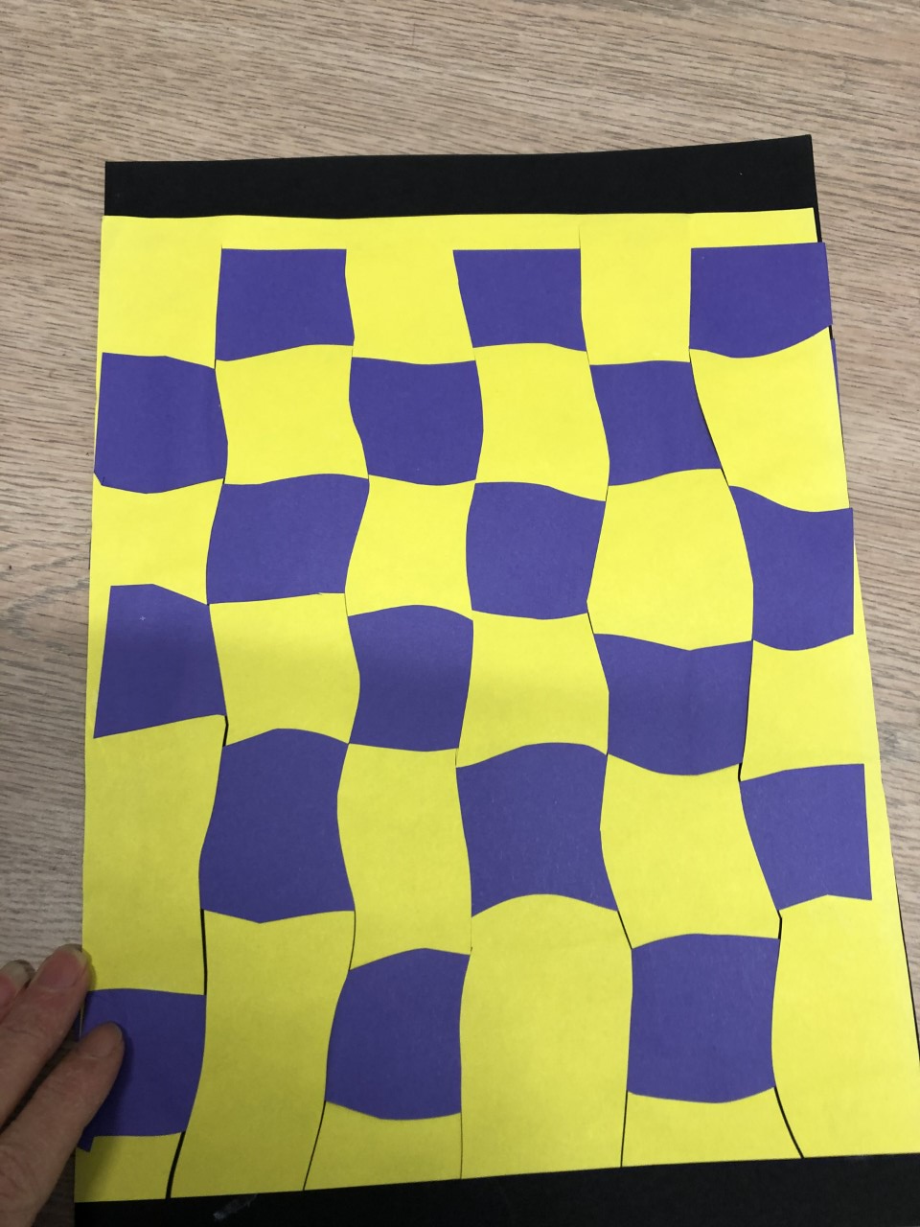
Try Different Styles of Weaving

Slide 8
Card Loom Weaving
You can use a card loom to weave wool, fabric strips, ribbon or even plastic bag strips to create some nice little products.
It’s a great way of using up and recycling old materials.

Slide 9
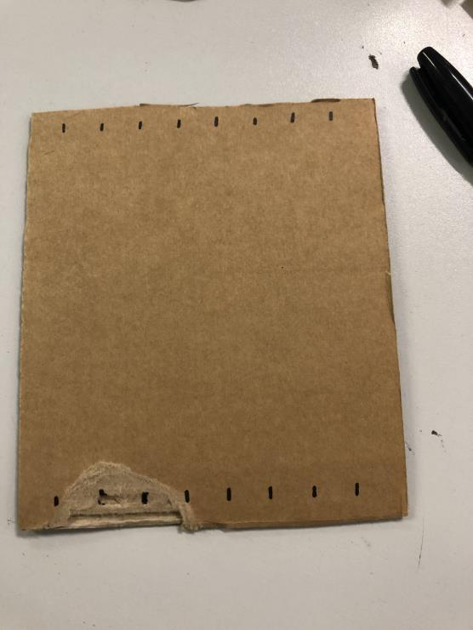
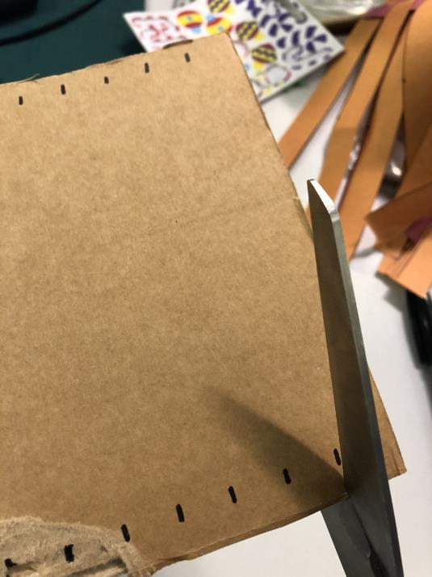
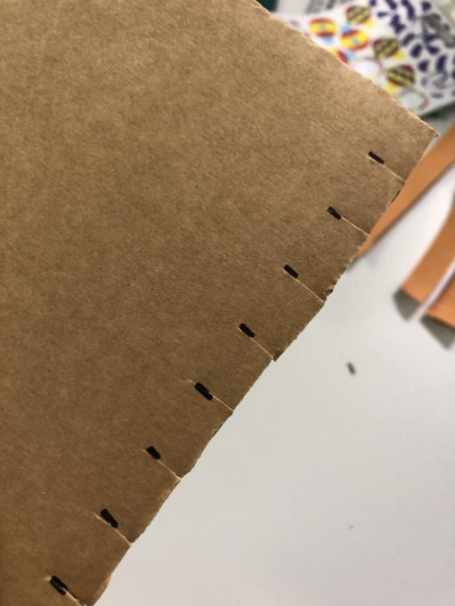
Cut a square of cardboard. Mark lines about 1-1.5cm apart from each other on each side of the card
Using scissors carefully snip into the card a little way to make a notch

Slide 10
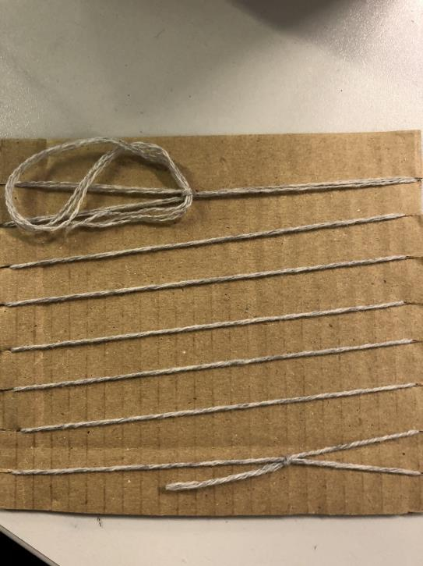
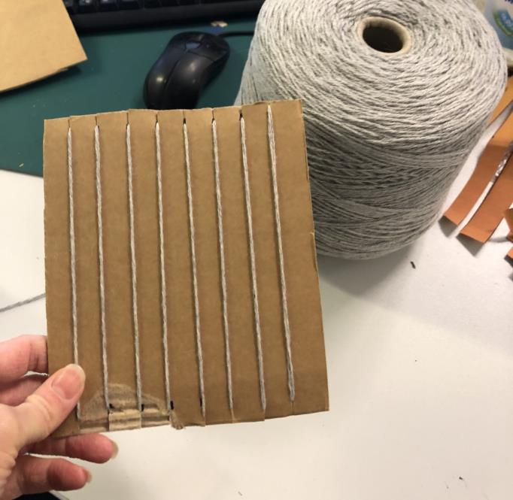
Wind wool/ string/ strips of fabric between the notches that you cut in the cardboard. Tie the ends of the wool together on the back of the card

Slide 11
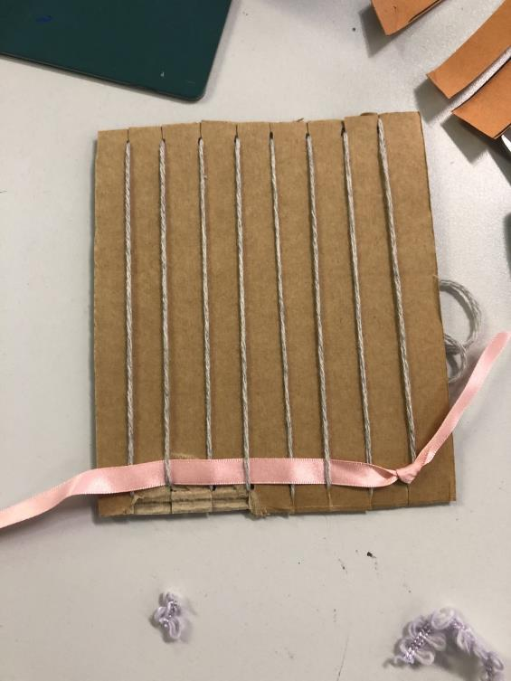
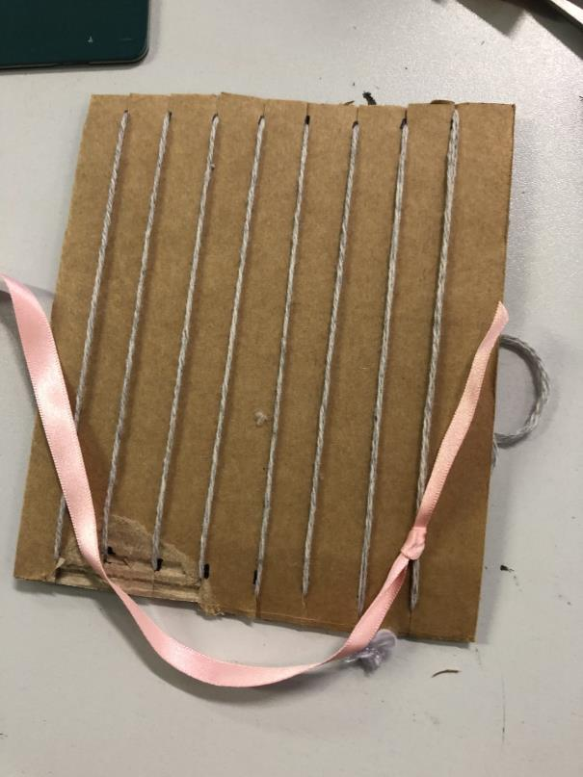
Tie your chosen material onto your string at one end of the loom. Weave the thread in and out of the strings over, under, over, under all the way along

Slide 12
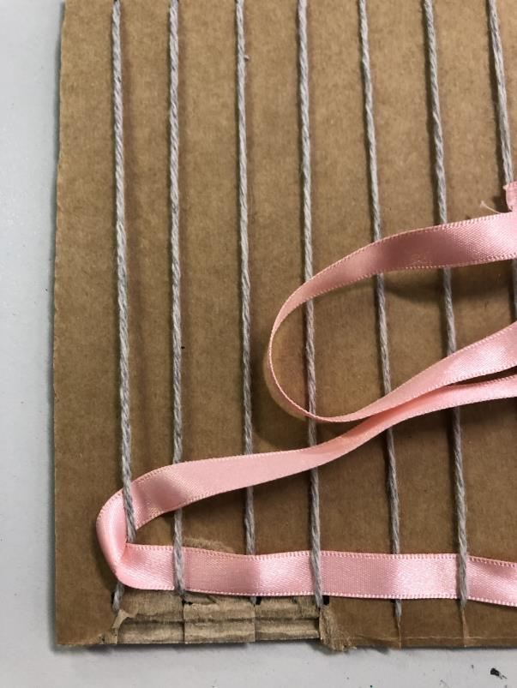
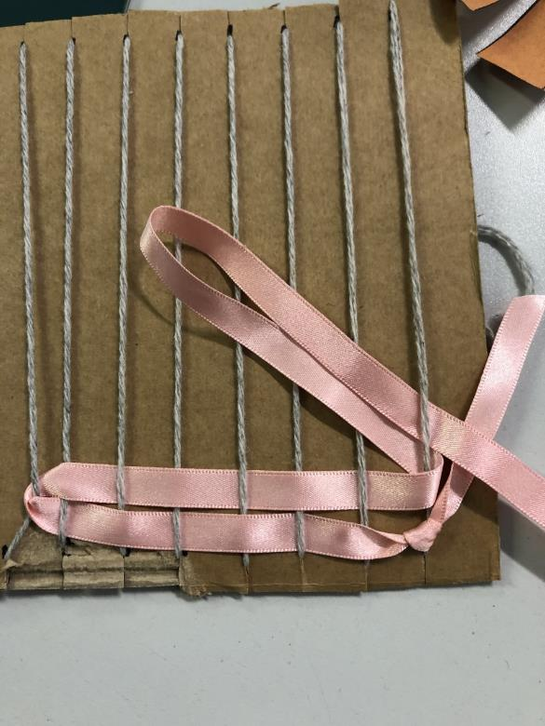
When you get to the end of the row. Loop the thread around the last string and go back the other way OR carry on round to the back of the loom and weave through the strings on that side
Go back through the strings going opposites to the first row. Repeat until you have filled your loom

Slide 13
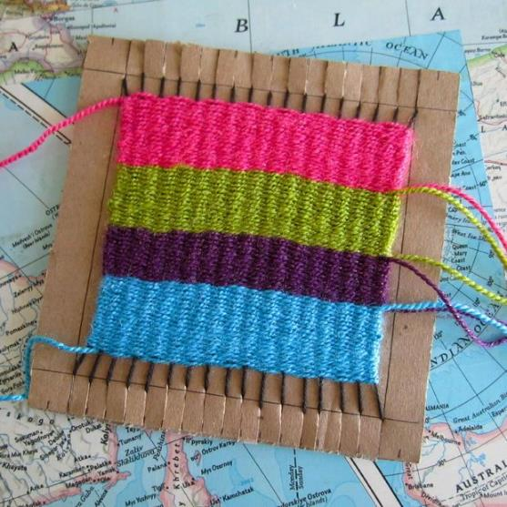
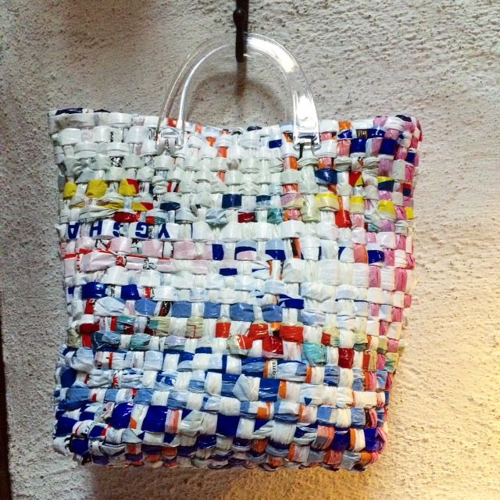
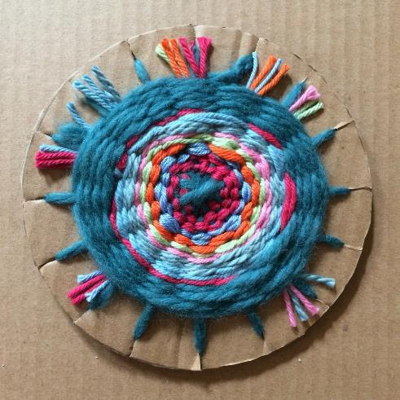
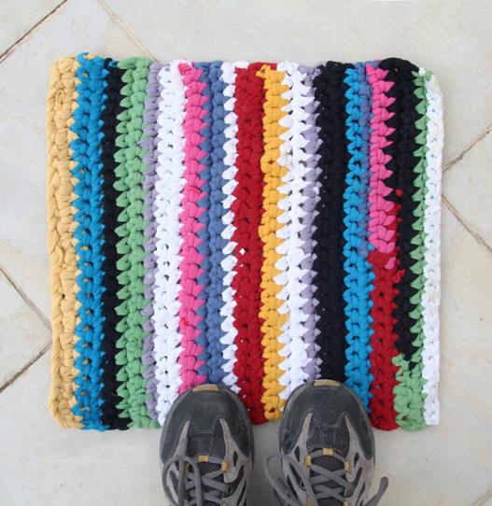
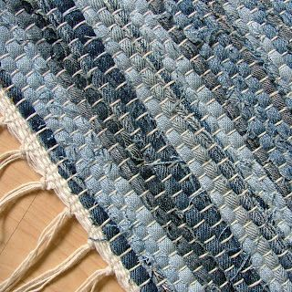
Try making a round loom.
Bag woven from plastic bags!
Rug made from weaving old t-shirts
Weaving strips of old denim

