Slide 1
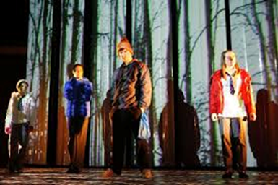
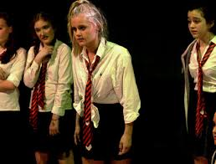
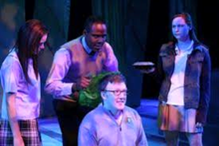
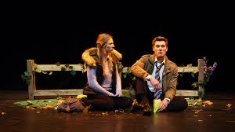
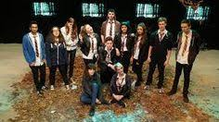
DNA KNOWLEDGE ORGANISER: COSTUME
Section A: This relates to the 9- and 12- mark Questions as a DIRECTOR. It is also useful for the 14-mark Question as DESIGNER
COSTUME DESIGN:
Colour
Hair/ Hat
Era
Economics
Shoes/ Shape
Extras
As a COSUME DESIGNER, you could also consider:
Make-Up
Hair Style
Accessories (Ear-Rings, Badges, Hats, Glasses, etc)
Will the costume be NATURALISTIC, perhaps with a basic school uniform, with more INDIVIDUAL additions for the different characters?
Or more ABSTRACT/STYLISED, such as Orange jump suits, or a different COLOUR for each CHARACTER?
What a COSTUME says about a CHARACTER?
Age
Status
Social Class
Temperament
Personality
Era/Time Period
Occupation
Mental State
Think about the following:
Which characters might wear RED, for example, or WHITE?
Which characters might be particularly TIDY or SCRUFFY?
Which character might wear a LEATHER JACKET?
Who might wear a SHORT SKIRT?
If school uniforms, how might characters wear their TIES differently?
How does the costume of a character CHANGE in the performance, to show the CHANGE through the play?

Slide 2
bout COSTUME in “DNA”
To….consider how COSTUME can communicate CHARACTER/THEME, etc
Because…it WILL be an option in the written exam…
COSTUME is likely to come up as an OPTION in the 12/14 mark Question. You won’t HAVE to choose it, but you will need to be prepared…
Remember, the 14 marker is from the point of view of a DESIGNER…

