Slide 1
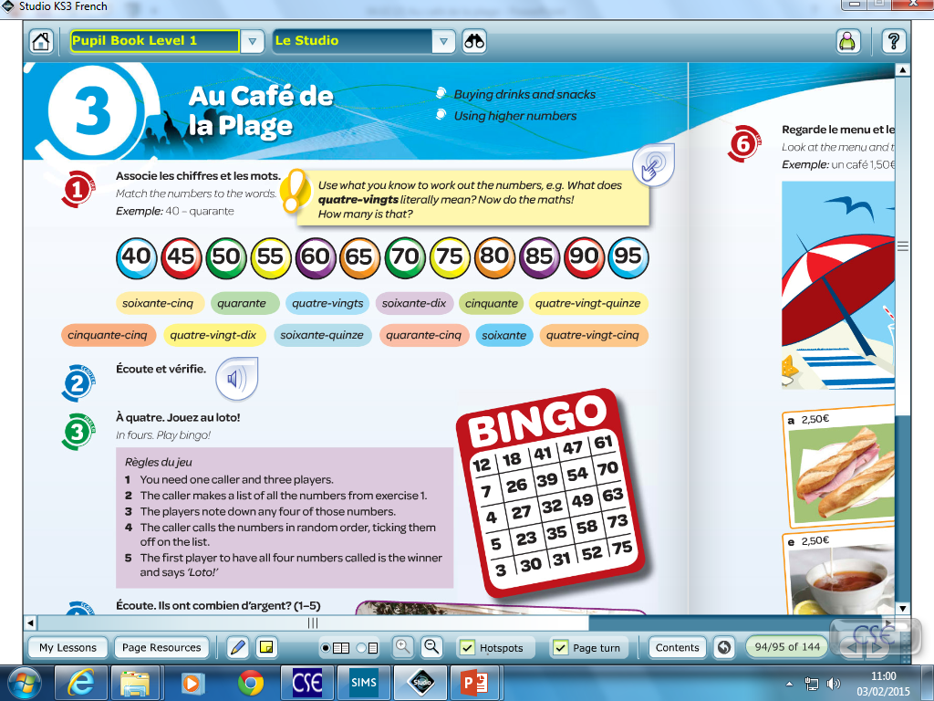
SILENT STARTER:
Match the words and the numbers…

Slide 2
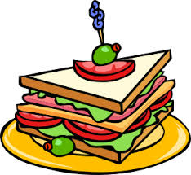


Au café de la plage
L’objectif:
ALL: will be able to count from 40 – 95.
MOST: will be able to give prices in French using EUROS.
SOME: will be able to give prices for food items and ask for items in a restaurant scenario.

Slide 3
Copy the following numbers into your book

Slide 4
Write 10 different prices in French like this one:
10, 50 €
Dix euros cinquante

Slide 5
Copy and translate these expressions.
Tu as combien?
(how much do you have)
J’ai cinq euros cinquante…
5, 50 € (I have 5 euros 50)

Slide 6
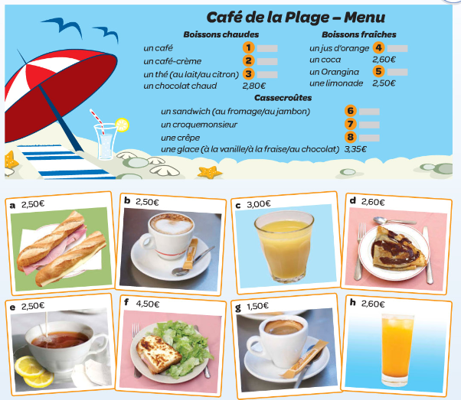
Fill in the gaps

Slide 7
Imagine you have a budget of 12 €.
Write a dialogue with what you want to order…
Serveur: Vous désirez?
Client: Je voudrais un café et une crêpe s’il vous plaît.
Serveur: Ça fait dix euros soixante.

