Slide 1
Je me prépare
L’objectif:
ALL: will be able to understand and say at least four phrases to describe getting ready.
MOST: will be able to understand and say at least six phrases to describe getting ready.
SOME: will be able to understand and say at least eight phrases to describe getting ready.

Slide 2
Copy the expressions and translate into English
Je me douche
Je me regarde dans la glace
Je me prépare
Je m’habille
Je me parfume
Je me lave
les dents
Je me brosse les cheveux
Je me fais une crête
Je me maquille
Je me rase

Slide 3
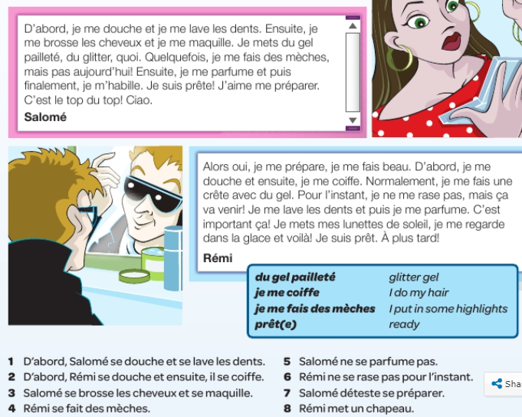
Read the text and answer the questions true or false

Slide 4
Write a text about what you do to prepare yourself for going out in the evening.

