Slide 1
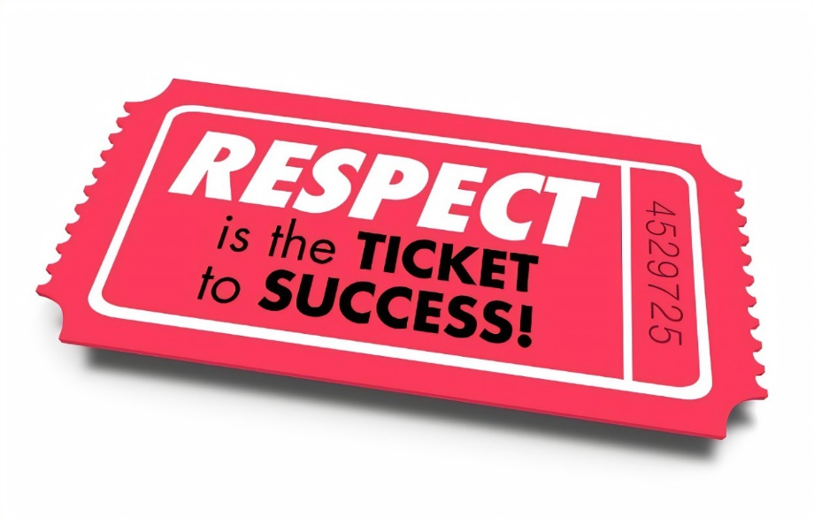
Lesson 1: Why do we study RESPECT?
In this lesson we are going to:
Evaluate the purpose of RESPECT as a course.

Slide 2
1: RESPECT our studies

Slide 3
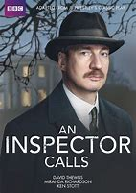
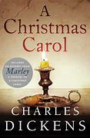
ENGLISH

Slide 4
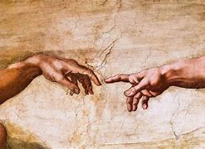
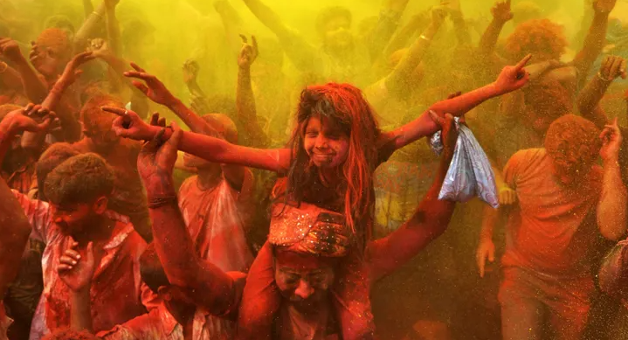
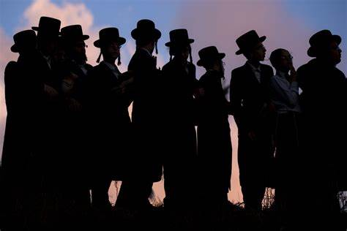
Art/ Photography / DT

Slide 5
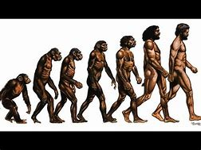
Science

Slide 6
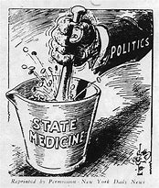
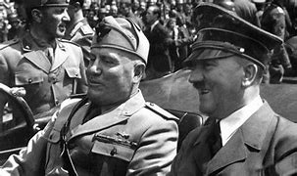
History

Slide 7
Music

Slide 8
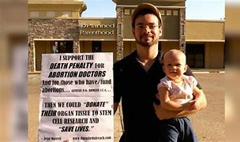
R.E

Slide 9
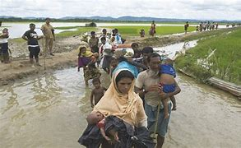
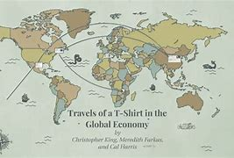
Geography

Slide 10
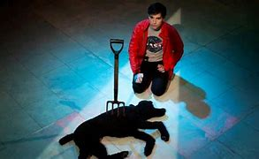
Drama

Slide 11
RESPECT – “Knowledge that flavors the claim”

Slide 12
2: RESPECT Ourselves and Communities
(40) Michelle Obama's Best Advice For Students | How To Succeed In Life - YouTube

Slide 13
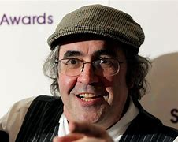
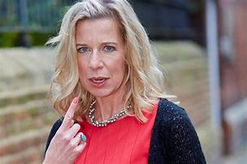
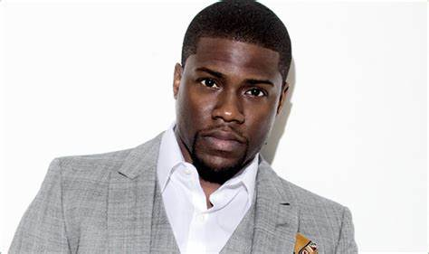
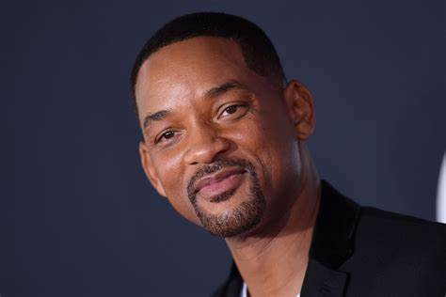
3: Respect Others
Notes:
Danny Baker – Danny Baker
Broadcaster Danny Baker was sacked from his 5 Live show after tweeting about the royal baby using a photo of a chimpanzee. He was accused of racism after seemingly mocking Meghan Markle’s racial heritage in a now deleted post that featured an image of two people holding hands with a small monkey dressed in a suit.
Katie Hopkins - Katie Hopkins was sacked from LBC in May 2017 for appearing to call for genocide in a tweet following the Manchester terror attack that killed 22. "We need a final solution," she wrote.
Kevin Heart - Kevin Hart may not technically have been sacked from hosting the Oscars in 2019, but the actor-comedian stepped down after refusing to apologise for resurfaced homophobic tweets. “I chose to pass. I passed on the apology,” he said, repeating that the issue of the tweets had been addressed in the past.
Jack Maynard – 5 years early posted homophobic and racist tweets resulting him being kicked of the show.

Slide 14
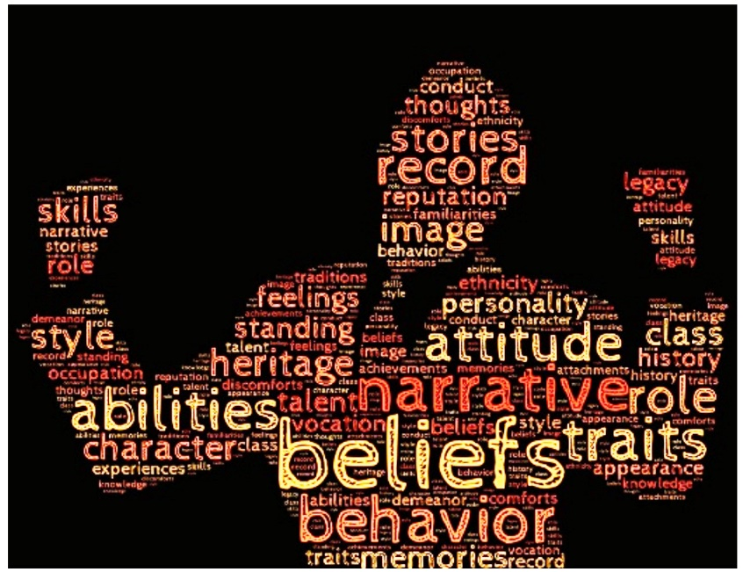
Lesson 2: Identity!
In this lesson we are going to:
Evaluate what is more important personal identity or group identity?
Notes:
Discuss this question with pupils. Then ask them to make a choice/move to one side of the room or the other. Once they have done this they should discuss their reasons within their groups, elect a spokesperson and then each spokesperson should explain why they have chosen their option. Tally the amount on each side?

Slide 15
What is more important?
Personal identity
Group identity
Why?
Notes:
Discuss this question with pupils. Then ask them to make a choice/move to one side of the room or the other. Once they have done this they should discuss their reasons within their groups, elect a spokesperson and then each spokesperson should explain why they have chosen their option.

Slide 16
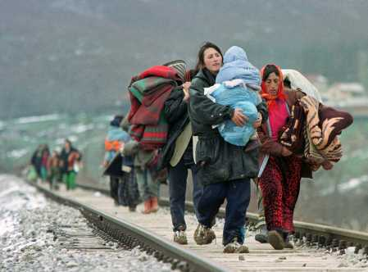
Notes:
Starter activity:
Who are these people? What are the things that bind them together (the things they have in common)? How might be they different from one another? Is it always right to think of a group of people as the same?

Slide 17
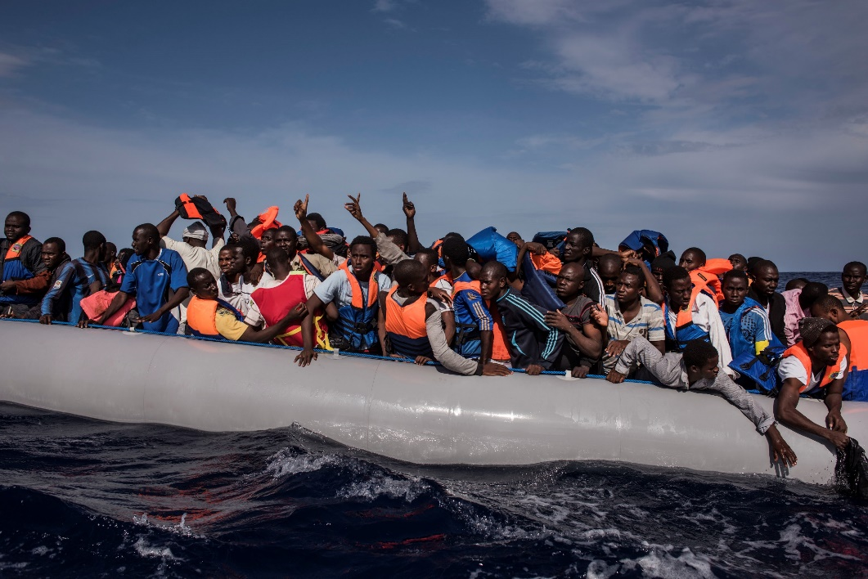
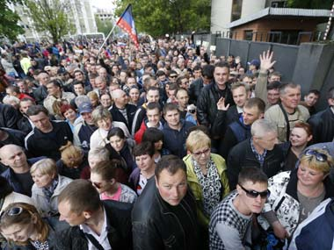
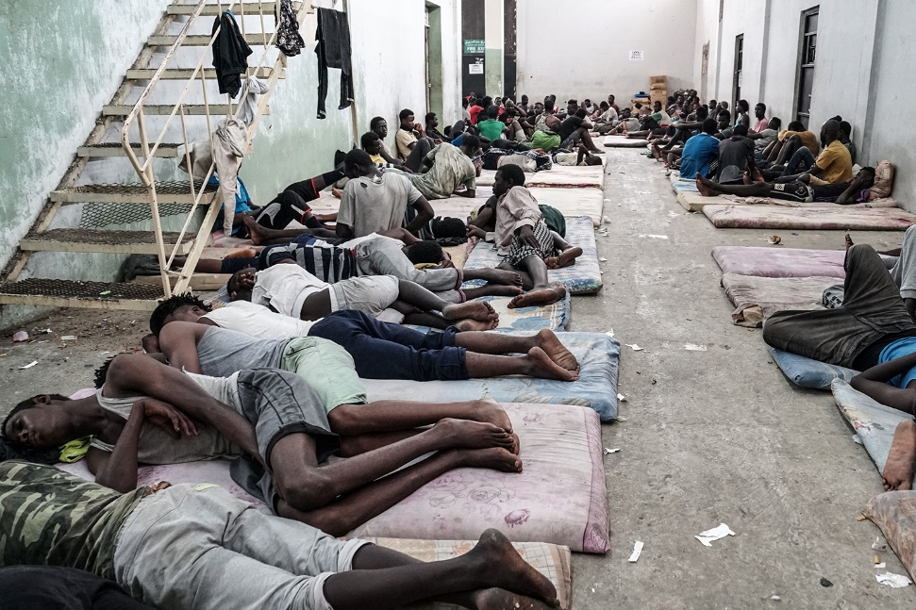
Notes:
Starter activity:
Who are these people? What are the things that bind them together (the things they have in common)? How might be they different from one another? Is it always right to think of a group of people as the same?
(40) Old City, New Voices: Bristol Welcomes Little Amal – YouTube – Discuss one puppet representing 32million displaced children,

Slide 18
Group work task:
Draw a large circle in the middle of your group’s sheet of sugar paper
Now find out one unique fact about each other (write this outside the circle)
Now find four things
you all have in common
and write these inside the
circle
Tom can speak
Portuguese
Live in Gloucestershire
Notes:
Split class into smaller groups for this activity. Discuss the results. Which are more important, the things that hold them together or the things that make them individual?

Slide 19
Does religion identify who you are?
(2) Religion, faith and the role they play today | The Economist - YouTube
Notes:
Religion and faith are an integral part of people’s lives worldwide. But in many countries the number of people who believe in God is in decline.
Does religion identify who you are?

Slide 20
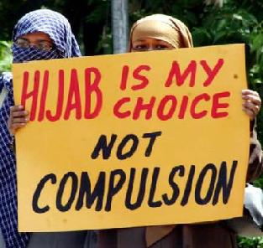
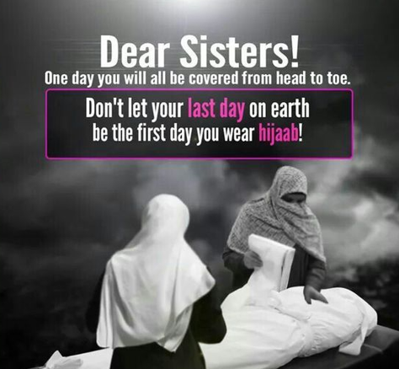
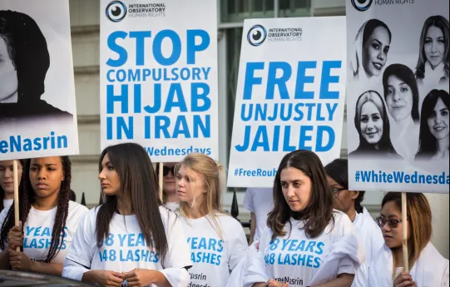
Notes:
Does religion identify who you are and what you believe?

Slide 21
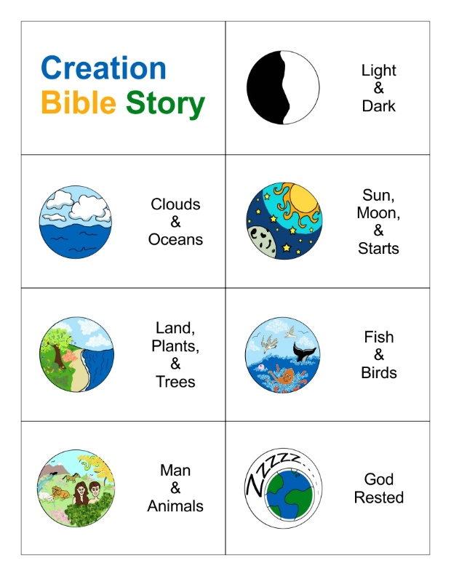
Notes:
Does religion identify who you are and what you believe?

Slide 22
Lesson 2: Identity!
In this lesson we are going to:
Evaluate what is more important personal identity or group identity?
Notes:
Exit Poll – Give the students a post it note, they need to write on it the reason for their view. Have two walls one for personal identity one for group identity ask them to vote by placing the sticky note with their justification on it. See if this has changed from starter.

Slide 23
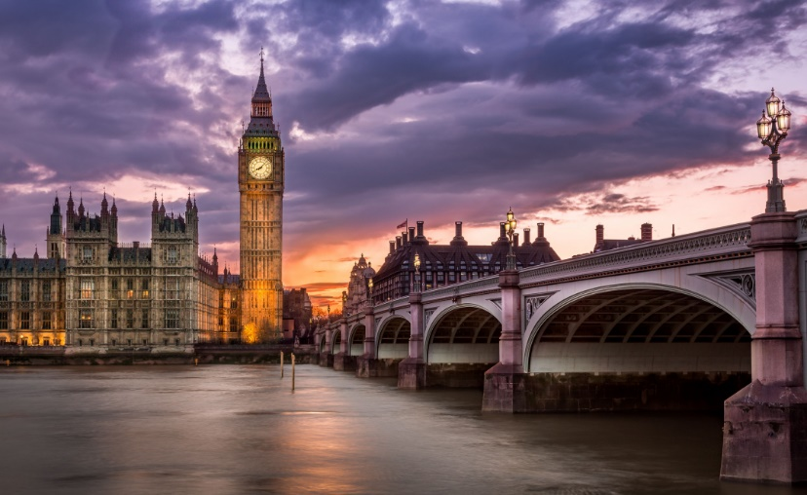
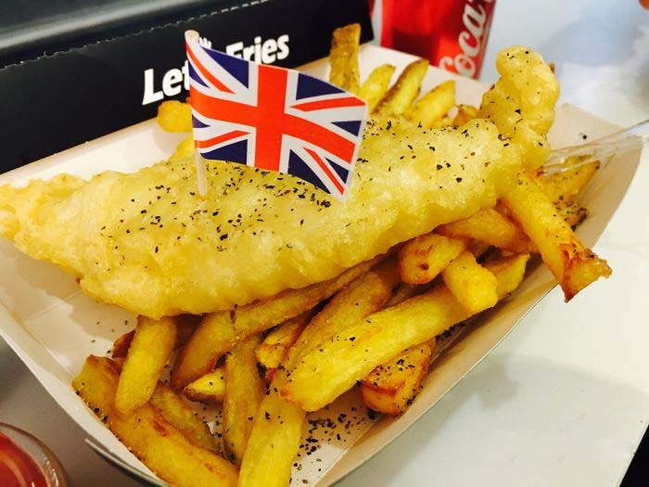
Lesson 3: What is Britishness?
In this lesson we are going to:
Evaluate what is “Britishness”?

Slide 24
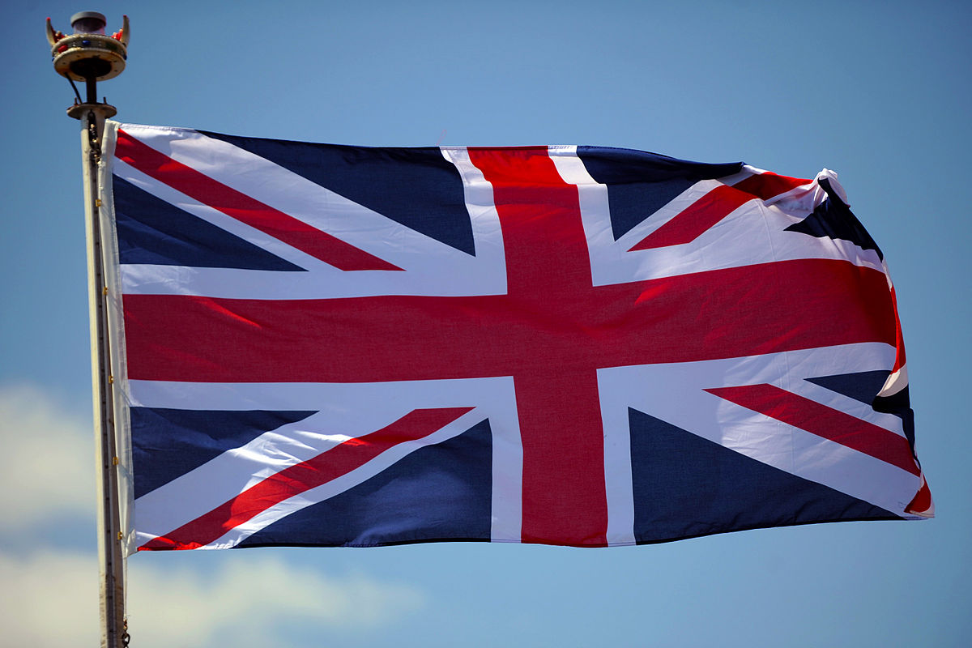
Brit·ish·ness
[ˈbrɪtɪʃnəs]
NOUN
the quality of being British or of having characteristics regarded as typically British:
Notes:
On a scale of one to ten, how British do people feel?

Slide 25
(100) History of the Union Jack – YouTube
Task 1: What does this flag represent? Explain the different parts of the flag.

Slide 26
Task 2: Create a list what it actually means to be British?
How many of these did you get?

Slide 27
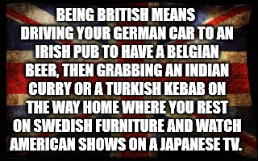

Slide 28
Task 3: Answer in your book;
Is it true, do we do those things?
What do you think other countries think about the British? Give an example.
What do you think it means to be British?

Slide 29
How to become British!
Challenge 3 : In your booklet have a go!!!

Slide 30
Answers

Slide 31
The Four Key British Values
Tolerance and respect for diversity
1. Personal freedom
Equality of opportunity
Representative democracy and the rule of law

Slide 32
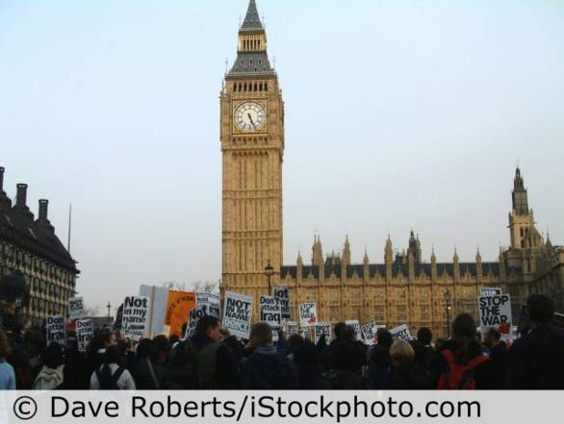
1. Personal freedom
We have the right to protest about things we don’t agree with.
What other personal freedoms do we have?
Notes:
(16) The Harm Principle: How to live your life the way you want to – YouTube
liberty, privacy, freedom of conscience and expression, and to freedom of association and assembly

Slide 33
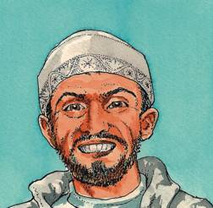
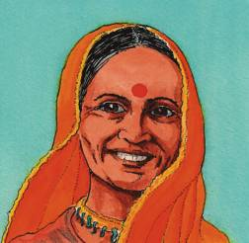
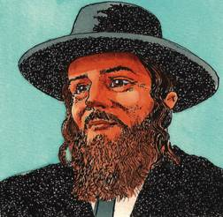
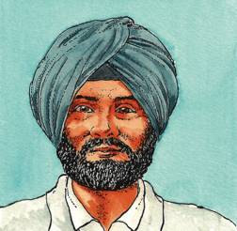
Tolerance and respect for diversity
NOUN
the ability or willingness to tolerate the existence of opinions or behavior that one dislikes or disagrees with:
"the tolerance of corruption" ·

Slide 34
Refugees
Sexuality
Ethnicity
Migration
Wealth
Language
Nationality
Faith
Genders
Class
Notes:
What effect do this different aspects of diversity have upon our lives? Discuss

Slide 35
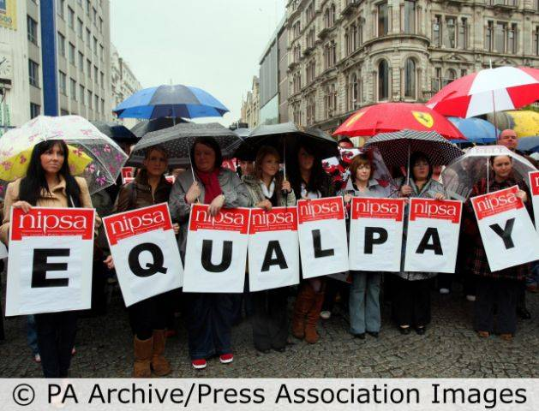
Equality of opportunity
Women’s equality at work is protected by law.
Does this mean women and men are treated equally?
Notes:
Unfortunately, we're still a long way off achieving true equality in the workplace. 20th November 2020 marked Equal Pay Day; the day women effectively start working for free relative to men because of the gender pay gap. That's a whole 42 days of unpaid work.

Slide 36
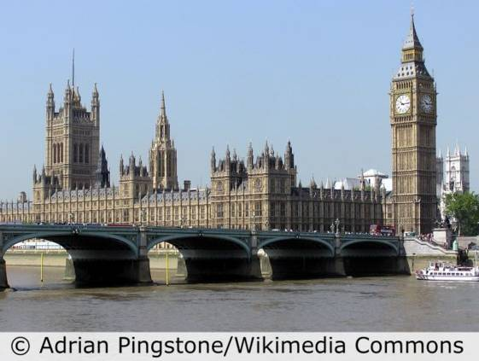
Representative democracy and the rule of law
We vote for our leaders and obey the law.
What connects these two ideas?

Slide 37
Town Hall Debate
Tolerance and respect for diversity
1. Personal freedom
2. Equality of opportunity
Representative democracy and the rule of law
Notes:
Split the class into four groups. Each group represents one of the four key features of Britishness. The group should discuss and come up with ideas as to why their feature is very important (not necessarily the most important, but why it is important in itself). They should then appoint a spokesperson to feedback to the rest of the class.

Slide 38
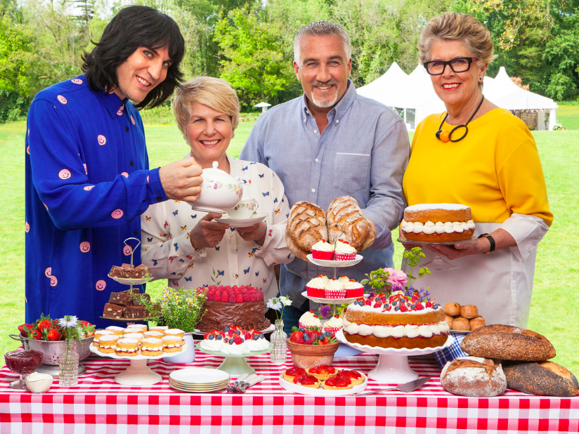
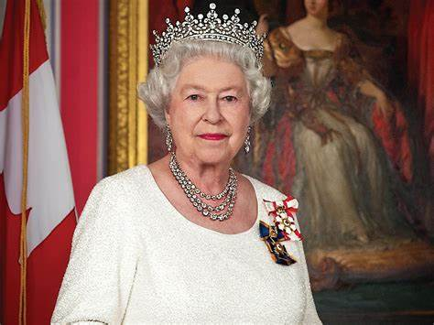
Lesson 4: How British are you?
In this lesson we are going to:
Analyse what makes someone British?
Notes:
Out of 10 how British do the students think they are?

Slide 39
Lesson 4: How British are you?
Challenge 1: One minute to list as many ways you can judge Britishness!
Challenge 2: Three Minutes Can you write down all the words of the National Anthem.
Notes:
Set 1 minute timer
Set 3 minute timer

Slide 40
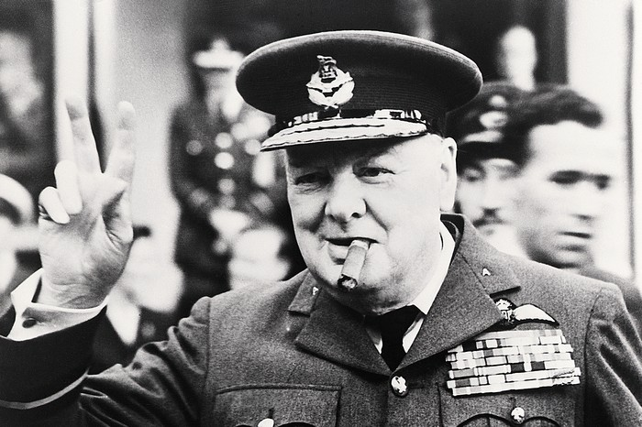
In 2002 this man was voted the greatest ever Briton.
Who is he and why was he so popular?

Slide 41
Please be upstanding for the National Anthem
https://www.youtube.com/watch?v=G9eK9fWUb3s
Did you get all the words right?
Are there any words that are controversial?
Notes:
Scatter our* enemies, And make them fall! Confound their politics, Frustrate their knavish tricks, Not in this land alone, But be God's mercies known, From shore to shore! Lord make the nations see, That men should brothers be, And form one family,
Lord grant that Marshal Wade May by thy mighty aid Victory bring. May he sedition hush, And like a torrent rush, Rebellious Scots to crush. source: https://www.lyricsondemand.com/n/nationalanthemlyrics/britiannationalanthemlyrics.html source: https://www.lyricsondemand.com/n/nationalanthemlyrics/britiannationalanthemlyrics.html

Slide 42
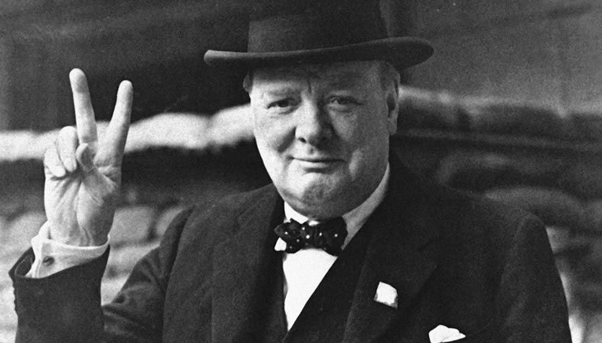
How other countries perceive the British
(40) USA - Thoughts on the British – YouTube
(40) What Do Europeans Really Think About British culture? – YouTube
(40) What the Chinese think about the UK – YouTube
(40) Churchill's legacy still painful for Indians - BBC News - YouTube
Notes:
IF short on time, watch USA and India.
India is damning of the British, sets up for thinking about legacy later.

Slide 43
Lesson 4: How British are you?
In this lesson we have:
Analyse how a person can be judged as British?
Notes:
Out of 10 how British do the students think they are?

Slide 44
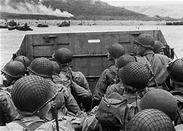
Lesson 5: What do we celebrate as British?

Slide 45
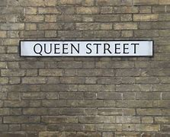
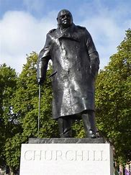
How do we commemorate

Slide 46
Lesson 5 : What do we celebrate as British?

Slide 47
Lesson 5: What do we celebrate as British?
In this lesson we are going to:
Understand who Edward Colston is.
Assess the reasons why his statue was famously thrown in the river.
Evaluate whether if the removal of the statue was against British values.

Slide 48
Who was he?
Colston was born in 1636 to a merchant family that had been living in Bristol since the 14th century. While he grew up in Bristol till the English Civil War of 1642-51, his family later moved to London, where Colston began his professional life.
Colston made his fortune through human suffering. Between 1672 and 1689, his ships are believed to have transported about 80,000 men, women and children from Africa to the Americas.
Youtube clip introducing Edward Colston
Notes:
In this section, your students will now begin to feel negative emotions towards him. - We will talk about the video clip on the next slide.

Slide 49
Divided opinions on whether the statue should have been brought down or not, what do you think?
Write down your own personal opinion on the opinion line given to you, be prepared to share with the rest of the class.
Let’s revisit what some British politicians have said about the pulling down of the statue. Summarise their opinion and write it down on the opinion line. (Does their opinion influence yours?)
Challenge: Add your personal viewpoint to their opinions, do you agree or not and why?
Notes:
Ask them to formulate their opinion first in a sentence or two.

Slide 50
Leader of the Opposition (Labour Party) – Keir Starmer
Although he is saying that it was wrong to pull down the statue in that manner, what was he suggesting?
Do you agree with his viewpoint?
Add his viewpoint to the opinion line.
Keir Starmer on the pulling down of the statue

Slide 51
Home Secretary – Priti Patel (part of the current Cabinet)
Priti Patel has made it clear that she is against protesting in the midst of a Global Pandemic.
She also speaks out against violence against the police, something we can all agree with.
She also called the pulling down of the statue as ‘disgraceful’ and ‘vandalism’.
Does this show that she possibly doesn’t understand the motives or reasons behind these actions?
Add her viewpoint to the opinion line.
Priti Patel on the violent protests and Edward Colston

Slide 52
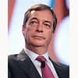
Former Leader of the UK Independence Party (UKIP) and Brexit Party from 2019 to 2021.– Nigel Farage)
Nigel Farage has made it clear that he is against ‘Cancel Culture’ the mass boycotting as a way of expressing disapproval and exerting social pressure.
Nigel Farage was a British MEP who stood as a candidate representing eurosceptic parties UK Independence Party (UKIP) and The Brexit Party since 1994. He was also a proponent of the UK leaving the European Union in the 2016 referendum, in which the electorate voted to do so by 52% to 48%.
Add his viewpoint to the opinion line.
Nigel Farage says taking down statues will not end protests - YouTube

Slide 53
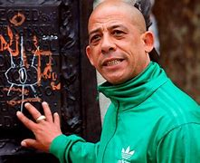
Lawrence Hoo
A Bristol poet,
Grew up in the care system
Preforms poetry about how the slave trade is viewed by his community.
Bristol needs to be 'forced to change', says poet - BBC News

Slide 54
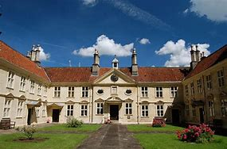
More information on Edward Colston
Colston donated considerable sums to good causes in Bristol.
He founded two alms-houses (accommodation houses for the poor) and a school and gave money to other schools, churches and hospitals. He also lent money to the Bristol corporation and was MP of the city for a short time.
Bristol's largest concert hall is called Colston Hall and a bronze statue of Colston stands in Colston Avenue, one of a number of streets in Bristol named after him.
Does this change your viewpoint on him? Why?

Slide 55
Was the removal of the statue against British values?
Personal freedom
Tolerance and respect for diversity
Equality of opportunity
Representative democracy and the rule of law

Slide 56
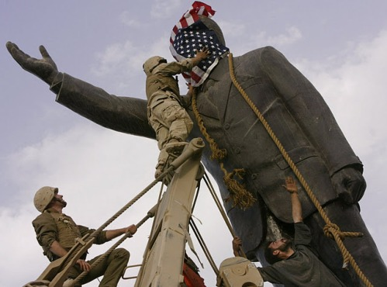
Should the statue remain intact in place?
Notes:
Exit pol – Strongly agree one side, strongly disagree, other, students can filter
(40) 'Iconic': residents react to Black Lives Matter statue replacing Edward Colston in Bristol – YouTube – It was taken down currently empty.

Slide 57
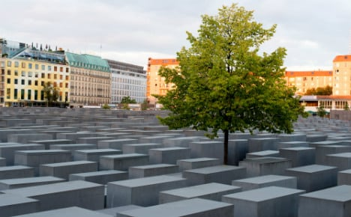
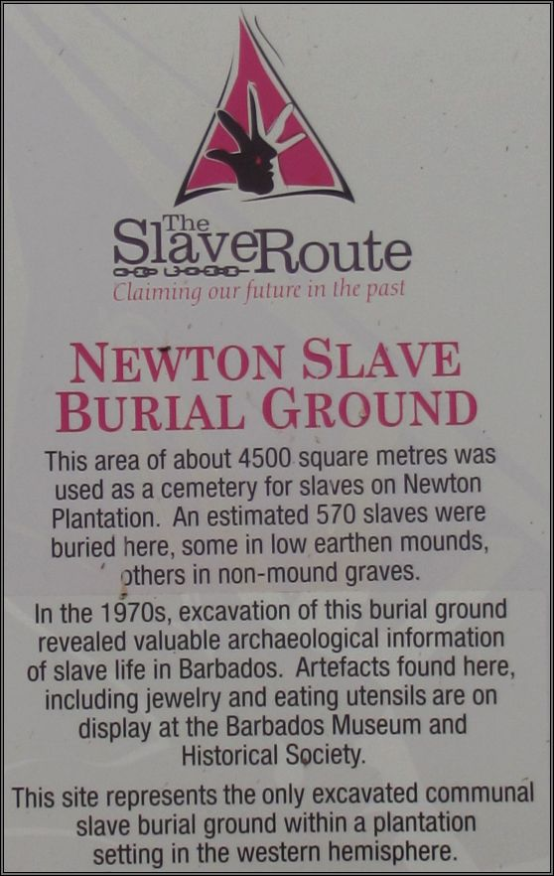
Lesson 6: How should we commemorate our past?
In this lesson we are going to:
Assess how should Bristol remember Bristol's slaving past?

Slide 58
A large space is now empty in the middle of Bristol city centre.
How do you propose the government and local council should fill this space?
Especially in light of the recent BLM protests around the world?
Notes:
(40) 'Iconic': residents react to Black Lives Matter statue replacing Edward Colston in Bristol – YouTube – It was taken down currently empty.

Slide 59
How are dark parts of History remembered?
Notes:
Holocaust Remembrance Berlin
Native American Burial Ground

Slide 60
How should we remember Bristol's slaving past?

Slide 61
How should we now fill that space?
A large space is now empty in the middle of Bristol city centre.
How do you propose the government and local council should fill this space?
Especially in light of the recent BLM protests around the world?

Slide 62
How should we remember Bristol's slaving past?
Each group is to come up with a proposal of how Bristol’s slaving past should be remember.
You need a poster explaining your ideas
Be ready to feedback

Slide 63
Lesson 7: What is the most important British Value?
In this lesson we are going to:
Debate which of the four British Values are most important.

Slide 64
Balloon Debate
Tolerance and respect for diversity
1. Personal freedom
2. Equality of opportunity
Representative democracy and the rule of law
Notes:
Split the class into four groups. Each group represents one of the four key features of Britishness.
Signpost to booklet that has ideas for each group. And links to clips that they may find useful.
Choose a spokesperson
Thumbs up heads down to vote off the Balloons.

