Slide 1
PSHEE TERM ONE – PERSONAL IDENTITY
INDENTITY AND EMPLOYABILITY
I will remember the rules for PSHEE.
I will think about how other people see me.
I will consider some of the issues surrounding online social networking.

Slide 2
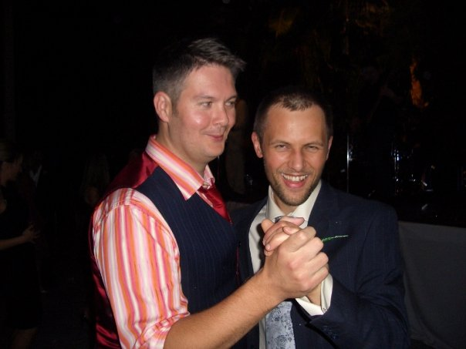

MYFACE PROFILE: MR MACAULAY
NAME: Mr Macaulay
BIRTHDAY: 20th March 1972
Hometown: Wigan
RELATIONSHIP STATUS: Married
INTERESTED IN: Philosophical Discussion
ABOUT ME:
I am a teacher at a school. I do teaching. My favourite colour is grey. I like collecting and painting stones. I paint them grey. I also like counting livestock in fields.
EMPLOYMENT HISTORY:
I am a teacher and I teach some kids who are taught by me and I teach them. I teach some of them on Monday, some of them on a Tuesday, some of them on a Wednesday, some of them on a Thursday and some of them on a Friday. I do the same again next week.
FAVOURITE SAYINGS:
“I would hand in my two week notice, but I’m too weak”. LOL!
Mr Macaulay is currently…
About to eat my dinner. OMG I had dinner last night too! I’m so random. OMG. LOL. ROFL!
YOU HAVE 0 FRIENDS

Slide 3
Guess who
• I WILL RECALL SOME OF THE SUCCESSES I HAVE HAD AT SCHOOL.
• I WILL THINK ABOUT HOW THESE ACHIEVEMENTS HELPED ME.
• I WILL THINK ABOUT HOW TO SELL MYSELF.

Slide 4
task
WRITE FIVE THINGS ABOUT YOURSELF THAT MOST PEOPLE IN THE GROUP WOULD NOT KNOW.

Slide 5
Create your timeline – include all major events
Start of primary school
End of year 9

Slide 6
TAKE THE PERSONALITY TEST!

Slide 7
Now find somebody who knows you
very well – a friend/parent/relative etc.
Ask them to write a list of five POSITIVE
things about you as a person.

Slide 8
Write a list of ten things that you have
achieved that you are REALLY
proud of.

Slide 9
TEENAGERS!

Slide 10
HEALTH WARNING!
Teenagers have the following properties.
They argue ALL the time. They are aggressive. They are only interested in themselves. They are lazy. They are smelly. They don’t think before they act. They are tribal. They steal stuff. They are bullies. They give up easily….
THEY COME IN THESE BASIC MODELS…

Slide 11
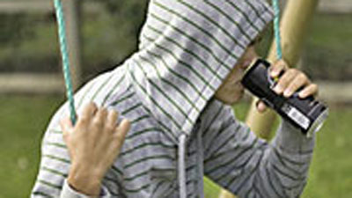
1. The Chav

Slide 12
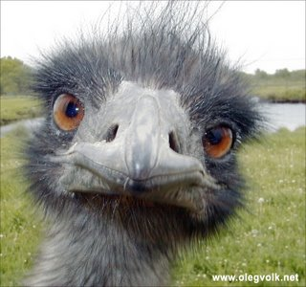
2. The emo

Slide 13
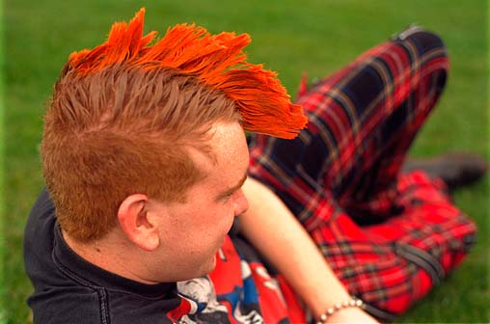
3) The punk

Slide 14

4) The Skater

Slide 15
But the truth is that in reality they are all EXACTLY the same!

Slide 16
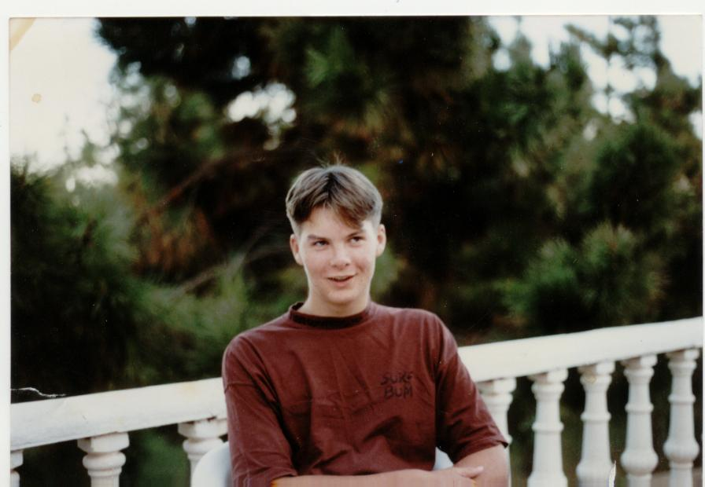
And I know this because I was one.

Slide 17



Lesson 3… Suitability…
Objective...
To understand how to assess your own Personal Skills and understand the Personal Skills requirements of specific Industry Sectors...

Slide 18


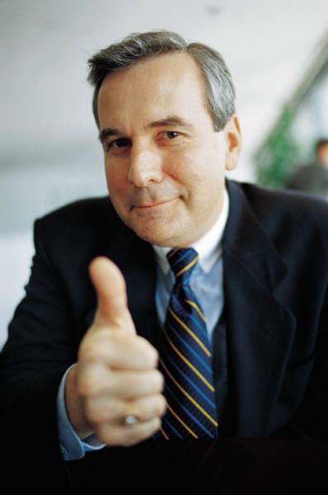
What are Personal Skills…?
Lesson 3… Suitability…
Star Qualities…
Are you RESOURCEFUL?
Do you have good INTERPERSONAL skills?
All jobs require different types of skills…
When jobs are advertising what skills they require they sometimes use confusing terminology…
When you research jobs it is important to understand this terminology…

Slide 19

Task One…
Lesson 3… Suitability…
Use your ‘u-xplore-U: Star Qualities’ handout.
See if you can match up the Personal Skills terminology with the correct definitions …
U-xamine-U!... Star Qualities…
YEAR 10 CAREERS… Lesson 3… Resource 2…
2. Artistic
You are skilled when sharing information and ideas with other people
1. Good Communicator
3. Creative
6. Natural Leader
You are able to work alone with ease.
You are able to work with other people with ease.
4.Team Player
5. Problem
solving
7.
Interpersonal
Skills
You are skilled at using or designing visual products.
Task Two…
You are full of energy and new ideas.
8. Dynamic
Now choose carefully and write THREE Star Qualities that you think best apply to you…
Write them in the stars provided by Task 2…
9.
Independent
You are sure of yourself and have a positive attitude to new experiences.
10. Organised
11. Motivated
You are skilled at creating systems and preparing yourself.
12. Confident
You enjoy and are skilled at meeting and getting on with other people.
14. Resourceful
13. Numeracy Skills
15.
Excellent Time Management
You are always keen to get on and do things well.
You find it easy to juggle many tasks within a short amount of time.
You find it easy to take charge and take on responsibilities.
You are able to quickly find ways of overcoming difficulties.
Task Three…
You can easily think of ways of overcoming barriers or difficulties.
You are excellent at calculations and solving mathematical issues.
Excellent at sharing information or ideas with other people
Good at using your imagination to come up with original ideas.
Now swap your sheet with a classmate and write three more that you think applies to them…
Task 2…
Now write three star qualities you have here…

Slide 20

Task Four…
Lesson 3… Suitability…
To understand whether a job is suitable for your personal skills, you must also be able to understand your own:
Strengths
Weaknesses
Skills
Likes and dislikes
u-xplore-u… Self Analysis…
YEAR 10 CAREERS… Lesson 3… RESOURCE 1…
Name…
Subjects Studying…
Age…
School…
1a) Subjects… Likes…
(b) What do you like doing in this subject?
(c) Personal Skills Used…
1.
2.
3.
Fill in the u-xplore-u self analysis sheet…
Fill in the personal details section…
Now fill in:
Part 1a) & (b): Subject likes
Part 2a) & (b): Subject dislikes
2a) Subjects… Dislikes
(b) What do you not doing in this subject?
© Personal Skills not favoured?
1.
2
3a) Indoor Hobbies….
(b)What do you actually do?
© Personal Skills Used…
1.
2.
3.
4a) Outdoor hobbies…
(b) What do you actually do?
© Personal Skills Used…
1.
2.
3.

Slide 21


Your hobbies can also show off your personal skills…
Task Five…
Lesson 3… Suitability…
What personal skills does this hobby and this type of job have in common?
Pick some ‘Star Qualities’ that you think can be applied to both…
4.Team Player
11. Motivated
12. Confident
7.
Interpersonal
Skills
6. Natural Leader
1. Good Communicator

Slide 22

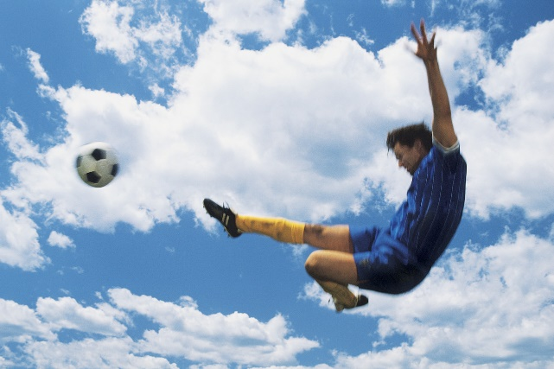
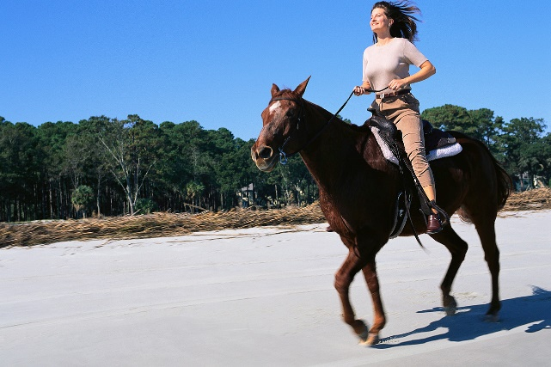
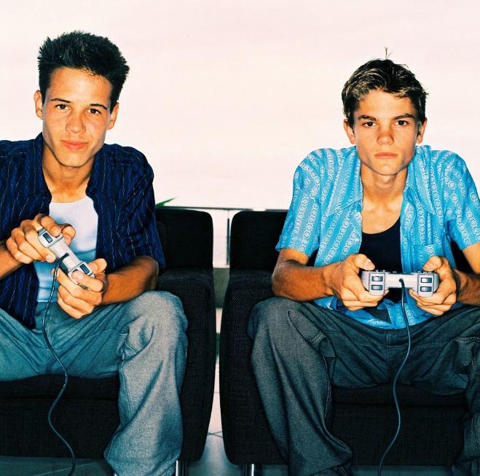
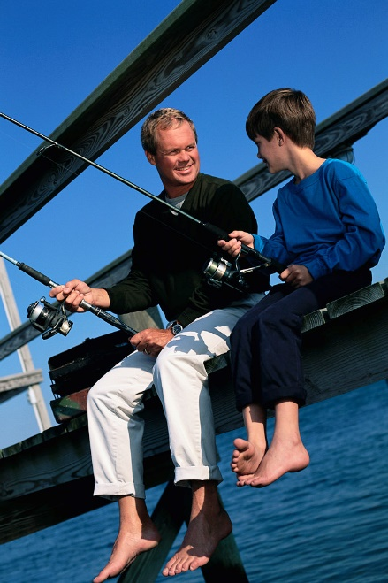
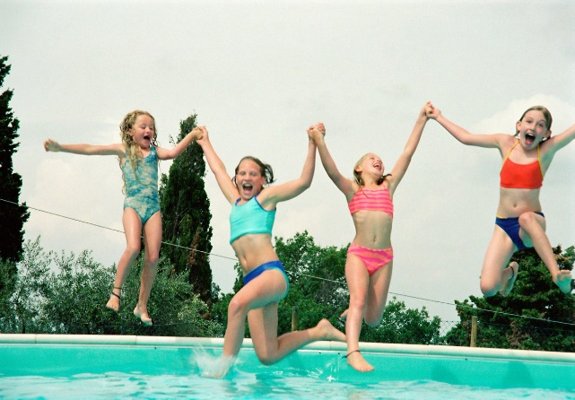
Task Six…
Lesson 3… Suitability…
Now write down as many of your own hobbies as you can in sections 3a and 3b on your u-xplore-u’ sheet…

Slide 23





Task Seven…
Lesson 3… Suitability…
Now look closely at what you like doing in your subjects and your hobbies…
Does what you do in your subject and hobbies also highlight any personal skills?
Write them in parts 1c, 2c, 3c and 4c…
Here are the personal skills to help you…but you can use your own ideas too…
2. Creative
1. Good Communicator
3. Literacy Skills
6. Natural Leader
u-xplore-u… Self Analysis…
4.Team Player
YEAR 10 CAREERS… Lesson 3… RESOURCE 1…
5. Problem
solving
Name…
Subjects Studying…
7.
Interpersonal
Skills
Age…
School…
8. Dynamic
1a) Subjects… Likes…
9.
Independent
(b) What do you like doing in this subject?
(c) Personal Skills Used…
1.
10. Organised
11. Motivated
2.
3.
12. Confident
13. Numeracy Skills
2a) Subjects… Dislikes
(b) What do you not doing in this subject?
© Personal Skills not favoured?
1.
14. Positive attitude
15.
Excellent Time Management
2
3a) Indoor Hobbies….
(b)What do you actually do?
© Personal Skills Used…
1.
2.
3.
4a) Outdoor hobbies…
(b) What do you actually do?
© Personal Skills Used…
1.
2.
3.

Slide 24
See!
You are a
multi-skilled
person!
Lesson 3… Suitability…
u-xplore-U…
Strengths Survey…
YEAR 10 CAREERS… Lesson 3… RESOURCE 4…
Name…
Star Qualities…
Excellent…
Good…
Average…
Poor…
1. Good Communicator
Task Eight…
2. Artistic
3. Creative
Now rate your own personal skills on your ‘u-xplore-u: Strength Survey…’
Tick the box you feel describes how good you are at each personal skill…
4. Team Player
5. Problem Solving
6. Natural Leader
7. Interpersonal Skills
8. Dynamic
9. Independent
10. Organised
11. Motivated
12. Confident
13. Numeracy Skills
14. Resourceful
15. Excellent Time Management

Slide 25
CREATING A CV

Slide 26
There are no strict rules about what should be covered but, as a general guide,
your CV needs to include:
 |  | Your name (in full).
 |  | Your address including postcode.
 |  | Your telephone number (including area code) and/or your mobile number.
 |  | Your date of birth (optional - for a CV example see Helen Hibson CV).
 |  | A personal profile: describing yourself in a way that helps the employer to form a clearer picture of you and your skills and strengths. This may well separate you from others with similar qualiofiactions
 |  | Education: list schools and colleges attended. List the most recent first.
 |  | Examinations: list all the exams you have taken and all the grades you have achieved or expect to achieve, with dates.
 |  | Work experience: include any weekend, evening or holiday jobs, including helping out in a business owned by family or friends. Add work experience undertaken at school - whatever it was - as it demonstrates you are familiar with the work environment, instructions and behaving responsibly. Any voluntary work should also be listed.
 |  | Personal details: these can include your interests and hobbies which you may be asked to discuss at interview (but don’t feel tempted to exaggerate your skills and glamorise your hobbies!).
 |  | References: include an academic reference from school or college and one character reference. You should not ask a member of your family to write you a reference. Ask those concerned first before you include their names.

Slide 27
TIPS
 |  | Have your CV typed or word-processed if possible
 |  | Use good quality plain A4 paper
 |  | Keep your CV up-to-date
 |  | Always keep a copy of your CV for your own reference

