Slide 1
https://www.youtube.com/watch?v=_pyJlERCrJE
Social Media & Reputation.
Notes:
Hands up if you use twitter or facebook!
What is reputation?
our online reputation is now probably more important than your traditional offline reputation, especially for companies that have any kind of online presence, but certainly just about anybody. I mean, we don’t go the local Starbucks and meet up with a couple of friends anymore and complain and gripe about a company that was rude to us or their product sucked. We go online. We reach, even if it’s just a few hundred people on Twitter, that’s far more people than we can speak to at a coffee shop or around a water cooler or something like. So it just makes it easier for us. I think that consumers and individuals and companies are realizing as well that they’ve got a voice there. They know that they can get some attention. If that customer service email goes unanswered for 10, 20, 30 minutes, then they head online and start asking there. Or it takes them 20 minutes to write a blog post that ends up ranking in the top five of Google. So it really is important to understand your reputation online. What is it currently? What are the potential damaging situations that could happen? What’s your Achilles’ heel? Then listen to those conversations, get feedback and improve. Be better than your competition. So it’s absolutely vital.

Slide 2
Learning Objectives
All: Will understand the importance of an individuals ‘online profile’
Most: Will be able to explain and give examples of good or bad practice.
Some: Will be able to analysis statistics and link how they relates to today’s society.

Slide 3
Post – it Note Race
Using the post it notes on your table, name as many social media platforms as you can think of and put them in the middle of your table.
Table with the most win extra sweets!
Notes:
What are the pros and cons of social media?

Slide 4
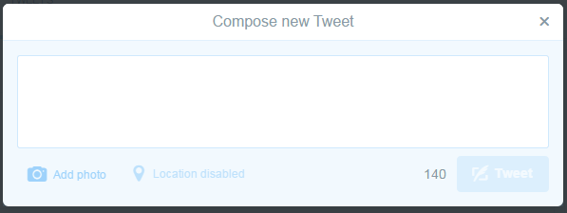
On your tables there are several different tweets – as a group you have to come up with a response, but remember you only have 140 characters.

Slide 5
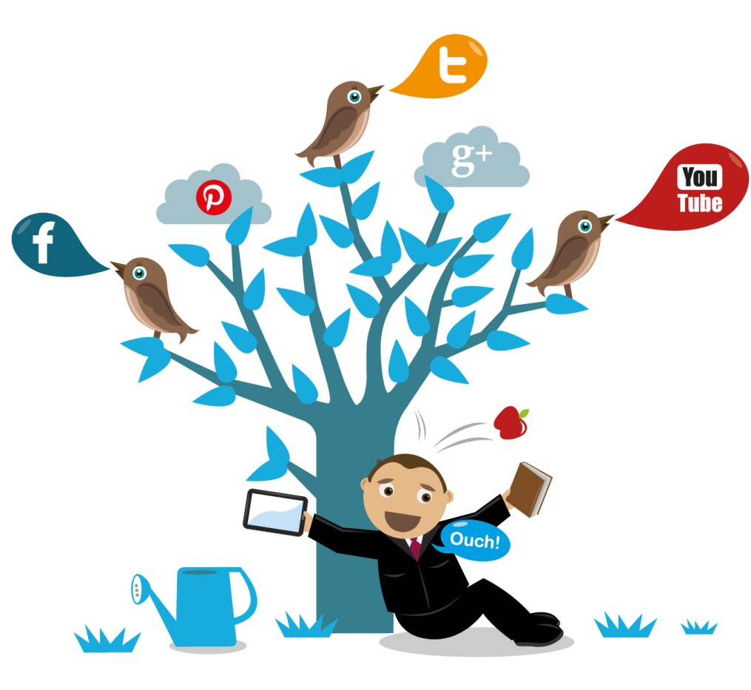
Using the same tweet you must respond as one the different people in society . you could be one of the following;
Each group have to consider how would you be viewed from the following perspective:
If they already knew you
how they would see you now
how would they judge you
how would this situation alter their perspective
how would they consequently treat you???
Parent
MP
Police
Teacher
Employer
Stranger

Slide 6
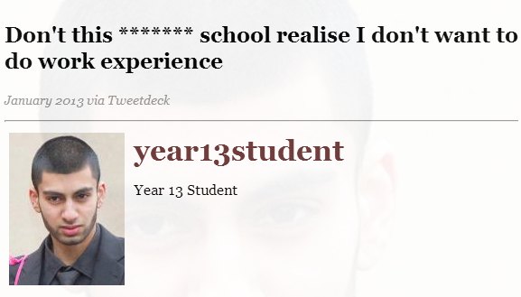
A Gloucester A Level student wrote to his MP asking for work experience…

Slide 7
The response….
What percentage of employers use social media to screen employees?
January 25th
I'm sorry but I am turning down your request because although your letter and CV were acceptable, your attitude to your school and life in general on Twitter is inappropriate.
Please be aware that your entries on social media reflect on you, and that potential employers do take them into account when considering your interest. Responsibility does matter.
Richard Graham MP
Notes:
At the end of this slide, ask what percentage of employers use social media to screen employers.

Slide 8
What percentage of employers have said no to a candidate based on what they have found?
What percentage of employers use social media to screen employees?
38%
69%

Slide 9
Why were those candidates rejected?

Slide 10
It’s not just your job that your online reputation can damage….

Slide 11
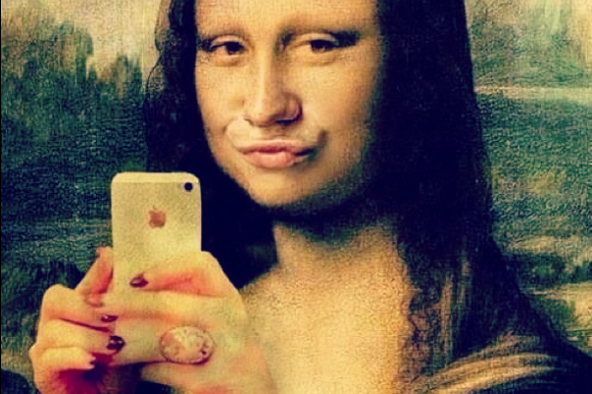
How do you think you present yourself online…..
Notes:
150 is the max amount of friends our brain can maintain… how many friends do you have on facebook or twitter… would you say you know them all.
What sort of things would you tell people on twitter or facebook… what do you keep from fb or twitter..

Slide 12
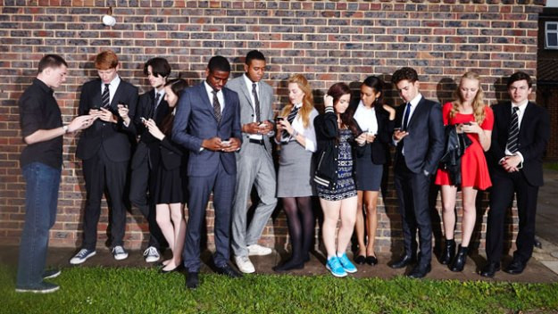
Channel 4’s ‘Teens’
https://www.youtube.com/watch?v=3kY5IMJscMk

Slide 13
‘sexting images’
It is illegal to take, possess or share 'indecent images’ of anyone under 18 even if you're the person in the picture.
Today Programme USA
Notes:
Even Snapchat thinks people should be careful what they post. Images video do not necessairly dissapear forever, some software means people are able to still access pictures even when they have timed out etc

Slide 14
POP QUIZ
Give yourself a team name!

Slide 15
Do you know the numbers? 10 seconds to discuss the answer as a team, then write the answer on the whiteboard
1.How many snapchats do you think are sent per day ?
a) 30 million b) 10 million c) 25 million
2.What percentage of teenagers have sent nude or semi-nude images online?
a) 25% b) 39% c) 7%
3. How many teens have received nude or semi-nude photos via text?
1 in 20 b) 1 in 10 c) 1 in 6
4.What percentage of teens have forwarded on a sexting image they have received?
a) 20% b) 17% c) 45%
5.What percentage of those who were forwarded the photo, passed it on?
a) 55% b) 10% c) 36%

Slide 16
Plenary
One thing you’ve liked or learnt this lesson.
One thing that shocked or surprised you.

Slide 17
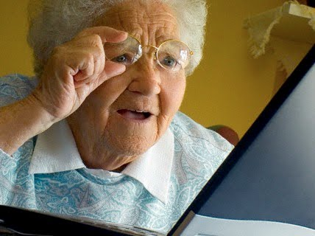
If you wouldn’t show it or say it to your granny…..
Don’t send it!

