Slide 1
LESSON ONE
GOOD
&
EVIL
https://online.clickview.co.uk/exchange/videos/10752578/are-you-good-or-evil-
Notes:
Lesson one: start by asking the group who considers themselves to be a good person and who considers themselves to be a bad person? Why? What reasoning do they apply to their decision? Would anybody go as far as to say that they are evil? Why/why not? Watch the video “Are You Good Or Evil?” It is worth stopping the video at key points to discuss the suggestions and ideas further. Suggestion to discuss:
Can babies know right from wrong?
Can murder ever be considered a good action?
If you are a soldier does it matter which country/cause you fight for?
Does morality simply come down to a matter of chemicals in the brain/evolutionary responses to situations?

Slide 2
Discuss then note down your responses to the following questions
Can babies know right from wrong?
2. Can murder ever be considered a good action?
3. If you are a soldier does it matter which country/cause you fight for?
4. Does morality simply come down to a matter of chemicals in the brain/evolutionary responses to situations?

Slide 3
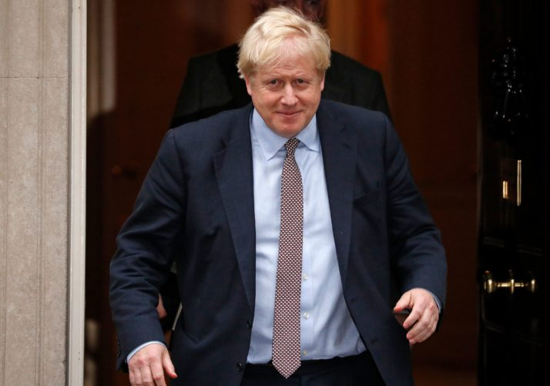
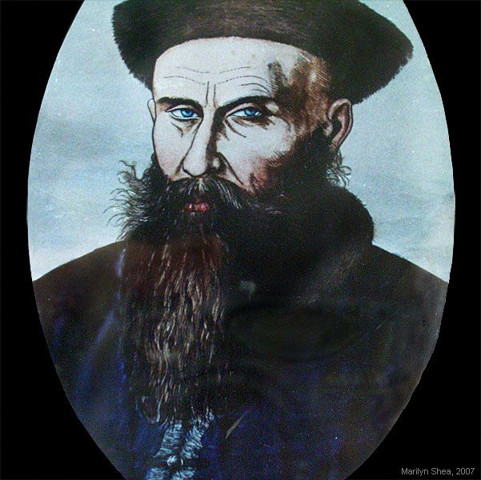
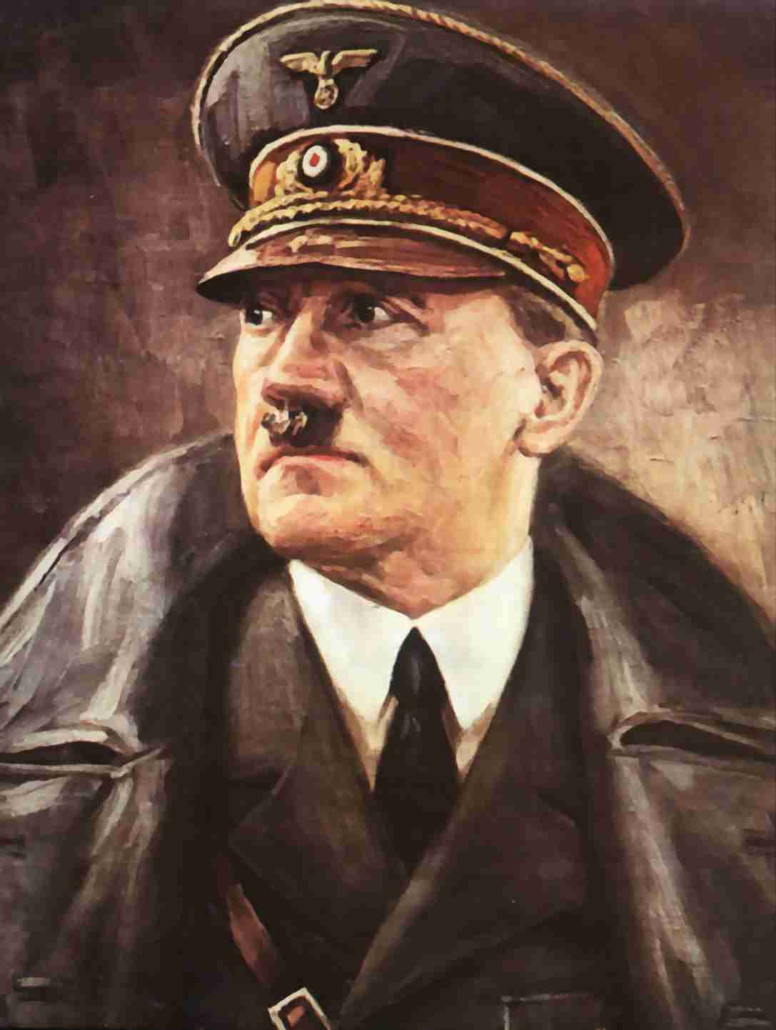
LESSON TWO
Notes:
How good or bad are the people on these three pictures? The first is our current prime minister, the second is Adolf Hitler, the third is the man who invented and built the first motor car. Does the fact that cars are responsible for so many deaths/so much pollution make him a bad person?

Slide 4
GOOD OR EVIL?
I will know what we mean when we say words like “good” and “evil”.
I will think of ways that some things can be seen as being both good and evil.
I will understand why it is sometimes difficult to know what is good and what is bad.
Have you ever done something that you thought was good, but that somebody else thought was bad?
SKILLS
Critical thinking
Evaluation
Debate and argument forming.

Slide 5
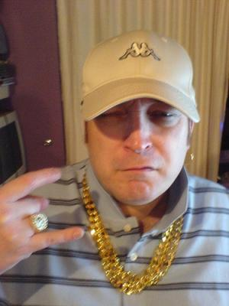
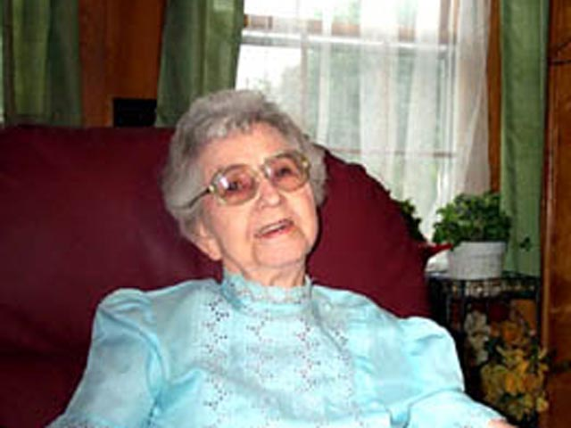
CASE STUDY
What is right?
You see this man – Big Bad Barry Beasley (a known criminal) – approach little old Granny Smith at the cash point as she withdraws fifty pounds,
He pushes her to one side and takes the money before running off.
What should you do?
Barry is a petty thief. His wife left him to bring up their twelve children on his own. He tries his best, but finds it difficult to cope. He is not good with money and the littlest Beasleys are in danger of starving.
Granny Smith is the ring leader of a criminal gang. She imports large quantities of heroin and has made a fortune out of other people’s misery.
Notes:
Discussion – at each stage discuss with the class what the correct response should be.

Slide 6
Good |  | Evil
 | Giving away money Experimenting on live animals. Theft Killing people Corporal punishment Being honest.
Use the examples to describe what the words “good” and “evil” mean.
Notes:
Pupils should work in pairs to write the different points into the column (Good or Evil) that they think each one should go in. Then they should work individually to try to write paragraphs showing awareness that sometimes things that seem good can be bad, or things that are unacceptable in certain situations can be seen as acceptable in others

Slide 7
The Right Thing To Do?
I will consider the arguments for and against different actions.
I will be able to justify my own arguments.
I will know the difference between good and bad.

Slide 8
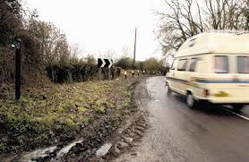
1. The Car Phone Lady
Action: I took some photos and called the local police to inform them of the woman’s behaviour.

Slide 9
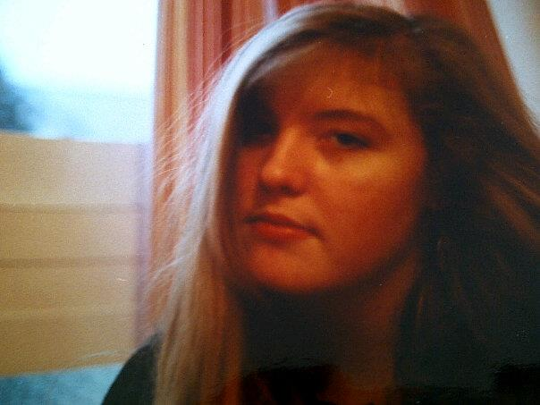
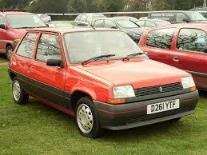
2. Alison Lewis
Action: I put the note on her windscreen and watched from a safe distance to make sure she definitely got it.

Slide 10
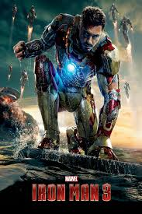
3. Iron Man 3
Action: I called the local police. After a brief search of the premises she was awarded a fine of around £300 and now has a criminal record.

Slide 11
4. Telling lies to
Y11 students
?

Slide 12
http://news.bbc.co.uk/1/hi/england/staffordshire/8286715.stm

Slide 13
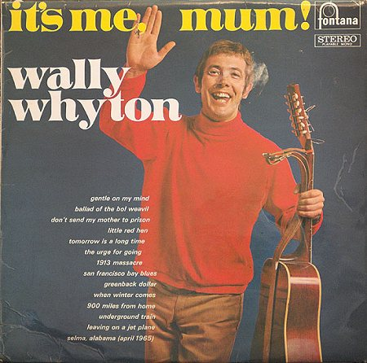

Slide 14
Featuring Meatloaf!

Slide 15
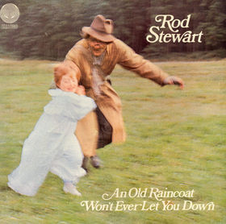
If you, or any member of your family is affected by issues depicted on this album cover, please call CHILDLINE….

Slide 16
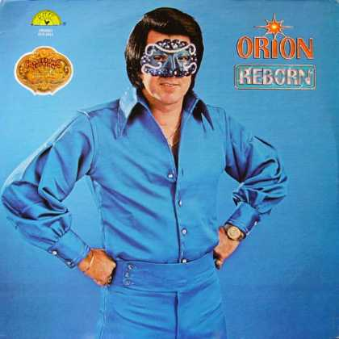

Slide 17
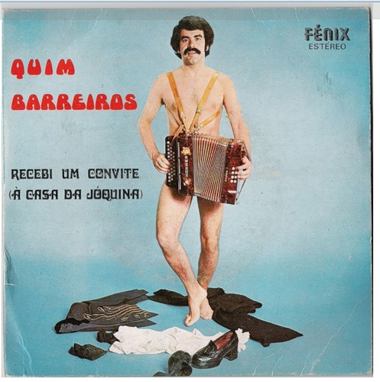
Careful with that
Accordion!

Slide 18
POSSIBLY THE
SCARIEST
DOUBLE-ACT EVER

Slide 19
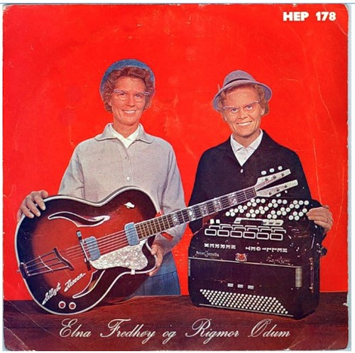
Apart from this one.
Whose hand?

Slide 20
I’ll give it a miss, thanks.

Slide 22
The Law
I will understand why we have laws.
I will know the difference between criminal and civil law.

Slide 23
A
Are the laws about minimum age good or bad? Why?
B
Are the laws about speed restrictions good or bad? Why?
C
What should the correct punishment for theft be? Give reasons.
D
Should the courts be allowed to interfere with family life? Give reasons.
E
What is the best way of solving disputes between neighbours?

Slide 24
Criminal Law
This covers actions that are regarded as crimes against ___________ as a whole. These include _________, murder, speeding and criminal ____________.
If someone is accused of committing a crime, the police will arrest them, charge them and they will be put on trial in a criminal __________. The ____________ is carried out in England and Wales by the Crown Prosecution Service on behalf of the State.
Civil Law
This covers __________ between people. It is usually about rights. Usually civil cases involve situations where someone feels that __________ has been done to them. This person, called the _____________, brings a case against the other person, called the ______________. The case is heard in a Civil Court.

Slide 25
http://www.channel5.com/shows/the-nightmare-neighbour-next-door/episodes/episode-1-662
http://www.youtube.com/watch?v=tmmkSN-MEDc

Slide 26
Small Claim | Claims of under £10000
Defendant | The person accused of an offence
Prosecution | Prosecution lawyers work on behalf of the Crown and in cooperation with the police to prove that the defendant is guilty.
Jury | A group of ordinary people aged eighteen and over. They decide whether the accused person is guilty or not guilty
CPS | Crown Prosecution Service
Legal Aid | Financial assistance provided by the government

Slide 27
Key Legal Principles
The presumption of innocence.
People must be seen as innocent until proven guilty. When a defendant is brought to court charged with a criminal offence, the prosecution must prove that the defendant is guilty. It is not the responsibility of the defendant to prove his/her innocence.
A defendant does not have to:
Answer questions in a police interview
Provide a defence case statement
Give evidence at trial
Provide any explanation for any of the issues raised by the prosecution
Answer questions asked by the prosecution

Slide 28
Crime And The Police
I will know what crime is.
I will understand the role of the police.
I will understand how cases are taken to court.

Slide 29
‘An action which breaks the law and which will be punished if a conviction is gained.’
Most crimes fall into two categories:
Crimes against property – such as theft, arson or burglary
Crimes against people’s health and safety – such as assault or robbery

Slide 30
Can you think of five more crimes which would fit in each category?
Crimes against property | Crimes against people’s health and safety

Slide 31
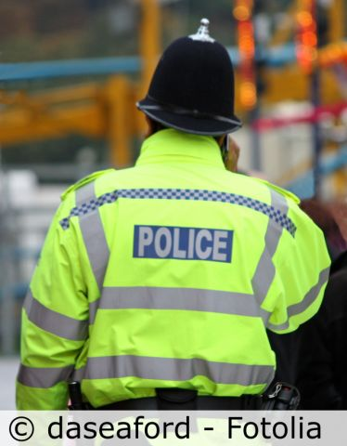
The police have the legal responsibility to uphold the law and to protect people from crime.
They record crimes that are reported to them.
They investigate most crime reports.
They have a legal right to stop, search and arrest someone in connection with a crime and to charge them with an offence. The accused person is entitled to legal help and advice.
What else do the police do?

Slide 32
Who decides to take a case to court?
The Crown Prosecution Service is responsible for prosecuting criminal cases investigated by the police in England and Wales. Their website says:
The CPS exists to ensure that wrongdoers are brought to justice, victims of crime are supported and that people feel safer in their communities.
The lawyers who work for the CPS have to decide whether the matter is serious enough to go to court and whether there is a good chance of winning the case.

Slide 33
Why don’t the police have the responsibility of deciding whether to take a case to court?
Try to think of examples when this would not be appropriate.
Notes:
33

Slide 34
ULTRACOP

Slide 35
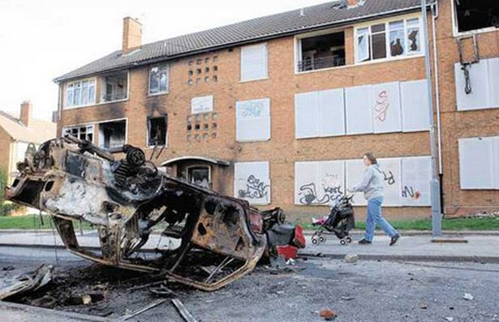
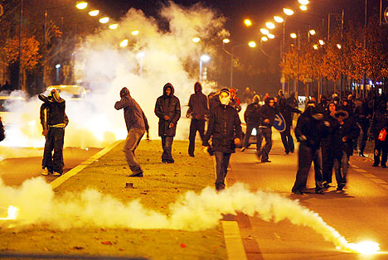
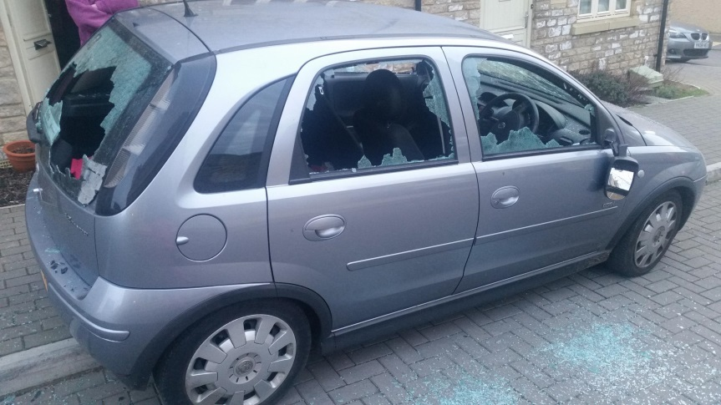
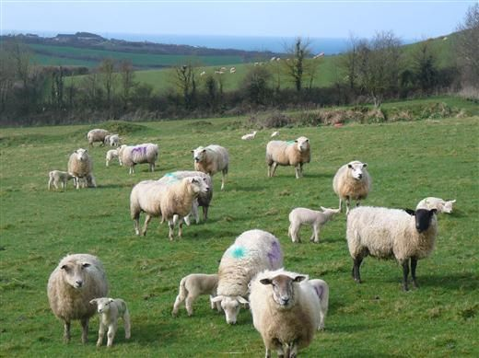
CIRENCESTER 2022
Poverty
Unrest
Vandalism
Gangs

Slide 36
Crime type | Total | Percentage
Anti-social behaviour | 697 | 37.96%
Bicycle theft | 21 | 1.14%
Burglary | 107 | 5.83%
Criminal damage and arson | 162 | 8.82%
Drugs | 50 | 2.72%
Other crime | 17 | 0.93%
Other theft | 148 | 8.06%
Possession of weapons | 7 | 0.38%
Public order | 33 | 1.80%
Robbery | 15 | 0.82%
Shoplifting | 211 | 11.49%
Theft from the person | 11 | 0.60%
Vehicle crime | 70 | 3.81%
Violence and sexual offences | 287 | 15.63%
0
100
200
300
400
500
600
Violence and sexual offences
Shoplifting
Robbery
Possession of weapons
Other theft
Drugs
arson
Burglary
Vehicle crime
Theft from the person
Public order
Other crime
Bicycle theft

Slide 37
Crime type | Total | Percentage
Anti-social behaviour | 723 | 42.76%
Bicycle theft | 6 | 0.35%
Burglary | 107 | 6.33%
Criminal damage and arson | 172 | 10.17%
Drugs | 31 | 1.83%
Other crime | 13 | 0.77%
Other theft | 171 | 10.11%
Possession of weapons | 9 | 0.53%
Public order | 22 | 1.30%
Robbery | 5 | 0.30%
Shoplifting | 122 | 7.21%
Theft from the person | 18 | 1.06%
Vehicle crime | 50 | 2.96%
Violence and sexual offences | 242 | 14.31%

Slide 38
Responsibilities
As a police officer you’ll need to:
work alongside communities, liaising with community groups and individuals;
provide a visible presence to deter crime and reassure the community;
conduct patrol duties on foot, by car and bicycle;
develop community knowledge to identify individuals and locations at risk of being involved in crime;
respond to calls and requests from the public to assist at incidents;
keep the peace at public meetings, social events, processions, trade disputes or strikes;
diffuse potentially volatile situations with due regard for the safety of all involved;
act with sensitivity when dealing with situations such as delivering news of a sudden death or when dealing with sexual crimes;
conduct initial investigations, gather evidence, take statements and comply with relevant legal requirements;
interview suspects, victims and witnesses in accordance with relevant legislation;
conduct arrests with due regard for the human rights, security and health and safety of detained individuals, members of the public, colleagues and self;
prepare crime reports and present case files to senior officers and the Crown Prosecution Service (CPS) (attend and give evidence in court and at other hearings;
investigate and take action on information received from members of the public;
gather, record and analyse intelligence to achieve community safety and crime reduction objectives and provide crime prevention advice;
attend road-related incidents including collision scenes, vehicle check points and traffic offences;
enforce road traffic legislation and issue fixed penalties for relevant offences;
deal with lost or found property.

Slide 39
SKILLS
QUALITIES
ABILITIES
QUALIFICATIONS
EQUIPMENT
PHYSICAL ATTRIBUTES

Slide 40
https://www.youtube.com/watch?v=-RUoEog2M1Q
https://www.youtube.com/watch?v=fjjiqFWlhho
https://www.youtube.com/watch?v=ls0rbrtfbKU

Slide 41
How do courts deal with criminal behaviour?
All criminal cases start in a Magistrates’ Court
More serious cases are sent to the Crown Court for trial (if the sentence or fine may need to be more than six months or £5000)
Less serious cases will be tried and sentenced here
In a Magistrates' Court, the magistrates decide if the defendant is guilty or not
In a Crown Court a jury decides whether the defendant is guilty or not guilty. The judge will decide what the sentence should be.

Slide 42
Punishment
The main reasons for inflicting punishment are:
Deterrence
Retribution
Reform
Protection
Compensation

Slide 43
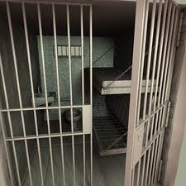
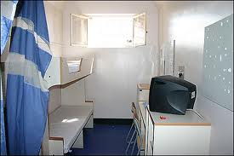
Retribution
This means that offenders deserve to be punished.
This type of punishment is a type of revenge.
‘Whatever injury he causes another person shall be done to him in return.’
Leviticus 24:19-20

Slide 44
Reform
Punishment should change the offenders ways.
If they re-offend, the punishment hasn’t worked.
This is linked to the idea of rehabilitation.

Slide 45
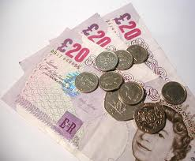
Compensation
Is when something (often money) is given in repayment.

Slide 46
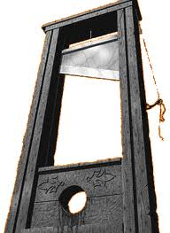
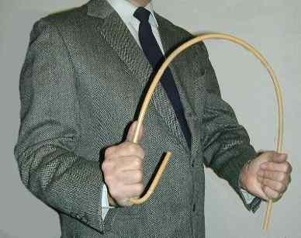
Deterrence
This means that punishment should stop people committing crimes again.

Slide 47
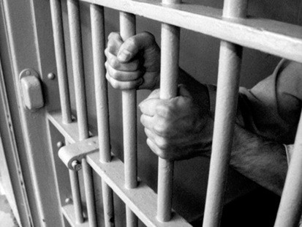
Protection
This is also known as containment.
Dangerous criminals who could well re-offend should be kept away from other people. This is safer for them and for the public.

Slide 48
In the UK, if you break the law you may be:
Taken into custody: People over 21 are sent to prison. Sometimes the sentence is suspended. This means the offender will not go to prison unless he or she offends again during a set period of time. People under 21 go to young offenders institutions.
Fined
Given a set number of hours’ community service
Conditionally discharged: the offender is made to keep a promise not to re-offend.
Ordered to go to attendance centres: Young offenders go to them for a set number of hours.
Probation orders: offenders have to see a probation officers or attend a probation centre. A probation order can be combined with a community service order.
Care: Some juvenile criminals - aged 18 & under - can be taken into care by the local authority.
Caution: Some offenders, especially juveniles, are given a formal caution by the police.

Slide 49
Crime | Punishment
A mother of two small children who was guilty of drug dealing?
Two youths who steal cars and joyride.
A serial killer who shows no remorse.
A young man who has committed credit card fraud.
A man who has sexually abused children.

Slide 50
Does Prison Work?

Slide 51
Lesson objectives
To have discussed the effectiveness of prison.
To have thought about alternative punishment.
To have discussed whether age should be reflected in the type of punishment.

Slide 52
Crime Quiz
Most people in Britain do not report crime
True
False
How many crimes were reported by police last year?
100,000
½ a million
1 million
More

Slide 53
What % of crimes reported to the police result in a conviction?
4%
10%
50%
More
Violent crime is the most common crime
True
False

Slide 54
How many males in the classroom will have a criminal record by the time they are 40?
5%
20%
More
How many people are serving life sentences in UK jails?
500
4000
10,000
100,000

Slide 55
Most people who get a life sentence spend their life in jail.
True
False
Most young offenders let out of prison do not offend again.
True
False

Slide 56
Who has the highest rate of offending?
11 – 14 year olds
15 – 17 year olds
18 – 20 year olds
21 – 24 year olds
25 – 30 year olds
Prison is cheaper than community service
True
False

Slide 57
Answers
B) False – 13.9 years
B) False – 75% do
C) 18 - 20
B) False £24,000 - £2000
A) True
D) More, 5 Million
A) 4%
B) False
C) More - 33%
B) 4000

Slide 58
Key Facts
Over 60 people committed suicide in prison in 1997.
Around 75% of young people sent down re-offend within two years of release.
Over half of convicted prisoners re-offend within two years of release.
The average life sentence served is 13.9 years.
One third of males have been convicted of a criminal offence by the time they are 40 years old.
It costs £24,000 approx per year to keep someone in prison.

Slide 59
Does prison work?
Arguments for prison | Arguments against prison

Slide 60
Does prison work for young offenders?

Slide 61
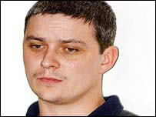
Huntley guilty of Soham murders
Huntley murdered 10-year-olds Holly Wells and Jessica Chapman.
Ian Huntley has been found guilty of the murders of Soham schoolgirls Holly Wells and Jessica Chapman and given two life sentences.
As the verdicts came in, it emerged Huntley, 29, had been accused of having sex with underage girls and of rape several times in the past.
What is your opinion? Was this the right punishment?

Slide 62
3,2,1…
3 alternative forms of punishment
2 negative aspects of prison for society
1 positive aspect of prison for society

Slide 63
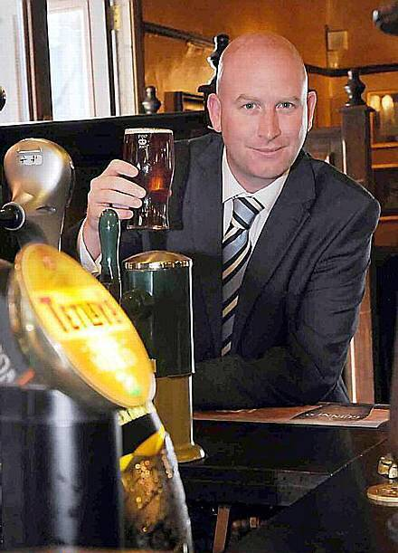
I’m in favour of restoring the _______ _________ for child and serial __________.
PAUL NUTTALL, MEP.
What IS HE ON
ABOUT?

Slide 64
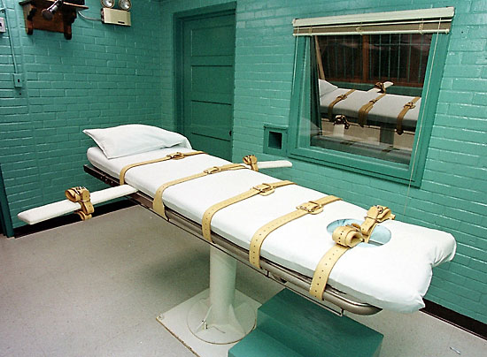
CAPITAL PUNISHMENT
What words would you associate with Capital Punishment?

Slide 65
Where do you stand?
Yes, bring back capital punishment.
No, we don’t want the death penalty.
Good arguments also need to use the correct language, they should sound intelligent and be persuasive.

Slide 66
“Too much attention is paid to the so called ‘human rights’ of offenders. What about the rights of the victims and their families?
It is time to bring back the death penalty for the good of our society”

Slide 67
Is there…
An informed personal response?
Thorough analysis and evaluation of issues?
Persuasive arguments?
Exploration of different points of view?
Examples from real life?
Discussion of human rights?
A good conclusion?

Slide 69
Where do you stand?
Yes, bring back capital punishment.
No, we don’t want the death penalty.

Slide 70
Bible Rules…
Don’t plant more than one kind of crop in a field.
Don’t let cattle graze with other kinds of cattle.
If you have a dream about another god you must die.
Don’t wear clothes made of more than one fabric.
Don’t cut your hair or shave.
Any person who curses their father or mother must die.
If a man cheats on his wife then he and the woman must die.
If a man sleeps with his fathers wife. They ALL must die.
If a man or woman sleeps with an animal then the man/woman AND the animal must die.
If a man sleeps with his wife while she is menstruating, they must be exiled from their people.
All gay people must die.
People who have flat noses must not go to church.
People who have a different religion must be killed. If you discover a city where they have a different religion, destroy it and kill the people.
If a priest’s daughter is a whore, she must be burned at the stake.

