Slide 1
What Is God Like?

Slide 2
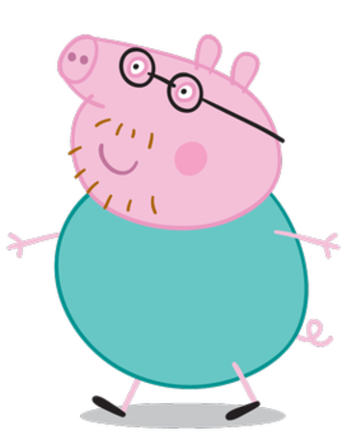
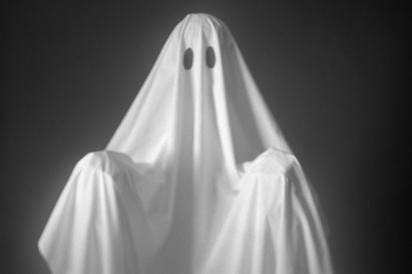
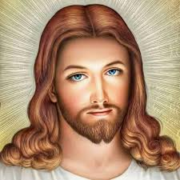
What Is God Like?
Who’s the daddy?

Slide 3
Unitarians
You’re not that special, son
Who’s the daddy?

Slide 4
Jehovah’s Witnesses
You’re not that eternal, son
Who’s the daddy?
I’m the power through which God does his works!

Slide 5
Western Church
So what sort of daddy does that make ME??
To be fair, in John Ch1 it does say that all things are made through the son.
I come from you both!
Who’s the daddy?

Slide 6
Eastern Orthodox Churches
Who’s the daddy now, Soyboy?
To be fair, Jesus, it does say in John Ch 15 that the Holy Spirit “proceeds from the Father.”
Who’s the daddy?
I only come from the Father.

Slide 7






Notes:
Students should read through the seven day creation story in the bibles. They should draw pictures of the events of each of the six days in their books, writing in what was created in the spaces below.

Slide 8
IMPORTANT POINTS
God created the world
God was in total control. He just said stuff and it happened.
Everything was GOOD – (God cannot do bad).
God created “out of nothing”.
Humans were created last
Humans are the most important creation
What does this say about God’s
relationship with the world?

Slide 9
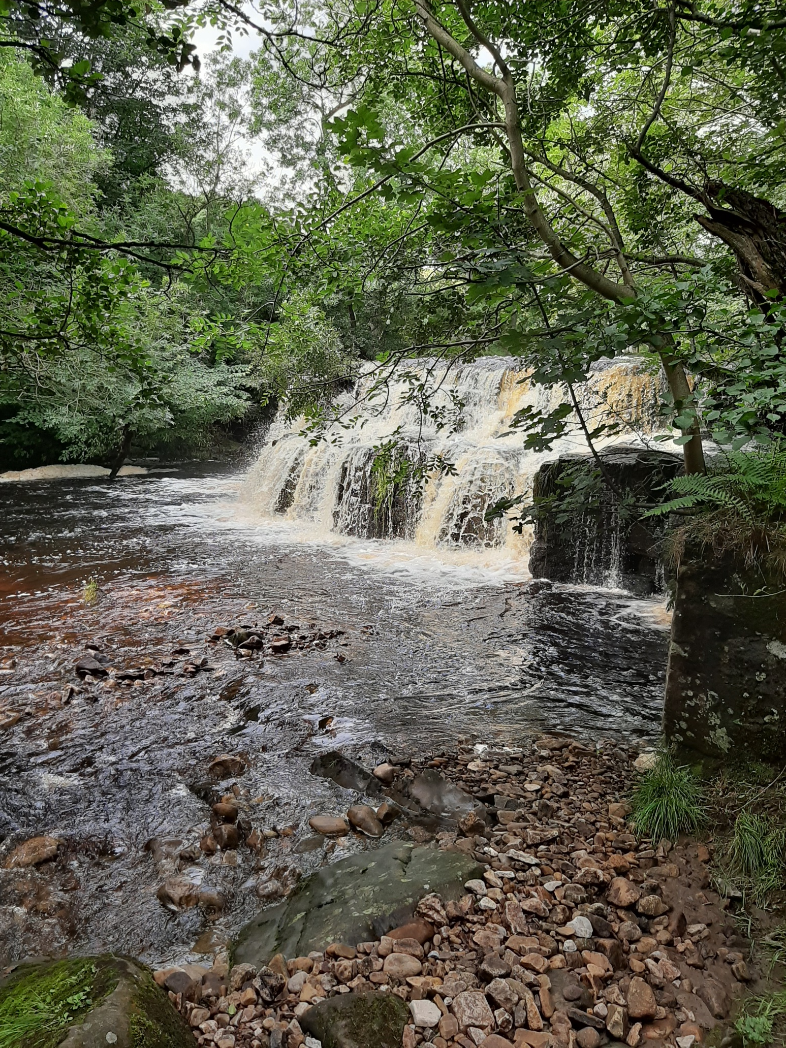

Slide 10
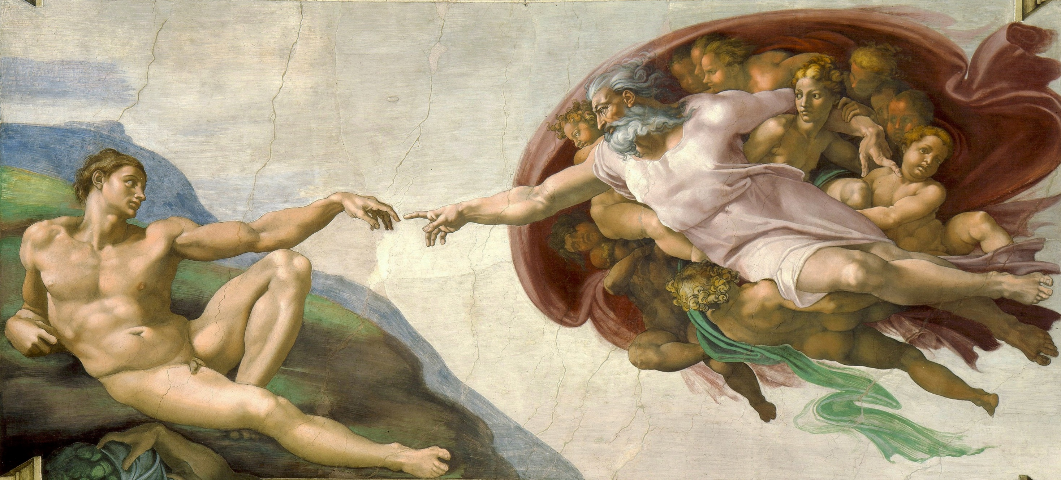
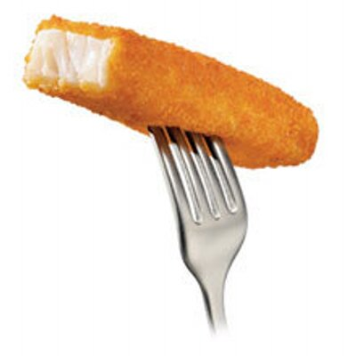
“Let us make man in our image, in our likeness.”

Slide 11
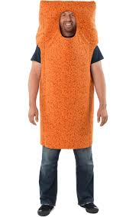
I’m giving you lots of miracles to help you, a promised land, a load of laws to help you build a society and a way to sacrifice animals to keep me happy.
Ta
Who’s the daddy?

Slide 12
And when none of that works…I’m going to kill this guy for you.
Thanks dad.
Not eternal
Who’s the daddy?

Slide 13
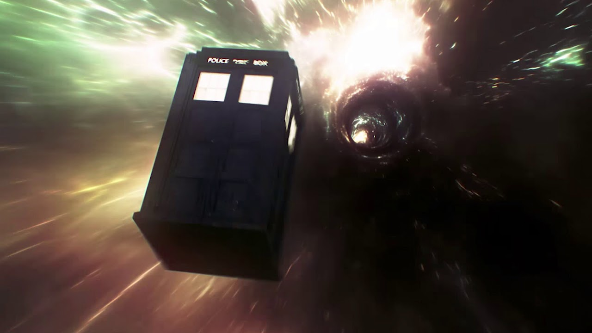

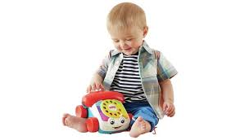
Call me!

Slide 14
The Cosmological Argument
Also known as the “First Cause Argument”.

Slide 15
Cosmological from the word ‘cosmos’ meaning universe
The Cosmological Argument is one of the oldest arguments to prove the existence of God.
Ockham’s Razor – the idea that the simplest explanation is the correct one.
Cosmological Argument is based on the idea of cause and effect.

Slide 16
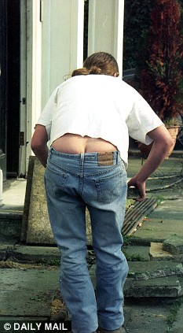
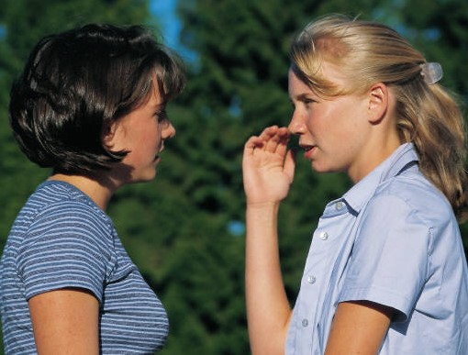
Posteriori and A Priori
The Cosmological argument is an a posteriori argument as opposed to an a priori one.
A Posteriori arguments are ones based on evidence ie posterior ( your behind, what is behind us) in the case of the Cosmological Argument it is the existence of the universe.
An a Priori argument is one that does not depend on evidence but on reason alone.

Slide 17
A RULE TO REMEMBER:
NOTHING HAPPENS WITHOUT SOMETHING CAUSING IT TO HAPPEN.
Can you think of anything that has happened without something causing it to happen?
No, I didn’t think so.

Slide 18
For instance…

Slide 19
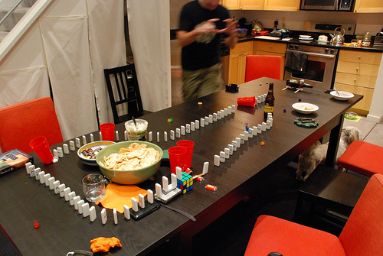
Life is just one big domino rally! But what set it going?
Trace the “dominoes” back – what was the first ever event?

Slide 20
3
There are
reasons why the answer can only be…
god

Slide 21
1.
Everything has a cause.
To have an infinite regression of cause and effect is impossible. So there must be a FIRST CAUSE.
The only thing that can possibly have been the FIRST CAUSE is something that needs no cause.
Only something that has no beginning needs no cause.
The only thing that has no beginning is god (because according to the definition, god is eternal).

Slide 22
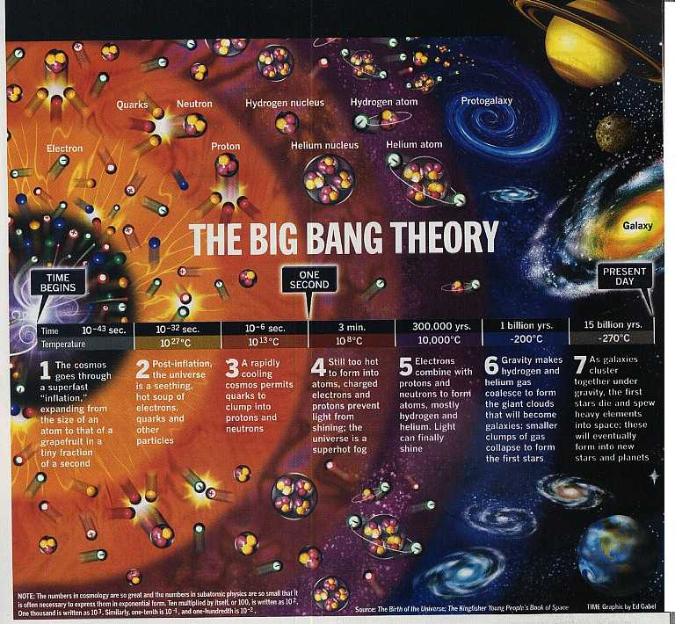

Slide 23
2.
THINK ABOUT
WHAT THINGS MUST
HAVE BEEN LIKE
BEFORE THE "BIG BANG"

Slide 24
Like this?
.
There is NOTHING outside the universe.
Even time does not exist here.

Slide 25
WHAT CAN HAVE CAUSED THE BIG BANG?
It must have been something that exists outside time because time only started when the universe was created.
Definition of god - god is eternal
(no beginning and no end,
exists outside time).

Slide 26
3.
.
There is NOTHING outside the universe.
No raw materials to build things from. No power source to begin the great expansion of the Big Bang.

Slide 27
WHAT CAN HAVE CAUSED THE BIG BANG?
It must have been something with unlimited power because there was nothing there to create the universe from.
Definition of god - god is omnipotent -
(has unlimited power).

Slide 28
Before we start...
Let’s have some cake!

Slide 29
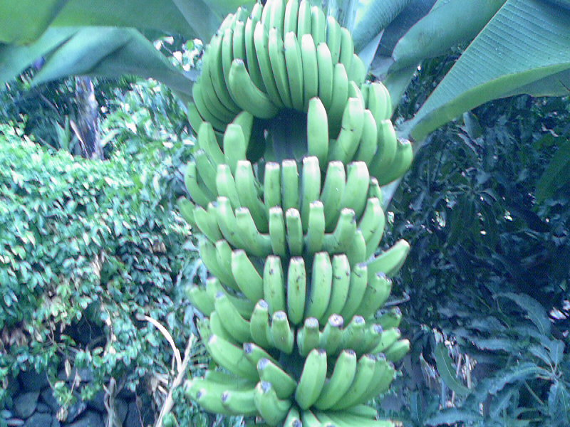
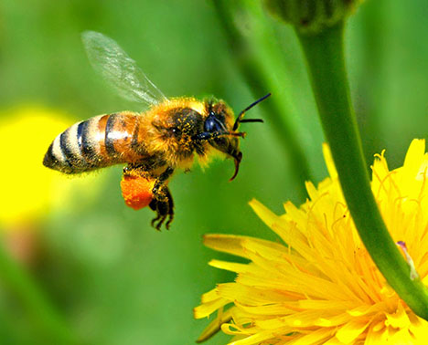
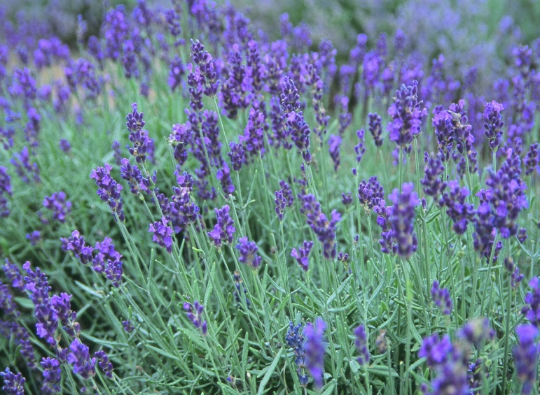
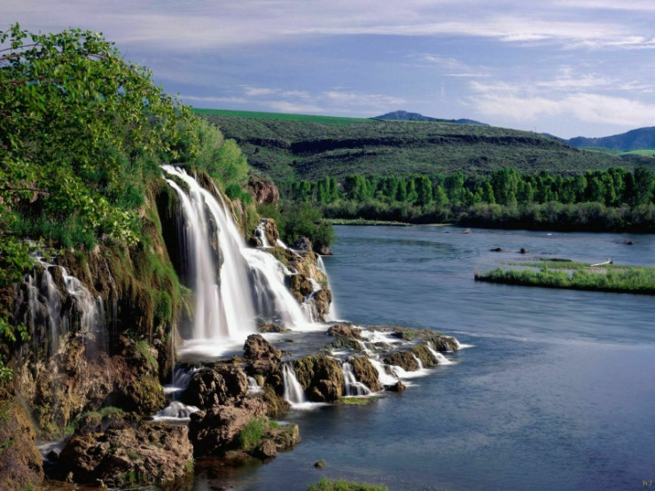
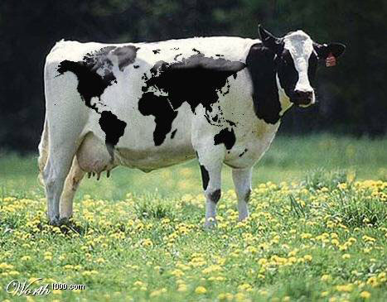
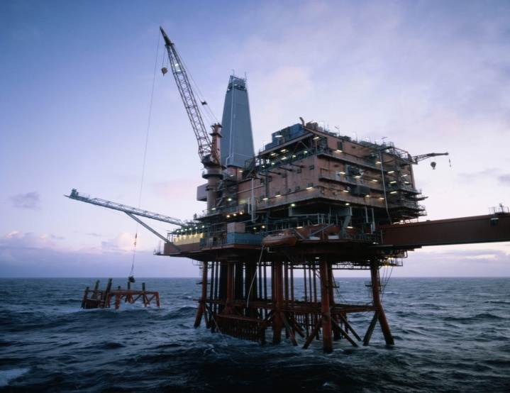
The more we know about the world around us, the more evidence we have of an intelligent creator. (Mankind’s Search for God, 1990)
AGREE? ...OR NOT?

Slide 30
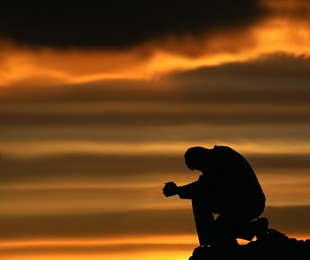

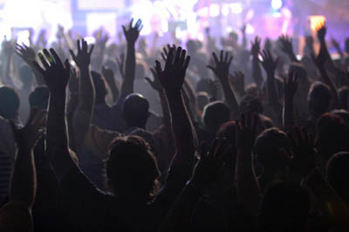

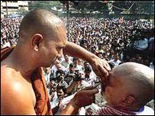
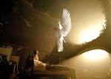
Argument from Religious Experience
Theists argue God exists because they have claimed to have experienced God in some way

Slide 31
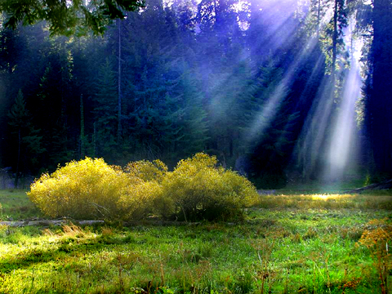
The NUMINOUS (feeling God’s presence)
When people are looking at something like a religious building, a beautiful place or looking up at the stars – they may feel that there is something greater than them – God.
It is often described as an experience of something going beyond the normal everyday experience.

Slide 32
Prayer and Meditation
Through prayer, believers are not only speaking to God but are also listening to God’s reply. During such times, believers say that they have felt God’s presence and don’t doubt His existence.
Some worshippers use meditation to feel closer to God, others will withdraw from everyday life to give their full attention to God

Slide 33
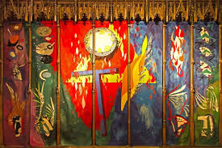
The Trinity- Chichester Cathedral

Slide 34
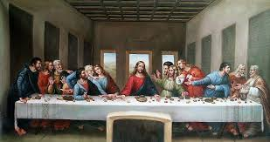

Slide 35
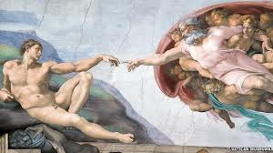

Slide 36
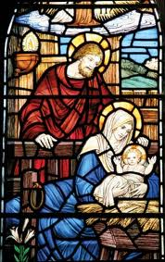

Slide 37
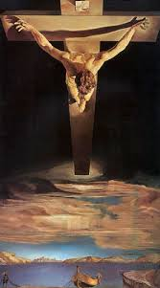

Slide 38
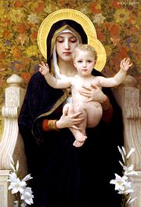
Virgin of the Lilies, Bouguereau, 1899

Slide 39
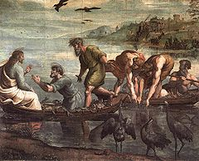
Raphael, The Miraculous Draught of Fishes (1515)

Slide 40
https://www.youtube.com/watch?v=vYxhhWSr8Q8&safe=true
https://www.youtube.com/watch?v=m-7px5Xyzlg&safe=true
https://www.youtube.com/watch?v=cQ4114XO-Xo&safe=true

Slide 41
Presence of God in Nature
Some believers are convinced that they have felt the presence of God while walking in the countryside because of feelings of awe and wonder they experience while looking at the beauty of nature

Slide 42
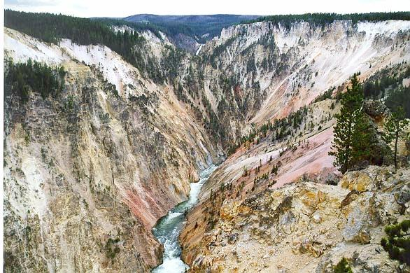
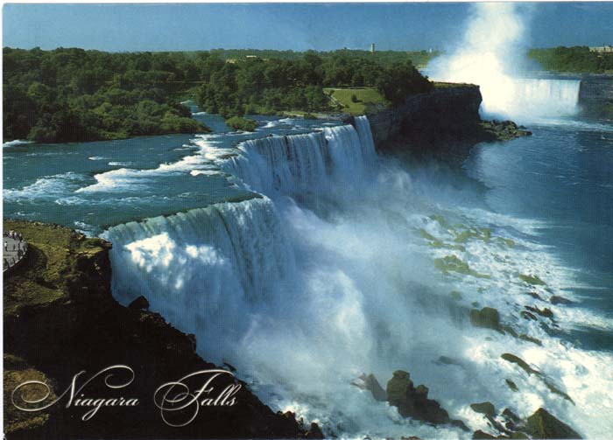
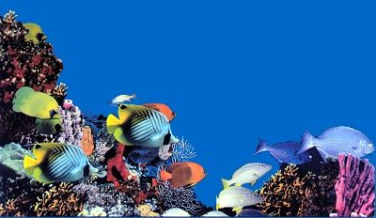
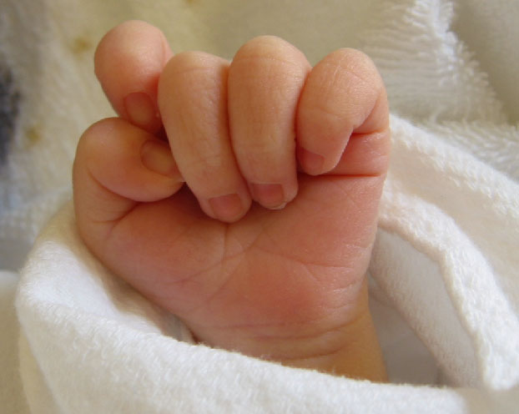

Slide 43
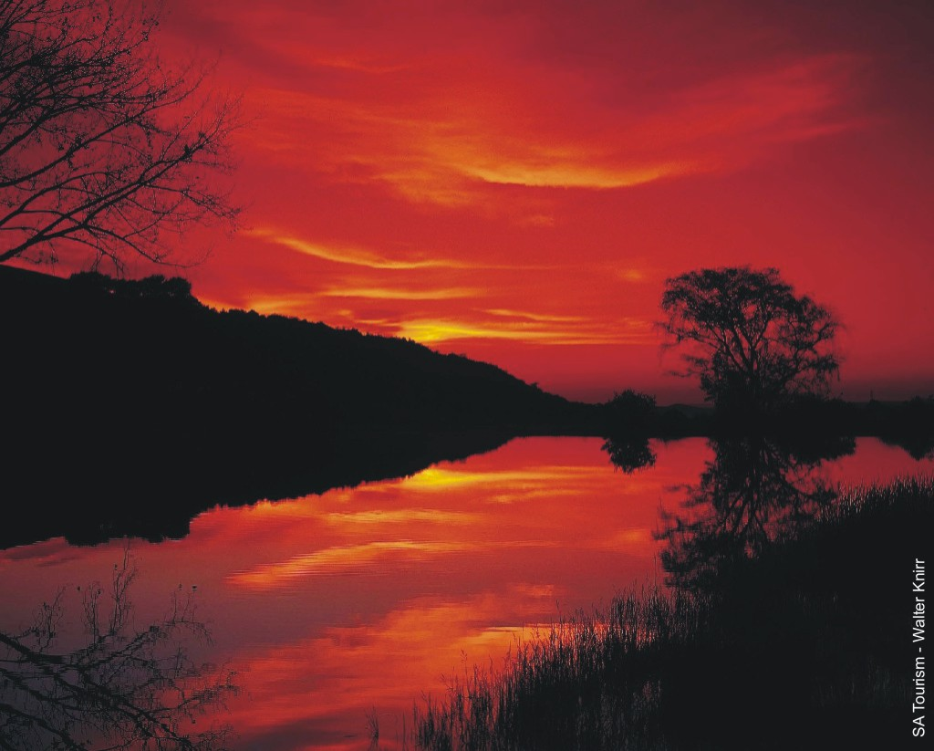
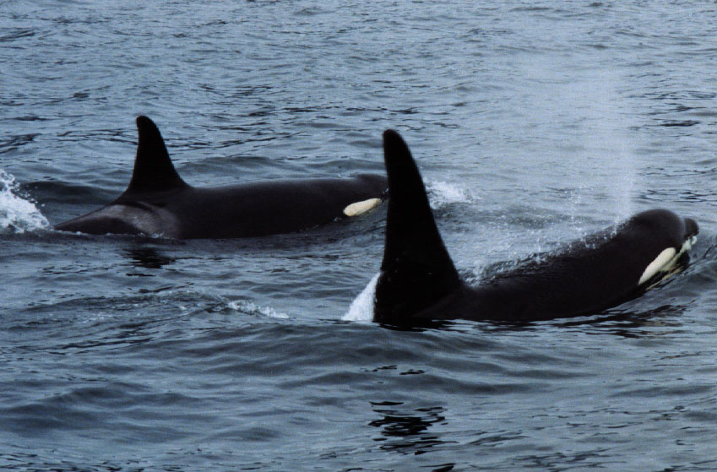
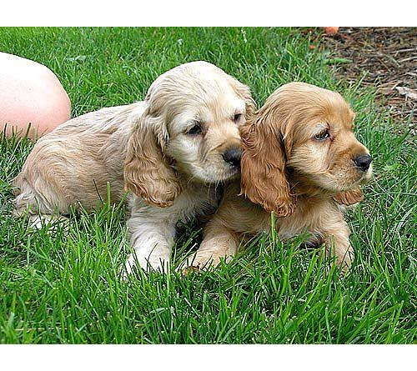
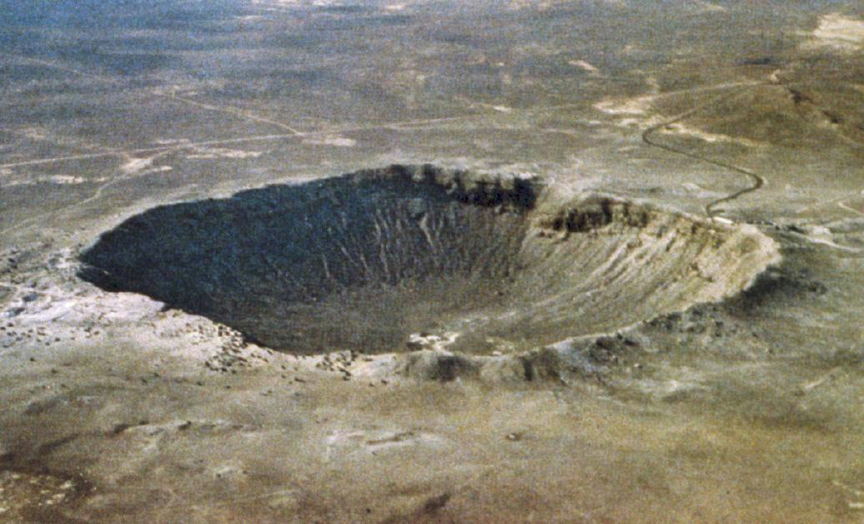

Slide 44
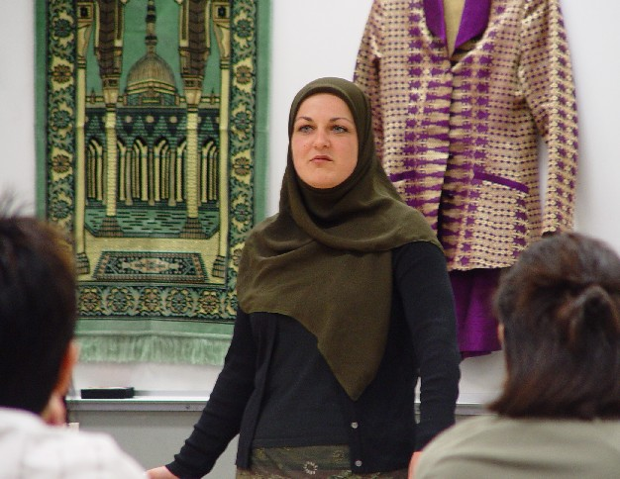
Experiencing a Conversion
When a person experiences God which is so great that that person wants to change their life and commit themselves to God in a special way.
It can be used to describe an experience that causes someone to change their religion or change from non belief (atheism) to belief in God.

Slide 45
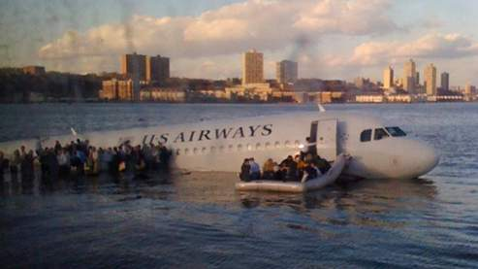
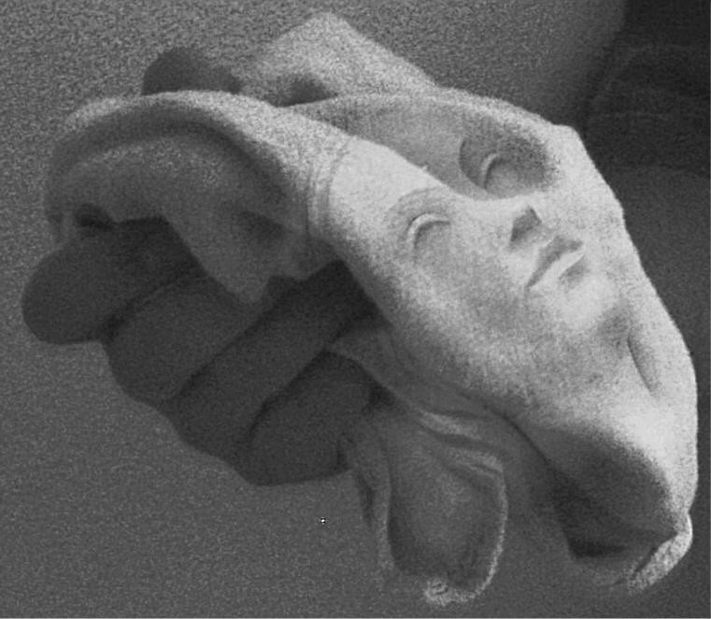
Experiencing a Miracle
An event that has taken place that violates the law of nature
Miracles help people believe in God as they believe that God is the one that causes them to happen.
A miracle is an event that seems to break all laws of science – so the only explanation has to be God.

Slide 46
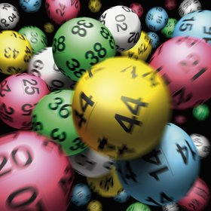
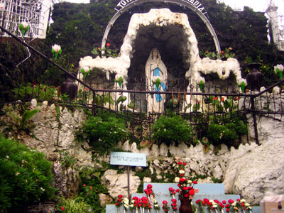
Argument From Religious Experience
Read the following scenarios of how people may believe God exists....
After 20 years of playing the lottery and not winning a penny, the night you said a prayer you had a massive win
You went to Lourdes on a pilgrimage and witnessed your friend being healed of an incurable disease with holy water
Your grandma was dying of cancer. The doctors said that there was no more drugs for her to try. The next day she was cured!
You saw an angel in your bedroom last night
You had a vision of a train crash and then it happened a week later
A baby fell from the 16th floor of a tower block and was only bruised. It should have died
A boy had his foot caught on a train track. The train was heading towards him at top speed, slammed its breaks on and stopped within an inch of the child
You witnessed Jesus turning water into wine and were able to later drink some of the wine
TRAFFIC LIGHT EXERCISE
Does it prove God exists?
GREEN – YES
YELLOW – DON’T KNOW
RED – NO

Slide 47
DRAW A UNICORN!
DEFINE A UNICORN.

Slide 48
THE ONTOLOGICAL ARGUMENT
LOGIC

Slide 49
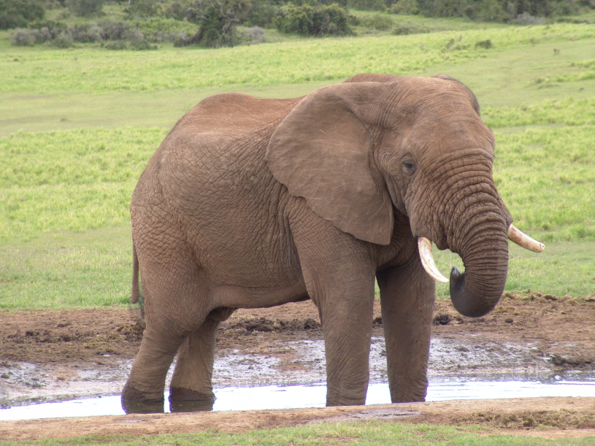
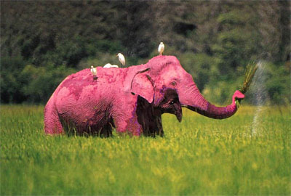

Slide 50
god must exist because:
1) He is perfect
2) You can imagine him

Slide 51
God is…
That greatest thing that you can possibly imagine.
You cannot possibly imagine anything greater than God!
STOP TRYING!
YOU CAN’T!

Slide 52
God is perfect!
WHAT DOES PERFECT MEAN?
WHAT MAKES SOMETHING PERFECT?

Slide 53

EXCUSE ME WHILE I ENJOY A REFRESHING BEVERIDGE.

Slide 54
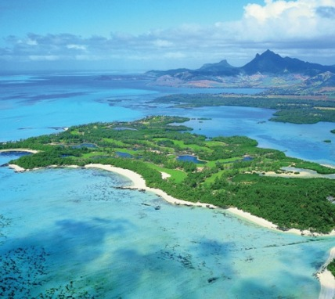
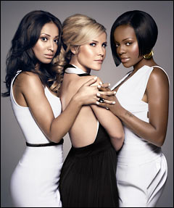
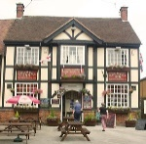



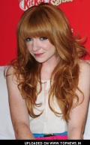








Imagine an island….

Slide 55


Slide 56


Slide 57

Now matter how many Nicolas I put on my imaginary island,
it is still an imaginary island.
A real island is better than it, just because a real island actually exists.
A real island with no Nicolas on it is better than an imaginary island with loads of Nicolas and a TWIX factory.
If god really is “the greatest thing you can imagine”
Then god must exist.
Real things are always better than imaginary things. And if god is the greatest thing you can imagine then he must be real because real things are always greater than imaginary things.
How'd ya like them apples?

Slide 58

One of the qualities that god must have = he is perfect.
Something that doesn’t exist isn’t perfect.
Even a grotty road island that does exist is closer to perfection than a wonderful island that is imaginary.
If god is the greatest thing you can imagine, then it must be because he exists which would be the ONLY quality that would make him better than all those other wonderful things you can imagine.
If god is perfect then he must exist because one of the qualities you need in order to be perfect is existence.
SIMPLES!

Slide 59

Morality
Morality is your sense of right and wrong and moral decisions are based on right or wrong actions.

Slide 60
Morality
There are two types of decision making:
Absolute morality (always right or wrong) – a situation where there is little doubt that the action is right or wrong.
Relative morality (sometimes right or wrong)- morality is not simple. We have to weigh up what is right or wrong in the circumstances.

Slide 61

The Axe Murderer
A philosopher called Immanuel Kant was an absolute moralist and felt that if it was part of your moral code not to lie, then you should never ever lie under any circumstances.
Let’s imagine that your best friend has come over and a crazed axe murderer turns up at your door looking for your friend who is now hiding under your bed. You are an absolute moralist.
What do you do? How do you make your decision? Explain. Now consider yourself as a relative moralist – answer the same questions.

Slide 62

Kant and the Moral Argument
What do we know about Kant?
18th Century
Protestant
A bit weird.

Slide 63
The MORAL ARGUMENT
The starting point for our morals cannot be the data interpreted by our senses. Our senses mislead us.
We have no real understanding of the universe.
YET we all have a strong and similar sense of morality.
You do not find out first what is “right” and then decide that you ought to do it.
The thing that you feel is right is what you should do.
But where does this universal feeling/knowledge of right and wrong come from?

Slide 64

Sources of moral authority
Making moral decisions is not easy and there are many different sources which lead us into making decisions. Some are external such as parents or the law and some are inbuilt such as our conscience.
Individuals exposed to the same external forces will not always make the same decision, they will also rely on their own mind or conscience.
An example of this can be seen in the Simpsons – Bart and Lisa both have the same upbringing yet their actions differ greatly because of their own individual conscience.

Slide 65
According to religion, where do we get morality from?
There are two theories in Christianity about where our morality comes from.
The first is that we believe things are right or wrong because of the things we see in the Bible, hear from religious leaders, Jesus’ example – they are all God’s way of showing us what is right.
This means that people are driven to do right so that God will reward them – in this life or in Heaven. They are also prevented from doing wrong by the threat of divine retribution (eg., an eternity in Hell).

Slide 66
Christian Moral Authority
The Bible
The Ten Commandments
Put God before all else.
Worship only one God.
Don’t say naughty things about God.
Keep the Sabbath day holy.
Respect your parents
Don’t kill people.
Don’t commit adultery.
Don’t steal.
Don’t tell lies.
Don’t be envious of your neighbour’s ass.

Slide 67
Other Bible Rules…
Don’t plant more than one kind of crop in a field.
Don’t let cattle graze with other kinds of cattle.
If you have a dream about another god you must die.
Don’t wear clothes made of more than one fabric.
Don’t cut your hair or shave.
Any person who curses their father or mother must die.
If a man cheats on his wife then he and the woman must die.
If a man sleeps with his fathers wife. They ALL must die.
If a man or woman sleeps with an animal then the man/woman AND the animal must die.
If a man sleeps with his wife while she is menstruating, they must be exiled from their people.
All gay people must die.
People who have a different religion must be killed. If you discover a city where they have a different religion, destroy it and kill the people.
People who have flat noses must not go to church.
If a priest’s daughter is a whore, she must be burned at the stake.

Slide 68
According to religion, where do we get morality from?
The second theory is that our knowledge of right and wrong comes directly from God.
He has either
Cunningly planted it within our heads or…
We sense it through our link with the Creator who is the source of all Good in the world.

Slide 69


Conscience
Many people believe that they instinctively know the difference between right and wrong because their conscience tells them.
Deciding the right course of action based on upbringing.
Or, as some Christians think, it is the ‘voice of God’ telling them what to do.
What do you think and why?

Slide 70
GUILT

Slide 71

Where you going?
Eat more veg.
Off being good, innit?
Your soul-making journey towards “Good”ness continues even after you die.

Slide 72
HOW IS YOUR JOURNEY TO
GOODNESS GOING?

Slide 73




But how good is God?
Who’s the Baddy?

Slide 74
How Does God
Show Himself To
Humans?
BOO!
I will reveal
myself!

Slide 75





Here in the Dutch Reformed Church we also like this view. Because in Genesis 11 it says about separating races. And we love that God is on our side!
It is literally the word of God recorded on paper. There are no mistakes. God can’t be wrong. But scientists can, so the Bible is always right. You always have to put your trust in the word of God as it is in the Bible.
Fundamentalist Fred
We agree with Fred. That’s why we do this.
Scientists are neigh good!

Slide 76

CONSERVATIVE VIEW
Write this down…
I wonder what time Corrie is on…
Conservative view = the Bible was written by humans who were inspired by God.
BUT because they were human they were fallible, made mistakes and were very much influenced by their own societies at the time.
BUT THE BIBLE ALWAYS IS MORE IMPORTANT THAN SCIENCE ETC.
The Bible
Part 1

Slide 77


LIBERAL VIEW
You can learn a lot from this stuff.
Its full of cymbals!
MYTHS
&
FABLES
I interpret that as “symbolism”.

Slide 78
GOD REVEALED
THROUGH JESUS
WORD, JC!
WORD!
“The Word became flesh and made his dwelling among us…”
Christian view = God Himself came to earth as Jesus. He did this to…
Show his love
Teach people
Provide an example for Godly living
Do a few miracles
Make the ultimate sacrifice.

Slide 79







Slide 80
A physically impossible event that occurs against the normal natural laws of the universe
and is performed THROUGH THE POWER OF GOD.
Miracle = ?
Therefore miracles in themselves
(both in the Bible and in the world
today) are examples of God
revealing himself to humans.

Slide 81

Some say God reveals Himself through inspirational people
Find out about some more inspirational Christians.
How might they influence people?

Slide 82



You know God is revealing himself to you when…
There is unexpected
bright light and a
lot of falling down.

Slide 83




You know God is revealing himself to you when…
A strange feeling
like being drunk

Slide 84



You know God is revealing himself to you when…
The Holy Spirit
sets fire to your
head.

Slide 85

You know God is revealing himself to you when…
You get a feeling
of awe and
Wonderment.

Slide 86


You know God is revealing himself to you when…
You start chatting
a load of mad stuff.

