Slide 1
RELIGIOUS EDUCATION
TERM ONE
Year 9

Slide 2
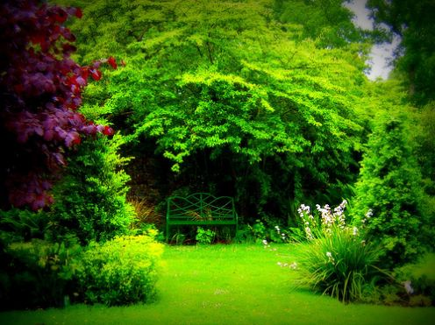
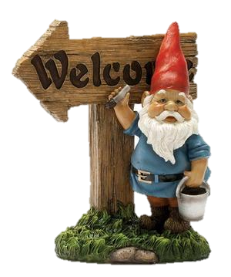
Welcome to RE!
Rules and Expectations

Slide 3
What is RE all about?

Slide 4
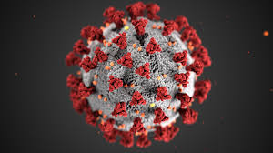
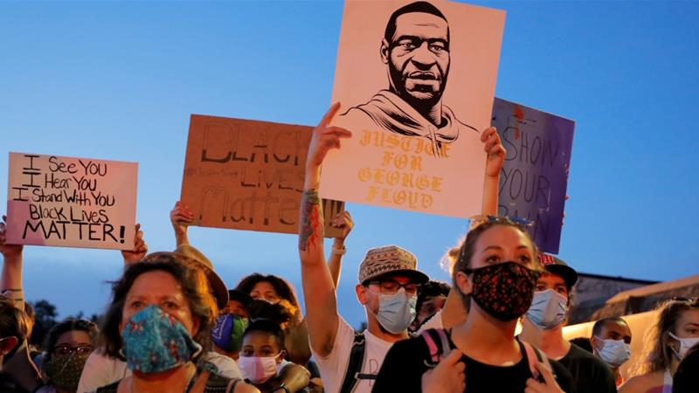
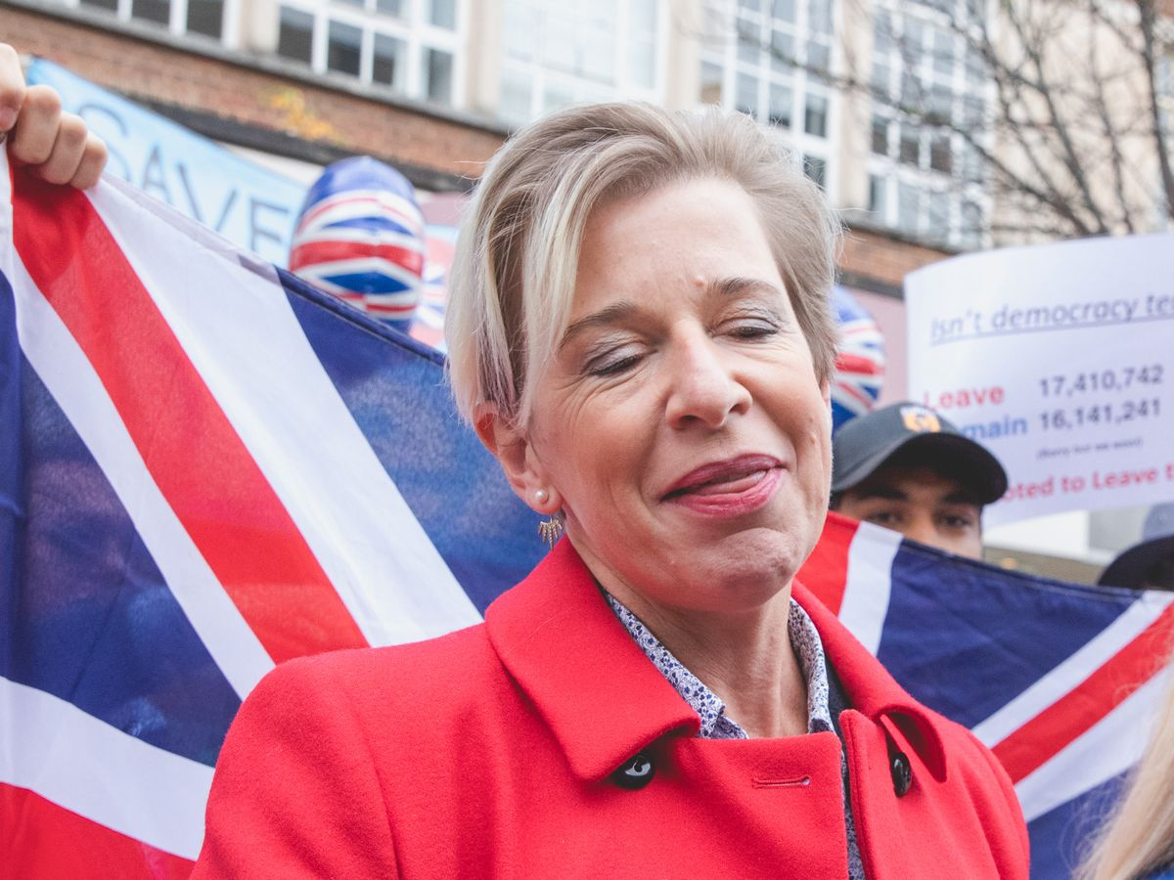
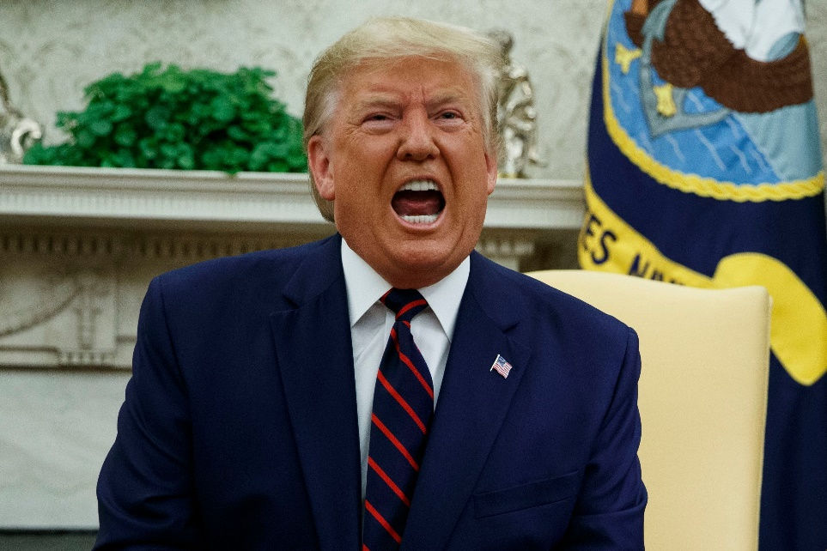
CURRENT AFFAIRS

Slide 5
Starter
Write a definition of God
God is…

Slide 6
Our hypothesis:
“You cannot define something like god.”
Starter task
Write a sentence to explain your view

Slide 7
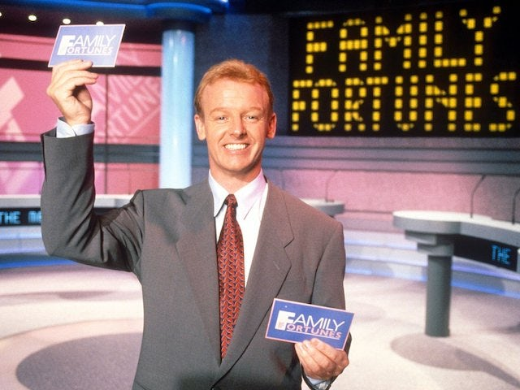
What is God?
We asked one hundred different people to describe “God”…
Ask as many different people as you can to describe God. Write down the things they say in the form of a list.

Slide 8
Your Task
Using your notes draw an image of God.
You can NOT use any words or titles.
Include a paragraph on what your image is of and how it represents God.

Slide 9
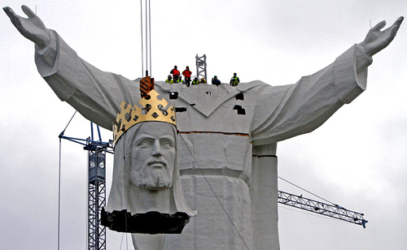
Building an image of God
NEXT HYPOTHESIS…
“God is a bearded chap who sits on a cloud.”

Slide 10
Plenary
HYPOTHESIS…
“God is a bearded chap who sits on a cloud.”
Write the above hypothesis in your books.
Write whether it is true or false and why.

Slide 11
God- the official definition
  I will know the official definition of God.
  I will understand what this definition is saying about God.
  I will know how many Christians view God.
Write down the title and targets in your book and then hold up your pictures of God!

Slide 12
The official definition of
God
GOD IS…
__________________ which means ____________________________
__________________ which means ____________________________
__________________ which means____________________________
__________________ which means ____________________________
__________________ which means ____________________________
?
Notes:
Hand out packs to groups of around 5. Packs are in folder.

Slide 13
Each group has three definitions, but one of them is wrong!
Write down the two you think are correct
2. You can then swap one ONLY with another group
You may want to be tactical and give them the wrong one!
First group to get all correct wins!!

Slide 14
The answers…

Slide 15
GOD IS…
Omnipotent which means all-powerful.
Omniscient which means all –knowing.
Omni-benevolent which means all – loving.
Eternal which means everlasting (no beginning and no end).
Perfect which means faultless.

Slide 16
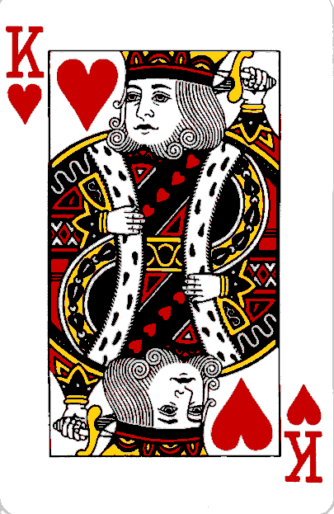
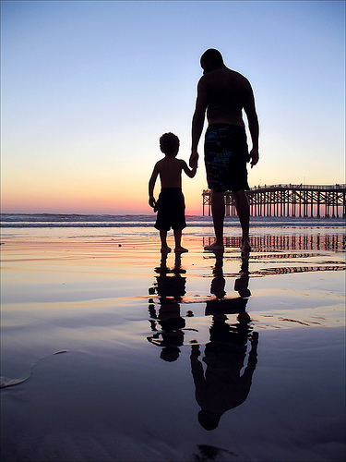
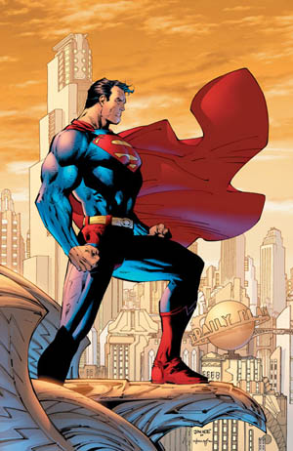
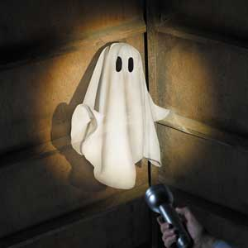
How do CHRISTIANS VIEW GOD?
+
CREATOR?
WIZARD?
SAVIOUR?

Slide 17
The Cosmological Argument
Also known as the “First Cause Argument”.

Slide 18
A RULE TO REMEMBER:
NOTHING HAPPENS WITHOUT SOMETHING CAUSING IT TO HAPPEN.
Can you think of anything that has happened without something causing it to happen?
No, I didn’t think so.

Slide 19
For instance…

Slide 20
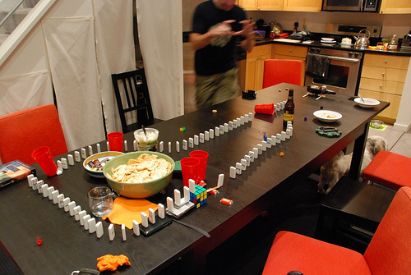
Life is just one big domino rally! But what set it going?
Trace the “dominoes” back – what was the first ever event?

Slide 21
3
There are
reasons why the answer can only be…
god

Slide 22
1.
Everything has a cause.
To have an infinite regression of cause and effect is impossible. So there must be a FIRST CAUSE.
The only thing that can possibly have been the FIRST CAUSE is something that needs no cause.
Only something that has no beginning needs no cause.
The only thing that has no beginning is god (because according to the definition, god is eternal).

Slide 23
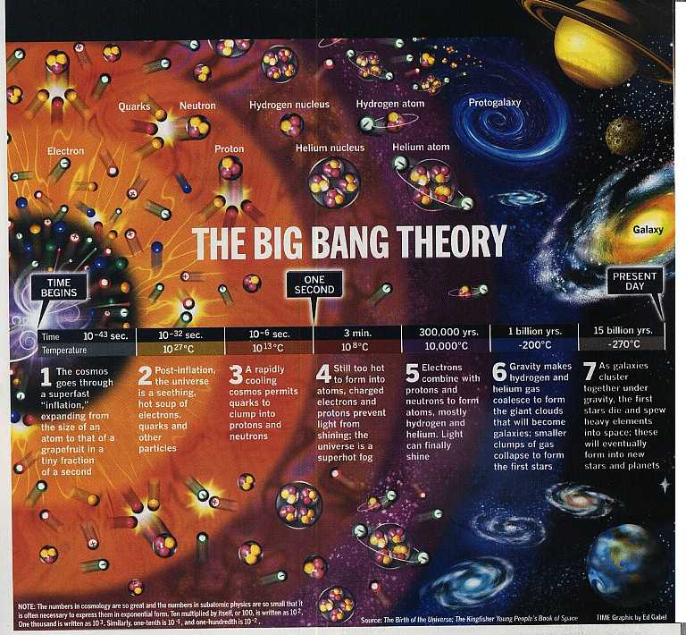

Slide 24
2.
THINK ABOUT
WHAT THINGS MUST
HAVE BEEN LIKE
BEFORE THE "BIG BANG"

Slide 25
Like this?
.
There is NOTHING outside the universe.
Even time does not exist here.

Slide 26
WHAT CAN HAVE CAUSED THE BIG BANG?
It must have been something that exists outside time because time only started when the universe was created.
Definition of god - god is eternal
(no beginning and no end,
exists outside time).

Slide 27
3.
.
There is NOTHING outside the universe.
No raw materials to build things from. No power source to begin the great expansion of the Big Bang.

Slide 28
WHAT CAN HAVE CAUSED THE BIG BANG?
It must have been something with unlimited power because there was nothing there to create the universe from.
Definition of god - god is omnipotent -
(has unlimited power).

Slide 29
Your Task
In your groups you are going to prepare a presentation to show how the cosmological argument works.
You have 10 minutes.

Slide 30
Success Criteria
I will decide whether you are successful based on the following criteria:
  Argument is correctly presented
  Props are used to aid argument
  All members of the group contribute
  Key terms are used correctly
  Write it down!

Slide 31
Before we start...
Let’s have some cake!

Slide 32
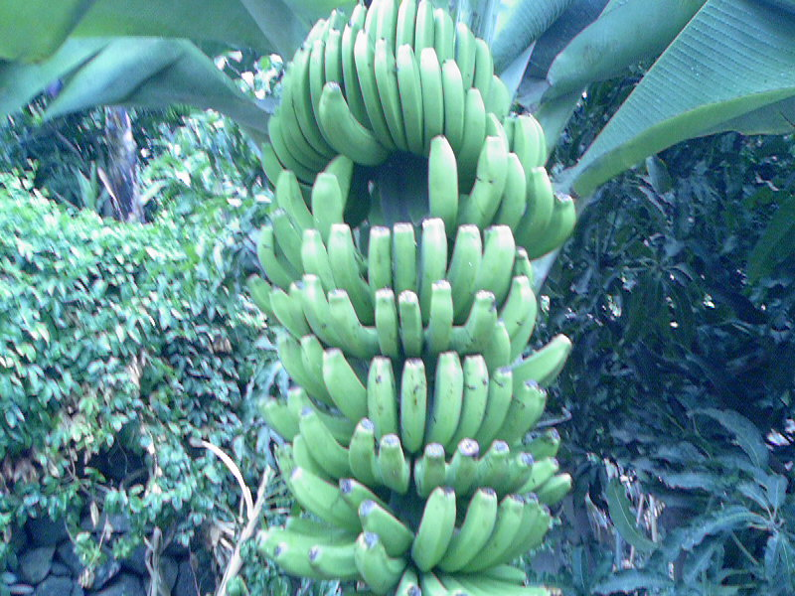
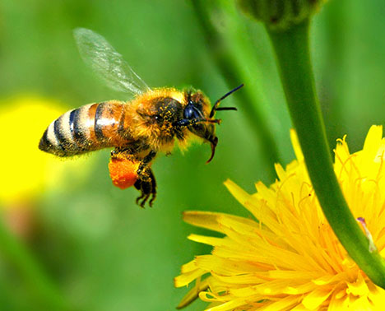
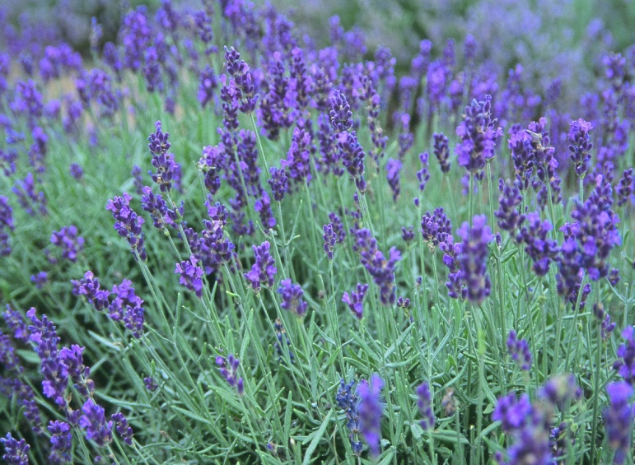
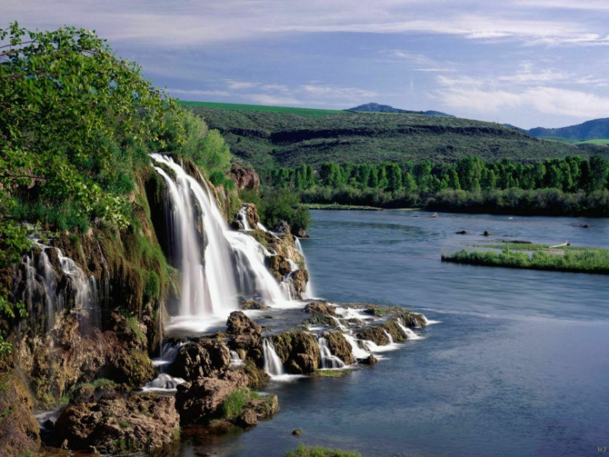
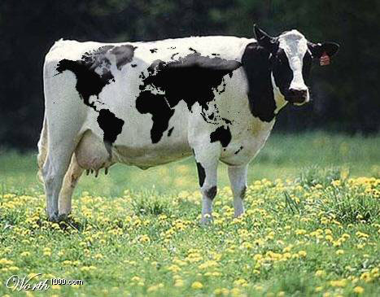
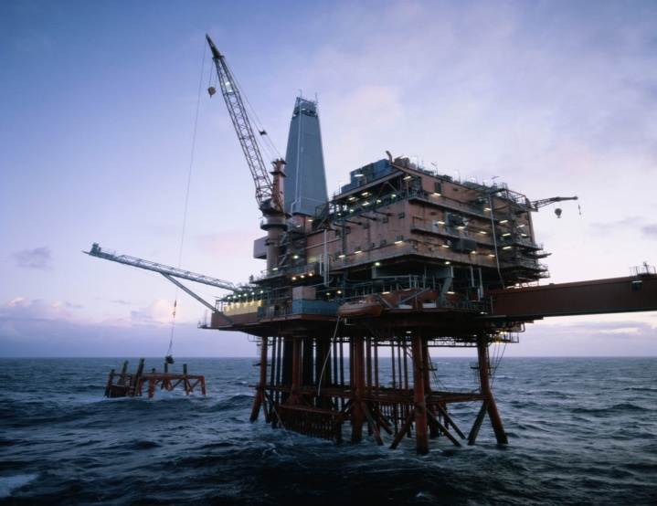
The more we know about the world around us, the more evidence we have of an intelligent creator. (Mankind’s Search for God, 1990)
AGREE? ...OR NOT?

Slide 33
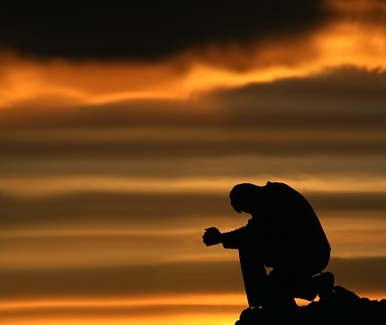
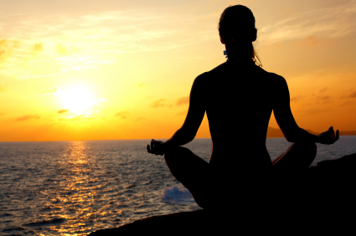
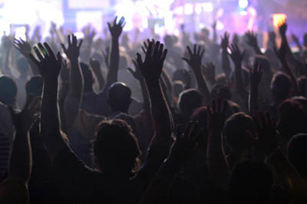
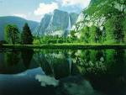
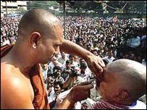
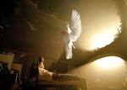
Argument from Religious Experience
Theists argue God exists because they have claimed to have experienced God in some way

Slide 34
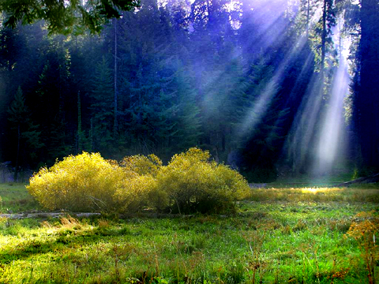
The NUMINOUS (feeling God’s presence)
When people are looking at something like a religious building, a beautiful place or looking up at the stars – they may feel that there is something greater than them – God.
It is often described as an experience of something going beyond the normal everyday experience.

Slide 35
Prayer and Meditation
Through prayer, believers are not only speaking to God but are also listening to God’s reply. During such times, believers say that they have felt God’s presence and don’t doubt His existence.
Some worshippers use meditation to feel closer to God, others will withdraw from everyday life to give their full attention to God

Slide 36
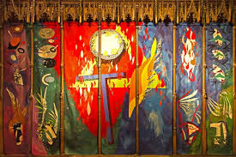
The Trinity- Chichester Cathedral

Slide 37
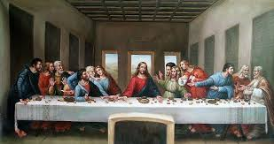

Slide 38
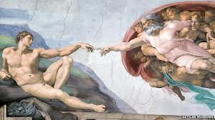

Slide 39
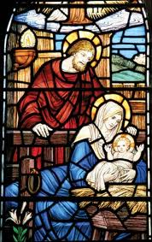

Slide 40
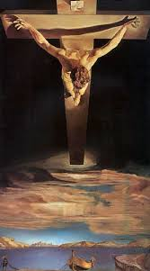

Slide 41
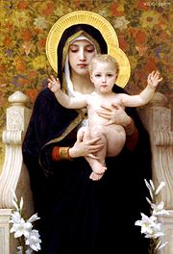
Virgin of the Lilies, Bouguereau, 1899

Slide 42
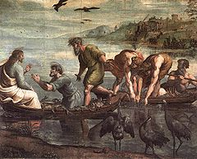
Raphael, The Miraculous Draught of Fishes (1515)

Slide 43
https://www.youtube.com/watch?v=vYxhhWSr8Q8&safe=true
https://www.youtube.com/watch?v=m-7px5Xyzlg&safe=true
https://www.youtube.com/watch?v=cQ4114XO-Xo&safe=true

Slide 44
Presence of God in Nature
Some believers are convinced that they have felt the presence of God while walking in the countryside because of feelings of awe and wonder they experience while looking at the beauty of nature

Slide 45
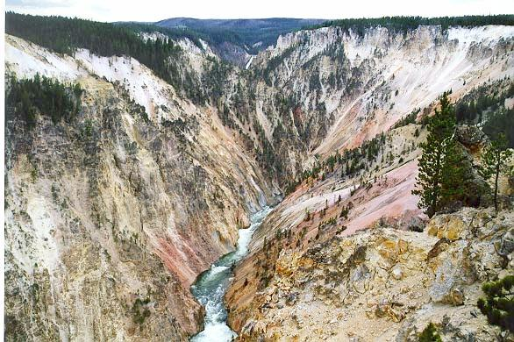
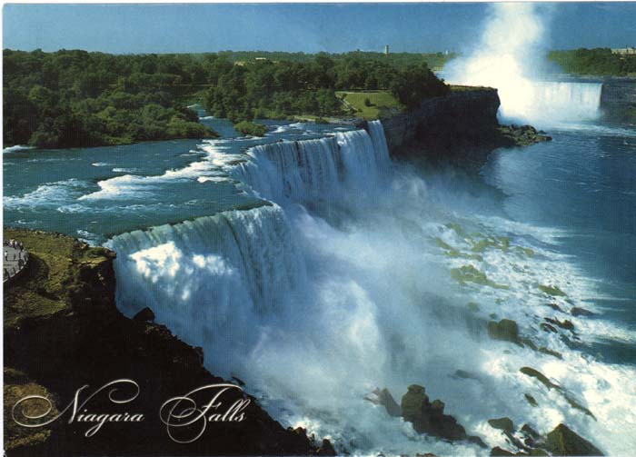
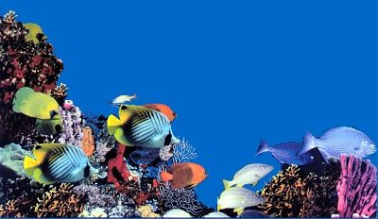
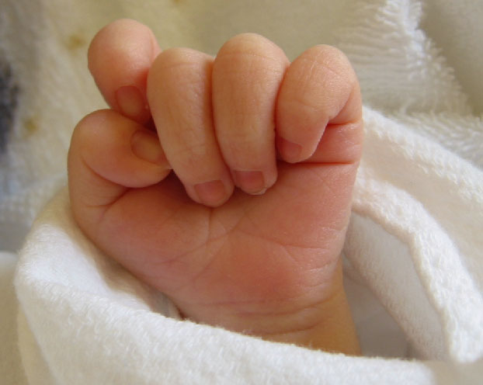

Slide 46
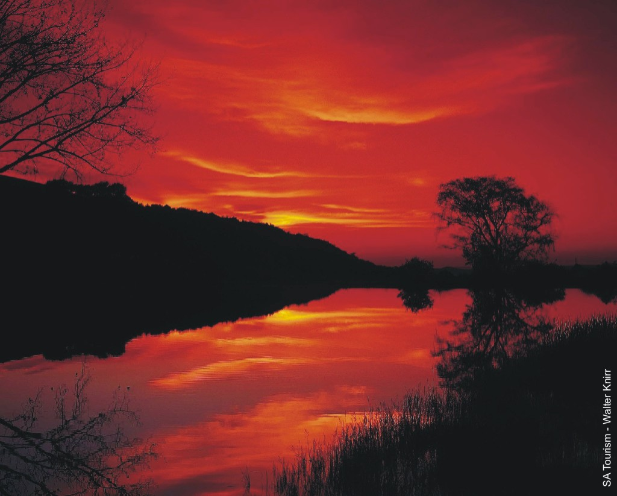
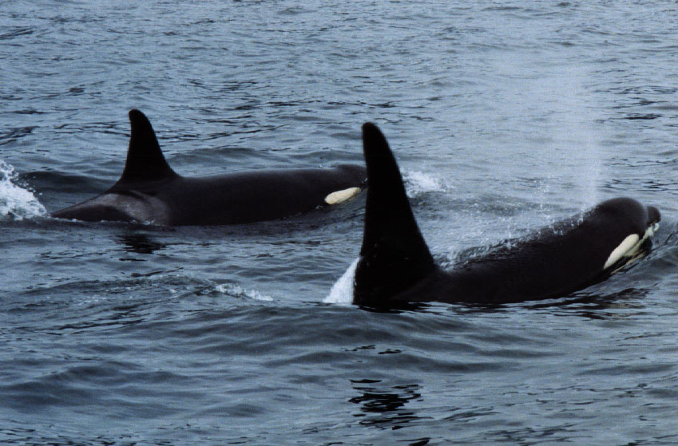
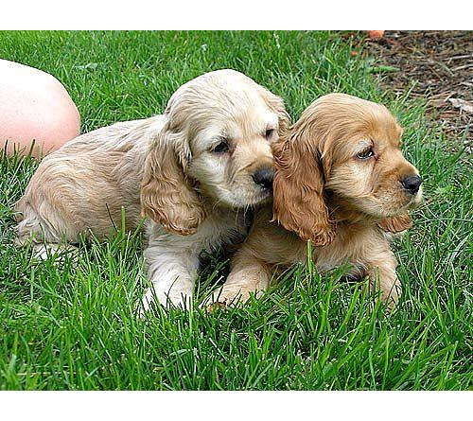
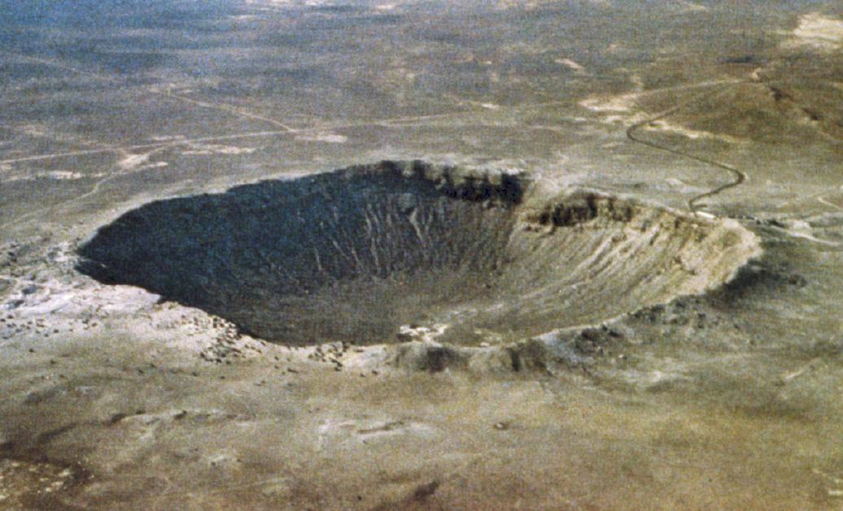

Slide 47
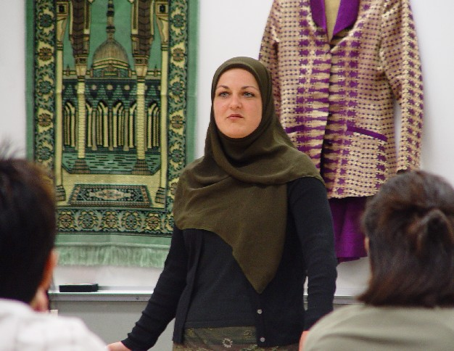
Experiencing a Conversion
When a person experiences God which is so great that that person wants to change their life and commit themselves to God in a special way.
It can be used to describe an experience that causes someone to change their religion or change from non belief (atheism) to belief in God.

Slide 48
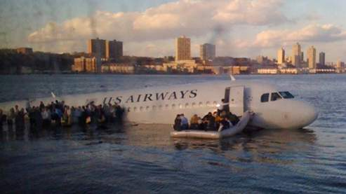
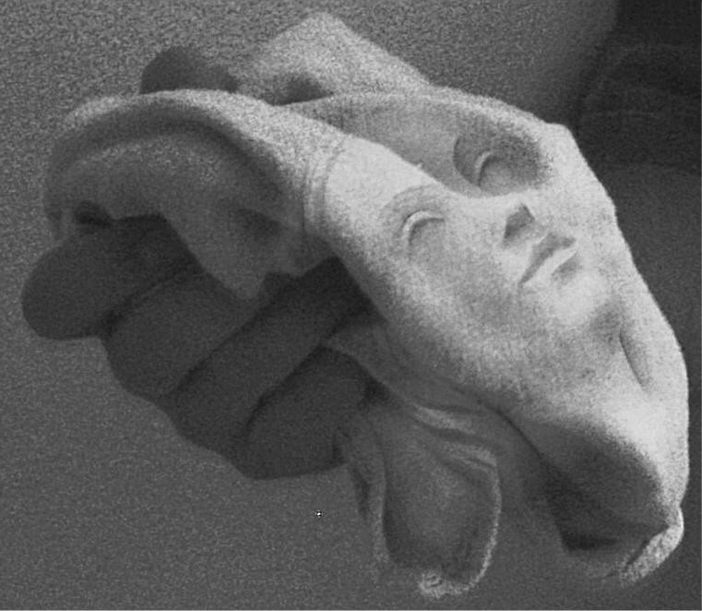
Experiencing a Miracle
An event that has taken place that violates the law of nature
Miracles help people believe in God as they believe that God is the one that causes them to happen.
A miracle is an event that seems to break all laws of science – so the only explanation has to be God.

Slide 49
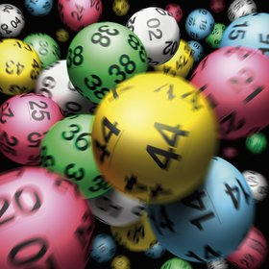
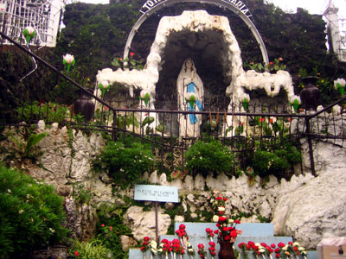
Argument From Religious Experience
Read the following scenarios of how people may believe God exists....
After 20 years of playing the lottery and not winning a penny, the night you said a prayer you had a massive win
You went to Lourdes on a pilgrimage and witnessed your friend being healed of an incurable disease with holy water
Your grandma was dying of cancer. The doctors said that there was no more drugs for her to try. The next day she was cured!
You saw an angel in your bedroom last night
You had a vision of a train crash and then it happened a week later
A baby fell from the 16th floor of a tower block and was only bruised. It should have died
A boy had his foot caught on a train track. The train was heading towards him at top speed, slammed its breaks on and stopped within an inch of the child
You witnessed Jesus turning water into wine and were able to later drink some of the wine
TRAFFIC LIGHT EXERCISE
Does it prove God exists?
GREEN – YES
YELLOW – DON’T KNOW
RED – NO

Slide 50
DRAW A UNICORN!
DEFINE A UNICORN.

Slide 51
THE ONTOLOGICAL ARGUMENT
LOGIC

Slide 52
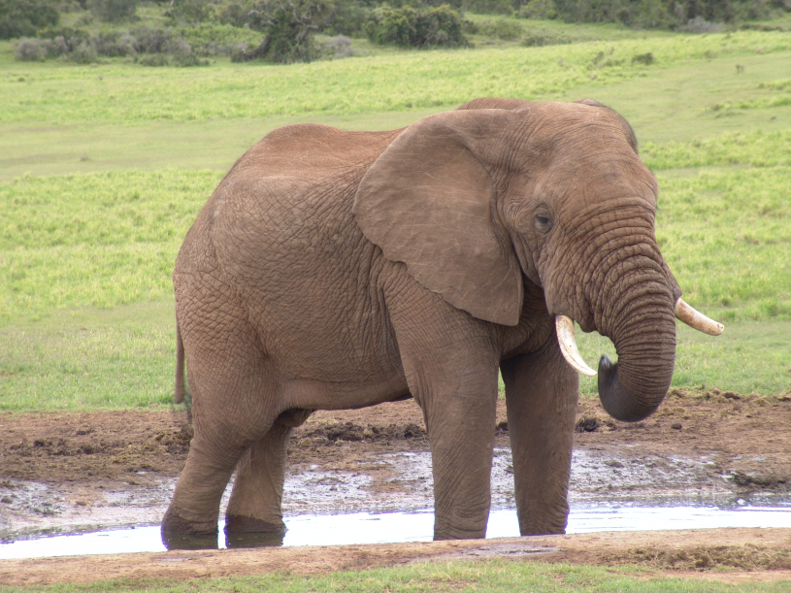
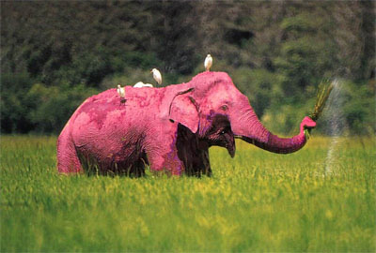

Slide 53
god must exist because:
1) He is perfect
2) You can imagine him

Slide 54
God is…
That greatest thing that you can possibly imagine.
You cannot possibly imagine anything greater than God!
STOP TRYING!
YOU CAN’T!

Slide 55
God is perfect!
WHAT DOES PERFECT MEAN?
WHAT MAKES SOMETHING PERFECT?

Slide 56

EXCUSE ME WHILE I ENJOY A REFRESHING BEVERIDGE.

Slide 57
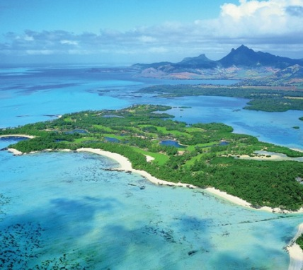














Imagine an island….

Slide 58


Slide 59


Slide 60

Now matter how many Nicolas I put on my imaginary island,
it is still an imaginary island.
A real island is better than it, just because a real island actually exists.
A real island with no Nicolas on it is better than an imaginary island with loads of Nicolas and a TWIX factory.
If god really is “the greatest thing you can imagine”
Then god must exist.
Real things are always better than imaginary things. And if god is the greatest thing you can imagine then he must be real because real things are always greater than imaginary things.
How'd ya like them apples?

Slide 61

One of the qualities that god must have = he is perfect.
Something that doesn’t exist isn’t perfect.
Even a grotty road island that does exist is closer to perfection than a wonderful island that is imaginary.
If god is the greatest thing you can imagine, then it must be because he exists which would be the ONLY quality that would make him better than all those other wonderful things you can imagine.
If god is perfect then he must exist because one of the qualities you need in order to be perfect is existence.
SIMPLES!

Slide 62
The Balloon Debate
Your will be working in groups of four. Each one of you will be given a different argument for the existence of God.
This assessment task in focused on helping you to retain knowledge of the different arguments and to evaluate them.

Slide 63
Pathway Guide
 | Just about did it | Did it really well
I can describe in detail one of the arguments for the existence of god, using some of the technical words.
I can think of good questions to ask about the arguments for the existence of god.
I can show links between the arguments and the official definition of god. I can compare the different arguments.
I can use the arguments to compare my views about god with those of other people.
I can show my understanding of the arguments and give reasons why people might agree or disagree with them.
I can use my own knowledge of the world to help me to find strengths and weaknesses in the arguments.
I can show how different beliefs and experiences of the world might influence the way people respond to the arguments.
I can give different religious and non-religious views on the arguments, looking at them from different sides.

Slide 64
Assessment.
Lesson Objectives
I will recap on everything I have learnt about the arguments for the existence of God.
I will show that I understand the arguments.
I will evaluate the arguments.
I will write persuasive speeches.

Slide 65



Your Assessment Task
To write a speech outlining your argument and explaining why it is the best one.
2. To write a second speech arguing why the other arguments are weaker than yours.

Slide 66
Your Assessment Task
To finish your first speech outlining your argument and explaining why it is the best one.
To write a second speech arguing why the other arguments are weaker than yours.
If you get through to speech three you can make it up as you go along – aim to attack your remaining opponent’s points.
Each speech must be 1 minute long.

Slide 67
Order of the Debate
Each speaker takes it in turns to present their first speech.
The audience/judges then decide to throw off.
Then the remaining speakers present their second speeches.
Again, the judges decide who to throw off.
Each remaining speaker must then improvise their third speech.
This process continues until there is one speaker left.

Slide 68
Self Assessment
2 things I did really well
2 things I could improve on.

