Slide 1

Recap Quiz
5 October 2021
What is the Cosmological argument?
How does the Cosmological argument explain how God is not created?
What is the counter argument to Cosmology?

Slide 2
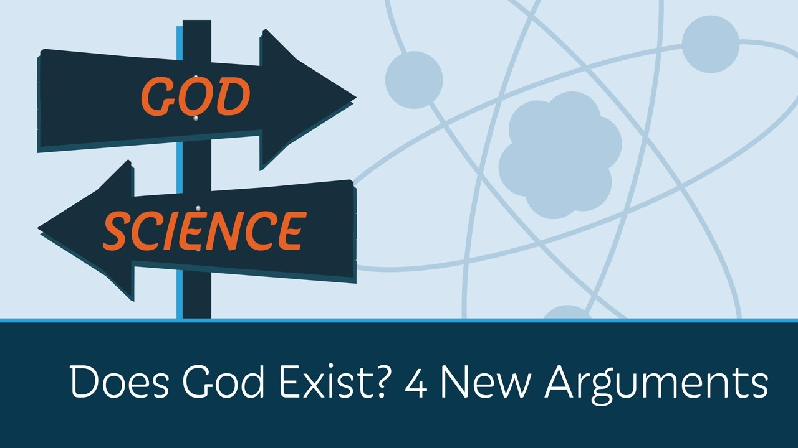
We will continue to look at 4 “God exists because….” theories
We will then look at what philosophers have to say against these statements
You will create an argument to explain and defend one theory as the most important
Your assessment will take the form of a debate….

Slide 3

What is the Teleological Argument?
5 October 2021
LO:
To define the ‘teleological’ argument for God.
Search for the ‘telos’ in the world.
An argument for the existence of God or, more generally, for an intelligent creator "based on perceived evidence of deliberate design in the natural or physical world”

Slide 4

Task 1: What is the argument?
Premise: The universe has order, purpose and reason.
P: The complexity of the universe shows evidence of design.
P: Such design implies a designer.
Conclusion: The designer of the universe is God.
Copy this into your books.

Slide 5
Task 2…listen up!
Listen to the lyrics in the following song that supports the Teleological argument.
Creations Call
Is the argument convincing? Why / why not?
Paragraph please…

Slide 6


Task 3: Go and find Design!
You have 5 minutes to leave this room, head to the School Field. Photograph on your ipads at least 2 examples of God’s Design!
Success: email the photos to
dacock@cirencesterkingshill.gloucs.sch/uk ASAP!
Include your name and title
Be back on time to explain your choices and how they show ‘design’ in the world.

Slide 7

Consolidation: What have we learnt?
And I quote:
Ask the person next to you to Explain what the Teleological Argument is in their own words… (copy this down exactly!)
Then ask them to give you an example of Design in the world to support their point (quote them on this too in your book!)
E.g. Joe said the Teleological Argument is as follows…

Slide 8
Scholars you might want to use for debates!
Versions of the teleological argument / For it: | Scholars who criticise the teleological arguments:
Aquinas (13th century) | Hume (18th Century)
Paley (19th Century) | Mill (19th Century)
Tennant (20th Century) | Darwin (19th Century)
Swinburne (21st Century) | Dawkins (21st Century)

Slide 9
Scholars you might want to use for debates!
Existence of God - Higher Religious, moral and philosophical studies - BBC Bitesize The existence of God - God and truth - GCSE Religious Studies Revision - BBC Bitesize
https://app.senecalearning.com/dashboard/class/kfxqa53k2c/assignments/assignment/567502f4-d4ad-4d37-828c-abc3b660fcc5

