Slide 1
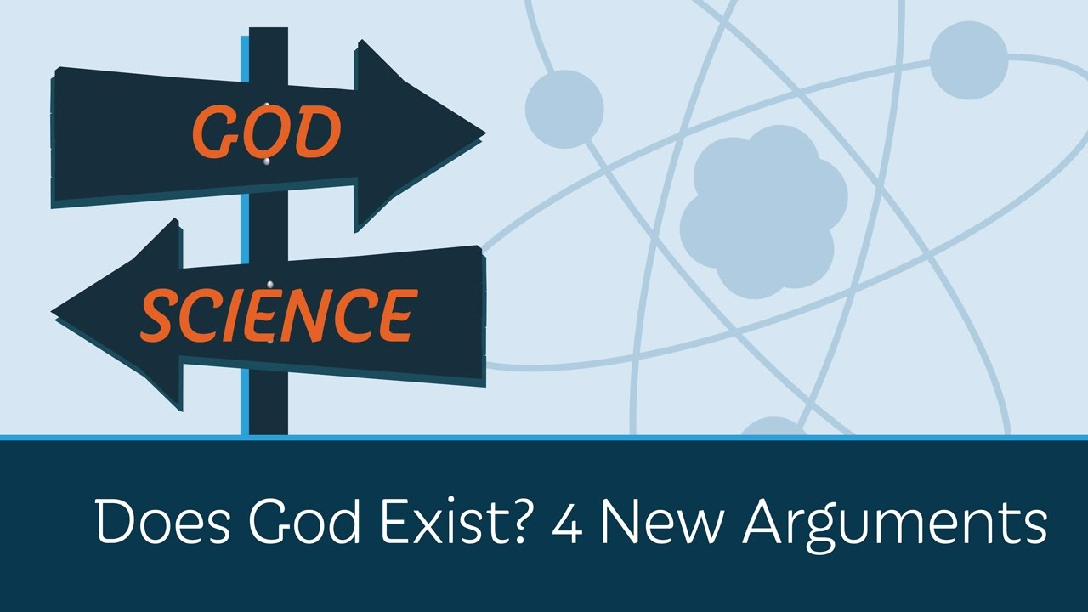
Next 3 Lessons we will look at 4 “God exists because….” theories
We will then look at what philosophers have to say against these statements
You will create an argument to explain and defend one theory as the most important
Your assessment will take the form of a debate….

Slide 2

Notes:
Open Hyperlink

Slide 3






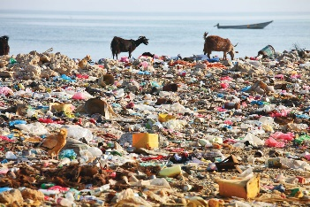


World War II? | This cake? | This computer?
This skyscraper? | This tree? | A Tsunami?
Plastic Pollution? | Sickness? | Life?
WHAT CAUSED OR CAUSES THESE THINGS? Jot down your ideas in the back of your book…

Slide 4

What do you think to this statement?
“God exists, because if He didn’t, there would be no universe at all. How do you get something from nothing?”
Notes:
TPS- write in booklet

Slide 5
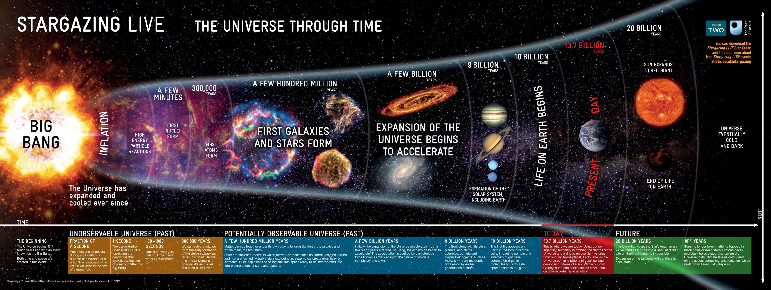
https://www.youtube.com/watch?v=8Are9dDbW24&safe=active
Notes:
Video 1 https://www.youtube.com/watch?v=8Are9dDbW24&safe=active

Slide 6
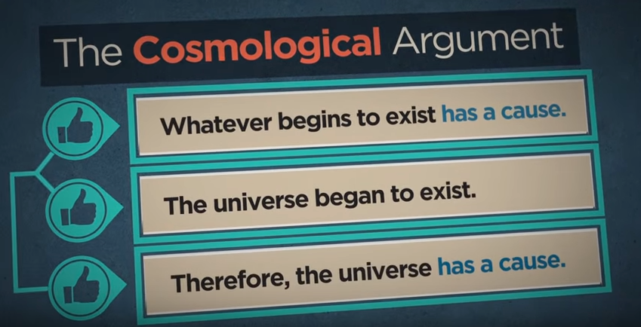
Task – Fill in Gaps activity for why God doesn’t need to exist to explain the universe!
https://www.youtube.com/watch?v=6CulBuMCLg0&safe=active
Notes:
Video 3: https://www.youtube.com/watch?v=6CulBuMCLg0&safe=active

Slide 7
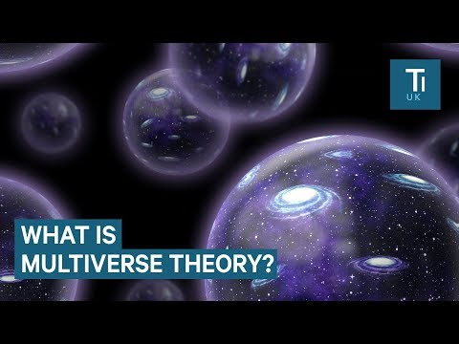

Task – Fill in Gaps activity for why God doesn’t need to exist to explain the universe!
Eternal Universe https://www.youtube.com/watch?v=q3MWRvLndzs&feature=youtu.be
Notes:
Video 2: Then fill in part 1 of the gap activity worksheet

Slide 8
Write your overall opinion in your booklet?
“God exists, because if He didn’t, there would be no universe at all. How do you get something from nothing?”

Slide 9
Homework: Preparation for assessment debate.
Task 1
“Complete the guided reading” by
A. Reading the text
B. Left hand side create a subtitle for each paragraph.
C. Right hand side summarise key points
Task 2:
Watch the YouTube clips showing how powerful religious experiences could be,
Explain which you tube clip is the most convincing that there is a God and explain why.

Slide 10
Scholars you might want to use for debates!
Versions of the cosmological argument / For it: | Scholars who criticise the cosmological arguments:
Aquinas (13th century) | Hume (18th Century)
William Ockham (14th century) | Immanuel Kant (18th Century)
J.L Mackie (20th Century) | Bertrand Russell (20th Century)
Swinburne (21st Century) | Dawkins (21st Century)

