Slide 1
RELIGIOUS EDUCATION
TERM ONE
Year 8

Slide 2
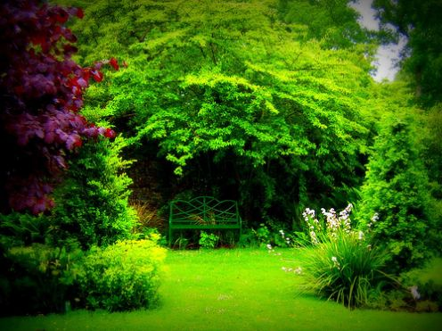
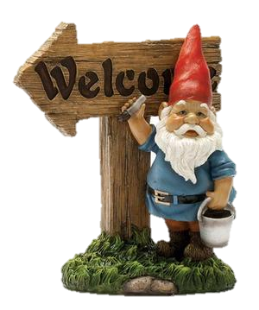
Welcome to RE!
Rules and Expectations

Slide 3
What is RE all about?

Slide 4
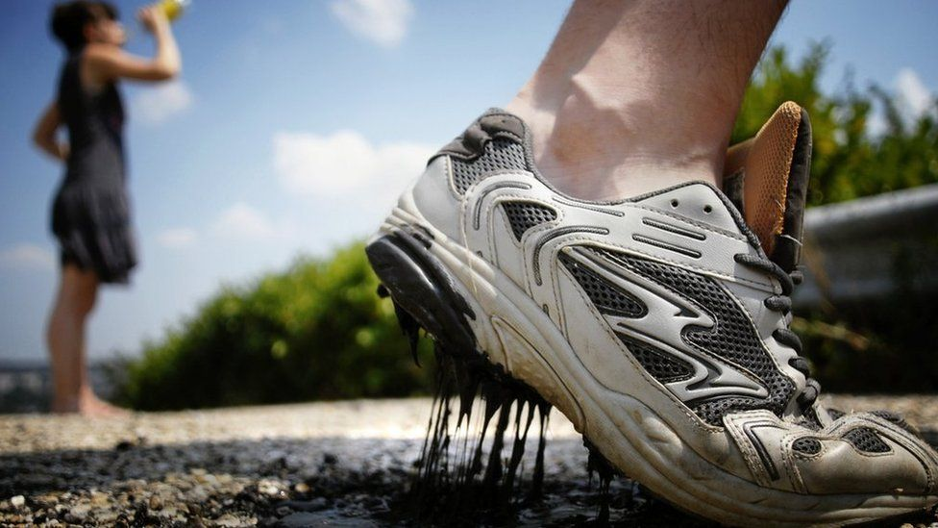
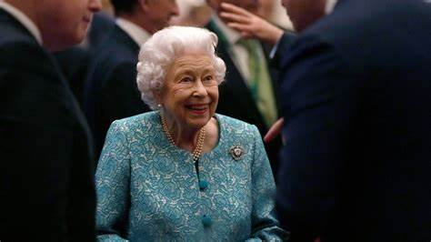
CURRENT AFFAIRS
?
Notes:
Change images to match current stories. How do they relate to topics covered in RE?

Slide 5
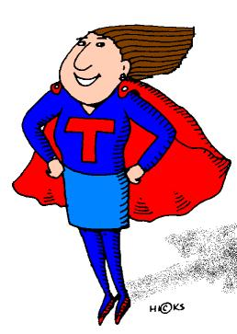
Super Teacher
Hypothesis: “It’s easy to be a good teacher”

Slide 6

By the end of this lesson I will…
… think about some of the qualities of a good teacher.
… design a super teacher.
… be able to explain what makes a teacher so great.

Slide 7
name
Three characteristics of a good teacher
What makes a good teacher?
Swap your sheet with somebody else
Two more characteristics that are not on the sheet.
Three enhancements.
In groups work out what the three most important things a person needs to be a teacher.
Two more enhancements.
One more enhancement.
Two super powers.
One more super power.
Pass the paper to the owner!!!!

Slide 8
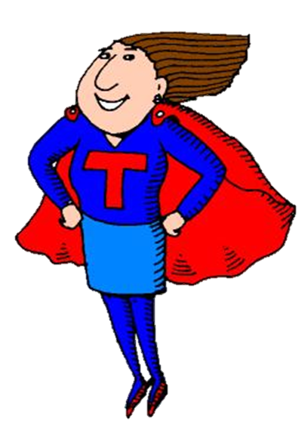
Your Task
Create your super teacher using all the attributes written on your sheet of paper
You should colour and label your drawing.
On the back of your paper you need to write a paragraph explaining which are the most important attributes and why.

Slide 9


The Ten Gurus Song
Look again at your Super Teacher picture. Think about the qualities of a good teacher.

Slide 10
I will…
… know some facts about the Sikh religion.
… know about the ten Gurus and what Sikhs think about them.
… help to create beautiful music!

Slide 11
01
Guru Nanak Dev
Guru Nanak Dev, first of the 10 gurus, founded the Sikh faith and introduced the concept of one God. He was the son of Kalyan Das ji (Mehta Kalu ji) and Mata Tripta ji, and the brother of Bibi Nanaki. He was married to Sulakhani ji and had two sons, Siri Chand and Lakhmi Das.
Guru Nanak Dev was born in Nankana Sahib, Pakistan, on Oct. 20, 1469. He was formally made guru in 1499 at about age 30. He died in Kartarpur, Pakistan, on Sept. 7, 1539, at the age of 69.
02
Guru Angad Dev
Guru Angad Dev compiled the writings of Nanak Dev and introduced the Gurmukhi script. He was the son of Pheru Mall ji and Mata Daya Kaur (Sabhrai) ji. He was married to Mata Khivi ji and had two sons, Dasu and Datu, and two daughters, Amro and Anokhi.
The second guru was born in Harike, India, on March 31, 1504, became guru on Sept. 7, 1539, and died in Khadur, India, on March 29, 1552, two days from 48 years old.
03
Guru Amar Das
Guru Amar Das, third of the 10 gurus, disavowed caste with the institution of langar, pangat, and sangat.
He was born in Basarke, India, on May 5, 1479, to Tej Bhan ji and Mata Lakhmi ji. He married Mansa Devi and had two sons, Mohan and Mohri, and two daughters, Dani and Bhani.
He became the third guru at Khadur, India, on March 26, 1552, and died at Goindwal, India, on Sept. 1, 1574, at the age of 95.
Notes:
Pupils should make their own notes on the Gurus from the three slides.

Slide 12
04
Guru Raam Das
Guru Raam Das began the excavation of the Sarovar in Amritsar, India.
He was born in Chuna Mandi (Lahore, Pakistan), on Sept. 24, 1524, to Hari Das ji Sodhi and Mata Daya Kaur ji. He married Bibi Bhani ji and they had three sons, Prithi Chand, Maha Dev and Arjun Dev.
He became the fourth guru at Goindwal, India, on Sept. 1, 1574, and died at Goindwal on Sept. 1, 1581, at the age of 46.
05
Guru Arjun Dev (Arjan Dev)
Guru Arjun (Arjan) Dev erected the Golden Temple (Harmandir Sahib) in Amritsar, India, and compiled and contributed to Adi Granth in 1604.
He was born in Goindwal, India, on April 14. 1563, to Guru Raam das and Ji Mata Bhani ji. He wed Raam Devi, who was issueless, and Ganga ji, and they had one son, Har Govind.
He was made the fifth guru at Goindwal on Sept. 1, 1581, and died in Lahore, Pakistan, on May 30, 1606, at the age of 43.
06
Guru Har Govind (Har Gobind)
Guru Har Govind (Hargobind) built the Akal Takhat. He raised an army and wore ​two swords that symbolized secular and spiritual authority. The Mughal Emperor Jahangir imprisoned the guru, who negotiated a release for whoever could hold on to his robe.
The sixth guru was born in Guru ki Wadali, India, on June 19, 1595, and was the son of Guru Arjun and Mata Ganga. He married Damodri ji, Nankee ji, and Maha Devi ji. He was the father of five sons, Gur Ditta, Ani Rai, Suraj Mal, Atal Rai, Teg Mall (Teg Bahadur), and one daughter, Bibi Veero.
He was pronounced the sixth guru at Amritsar, India, on May 25, 1606, and died at Kiratpur, India, on March 3, 1644, at the age of 48.

Slide 13
07
Guru Har Rai
Guru Har Rai, seventh of the 10 gurus, propagated the Sikh faith, maintained a cavalry of 20,000 as his personal guard, and established both a hospital and zoo.
He was born in Kiratupur, India, on Jan. 16, 1630, and was the son of Baba Gurditta ji and Mata Nihal Kaur. He married Sulakhni ji and was the father of two sons, Ram Rai and Har Krishan, and one daughter, Sarup Kaur.
He was named the seventh guru at Kiratpur, March 3, 1644, and died at Kiratpur, Oct. 6, 1661, at the age of 31.
08
Guru Har Krishan (Har Kishan)
Guru Har Krishan became guru at the age of 5. He was born in Kiratpur, India, on July 7, 1656, and was the son of Guru Har Rai and Mata Kishan (aka Sulakhni).
He became guru on Oct. 6, 1661, and died of smallpox at Delhi, India on March 30, 1664, at age 7. He had the shortest tenure of all gurus.
09
Guru Teg Bahadar (Tegh Bahadur)
Guru Teg Bahadar, ninth of the 10 gurus, was reluctant to leave meditation and come forward as guru. He ultimately sacrificed his life to protect Hindu Pandits from forced conversion to Islam.
He was born in Amritsar, India, on April 1, 1621, the son of Guru Har Govind and Mata Nankee ji. He married Gujri ji, and they had one son, Gobind Singh.
He became guru at Baba Bakala, India, on Aug. 11, 1664, and died at Delhi, India, on Nov. 11, 1675, at the age of 54.
10
Guru Gobind Singh
Gobind Singh, the 10th guru, created the order of Khalsa. He sacrificed his father, mother, sons, and his own life to protect Sikhs from forced conversion to Islam. He completed the Granth, bestowing upon it the title of everlasting guru.
He was born in Bihar, India, on Dec. 22, 1666, and was the son of Guru Teg Bahadar and Mata Gujri ji. He married Jito ji (Ajit Kaur), Sundri, and Mata Sahib Kaur and had four sons, Ajit Singh, Jujhar Singh, Zorawar Singh and Fateh Singh.
He became the 10th guru at Anandpur, India, on Nov. 11, 1675, and died at Nanded, India, on Oct. 7, 1708, at the age of 41.

Slide 14
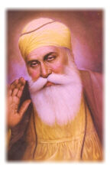
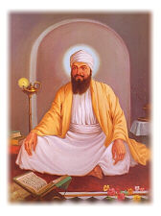
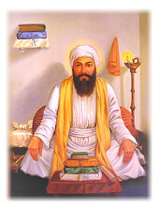
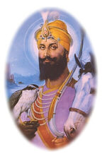
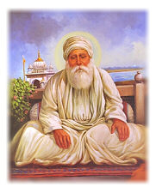
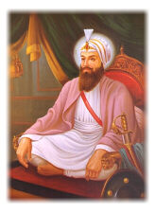
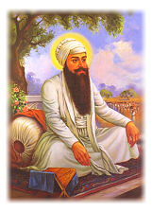
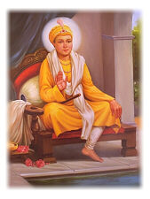
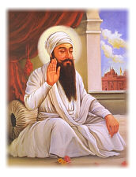
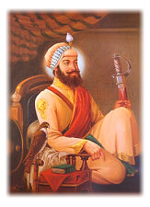
My name is Guru Nanak Dev.
I lived from 1469-1539. I was the first Guru and I began the Sikh religion. I strongly believe that all people are the children of God.
My name is Guru Tegh Bahadur.
I lived from 1621- 1675. I sacrificed my life because I was being forced to become a Muslim.
My name is Guru Angad Dev.
I lived from 1504- 1552. I encouraged people to learn the language of Punjabi and put together a set of hymns about Guru Nanak.
My name is Guru Gobind Singh.
I lived from 1666- 1708. I instructed Sikhs to keep the five K’s. I said that when I die Sikhs must follow the holy book.
My name is Guru Amar Das.
I lived from 1479 – 1574. I believed strongly that everyone is equal and fought for women’s rights.
My name is Guru Har Rai.
I lived from 1630- 1661. I continued with the military traditions. I also made Sikhism strong and popular.
My name is Guru Ram Das.
I lived from 1534- 1581. I started the city of Amistar. I also spread Sikhism to North India.
My name is Guru Harkrishan.
I lived from 1656- 1664. I was a Guru at the age of 5! I died from smallpox at the age of 8.
My name is Guru Arjan Dev.
I lived from 1563- 1606. I put together the book of the Guru Granth Sahib. I was the first Guru to be martyred .
My name is Guru Hargobind.
I lived from 1595- 1644. I introduced martial arts and weapons to be used in defence. He was imprisoned and he fought battles with the rulers.

Slide 15
SUCCESSFUL WORK WILL:
Be a catchy song!
Give at least five facts about the Sikh religion (keep it basic!)
Give the names of all of the Ten Gurus
Give two further facts about each guru.
Include contributions from all members of your group.
Be performed by the whole group (nobody sits it out).
Notes:
In groups pupils should write songs about the Sikh religion and the Ten Gurus. The important thing is that they all contribute to the writing of their song and they all get it written down. They do not have to stand at the front of the class to perform it (but they can if they wish to). Sometimes if I groups is very reluctant to perform their song I sing it for them. They can use chapters one and two in “The Sikh Experience” books to help them.

Slide 16
RE-O
Notes:
Song performances.

Slide 17
Guru Nanak and dedication
Objectives
I will know the story of Guru Nanak.
I will understand how dedicated he was.
I will know why the Sikhs thought he was a great teacher.
HYPOTHESIS…
“If you are going to succeed you need to be totally dedicated.”

Slide 18
https://www.youtube.com/watch?v=JavKCE2FAf0&safe=true

Slide 19
INDIVIDUAL WORK
Write down three bullet points that could be used as evidence to show Guru Nanak’s dedication to his religion.
How have you shown dedication to something in your life? Write down three bullet points that could be used as evidence to show your dedication.

Slide 20
GURU AMAR DAS AND EQUALITY
Targets
I will know the story of Guru Amar Das
I will think about what equality means
I will understand the Guru’s response to the gift

Slide 21
Please answer the following question in full sentences:
Do you believe people should be treated equally? Why?
2. How do the Sangat, Pangat and Langar promote equality?

Slide 22
Interview 2 people about equality and record their answers to the following questions:-
What does equality mean to you?
Should ALL people be treated equally? Why or why not?
If your greatest hero, and someone you didn’t like came round for dinner, do you think you would be able to treat them equally?

Slide 23
GURU GOBIND SINGH AND SELF SACRIFICE
Targets
I will know the story of Guru Gobind Singh
I will know what self sacrifice means
I will think about the things that are important to me
Hypothesis
There is nothing worth sacrificing your
life for.

Slide 24
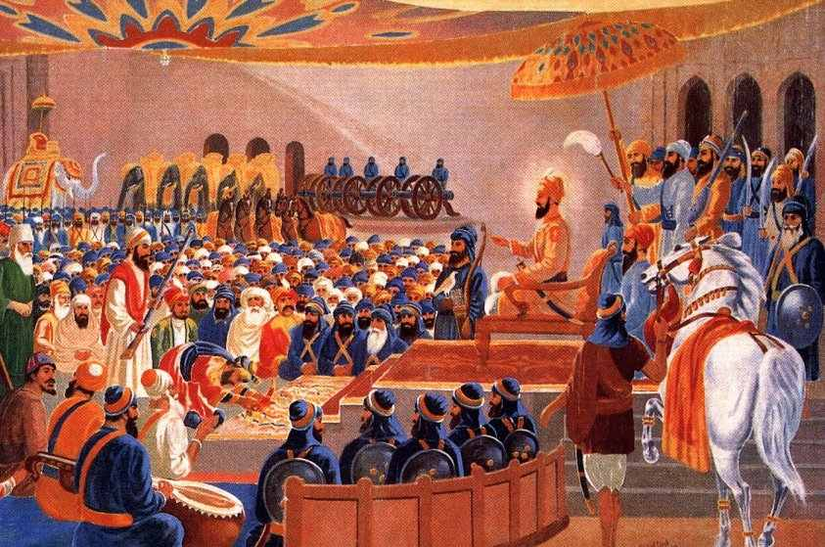
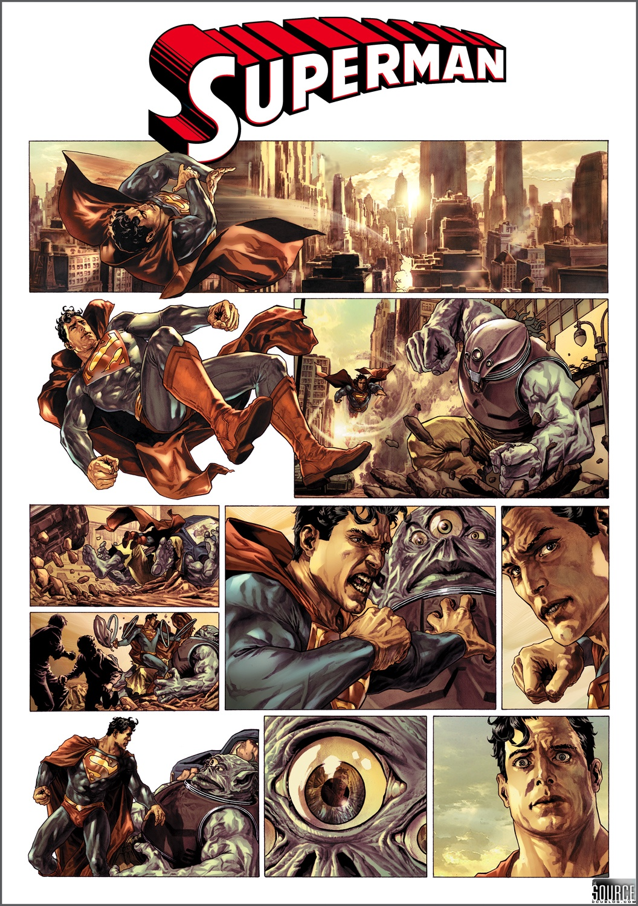
Task
Create a comic strip to depict the events at the festival of Vaisakhi. Use a full page of your books. Do not use any words.

Slide 25
The Balloon Debate
Lesson Objectives
I will recap on everything I have learnt about the 10 Gurus.
I will write a persuasive speech.

Slide 26



Your Assessment Task
To finish your speech arguing why your Guru is the best.
To write a speech arguing why other peoples Gurus are not the best!
Each speech must be 1 minute long.

Slide 27
Order of the Debate
Each speaker takes it in turns to present their first speech.
Each speaker in turn presents their second speech.
Then the opposing group votes for who is the weakest.
Each speaker must then improvise- giving another argument for their guru.
This process continues until there is one guru left.

Slide 28
Foundation | Secure | Confident | Exceptional
You will be able to give some details about your guru. You will outline the teachings of your guru. You will say what Sikhs might learn from the teachings. You can say why things the guru said or taught are important. | You will show clear understanding of the teachings of one guru. You will know the stories of the different gurus. You will use key words that Sikhs use. You can relate the teachings to real life. | You will show that you have thought carefully about the teachings of the gurus and how they would affect the lives of Sikhs. You will be able to compare and contrast the teachings of the gurus, showing similarities and differences. You will give clear reasons why your guru’s teaching are the most important. You can include references to current events and news items. | You will show that you understand why different people think that other teachings are more important, but you will still be able to argue for your guru. You will raise questions that are difficult to answer. You will write about how the time and place that people live in can affect their responses to teachings. You will show clear links between Sikh teachings and those of other relgions.

