Slide 1
RELIGIOUS EDUCATION
TERM ONE
Year 7

Slide 2
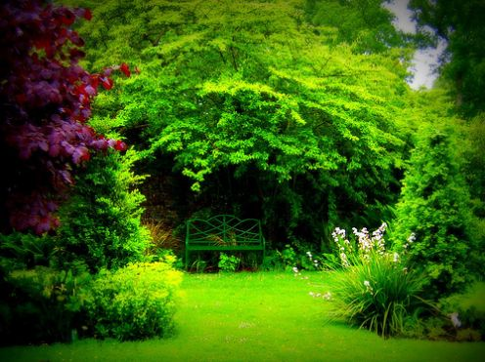
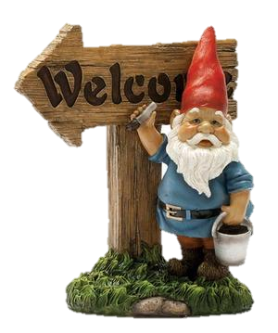
Welcome to RE!
Rules and Expectations

Slide 3
What is RE all about?

Slide 4
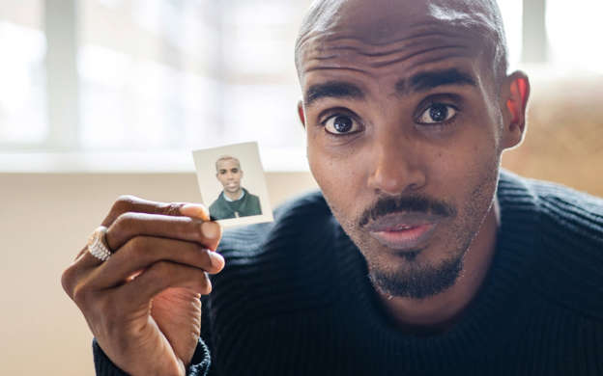
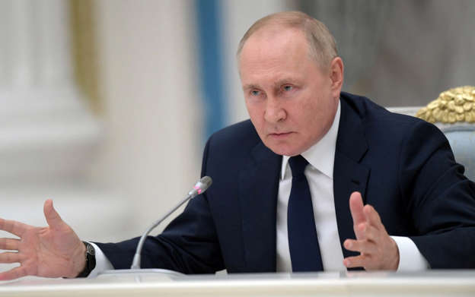
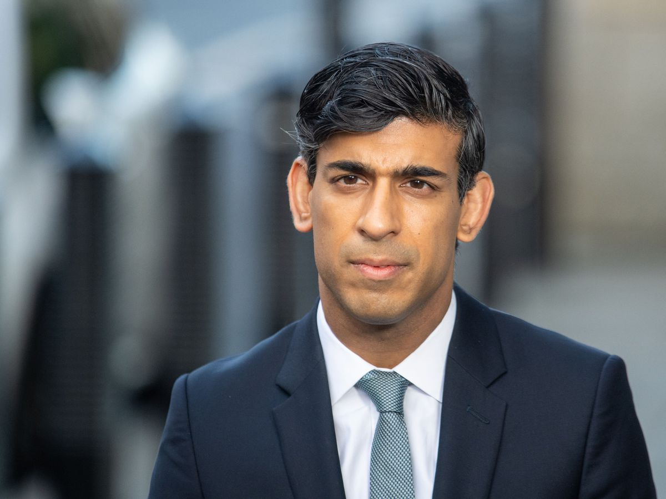
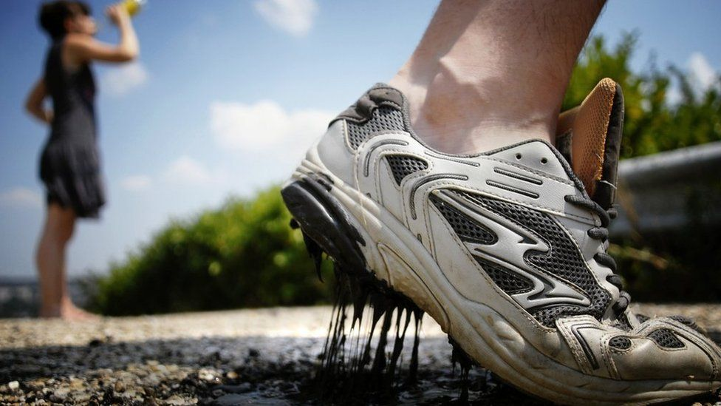
CURRENT AFFAIRS
?
Notes:
Change images to match current stories. How do they relate to topics covered in RE?

Slide 5
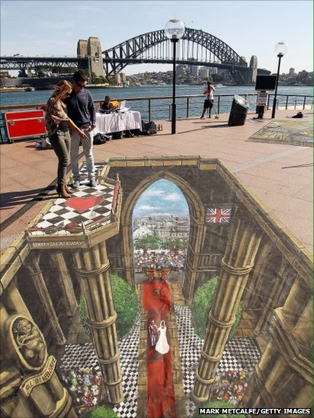
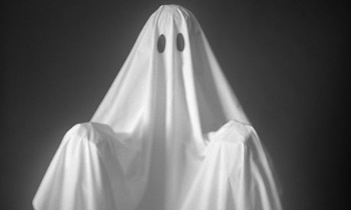


Think
Look at these images- What do you think is happening in them?

Slide 6
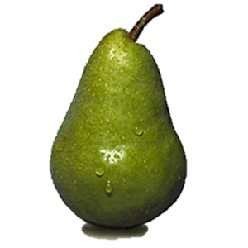
Pair
In your pairs look at all the different reasons that RE is important.
Put your cards in order with the most important reason on the top.

Slide 7
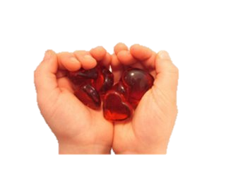
Share
… working in a four your must all completely agree with the order of your cards.
Hint: you will need to discuss or explain your reasons behind your choices!

Slide 8
Next…
Write the top three reasons why RE is important in your log book.

Slide 9
Homework
You need to ask the questions below at home.
What is Re all about?
Why is RE important?
Write the responses in your log books

Slide 10
“Is God RE people about or?”

Slide 11
– What is the question?
More importantly – what is the answer?

Slide 12
Your Task
In your groups you need to answer the question and then present it to the class.
However… each group will have it’s own style.
Notes:
Split the class into groups. One group should prepare the answer as a poster, but one without titles or words on it. Another group as a mime. Another group should prepare the answer as a poem, song or rap.

Slide 13
Evaluate each group’s presentation in terms of:-
The effectiveness of their presentation
The answer they gave to the question
What is the answer to the question?
What skills do you think you have used during the course of this lesson?

Slide 14
Ultimate Questions
  1. I will think about some of the mysteries of life.
  2. I will know what an ultimate questions is.
  3. I will think about the ways in which people answer ultimate questions.

Slide 15
Can you think of any of life’s mysteries

Slide 16
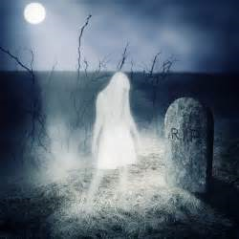
It’s a Mystery
  I will explain a real life mystery.
  I will show how people react to mystery.
  I will think about different ways of explaining the mystery.

Slide 17
Write a story about a real life mystery (something that has happened to you or you know about).
It should explain and describe the circumstances and events.
How did people react to it? What feelings did it make you have?
Come up with some possible explanations to the mystery using different beliefs.

Slide 18
Foundation | Secure | Confident | Exceptional
You will outline the mysterious event, giving a basic account of what happened and who was involved. 2) You will describe the mysterious event, giving a detailed account of what happened and who was involved. 3) You will say briefly how it made you feel. 4) You will give a full explanations of your feelings about the mystery. | 1) You will tell the story of your mystery. 2) You will outline the possible questions people might ask about the mystery. 3) You will use the words you have learned in RE. 4) You will explain at least one possible answer to your mystery. | 1) You will show that you know how different people might have different answers for the mystery. 2) You will show that you have thought carefully about what influences different people and how they answer mysteries. 3) You will be able to explain the questions that are raised by your mystery and suggest different possible answers. 4) You will consider why mysteries are important to us. | 1) You will show that you understand why different people think different things about the answer to your mystery, whether you agree with them or not. 2) As well as writing about your own views about your mystery, you will use other people’s answers to show arguments against your views. 3) You will write about your views on mysteries and life in general and write why you think you have these views. 4) You will make links between mysteries and religious beliefs.

Slide 19
What is an ‘Ultimate Question’?
“A question that we can't answer because it is beyond our power to do so.”

Slide 20
Think of three “ultimate questions.”
Make sure they are good ones – questions that we really cannot answer. Try to link them to some of life’s real mysteries if you can. Consider what it is that makes a really, really good ultimate question.

Slide 21
Homework
Ask someone at home for their answers to six really good ultimate questions.
You could also ask members of staff from other departments.
Write the answers to three questions in your book

Slide 22
Ultimate Answers
Objectives
  I will think about the way we answer ultimate questions.
  I will understand some of the things that influence our answers.
  I will begin to decide on my own answers.

Slide 23
Answering Questions
What colour is the sky?
What is 2+2?
3. Is love real?
4. Is God real?
But how do you know?

Slide 24
Task 1
Make a list of all the ways we are influenced to answer ultimate questions.
E.G Do your parents share your views about God?

Slide 25
Paired task
In pairs you have to choose an Ultimate Question to champion to the rest of the class.
You have to write two possible answers and how you got them.
then you have to explain why your question is the best/most difficult to answer to the rest of the class
EVALUATE – what pair had the best UQ and why?!

Slide 26

Ultimate

Slide 27
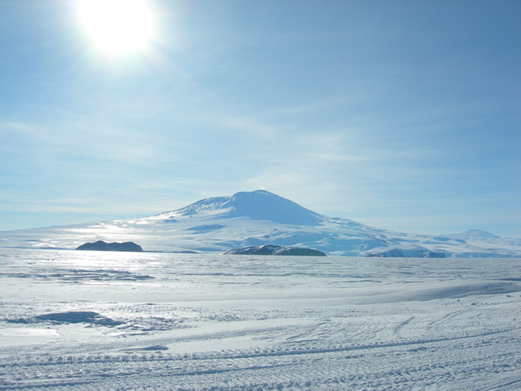

Slide 28
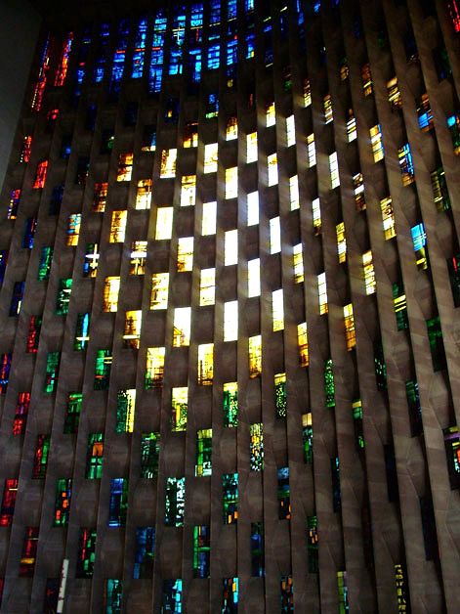

Slide 29
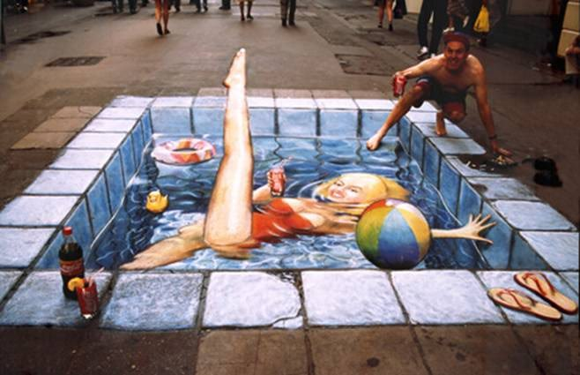

Slide 30
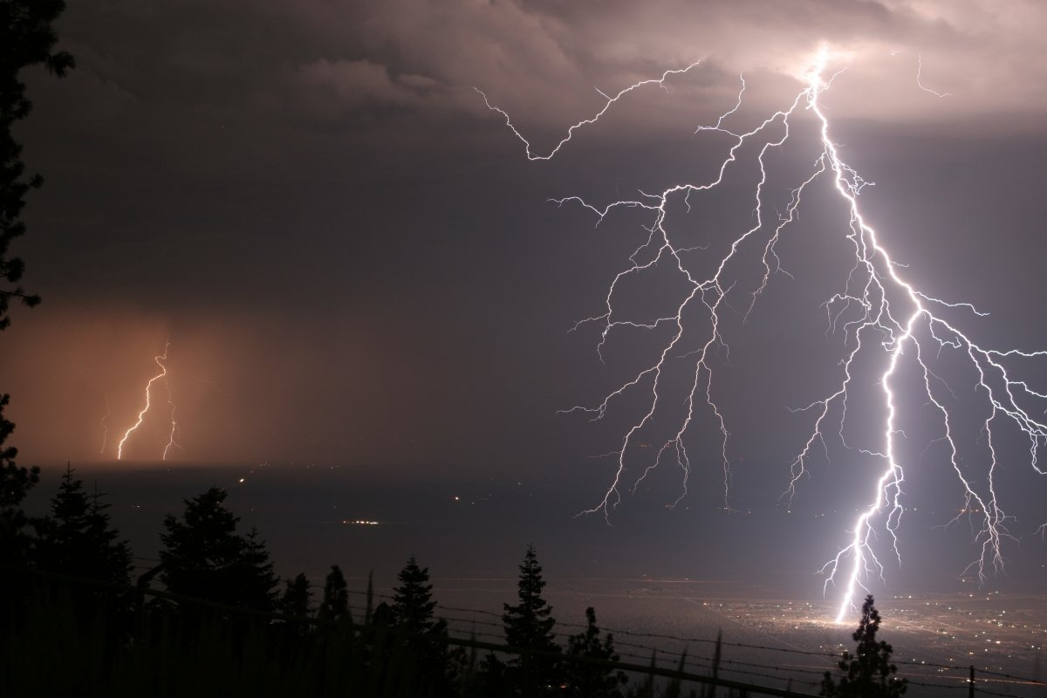

Slide 31


Slide 32
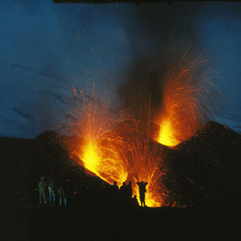

Slide 33
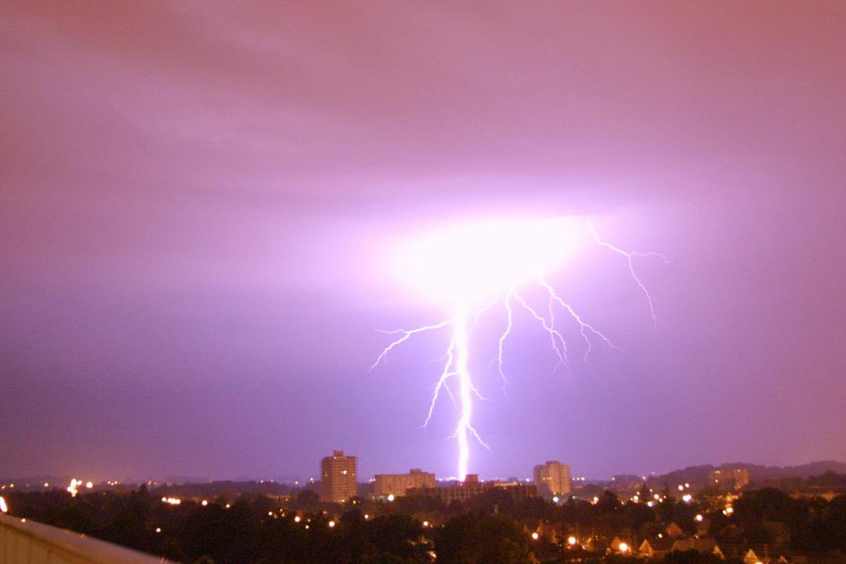

Slide 34
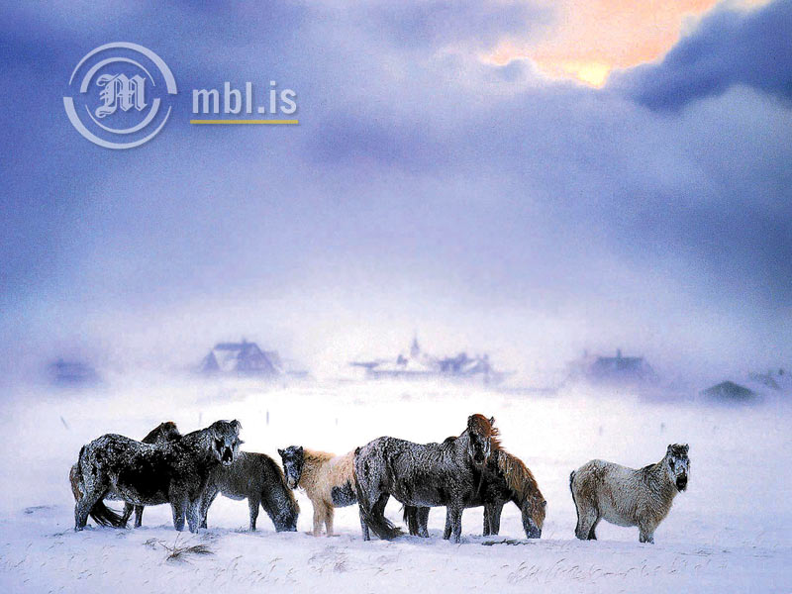

Slide 35
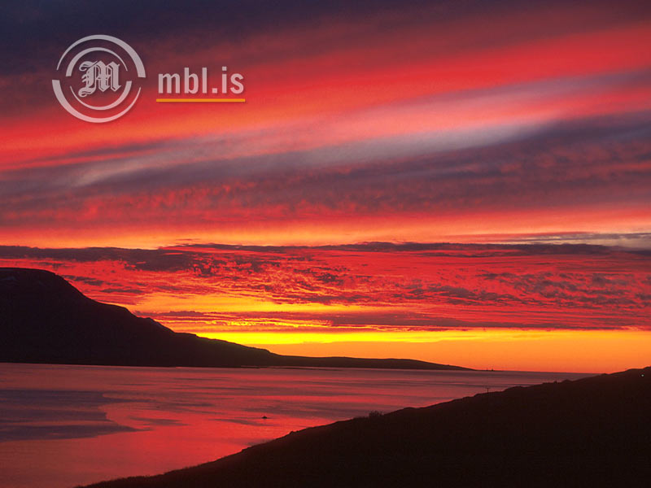

Slide 36
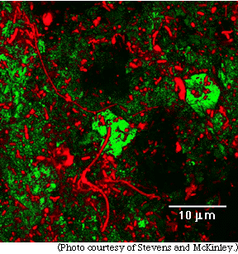

Slide 37


Slide 38


Slide 39

What are the physical and non-physical sides of us?
Brain

Slide 40
Your Task
Create a poster of the physical and non-physical elements of yourself.
You have only five minutes.
You can not use words.

Slide 41
The soul
“Spiritual or immaterial part of man, regarded as immortal; moral, emotional, or intellectual part of a person or animal”

Slide 42
Hypothesis
“Everybody has a soul and it is eternal”

