Slide 1
Poverty and Wealth
  I will think about the things we value.
  I will know what status symbols are.
  I will think about how we spend our money.

Slide 2

CONGRATULATIONS!
YOU HAVE JUST WON THE LOTTERY!
YOU ARE EIGHT MILLION POUNDS RICHER.

Slide 3
YOUR SHOPPING LIST
1)
2)
3)
4)
5)

Slide 4
Why?

Slide 5

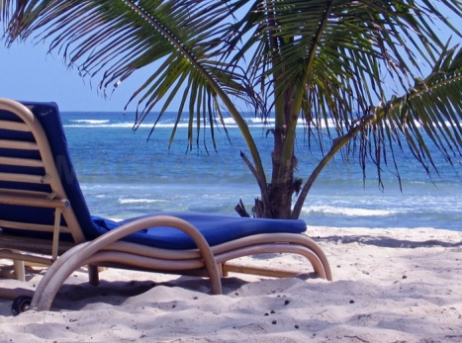
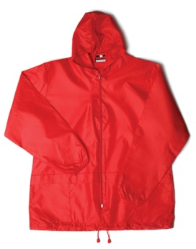
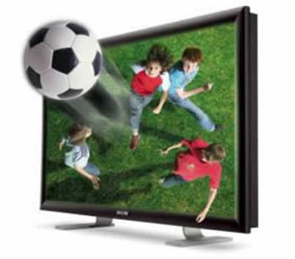
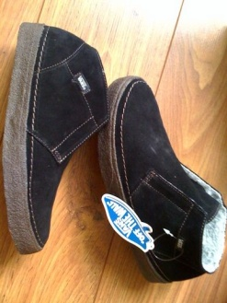
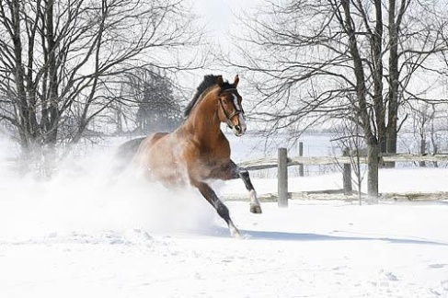
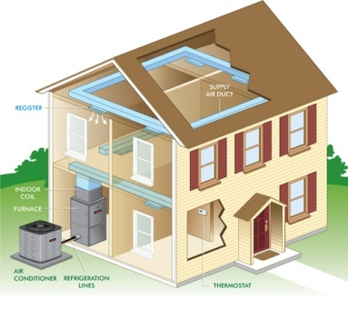


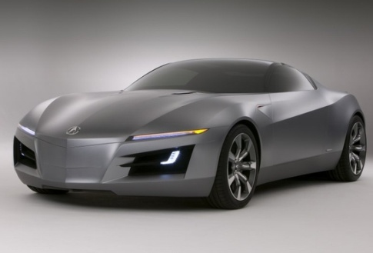
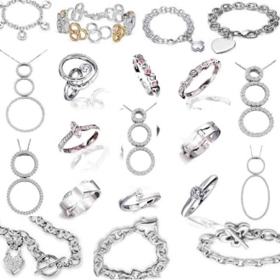
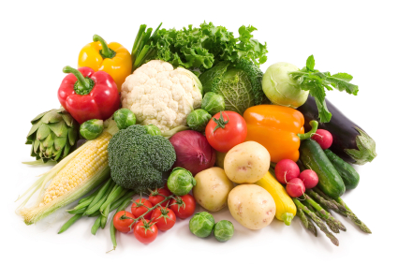
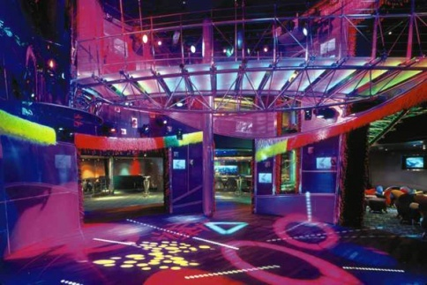
PUT THE FOLLOWING ITEMS IN ORDER OF HOW MUCH YOU WANT THEM.
A NEW BED
EXOTIC HOLIDAY
WATERPROOF COAT
3D TV
COMFY SHOES
A HORSE
HEATING
WATER BILLS PAID
DESIGNER CLOTHES
SPORTS CAR
DESIGNER JEWELLERY
SEASON TICKETS TO TOP NIGHTCLUBS
VEG

Slide 6
PUT THE FOLLOWING ITEMS IN ORDER OF HOW MUCH YOU WANT THEM.
A NEW BED
EXOTIC HOLIDAY
WATERPROOF COAT
3D TV
COMFY SHOES
A HORSE
HEATING
WATER BILLS PAID
DESIGNER CLOTHES
SPORTS CAR
DESIGNER JEWELLERY
SEASON TICKETS TO TOP NIGHTCLUBS
VEG

Slide 7
WORK
Decide what the five most valuable things in life are. You must be prepared to explain your choices fully and present your final answer to your teacher in a leaflet, power-point presentation or a speech.

Slide 8
Answer in full sentences
What is really of value to you?
Do you think you have too much money or too little money?
Why?
3. What do you think is the best way to spend your money?

Slide 9


Slide 10
“People who live in poverty should do more to help themselves.”
Do you agree? Explain

Slide 11
Images of Poverty
How do you respond to each picture?
Write down your thoughts using single words.
Don’t use the same word twice.

Slide 12
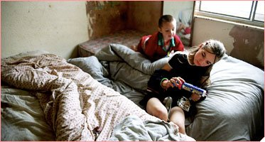

Slide 13
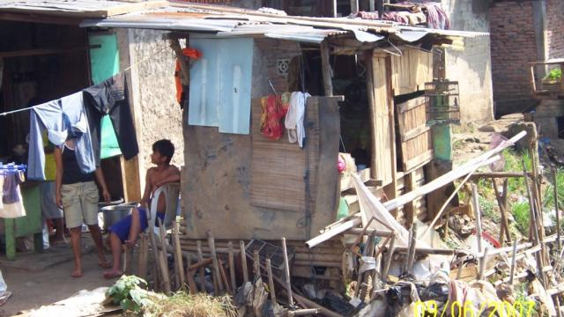

Slide 14
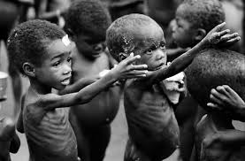

Slide 15
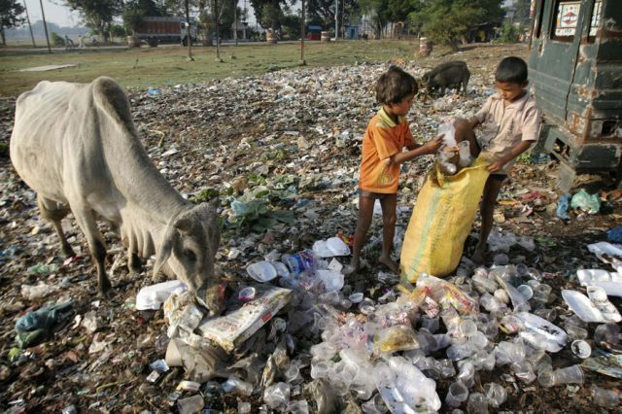

Slide 16
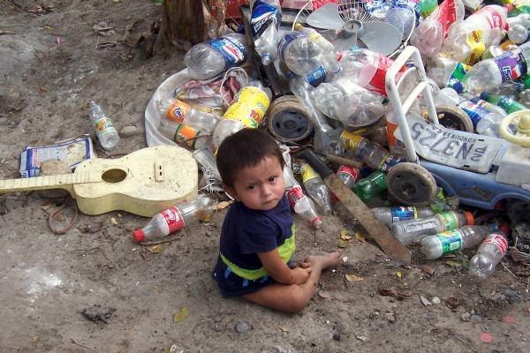

Slide 17
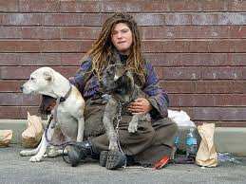

Slide 18
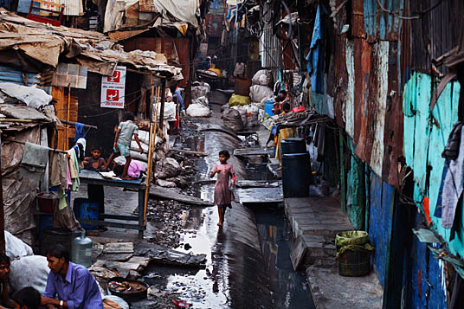

Slide 19
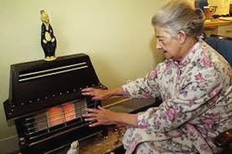

Slide 20
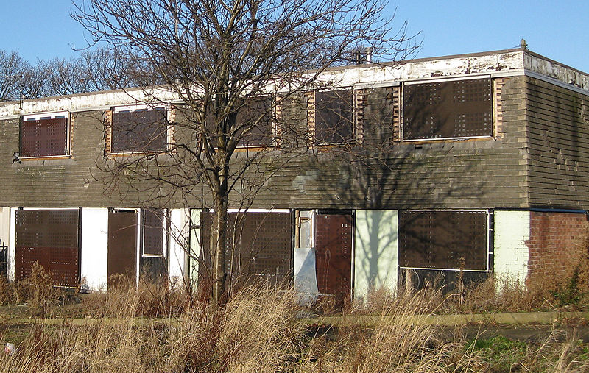

Slide 21
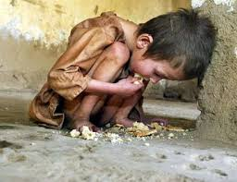

Slide 22
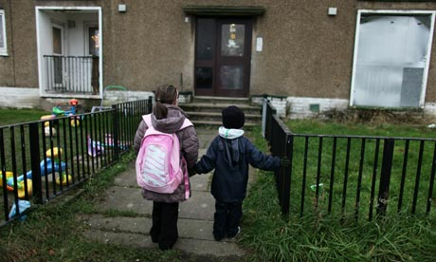

Slide 23
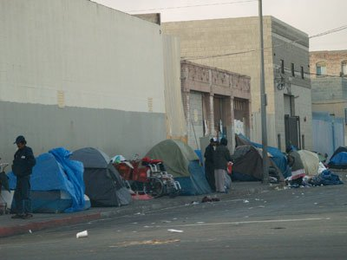

Slide 24
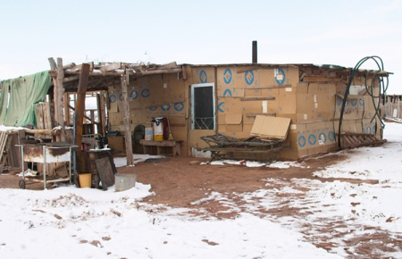

Slide 25
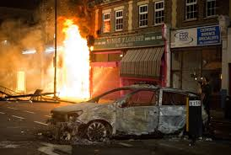

Slide 26
Tasks
Using the words you have gathered, write a definition of poverty.
Watch the clip then answer these questions;
what are the most valuable things in Daniel and Rojalba’s lives? https://youtu.be/V0VuMxSSsVM
https://youtu.be/6ge_4-xSfRg
What does it really mean to be poor?
Apart from food, water and shelter, what other aspects of life does poverty affect?

Slide 27
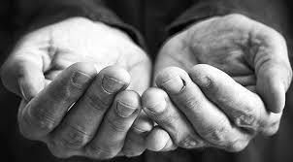
Poster Work
Create a poster to generate awareness of poverty in the world.
Include facts and colour
Challenge: suggest ways people could tackle this issue. What are the barriers?

Slide 28

LOADSAMONEY!
Objectives
To know and understand some of the problems charitable organisations face in allocating money to good causes.
To consider your own attitudes to charity organisations and the work they do.

Slide 29
Have a look round the
Red Nose Day Website
https://www.comicrelief.com/rednoseday/

Slide 30
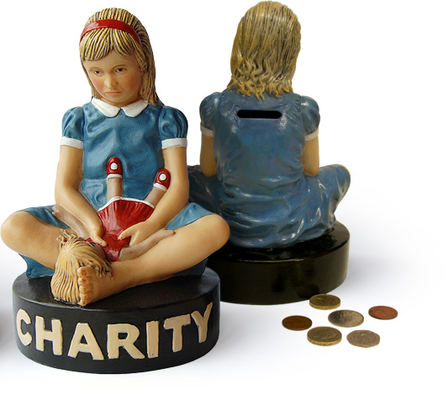
Choose four of the following sentence starters to complete. This will help you reflect on your own viewpoints:-
My attitude to charity giving is...
One thing I respect about people who work for charities is...
One thing I don’t think is right about charities is...
I’m surprised to find out that...
I’m interested to find out more about...
One important thing about justice is...
What politicians should do is...
What I’d like to know more about is...
Would I ever work for a charity? Well...

Slide 31
RESEARCH WORK
FIND OUT ABOUT THE FOLLOWING CHARITIES | WHAT IS THE CHARITY’S HISTORY | WHAT DOES THE CHARITY DO?
Christian Aid
CAFOD
Tearfund
The Salvation Army
After you have done the research, present your work as a leaflet, a series of posters, a speech or a power-point presentation.

