Slide 1
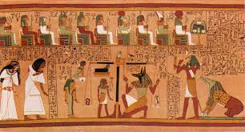
Starter – This is the oldest collection of religious texts and it comes from around 2400BCE. Where is it from? What do you think the purpose of the artefact was?

Slide 2
Lesson 15: The Oldest Religious Text The Book of the Dead A handy guide to make it to the afterlife
The world’s oldest collection of religious texts are the hundreds of spells written inside some of Egypt’s smaller pyramids.
The spells included spells to protect the mummified body. The spells or ‘coffin texts’ gave advice to the dead: such as ‘how to not die a second time’, ‘how not to rot’ and ‘how to avoid working’ in the land of the dead.
They also had maps showing routes to the next world. Eventually these spells were written on rolls of papyrus and they are known as ‘The Book of the Dead’.
There were also terrifying creatures waiting for the Egyptian soul in the land of the dead the Book of the Dead also had tricks and spells to get past these creatures unharmed.

Slide 3
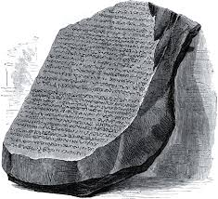
Lesson 15 the oldest religious text The Book of the Dead
Question: The Book of the Dead was not deciphered until 1900
Why was this?
Rosetta Stone

Slide 4
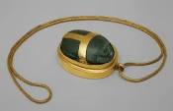
Lesson 15: The Oldest Religious Text The Book of the Dead Watch this video to answer the following questions:
What was your heart weighed against?
If your heart was found heavier when weighed, what animal would you be fed to?
What did the heart scarab protect you from?
What was the Field of Reeds?

Slide 5
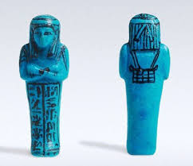
Lesson 15: The Oldest Religious Text The Book of the Dead
Task 1. Use the information from the History Revealed article and the video you just watched to create a list of all the artefacts that the ancient Egyptians were buried with to help them navigate the land of the dead? You must explain their purpose
Task 2: Use the information from the History Revealed article and the video you just watched to create a list of all the terrors that could stop the ancient Egyptian from safely reaching the Field of Reeds.
Extension: Draw the objects you are describing

Slide 6
Lesson 15: Homework The Book of the Dead
Use your knowledge to create a snakes and ladders board game. You must draw on to the template at least three snakes and three ladders.
Remember to write on the snakes head something bad that would stop the ancient Egyptian from getting to paradise with the Gods.
Remember to write at the bottom of the ladders something good that would help the ancient Egyptian to get to paradise.
It would be great if you could decorate your boards maybe include some pictures of ancient hieroglyphics or artefacts?
If they are good we will play the board games in class towards the end of term.

Slide 7
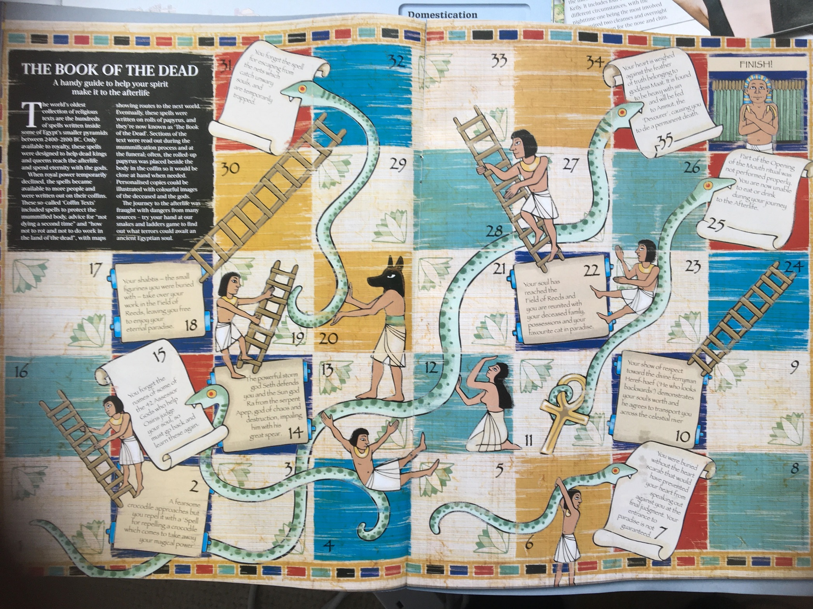
Example

Slide 8
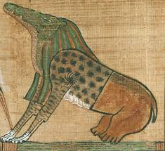
Plenary What is this?
Ammut: devourer of the dead a terrifying goddess with a crocodiles head, lions body and back legs of a hippopotamus. Who waited at the scales of judgement to eat the hearts of the sinners.

Slide 9
Plenary What is this?
Shabits: No one wanted to work for eternity the Book of the Dead said that if you were buried with a Shabit and the correct spell to bring they would work for their owner in the land of the dead.

Slide 10
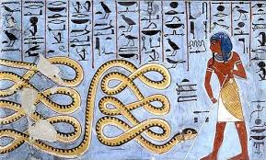
Plenary What is this?
Apep: ‘The Eater of Souls’ a great roaring serpent who tried to swallow the Sun god Ra each night to prevent him from rising again, plunging the world into darkness.

Slide 11
Plenary What is this?
The Heart Scarab on a amulet. Used to protect the heart from speaking against you at the final judgement.

Slide 12
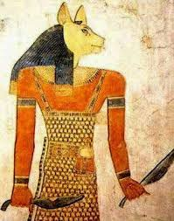
Plenary What is this?
Shezmu: ‘The Lord of Blood’
Hunted sinners for slaughter he was also known as ‘the One that dismembers bodies’
and used a wine press to crush human heads instead of grapes

Slide 13
Plenary What is this?
The Book of the Dead
A Handy Guide to help your spirit in the afterlife.
The world’s oldest collection of religious texts are the hundreds of spells written inside some of Egypt’s smaller pyramids.
Written around 1550 BCE

Slide 14
Plenary What is this?
The Rosetta Stone is a stone with writing carved into it. French soldiers found it in Egypt in 1799. It helped people get a better understanding of the Ancient Egyptian writing system called hieroglyphics. ... It had three pieces of writing on it that said the same thing in three different languages.

