Slide 1
Buddhism
I will know the story of the life of the Buddha.
I will understand why the prince acted as he did.
I will think about the middle path and what it means.

Slide 2
Starter
Write down any words you think of when you think of ‘Buddhism’.

Slide 3
Mime it!!
Create a mime that shows the main points of the story of the Buddha’s life.

Slide 4
The Middle Way?
Copy and complete this sentence:
Taking the “middle path” means…

Slide 5
Homework
Try to spend a day following the teaching of the middle path.
Be prepared to feedback to the rest of the group explaining how it went.

Slide 6
The Teachings of the Buddha
I will know some Buddhist teachings.
I will understand how the teachings relate to life.
I will think about the way I live my life.

Slide 7
Copy and comment
Hypothosis
“It is easy to put the needs of others before our own.”

Slide 8
The teachings
In pairs, discuss and then write down the teachings given by the Buddha.
What stories did he use to illustrate his messages?
Extension
Are they relevant today? Explain

Slide 9
The Vaguely Impossible Information Grid!
Rules
Only 1 person must speak at a time.
The first word you say will be counted.
The aim of the game is to include 5 facts.

Slide 11
Homework due 24/1
Try to spend a day following the teaching of the middle path.
Keep a diary
Be prepared to feedback to the rest of the group explaining how it went.

Slide 12
The middle path and the Four Noble Truths
I will think about Buddhist teachings.
I will know what is meant by the middle way

Slide 13
The Rules
Read through the chapter putting together five questions to ask me.
Questions must be sensible,
Questions must be from the correct chapter and based on the correct topics.
The answers to the questions must be clear and definitive and you must write down your answers below the questions.

Slide 14
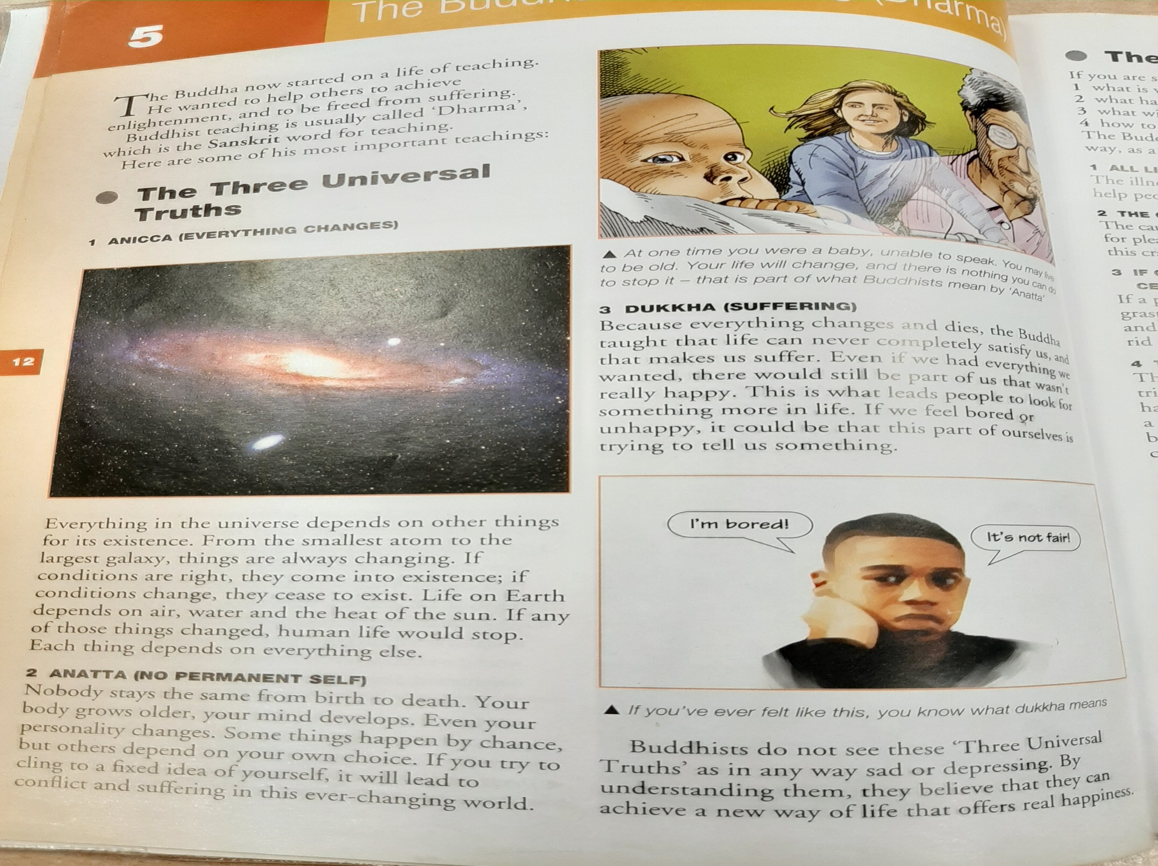

Slide 15
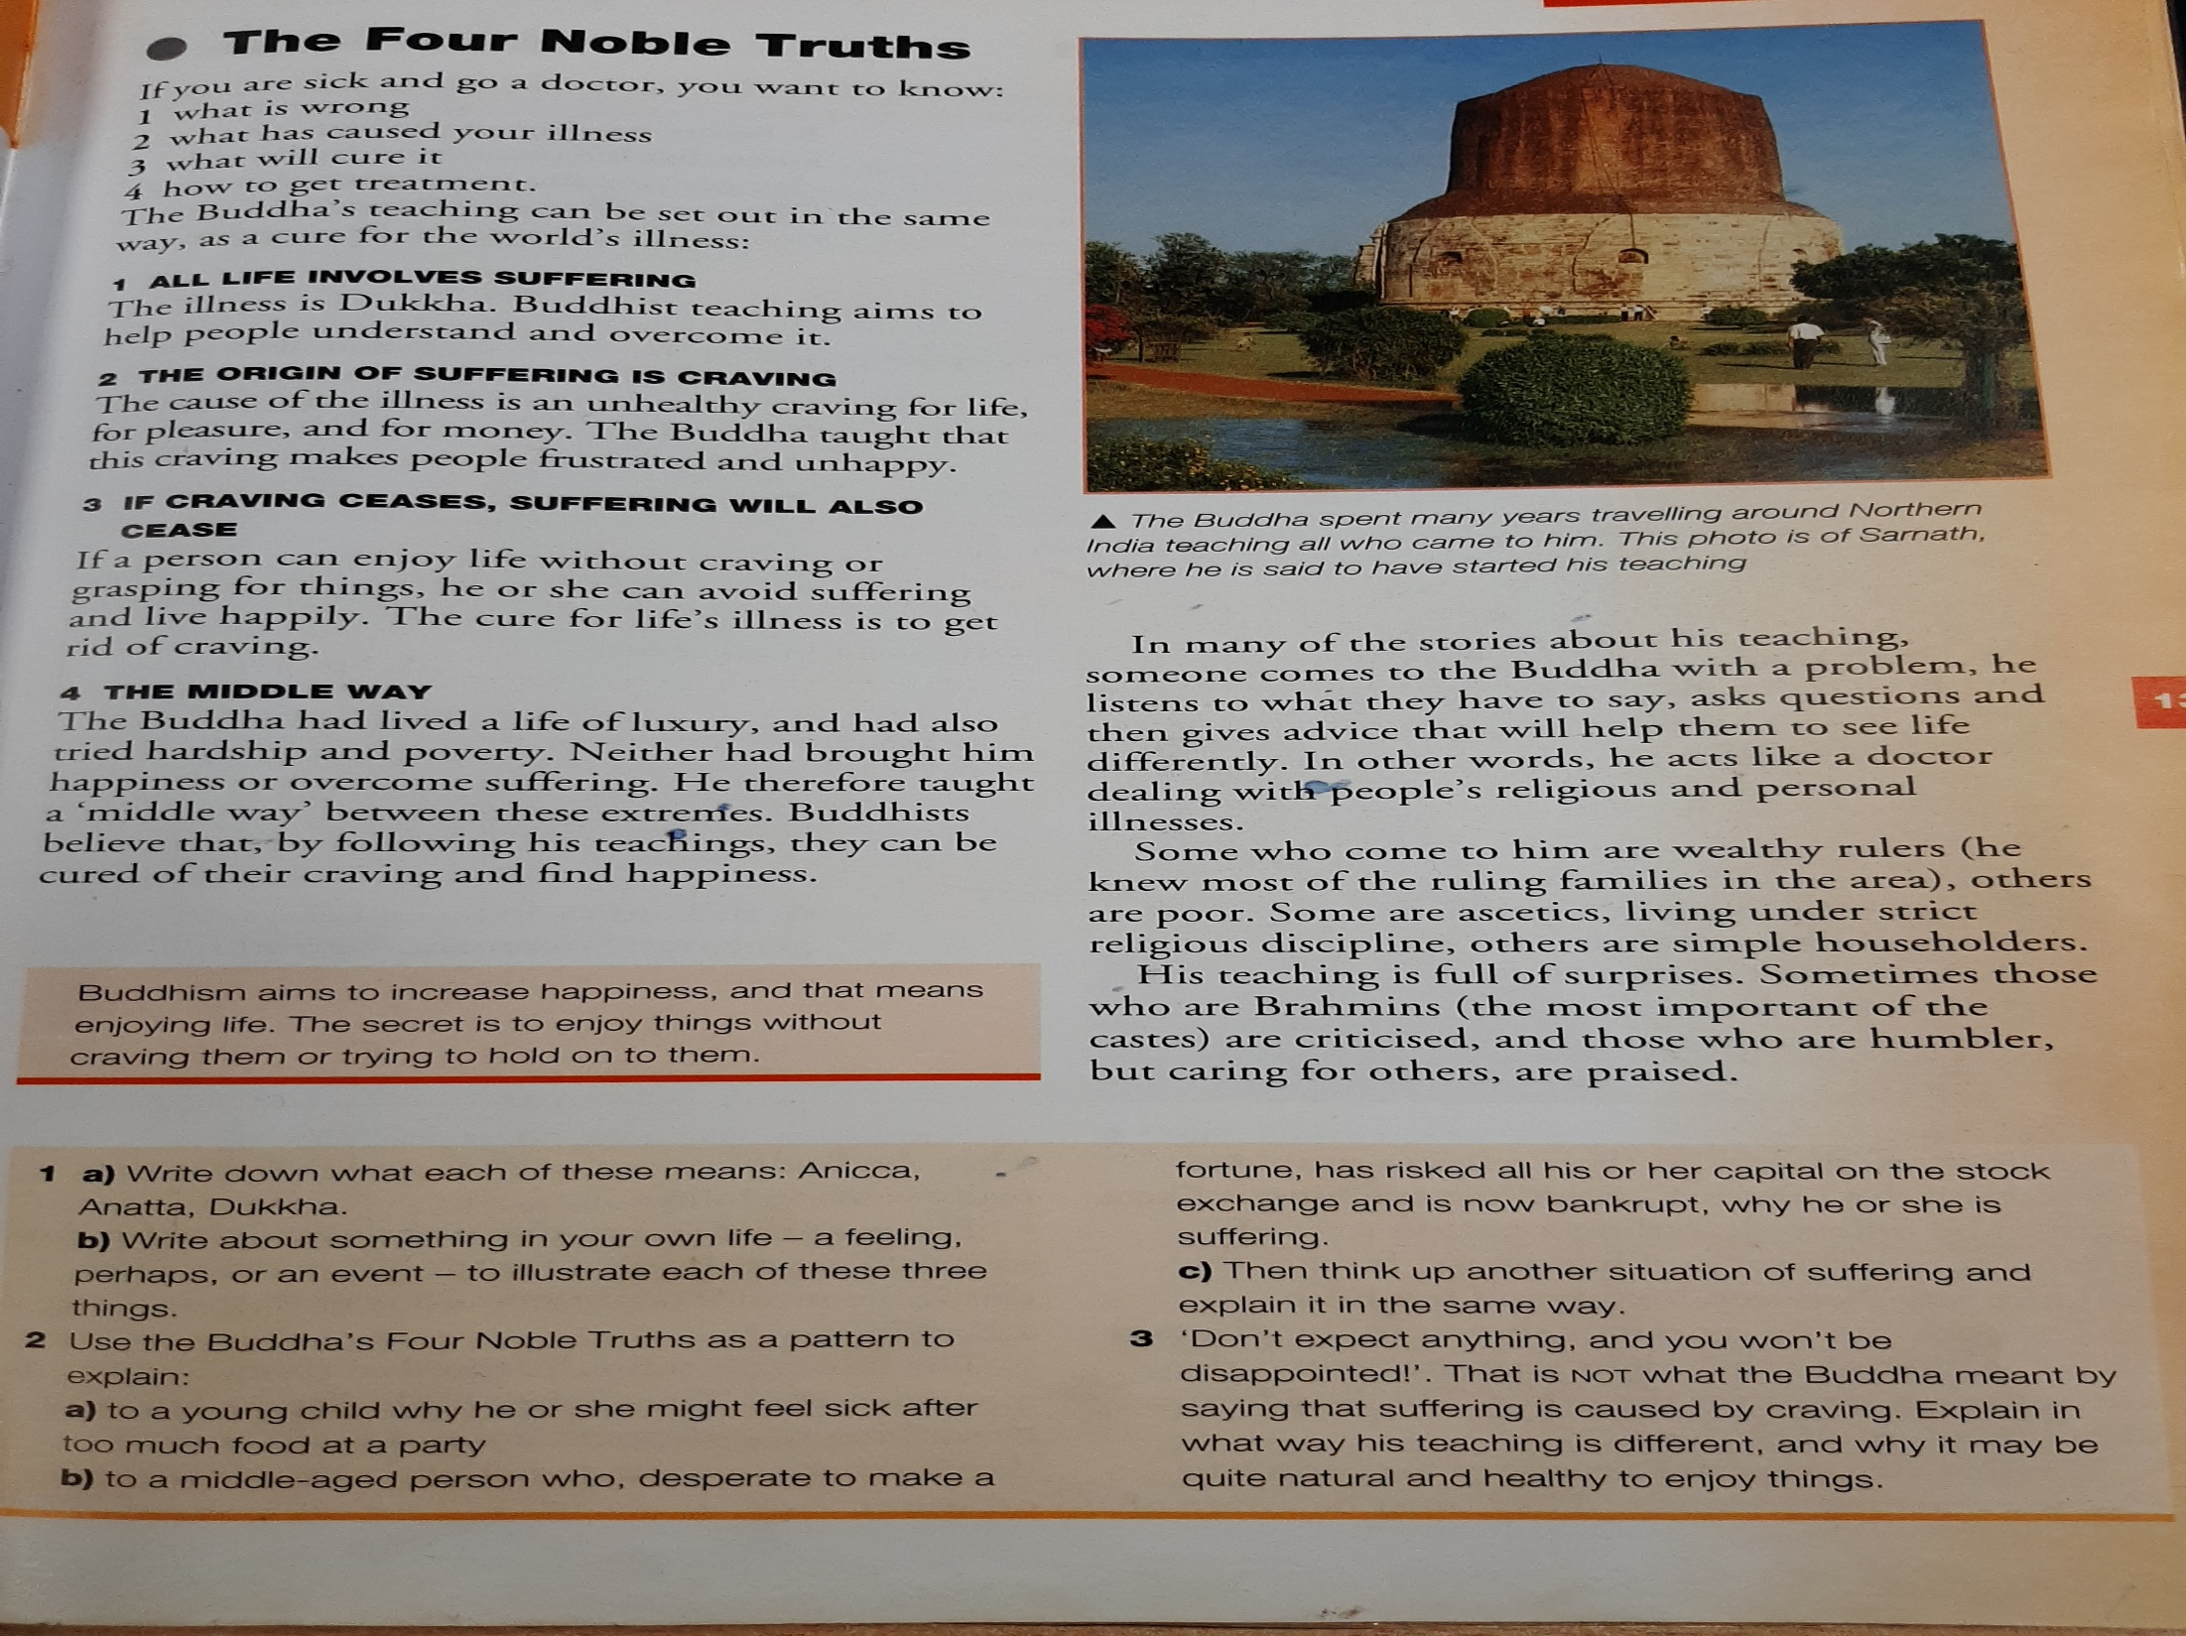

Slide 16
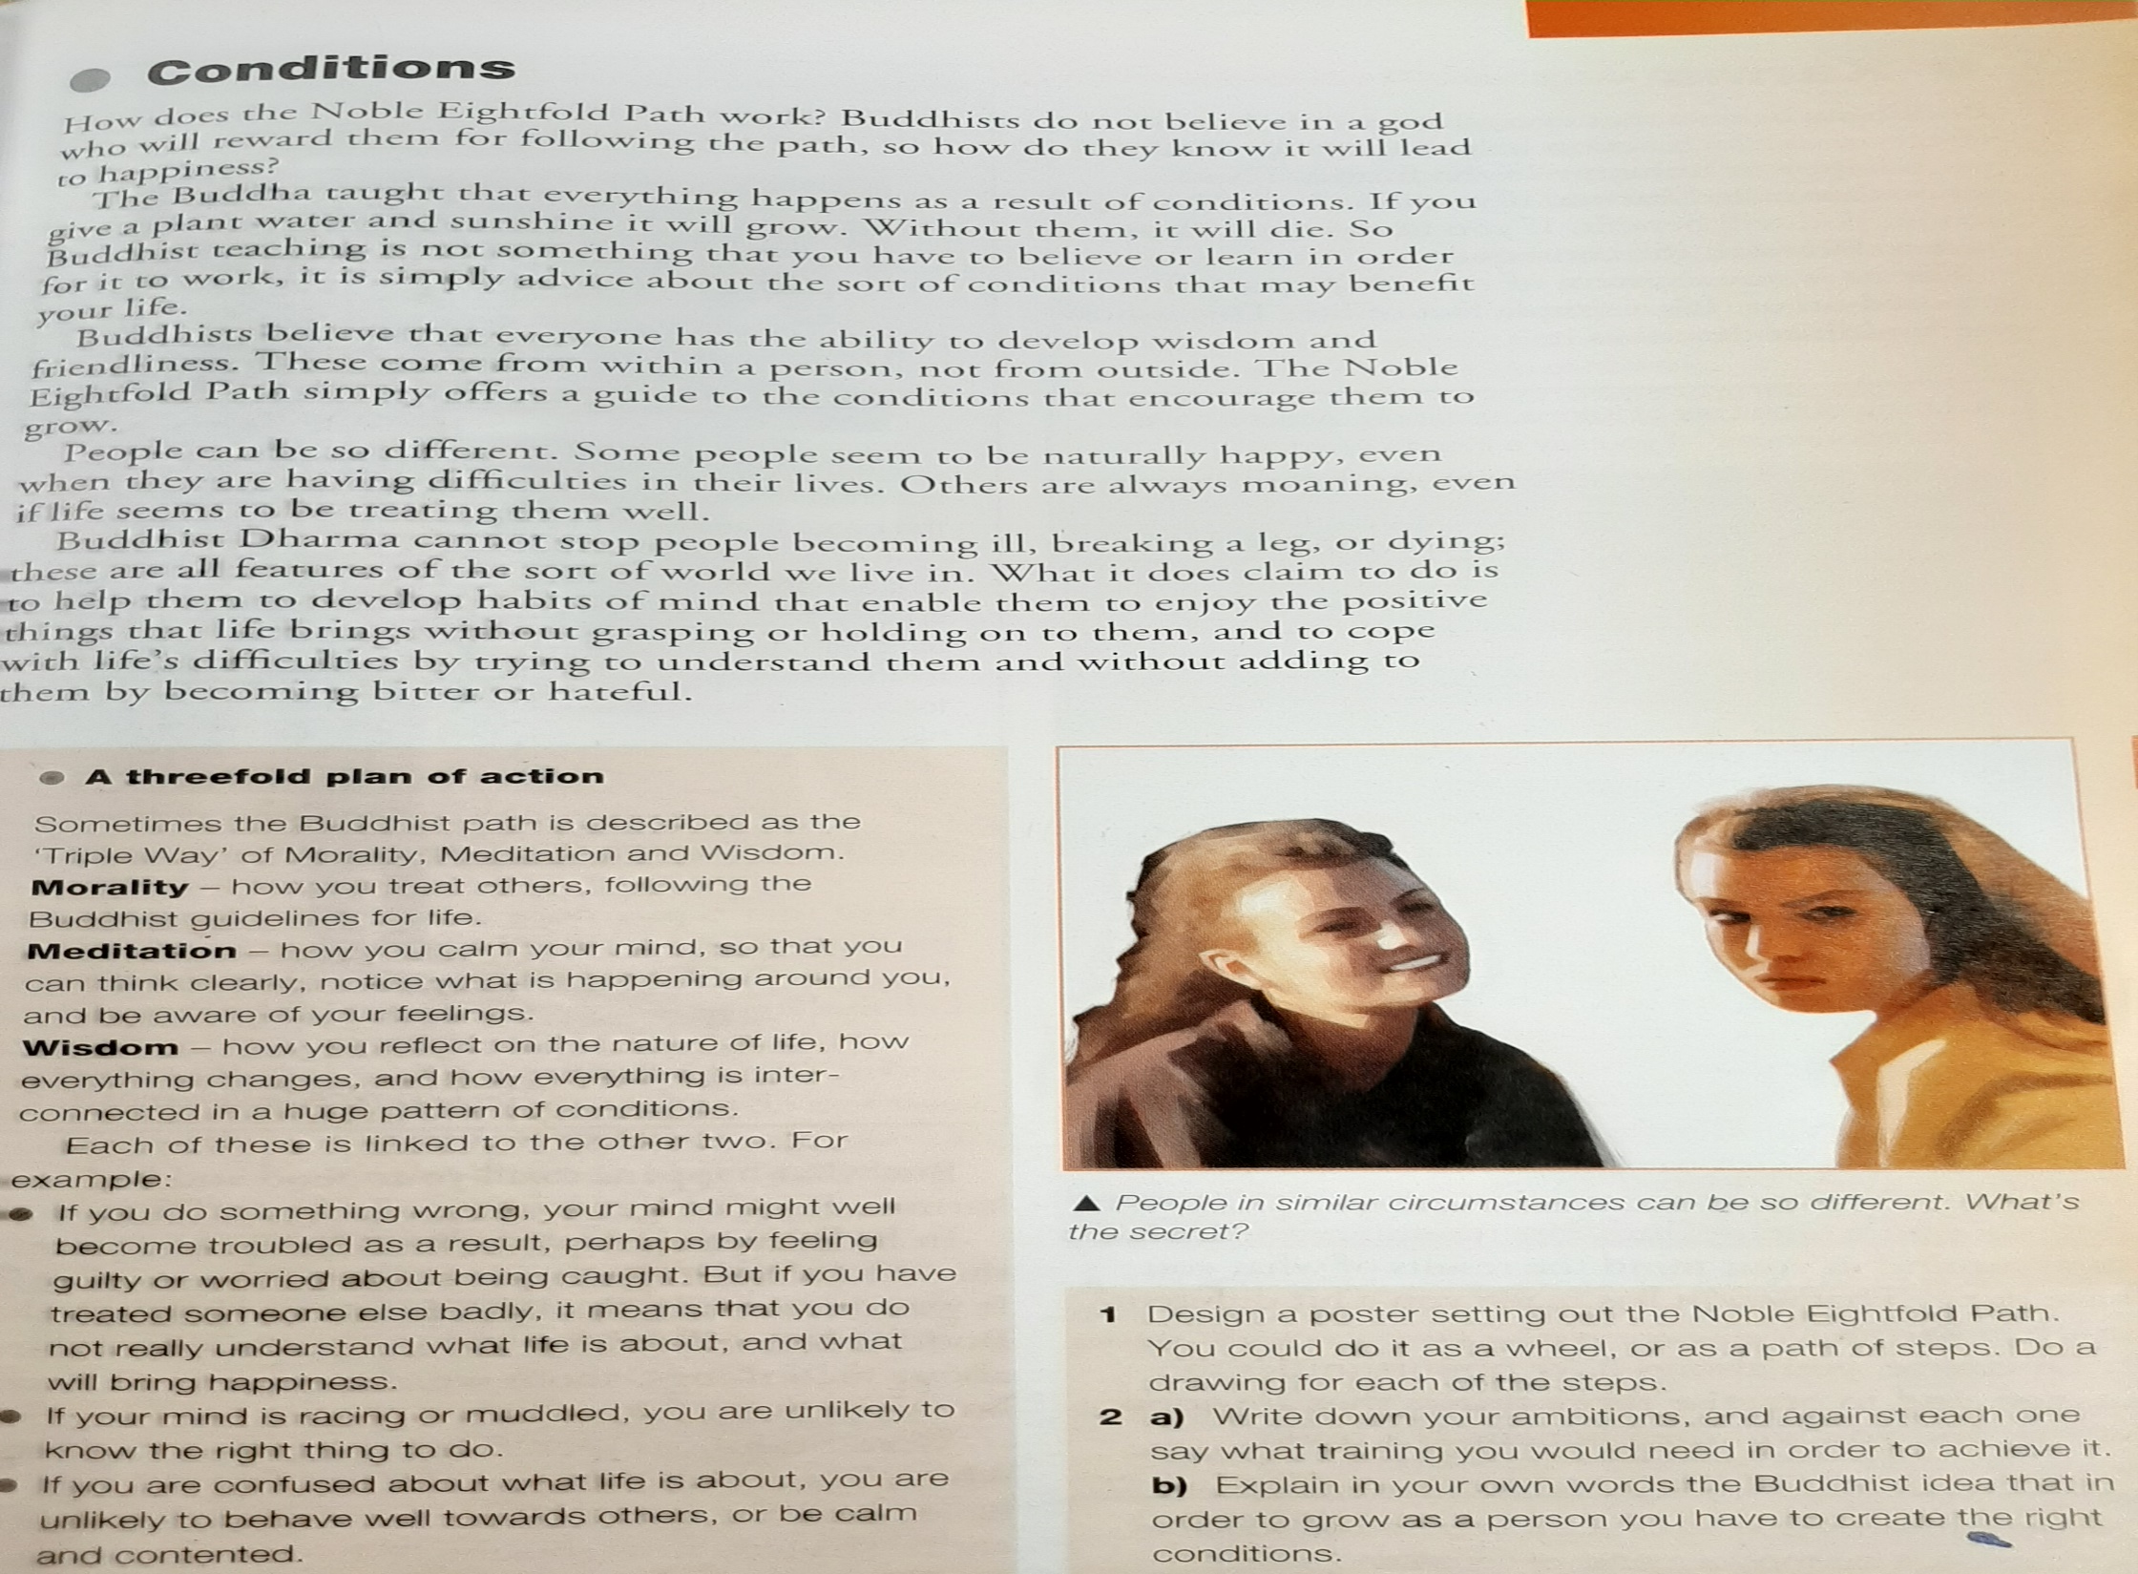

Slide 17
Homework
Write a paragraph explaining what you have learnt about Buddhist teachings.

Slide 18
Homework
Write an essay about duty and Buddhism.
You should compare Chinese Buddhism to Tibetan Buddhism and discuss the political influence Buddhist monks have had on Tibetan politics over the last 40 years.

Slide 19
The Eightfold Path
Today’s Aim:
To understand the concepts of the Eightfold Path.

Slide 20
Starter Activity
Right Mindfulness
No killing or two-timing!
Right Effort
No swearing
Right Livelihood
Not having a job that harmed others
Right Action
Understanding Buddhist teachings
Holding the mind in the right state until Nirvana is reached
Right Intention
Right Understanding
Not thinking bad thoughts
Right Speech
Doing good things for good reasons
Right Concentration
Keeping calm

Slide 21
Starter Activity
Right Mindfulness
Not thinking bad thoughts
Right Effort
Keeping calm
Right Livelihood
Not having a job that harmed others
Right Action
No killing or two-timing!
Right Intention
Doing good things for good reasons
Right Understanding
Understanding Buddhist teachings
Right Speech
No swearing
Holding the mind in the right state until Nirvana is reached
Right Concentration

Slide 22
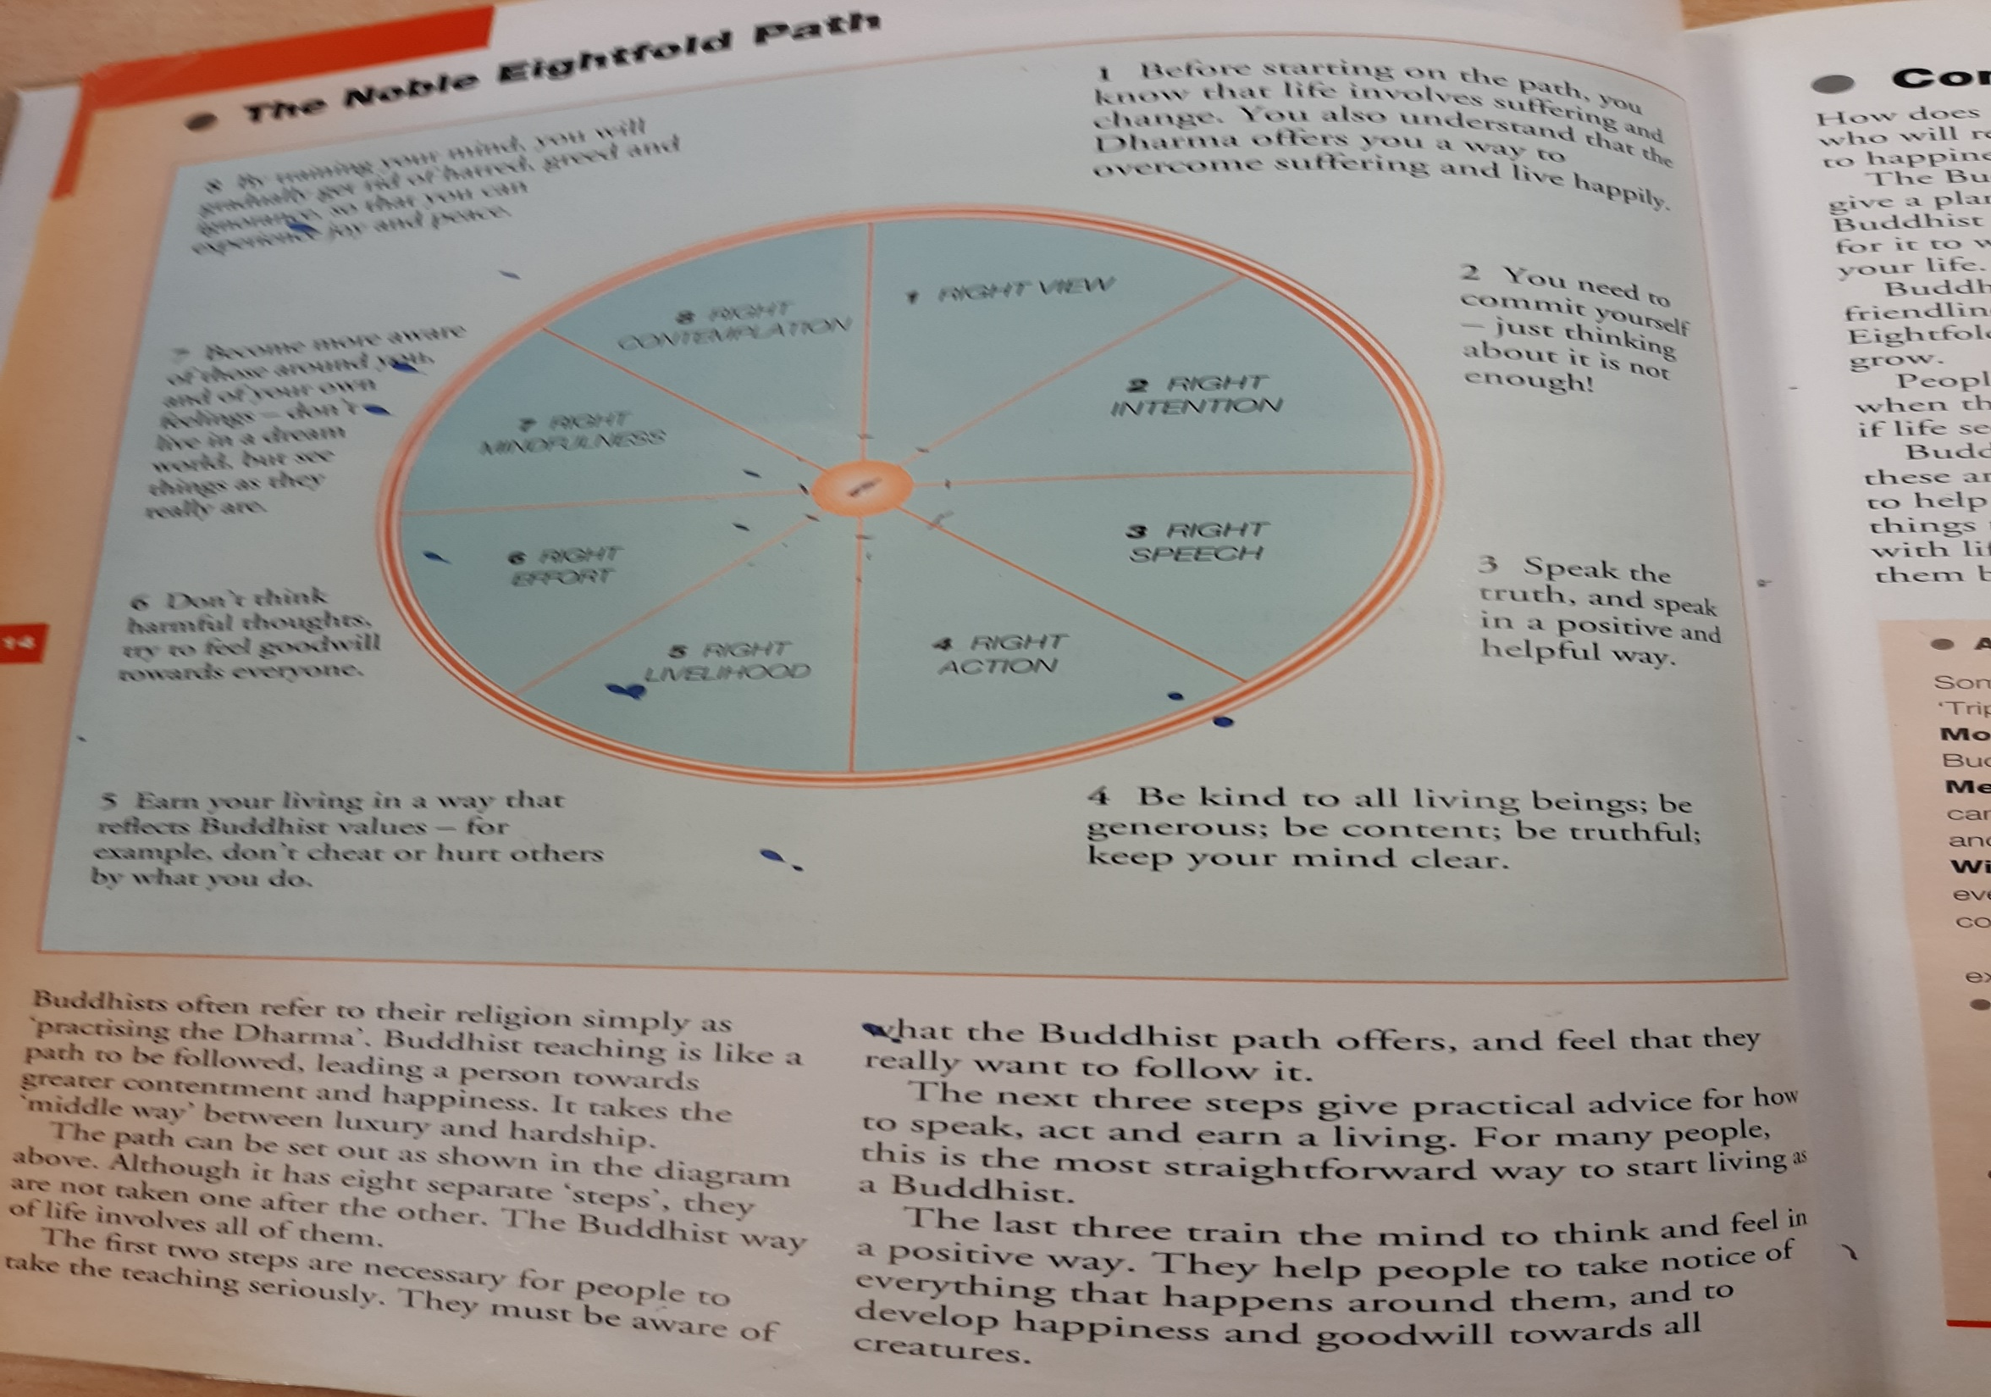

Slide 23
Homework
Write a paragraph explain what the Eightfold path is.

Slide 24
Task 1
All _________ beings ___________.
___________ is caused by ____________.
It is possible to __________ suffering.
There is a __________ to ___________ from suffering.
Suffering
Escape
Living
Craving
Path
Freedom
Haddock
Suffer

Slide 25
Task 1
Living
Suffer
All _________ beings ___________.
___________ is caused by ____________.
It is possible to __________ suffering.
There is a __________ to ___________ from suffering.
Suffering
Craving
Escape
Path
Freedom
Haddock

Slide 26
Your Task
Create a guide about the Four Noble Truths or the Eight Fold Path.
Think about…
How to follow it?
What to do/not do
Use pictures

Slide 27
Scenarios
During break your group of friends were calling others names.
What would a Buddhist advise you to do.
Write your response in full sentences.

Slide 28
90
Explain Right Livelihood.
60
Name one thing a Buddhist shouldn’t do.
1
How many points are in the Eightfold Path?
2
What religion are we studying?
25
Right ____ is not harming others.
100
Explain what Buddhists believe about the Eightfold Path.
100
Name one of the Four Noble Truths
90
What did the Buddha give up to find peace?
58
Name one thing a Buddhist should do.

Slide 29
Assessment Task
In your groups, create a presentation that includes:
One role play
One poster
Three pieces of written work (to be read out).

Slide 30
It should show that all members of your group know and understand all the Buddhist teachings.
It should evaluate the teachings, in other words – how good are the teachings? How easy are they for year seven students to follow in today’s world?

Slide 31
General Rules
1. Split the work fairly out amongst your group. Keep a record of who does what.
2. The poster must be larger than A4. It cannot have any writing/words/titles on it. The people who work on the poster must explain it to the rest of the class as part of your presentation.
3. Split the written work up between three people.
4. No fight scenes are permitted in the role play.

Slide 32
Level 3 | I can describe some of the Buddha’s teachings.
 | I can compare different views on the teachings including my own.
Level 4 | I can explain the meanings of the teachings.
 | I can imagine how different people would react to the teachings.
 | I can raise questions about the Buddha’s teachings and suggest appropriate answers - with reference to Buddhism.
Level 5 | I can give a range of responses to the question of the effectiveness of the teachings.
 | I can show how the teachings of the Buddha make a difference to people’s lives.
 | I can relate the teachings to my life and explain their relevance to me.

Slide 33
ASSESSMENT TASK:
MY THOUGHTS ON THE NOBLE EIGHTFOLD PATH
A short essay looking at the eightfold path, explaining what it is and how it might help somebody to be happy. In particular, it will explain how a year nine student today might use the points of the path to achieve happiness.
The best work will:
Correctly identify and explain all the “spokes” of the eightfold path. Apply them to real life today – how would they work? Include basic for and against arguments about how effective they would be. Include some personal thoughts and ideas.

