Slide 1
Shadow Curriculum brief: Sugar & Spice and all things nice
Where possible resource the following;
Interesting spoons (wooden/ metal/ china)
Herbs and spices ( any old ones from the cupboard which are unlikely to be used again)
Background e.g wooden chopping board / marble slab / slate etc.
Photograph the spices in the spoons as shown in the images on the next slide. Try lots of different compositions and backgrounds.
Take approximately 35 photographs. Bring to school on your memory card or memory stick
Research the food photographer “Her Dark materials”. Produce a research slide about her work.

Slide 2
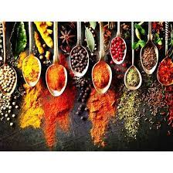
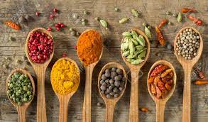
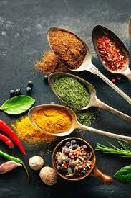
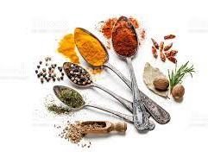
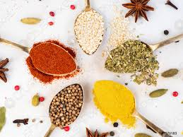
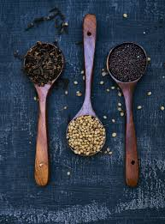
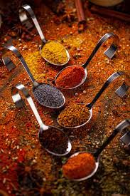
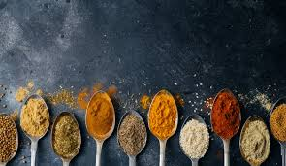
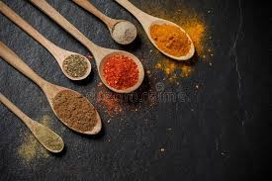

Slide 3
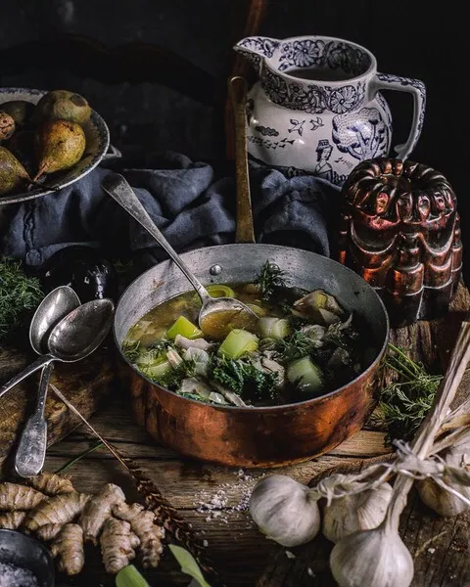
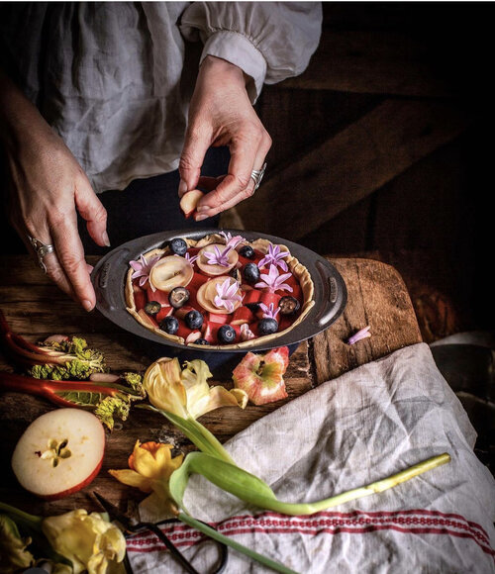
Her Dark Materials

