Slide 1
WFH week 2
Please email me your 6 best portrait photographs,
Even if you are able to print them at home I need to know that you have completed the task, just say in your email that you do not require the work to be printed and posted.
You should have completed research on 3 different collage artists from the youtube clip shown last week.
Please email your ppt .
When using ppt please remember to switch from widescreen to A4

Slide 2
WFH week 2:
Watch the attached youtube tutorials in readiness for tomorrows lesson. You will need to be collecting appropriate papers in readiness for creating collages.
https://www.youtube.com/watch?v=P49ISh6uY6k&safe=true
https://www.youtube.com/watch?v=rzh607-fwUM&safe=true
https://www.youtube.com/watch?v=X6Ckd__z_T0&safe=true

Slide 3
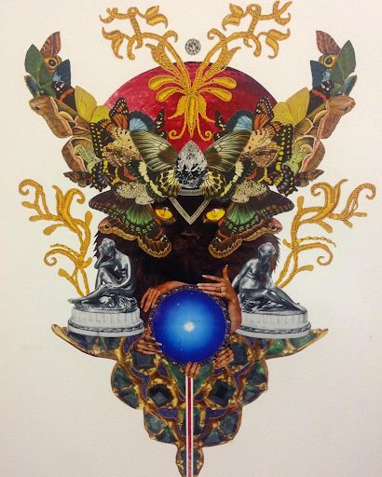
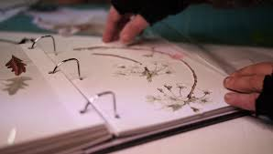
Jacob Intile

Slide 4
