Slide 1
How many of these issues can you relate to?
Feel pressured by friends
Family always arguing
Parent having a new partner
Lots of pressure from family to do well
Being bullied
Drinking too much
Feeling pressured to send a naked picture
Worried about being pregnant or having an STI
Feeling pressured to have sex
Don’t feel you fit in
Feeling pressure to drink alcohol
Having new step siblings
Family member working in a dangerous job
Taking too many drugs
Family members drinking too much
Worried about body image
Unhappy in a relationship
Worried about career
Somebody close to you has passed away
Family member unwell
Feel family don’t care about you

Slide 2
Stress!
To know what is meant by the term ‘stress’
To discuss the causes of stress
To identify the possible symptoms of stress

Slide 3
What is stress?
Stress is …
circumstances
demanding
emotional
mental
strain

Slide 4

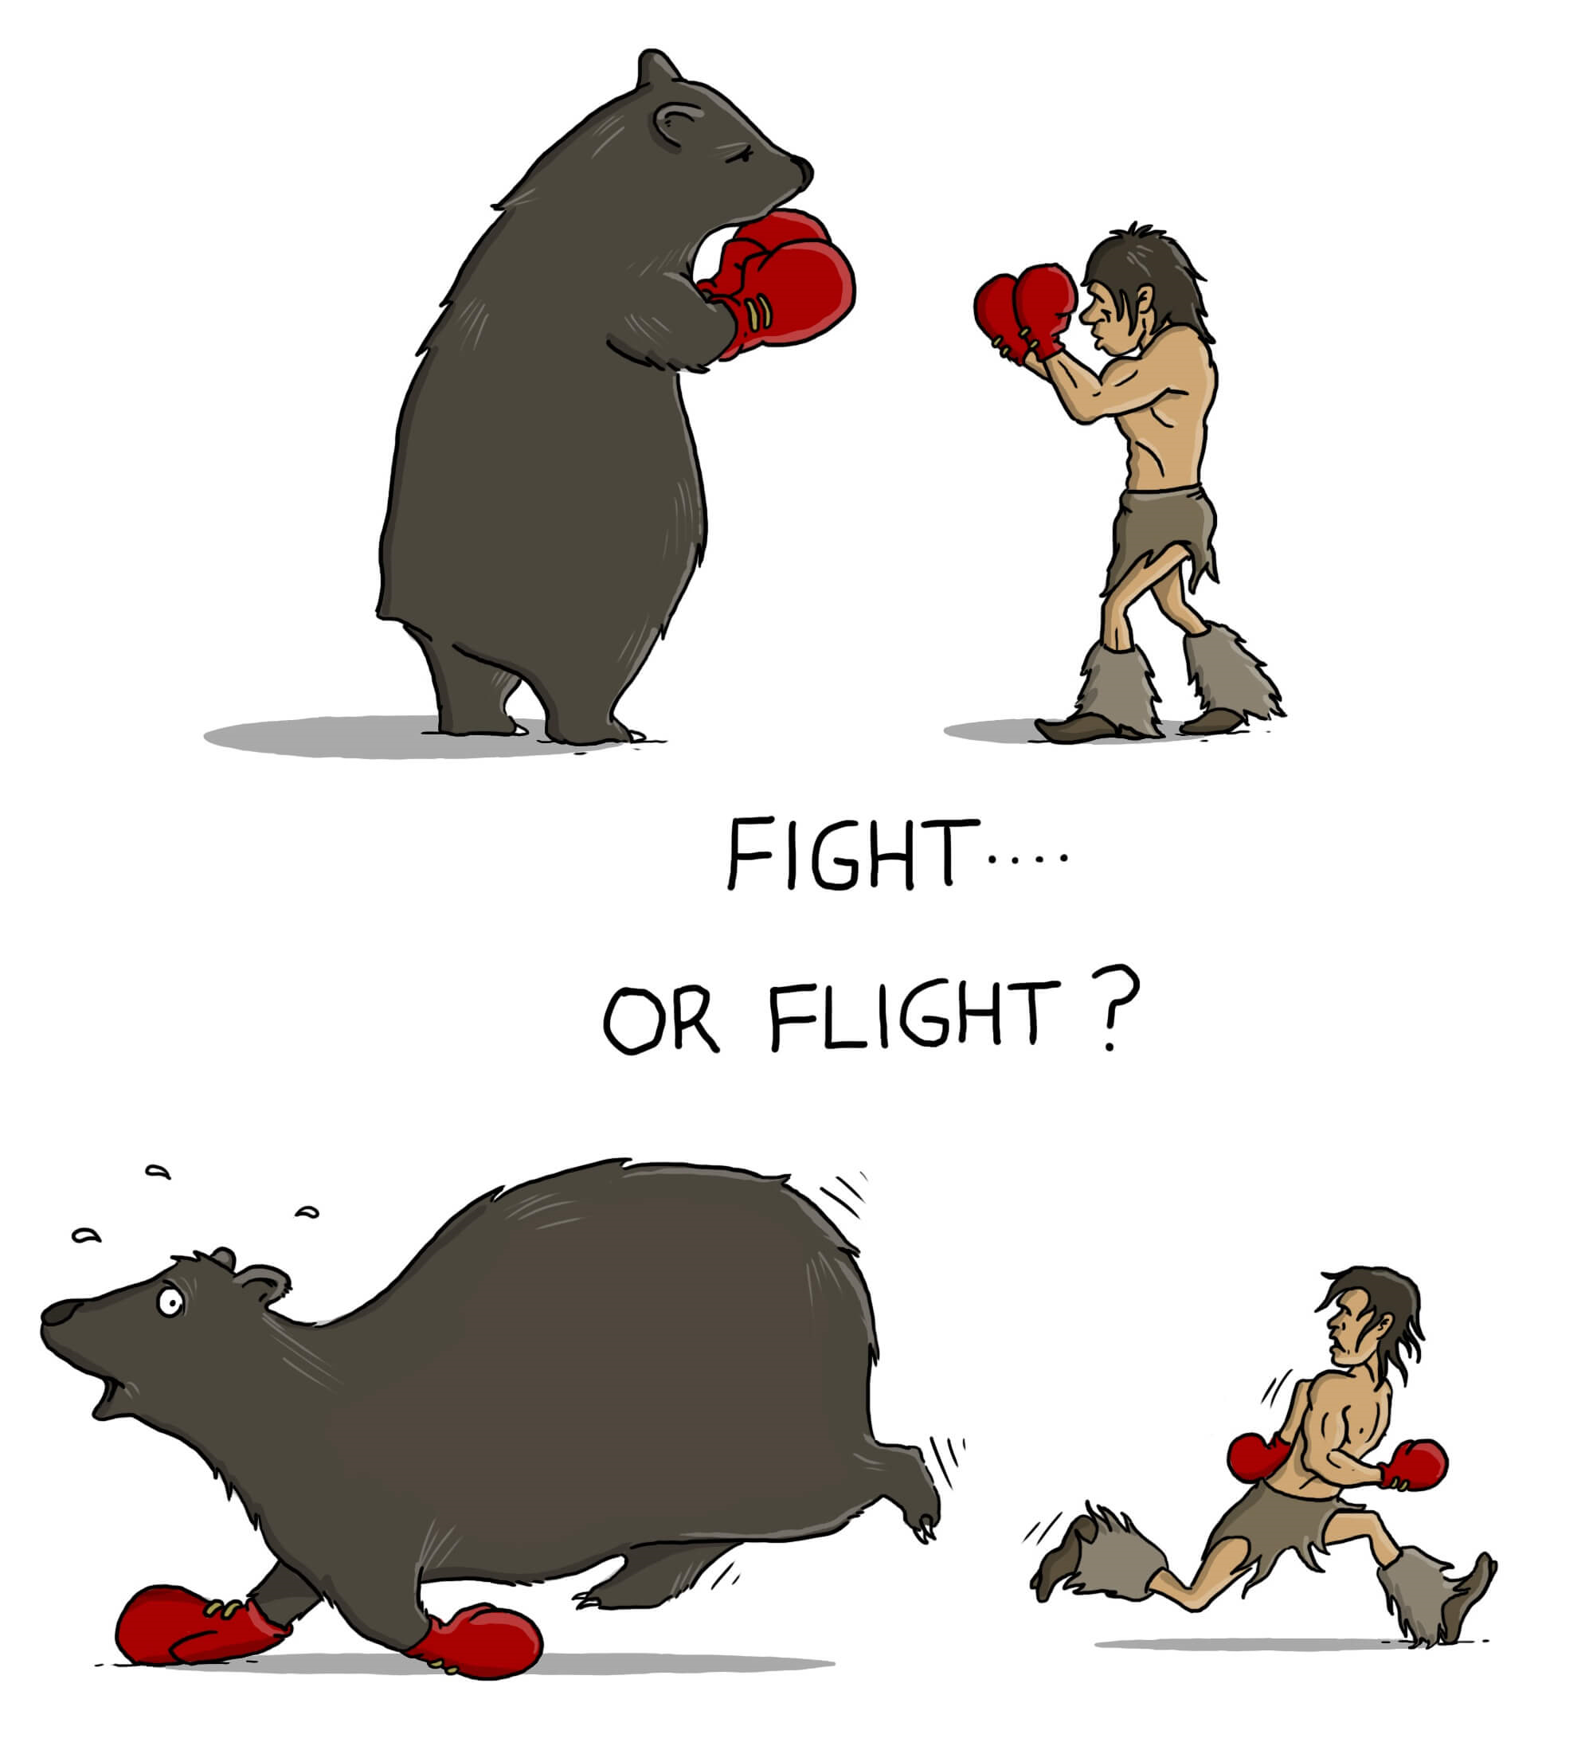
All of us will crack under pressure but we have different points
Warning distressing images!

Slide 5
THE STRESS TEST
 | STRONGLY AGREE | AGREE | DISAGREE | STRONGLY DISAGREE
I know when I am about to get stressed out before it happens.
Being stressed has a big effect on my work and behaviour
When I am stressed I feel like I can’t cope.
I worry a lot.
I know some coping strategies that help when I am stressed.
I recover from stress quite quickly.
Be honest.
Think carefully about your answers.
Don’t worry.

Slide 6
THE STRESS TEST
 | STRONGLY AGREE | AGREE | DISAGREE | STRONGLY DISAGREE
I know when I am about to get stressed out before it happens.
Being stressed has a big effect on my work and behaviour
When I am stressed I feel like I can’t cope.
I worry a lot.
I know some coping strategies that help when I am stressed.
I recover from stress quite quickly.
Be honest.
4
3
2
1
1
Think carefully about your answers.
Don’t worry.
2
3
4
1
2
3
4
1
2
3
4
4
3
2
1
4
3
2
1

Slide 7
THE STRESS TEST
Now write your score in.
Do you think it reflects the real you?
Where do you think you can improve?

Slide 8

In pairs discuss what it feels like when you are stressed...
How you might feel
How you might be physically affected
How you might behave

Slide 9
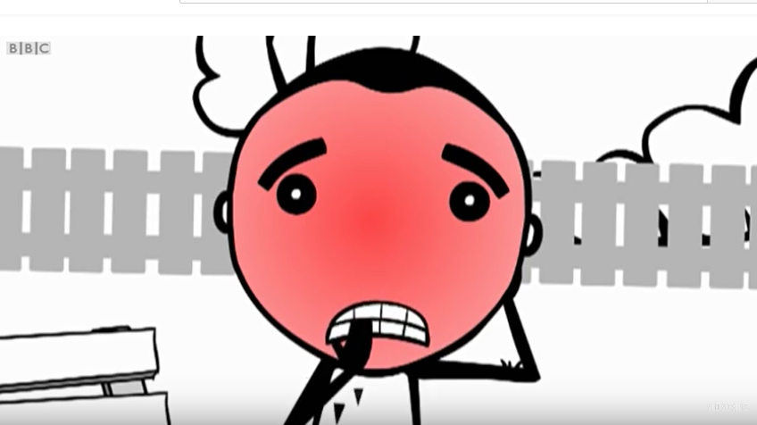
Dealing with Stress
To identify different ways of dealing with stress
To discuss positive and negative ways of dealing with stress
To create a plan to help deal with stress
Notes:
https://www.youtube.com/watch?v=hnpQrMqDoqE

Slide 10
Group Work
In your groups you need to discuss which of the ‘coping with stress’ mechanisms you use.
Strategies you use…
Strategies you don’t use…

Slide 11
Now divide the strategies into the two groups below (make sure you can explain your decisions):
Healthy strategies
Unhealthy strategies

Slide 12

The charity Mind recommends that you:
Identify your triggers
Organise your time
Address some of the causes
Accept the things you can't change

Slide 13
Being bullied on the bus on the way into school
I have got a massive spot
I have no idea what I want to do when I’m older
Will I play well in the match next week?
Did I make myself look like an idiot yesterday
Will I pass my exams?
My Worries
I’m always arguing with mum- we never get on anymore…
I’m starting to feel stressed in certain lessons
I’m fed up with being so short
I have got so many late homeworks for English already this year

Slide 14
THE STRESS TEST
 | STRONGLY AGREE | AGREE | DISAGREE | STRONGLY DISAGREE
I know when I am about to get stressed out before it happens.
Being stressed has a big effect on my work and behaviour
When I am stressed I feel like I can’t cope.
I worry a lot.
I know some coping strategies that help when I am stressed.
I recover from stress quite quickly.
Be honest.
Think carefully about your answers.
Don’t worry.

Slide 15
THE STRESS TEST
 | STRONGLY AGREE | AGREE | DISAGREE | STRONGLY DISAGREE
I know when I am about to get stressed out before it happens.
Being stressed has a big effect on my work and behaviour
When I am stressed I feel like I can’t cope.
I worry a lot.
I know some coping strategies that help when I am stressed.
I recover from stress quite quickly.
Be honest.
4
3
2
1
1
Think carefully about your answers.
Don’t worry.
2
3
4
1
2
3
4
1
2
3
4
4
3
2
1
4
3
2
1

Slide 16
THE STRESS TEST
Now write your score in.
Do you think it reflects the real you?
Where do you think you can improve?

Slide 17


@EducateCareers
Protected Characteristics
The Equality Act 2010 makes it unlawful to discriminate against people with a ‘protected characteristic’. When applying for a job an employer must not consider a protected characteristic when making a decision to employ or not employ someone. Can you spot which of the following 10 characteristics are protected?
Click icons for links to…

Slide 18


@EducateCareers
1
Age is a protected characteristic
An employer can’t decide whether to give you a job or not based on your age
True
False

Slide 19
@EducateCareers
1
Age is a protected characteristic
An employer can’t decide whether to give you a job or not based on your age
True
It is against the law for an employer to make a decision based on a candidates age. Certain careers are allowed to state an age requirement before anyone applies. An example of this is a soldier in the British Army must be between 18 and 28 when they apply.

Slide 20
@EducateCareers
2
Disability is a protected characteristic
An employer can’t decide whether to give you a job or not based on a disability
True
False

Slide 21
@EducateCareers
2
Disability is a protected characteristic
An employer can’t decide whether to give you a job or not based on a disability
True
A person with a disability must have an equal opportunity of getting a job to that of a person with no disability. There are around 7 million people in the UK with a disability or a health condition. In the past disabled people have been poorly represented in the workplace, this has prevented knowledgeable and skilled people from working due to a disability that can be accommodated for.

Slide 22
@EducateCareers
3
Marriage and Civil Partnership is a protected characteristic
An employer can’t decide whether to give you a job or not based on being married, unmarried or in a civil partnership
True
False

Slide 23
@EducateCareers
3
Marriage and Civil Partnership is a protected characteristic
An employer can’t decide whether to give you a job or not based on being married, unmarried or in a civil partnership
True
Being married, unmarried or in a civil partnership is a private matter than cannot be used when deciding who to offer a job to.

Slide 24
@EducateCareers
4
References are a protected characteristic
An employer can’t decide whether to give you a job or not based on your references
True
False

Slide 25
@EducateCareers
4
References are a protected characteristic
An employer can’t decide whether to give you a job or not based on your references
False
When applying for a job you would usually be expected to give the contact details of two referees. An employer will consider what the referees say about you when appointing someone to a job. Many people believe a reference must say positive things. Legally, a reference can say negative things provided the referee is being honest.

Slide 26
@EducateCareers
5
Pregnancy is a protected characteristic
An employer can’t decide whether to give you a job or not based on pregnancy
True
False

Slide 27
@EducateCareers
5
Pregnancy is a protected characteristic
An employer can’t decide whether to give you a job or not based on pregnancy
True
Having a child can mean an employee may be off work for maternity or paternity leave. This cannot be considered when making a decision on who to employ. An employer also can’t base the decision on whether the employee may decide to have children in the future.

Slide 28
@EducateCareers
6
Race is a protected characteristic
An employer can’t decide whether to give you a job or not based on race
True
False

Slide 29
@EducateCareers
6
Race is a protected characteristic
An employer can’t decide whether to give you a job or not based on race
True
Although race is not considered when appointing someone to the vast majority of jobs there are times when it can happen. When employing people to work in a particular themed restaurant (such as a Chinese restaurant) or employing someone to be an actor in a particular type of TV series (such as Downton Abbey) employers can specify race as it is directly related to the role.

Slide 30
@EducateCareers
7
Experience is a protected characteristic
An employer can’t decide whether to give you a job or not based on your experience
True
False

Slide 31
@EducateCareers
7
Experience is a protected characteristic
An employer can’t decide whether to give you a job or not based on your experience
False
This is often one of the most important aspects when applying for a job. Employers will want to know if you have any experience. Your ability to answer the questions related to experience will have a baring on whether nor not you are offered a job.

Slide 32
@EducateCareers
8
Religion or belief are protected characteristics
An employer can’t decide whether to give you a job or not based on your religion or beliefs
True
False

Slide 33
@EducateCareers
8
Religion or belief are protected characteristics
An employer can’t decide whether to give you a job or not based on your religion or beliefs
True
This is a private matter and won’t have any impact on an job offer. There are a few exceptions however, an example being if applying for a role as a chaplain you would be expected to hold a particular belief.

Slide 34
@EducateCareers
9
Appearance is a protected characteristic
An employer can’t decide whether to give you a job or not based on your appearance.
True
False

Slide 35
@EducateCareers
9
Appearance is a protected characteristic
An employer can’t decide whether to give you a job or not based on your appearance.
False
Employers can make a decision based on how you have dressed. Some employers would not consider employing someone who didn’t dress smart for their interview.

Slide 36
@EducateCareers
10
Sex is a protected characteristic
An employer can’t decide whether to give you a job or not based on being a man or woman
True
False

Slide 37
@EducateCareers
10
Sex is a protected characteristic
An employer can’t decide whether to give you a job or not based on being a man or woman
True
There are a few exceptions. Some roles (such as some PE teachers) need to be the same gender as those they work with, so a job would specify gender in the application. The vast majority of employers should consider men and women equally when deciding who to appoint.

Slide 38
@EducateCareers
Protected Characteristics
Employers must not make decisions about employment based on any of the following:
age
disability
gender reassignment
marriage and civil partnership
pregnancy and maternity
race
religion or belief
sex
sexual orientation
If an employer does make a judgement based on one of the protected characteristics they may be accused of discrimination and could be called to an employment tribunal.
There are a few situations when an employer can make a decision based on protected characteristics. This is called the occupational requirement exception.

Slide 39


Lesson 1… Personal Skills…
Objective...
To understand what skills are and how they are used in different job roles...

Slide 40



Your Lesson Objectives…
You Will…
Know…
What a skill is…
Understand...
That different skills are used in different jobs…
Be Able to…
Look at which skills we use in different areas of our lives…

Slide 41
Intro…
Lesson 1… Personal Skills…
Something we have
learned…
What is a skill…?
Something we have
practised…
Something we can
do well…

Slide 42
Match the skills to the definitions…
Task One…
Lesson 1… Personal Skills…
Problem Solving
Using your imagination
Thinking what needs to be done and doing it without being told
Investigating
Team Working
Expressing yourself clearly
Communication
Working well with other people
Thinking of solutions and ways to solve issues
Initiative
Monitoring your performance and recognising how you can improve
Reflecting
Creative Thinking
Getting involved in tasks and activities
Carrying out quality research
to help in your work
Organisation
Participating
Sorting out who will do what and when

Slide 43
Task Two…
Lesson 1… Personal Skills…
In your groups, number yourselves
1 to 3…
The team with the closest diagram to the original, wins…!
Number 1 will do ALL the writing and drawing. No one else…!
Number 2 and 3 take it in turns to go to the front and memorise a poster for 30 seconds …
After 30 seconds, they will go back to their group and describe what they saw to their Number 1, who must write down and draw what they say…
Number 2 and number 3 will get two turns each to go to the front so must remember as much as possible…!

Slide 44
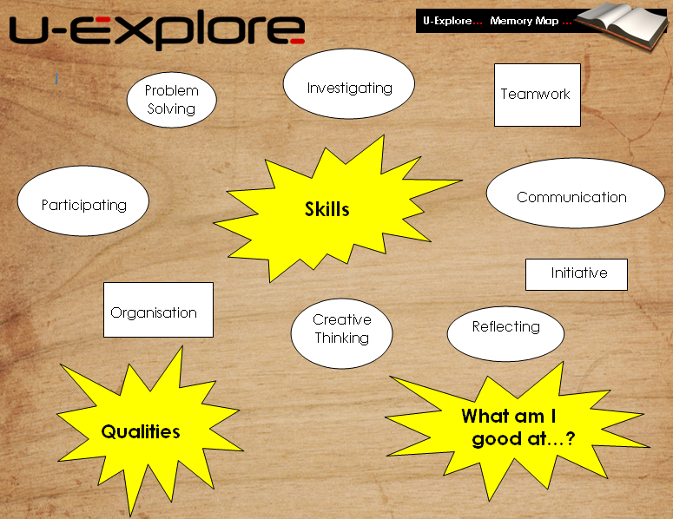
Task Two…
Lesson 1… Personal Skills…
Join up with another team and compare both of your diagrams…
How did you do…? Has the other team got something that you’ve forgotten…?

Slide 45
Here are some
of the skills
you have used
in Task One…?
Teamwork
Lesson 1… Personal Skills…
Communication
Listening
How did you
use this skill…?
Are there any
others you
have used…?
Participating

Slide 46
Task Four…
Lesson 1… Personal Skills…
Talking to friends
Think about all the things you do in your life…
Shopping
Housework
Sport
Homework
Classwork
Watching TV
All of these things use different skills…

Slide 47
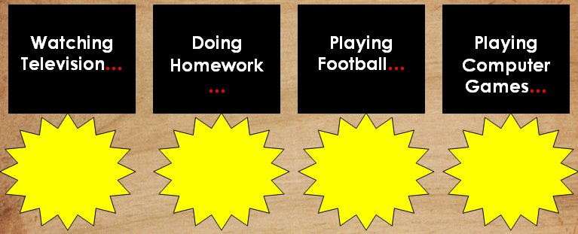
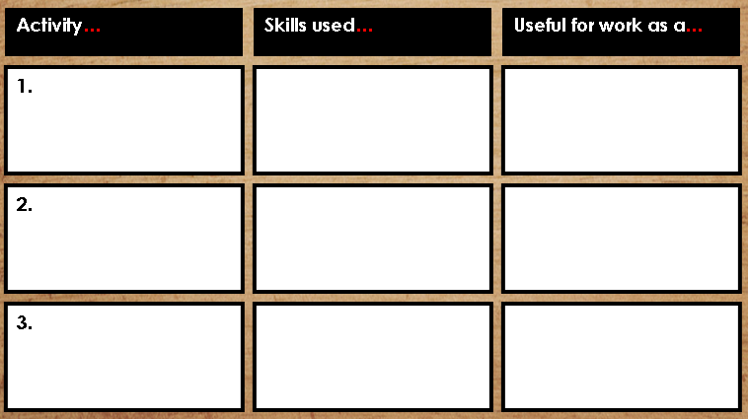
Task Four…
Lesson 1… Personal Skills…
Write down the skills you use for each activity…
Think of some more things you do at home, school and with your friends…
Which of these skills would be useful in the jobs you looked at…?

Slide 48
Task Six…
Lesson 1… Personal Skills…
Fill in the Star
Skill ladder with
all of the skills
you have used…
What skills have you
already used in
today’s lesson…?
Is this one of
your strongest skills…?
Shade in the stars
to give yourself a rating
out of 4…
Next, think of all the
other skills you have
used so far today and
write them in the
other skills ladder…
For Example…
Punctual – got to school on time
Organised – Did my homework when it was set
Literacy Skills – Read a magazine
Teamwork – helped to clean up at home

Slide 49
Lesson 1… Personal Skills…
CONGRATULATIONS !
You now know what a skill is and you can identify when you are using them in lots of different situations…

Slide 50
KS 3 Careers…
Lesson 5… Making Decisions…

Slide 51
Lesson 5… Making Decisions…
Objective...
To be able to make an informed career decision and justify your choices...

Slide 52


Your Lesson Objectives…
Lesson 5… Making Decisions…
You Will…
Know…
Different ways in which decisions are made…
Understand...
Who can offer help with decision making…
Be Able to…
Give a reason for your career decisions…

Slide 53
Task One…
Lesson 5… Making Decisions…
How would you choose a career…?
A) Wanting to learn the skills required for a job
B) Having an interest in a specific subject or course
C) Matching your skills to skills required
D) Asking for advice from professionals
E) Making sure you will earn enough money to live your chosen lifestyle
F) Conforming to expectations
(because your family or friends
think you should do a certain job)
G) Doing work experience to find out if you like the job
H) Accepting the first job you find
I) Thorough research and being logical / objective (weighing up pros and cons)
J) Getting a job through a friend or relative

Slide 54
Task Two…
Lesson 5… Making Decisions…
Now arrange these reasons for choosing a career into ‘Good Reasons’ and ‘Bad Reasons’…
Good Decision Making Method Bad Decision Making Method
A) Wanting to learn the skills required for a job
E) Making sure you will earn enough money to live your chosen lifestyle
B) Having an interest in a specific subject or course
F) Conforming to expectations
(because your family or friends
think you should do a certain job)
C) Matching your skills to skills required
H) Accepting the first job you find
D) Asking for advice from professionals
J) Getting a job through a friend or relative
G) Doing work experience to find out if you like the job
Are there any answers
you don’t agree with…?
I) Thorough research and being logical / objective (weighing up pros and cons)

Slide 55
Task Three…
Lesson 5… Making Decisions…
Choosing a career is a VERY important decision that will affect your life for a long time…!
You need to think carefully about how you will choose what you want to do…
Are there any job roles which help people to make this decision…?
Connexions Personal
Adviser
Careers Adviser
Recruitment Consultant

Slide 56
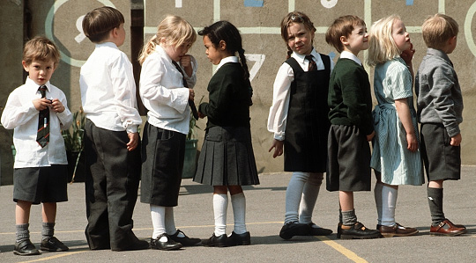
What choices of career do they have?

Slide 57
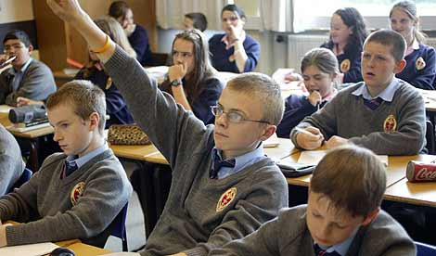
What choices of career does she have?

Slide 58

What choices do they have?

Slide 59
Copy the following VALUES and BELIEFS into your book.

Slide 60
FUN
FRIENDS
MONEY
SUCCESS
BEING FAMOUS
HELPING OTHERS
POWER
FAMILY
ADVENTURE
BEING PHYSICALLY FIT
ADMIRED BY FRIENDS
OWNING LOTS OF THINGS
GIVING
BEING “GREEN”
TOLERANCE
HARD WORK

Slide 61
Match them to the following statements.
I want to be rich.
I want everyone to know my name.
I am approachable.
I like to enjoy myself.
I like spending time with my mates.
I want to get to the top.
I love doing things with my family.
You get out what you put in.
I always want to be in control.
Exercise is important to me.
I need to know the latest fashion.
I like taking risks.
I want people to respect me.
I enjoy choosing presents for my friends and family.
I worry about Earth’s future.

Slide 62

TASK.
Write a mini paragraph explaining what your values were when you were YOUNGER.
“ All I really cared about was if Mum bought me the toy that I wanted, or if I could watch my favourite programme…”

Slide 63

Share your paragraph with your neighbour.
What questions could you ask each other?

Slide 64

TASK
Write a mini paragraph explaining what you hope your values will be in the FUTURE ( aged 30).
“ I would love to be respected by my family and friends for my ability to provide them with the things they wanted…..”

Slide 65
Share your paragraph with your neighbour.
What questions could you ask each other?

Slide 66
WATCH THIS.
http://www.youtube.com/watch?v=wr0RAkQ7Tuw

Slide 67
KS 3 Careers…

Slide 68
Lesson 6… Job Suitability…
Objectives...
To put together a presentation explaining your ideal career choice and a plan of action to achieve this…

Slide 69
Your Lesson Objectives…
You Will…
Know…
What your skills are…
Understand...
How to choose your ideal job…
Be Able to…
Present an action plan to your classmates…

Slide 70

Task Two…
Lesson 6… Job Suitability…
In this task, you are going to
design and deliver a presentation…
Your presentation must…
- Explain your choice of career
- Justify why you have chosen the industry / career
- Describe your plan of action that will make sure you reach your goals
Your skills, - the things you know you are good at (academically and non-academically).
Your values and beliefs- the things that are important to you.
Now you need to plan your presentation thinking back over the last lessons…
The jobs and careers that interest you.
Fill out each area of the
diagram and your own creative
ideas for how you would like your
presentation to look…
Your ambitions for the future

Slide 71

Task Two…
Lesson 6… Job Suitability…
Aim of the presentation:
Clearly showcase all of your ideas over the careers lessons…
Think about your skills / career choices and the reasons why you made your choices. Share this with other students and explain how you made your decisions…
You need to make it full of colour and perhaps include images of your chosen career. You can make your presentation on A3 or
on Power Point but make sure that it is interesting and informative…
You need to make it as informative as possible and include the information from previous lessons…

Slide 72

Task Three…
Lesson 6… Job Suitability…
Delivering a presentation like this is a good opportunity to build on your communication and creative thinking skills and to improve your confidence…
In groups of three, take it in turns to give your presentation to each other
Listen carefully to other students - you might be able to help them
with their career choices…!
You can include skills like this in your CV

Slide 73
Task Four…
Lesson 6… Job Suitability…
Now that you have finished your presentation, see what your group thought of it…!
What did they think was good about it…?
What do they think could improve…?
What did they think of your career choice…?

Slide 74
Lesson 6… Job Suitability…
CONGRATULATIONS !
You now know how to analyse the skills you have and use them to inform your career decisions…

Slide 75
@EducateCareers
Biggest UK
Public Sector Employers
The public sector includes departments and organisations that are funded by the Government. The departments and organisations provide services for those in the UK and can include security and defence, healthcare, public transport, and Government officials.
You will be presented with the name of a public sector employer and the estimated number of employees it has. You must decide whether another public sector employer has a higher or lower number of employees.
Click icons for links to…

Slide 76
@EducateCareers
Question 1
Parliament of the UK
1,475
Employees
BBC
British Broadcasting Company formed in 1922
Higher
Lower
or

Slide 77
@EducateCareers
Question 1
BBC
23,000
Higher

Slide 78
@EducateCareers
Question 2
BBC
23,000
British Army
Deals with ground warfare
Higher
Lower
or

Slide 79
@EducateCareers
Question 2
British Army
160,000
Higher

Slide 80
@EducateCareers
Question 3
British Army
160,000
Royal Air Force
Deals with aerial warfare.
Higher
Lower
or

Slide 81
@EducateCareers
Question 3
Royal Air Force
37,000
Lower

Slide 82
@EducateCareers
Question 4
Metropolitan Police
Responsible for law enforcement in Greater London
Royal Air Force
37,000
Higher
Lower
or

Slide 83
@EducateCareers
Question 4
Metropolitan Police
50,000
Higher

Slide 84
@EducateCareers
Question 5
Metropolitan Police
50,000
Network Rail
Manages most of the rail network in England, Scotland and Wales
Higher
Lower
or

Slide 85
@EducateCareers
Question 5
Network Rail
34,000
Lower

Slide 86
@EducateCareers
Question 6
Network Rail
34,000
Home Office
Ministerial department of the Government responsible for immigration and security
Higher
Lower
or

Slide 87
@EducateCareers
Question 6
Home Office
26,000
Lower

Slide 88
@EducateCareers
Question 7
Home Office
26,000
NHS Scotland
Provides healthcare in Scotland
Higher
Lower
or

Slide 89
@EducateCareers
Question 7
NHS Scotland
160,000
Higher

Slide 90
@EducateCareers
Question 8
NHS Scotland
160,000
NHS Wales
Provides healthcare in Wales
Higher
Lower
or

Slide 91
@EducateCareers
Question 8
NHS Wales
72,000
Lower

Slide 92
@EducateCareers
Question 9
NHS Wales
72,000
NHS England
Provides healthcare in England
Higher
Lower
or

Slide 93
@EducateCareers
Question 9
NHS England
1,400,000
Higher

Slide 94
@EducateCareers
Question 10
Ministry of Justice
The justice department of the UK Government
NHS England
1,400,000
Higher
Lower
or

Slide 95
@EducateCareers
Question 10
Ministry of Justice
68,000
Lower

Slide 96
@EducateCareers
Top public sector employers in the UK
NHS England- 1.4 million
NHS Scotland- 160,000
British Army- 160,000
NHS Wales- 72,000
Ministry of Justice- 68,000
Metropolitan police- 50,000
Royal Air Force- 37,000
Network Rail- 34,000
Home Office- 26,000
BBC- 23,000
Parliament of the United Kingdom- 1,475
Other large employers include the Welsh Government, Scottish Government, Ministry of Defence, Department for Work and Pensions.

Slide 97
@EducateCareers
Top paying companies in the UK
Ever wondered who the best paying companies are in the UK? Wonder no more!
The salaries shown are an average including bonuses and other benefits received by employees. Your job is to decide whether you think the next business pays a ‘higher’ or ‘lower’ average salary.
Click icons for links to…

Slide 98
@EducateCareers
Question 1
The average salary in the UK £27,500
BNP Paribas
A French multinational bank and financial services company
Higher
Lower
or

Slide 99


@EducateCareers
Question 1
BNP Paribas
£73,000
Higher

Slide 100
@EducateCareers
Question 2
BNP Paribas
£73,000
Google
A multinational technology company
Higher
Lower
or

Slide 101


@EducateCareers
Question 2
Google
£73,300
Higher

Slide 102
@EducateCareers
Question 3
Google
£73,300
McKinsey and Company
A worldwide management consulting firm
Higher
Lower
or

Slide 103


@EducateCareers
Question 3
McKinsey and Company
£85,499
Higher

Slide 104
@EducateCareers
Question 4
McKinsey and Company
£85,499
Cisco
A multinational technology conglomerate
Higher
Lower
or

Slide 105


@EducateCareers
Question 4
Cisco
£74,000
Lower

Slide 106
@EducateCareers
Question 5
Cisco
£74,000
EMC
Leader in cloud computing and data storage
Higher
Lower
or

Slide 107


@EducateCareers
Question 5
EMC
£86,500
Higher

Slide 108
@EducateCareers
Question 6
EMC
£86,500
Facebook
A social media website
Higher
Lower
or

Slide 109


@EducateCareers
Question 6
Facebook
£79,500
Lower

Slide 110
@EducateCareers
Question 7
Facebook
£79,500
Deutsche Bank
A German global bank and financial services company
Higher
Lower
or

Slide 111


@EducateCareers
Question 7
Deutsche Bank
£75,000
Lower

Slide 112
@EducateCareers
Question 8
Deutsche Bank
£75,000
Boston Consulting Group
A business consulting firm
Higher
Lower
or

Slide 113


@EducateCareers
Question 8
Boston Consulting Group
£83,311
Higher

Slide 114
@EducateCareers
Question 9
Boston Consulting Group
£83,311
Nomura International
A Japanese financial holding company
Higher
Lower
or

Slide 115


@EducateCareers
Question 9
Nomura International
£74,990
Lower

Slide 116
@EducateCareers
Question 10
Nomura International
£74,990
SAP
A German multinational software corporation
Higher
Lower
or

Slide 117


@EducateCareers
Question 10
SAP
£90,000
Higher

Slide 118
@EducateCareers
Top paying companies in the UK
BNP Paribas £73,000
Google £73,300
Cisco £74,000
Nomura International £74,990
Deutsche Bank £75,000
Facebook £79,500
Boston Consulting Group £83,311
McKinsey and Company £85,499
EMC £86,500
SAP £90,000

Slide 119
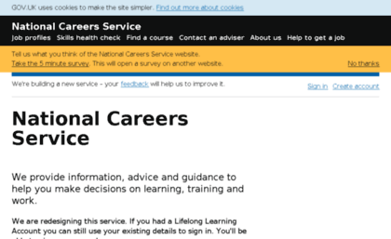
https://nationalcareersservice.direct.gov.uk/
Click on job profiles and make notes in your book on at least 3 careers including:
Job Title:
Hours of Work:
Possible Salary:
Entry requirements for the job:
Skills needed:
Other related careers:

Slide 120
Decision Making…
In the plus section write down all of the positive facts about the career, e.g. What about the job would you like the best?
Do you already have some of the skills?
In the minus section write down all of the factors that you might have to overcome.
e.g. Will you need to learn lots of skills? (some people might think this is a good thing).
Do you have to work shifts?
In the interesting section write down anything that you find interesting / unique about the job that will help you make your final decision.
e.g. Are there good opportunities to train and progress?
Maybe you will work outdoors.

Slide 121
Once you have filled in the Positive, Minus and Interesting points about each job, decide whether this job is suitable for you…
Would you like to do this job as a career in the future…?
Which factors have helped you to make your decision…?
Did you consider
any of the factors
from Task One…?

Slide 122
…
For the final task, you will need to choose one of the jobs that you were interested in doing as a career…
Consider what you have learned in the lesson and fill in the spaces on your handout…
Has this lesson made you think more carefully about your career choices and how to make a decision…?
Do you know what things will help you to make a decision about your career choice…?

