Slide 2
You will watch the EDF Energy trailer for their Pretty Curious campaign.
As you watch it, take note of the adjectives that are shown after ‘I’m pretty…’

Slide 3
Pretty Curious trailer
© EDF Energy 2016. All rights reserved
Notes:
The adjectives shown are curious, determined, inventive and focused.
Pretty Curious is a programme by EDF Energy which aims to address this under-representation of women in STEM careers, both now and in the future. They want to help change the perception of STEM subjects amongst teenage girls and address the reasons they are being put off from further STEM-related studies and careers. For more information on the Pretty Curious programme, please visit edfenergy.com/prettycurious.

Slide 4
Background to Hidden Figures
Hidden Figures tells the true story of the African-American women ‘computers’ who used their resourcefulness and ingenuity to help NASA to propel the first man into space.
It is centred around the NASA base in Langley, Virginia in the south of the USA in 1961. At this time, American society was segregated, the US was involved in the space race with the USSR and the feminist movement was in its early days.
The film is based on the non-fiction book of the same name by Margot Lee Shetterly, published in 2016.
Notes:
Further questions for discussion
Why do you think that the true story of these women has been made into a film recently?
Glossary
Computer
A clerical worker whose role involved checking mathematical calculations before the technological development of what we now call computers.
Jim Crow laws
The segregation law was known as Jim Crow laws, which was a derogatory term for a black man. The laws prevented black and white people from mixing in society, enforced segregation and restricted the rights of black people.
NASA
The National Aeronautics and Space Administration is part of the United States government and responsible for aeronautics and aerospace research.
Plessey vs Ferguson 1890
A legal case in Louisiana which resulted in the law that separate but equal facilities must be available for Caucasian and African-Americans in the US. In reality, the facilities offered to African-Americans were often below par. In the trailer, we can see that the African-American female NASA workers had to use the segregated bathrooms far from their office.
Segregation
A law in the US which meant that African-Americans were separated from other races in society. It was outlawed by the 1964 Civil Rights Act which activists such as Dr Martin Luther King protested for.
Space Race
A competition between the USSR and the United States of America to see who could make the most progress with space flight, in order to assert their nation’s superiority into space and for national security.
USSR
The abbreviation for the Union of Soviet Socialist Republics or Soviet Union which became known as The Russian Federation in 1991.

Slide 5
Trailer task
How does the trailer show that the women are:
Curious?
Determined?
Inventive?
Focused?
Notes:
If you are using this assembly for a tutor session or as part of a science, maths, PSHE, or citizenship lesson or extracurricular Into Film Club or STEM club, you can divide your learners into four groups with each group focusing on one of the areas, so that they can feed back their observations to the larger group.

Slide 6
Hidden Figures trailer
© 2017 Twentieth Century Fox Home Entertainment LLC. All rights reserved.
Notes:
The trailer for Hidden Figures.

Slide 7
Reflecting on the trailer
How does the trailer show that the women are:
Curious?
Determined?
Inventive?
Focused?
What advice would the characters in Hidden Figures give to the girls in the Pretty Curious advert about achieving their goals of working in STEM-related careers?
Notes:
How does the trailer show that the women are a) Curious? b) Determined? c) Inventive? d) Focused?
a) Curious
Mary Jackson (Janelle Monáe) considers becoming an engineer.
Dorothy Vaughan (Octavia Spencer) learns how to operate an IBM computer.
Mary Jackson finds the astronaut John Glenn attractive, despite the segregation laws in place in the US at the time.
Katherine Jackson wants to attend the briefing before she is turned away on account of her gender.
b) Determined
Mary Jackson learns how to operate the IBM computers in her free time using a library book.
Katherine Johnson asks to attend the briefing.
c) Inventive
Katherine Johnson uses her skills to solve the mathematical problem on the blackboard in the meeting.
d) Focused
Katherine is engrossed in solving calculations.
What advice would the characters in Hidden Figures give to the girls in the Pretty Curious advert about achieving their goals of working in STEM-related careers?
Young people may suggest that they would encourage them to work hard towards their dreams, despite any barriers that they may face.
Extension activities:
Ask learners to reflect on how they embody these four qualities in their own lives. For example, they could be curious because they learn how to use technology to make films in their spare time. Young people can pair up with a buddy who can suggest other ways that they embody the qualities. Students can then use their experiences to create a poster or booklet about themselves that they can add to their Record of Achievement or planner as inspiration. Alternatively, this could be a filmed presentation.
2. You could ask students to take on the role of one of the key women from Hidden Figures and send an email to one of the young girls in the Pretty Curious campaign trailer on slide 3 of the assembly presentation. In the email they could:
Explain the difficulties that they overcame back in the 1960s
Explain how curiosity, determination, inventiveness and focus helped them to put the first American into space and in the rest of their careers (this would require research into the lives of the women)
Explain the advantages that women have in the modern day compared to the 1960s and to also refer to the barriers that still exist
Encourage the girl to aim for her goal of a STEM-related career.

Slide 8
Breaking barriers
Watch the trailer again and identify the barriers that the women faced that hindered their STEM careers?
How are some of them shown to be overcome?
Notes:
You may wish to replay the trailer on slide 6 again so that young people can focus on the barriers shown in the trailer.
Students can break down the barriers into racial, gender and societal barriers, as shown below. If you have more time you can split the group into three smaller groups to focus on each type of barrier before sharing their observations with the whole group. Alternatively, you could ask learners to create a Venn diagram to show the different types of barriers and how they overlap. You may wish to copy and paste the suggestions below to print for students to sort on their Venn diagrams.
What barriers did the women face that hindered their STEM careers?
Racial:
Questioned by the police on their way to work
The police man being shocked that the African-American women work at NASA
The Caucasian female boss calls Katherine ‘coloured’ and tells her not to be an embarrassment
Katherine needs to use the segregated bathroom a mile away from the office
Mary Jackson says that the finish lines are moved just when they are about to get ahead
The women are expected to put up with poor work conditions on account of their race
Mary is stared at by students when she enters the college to study engineering
The African-American NASA workers stand in a separate line from their Caucasian colleagues to welcome the astronaut to their base.
Gender:
Mary Jackson is told that NASA doesn’t accept women in their engineering programme
The women are called ’girls’ by the astronaut John Glenn
When Katherine enters the control centre somebody presumes that she is the cleaner and not a colleague
Katherine is warned not to be an embarrassment in the control room as women have never worked in there before.
Societal:
As a working mother, Katherine has to deal with the guilt of being away from her children while working long hours on the space programme
Mary censors her dreams by saying: “I’m a negro woman, I’m not going to entertain the impossible.”
The women are expected to be happy to have a job at all despite the barriers and issues that they face.
How are some of the barriers overcome?
The trailer shows that Katherine is exceptional at her job and is more reliable than the computer.
John Glenn the astronaut has faith in Kathrine’s skills: “Glad to see NASA hasn’t given up on good old-fashioned brain power.”
The women are supportive of one another in the workplace and outside which helps them to achieve their goals.

Slide 9
Breaking barriers
Reflecting on the Hidden Figures trailer and your experiences, think about:
Why do you think the Pretty Curious programme was created by EDF Energy?
The barriers preventing girls and young women from having STEM careers today?
What do you think could help break down these barriers in:
Schools?
Workplaces?
Wider society?
Notes:
Possible answers:
1. Pretty Curious aims to inspire teenage girls to imagine a future where they use STEM – science, technology, engineering and maths – to help make a difference. Currently just one in five people working in core STEM areas today in the UK is a female *. This means there is a pool of undiscovered STEM talent. EDF Energy is hoping to increase the intake of female STEM graduates and apprentices to 30 per cent by 2018. This is an ambitious target, and one they're committed to dedicating resources and programmes, like Pretty Curious, to reach.
2. Students could suggest:
The expectation that boys will go onto study STEM subjects and have related careers, whereas girls will arts-based careers and not into STEM careers
Lack of visible women role models in STEM careers
Unconscious stereotyping by teachers, guardians or friends
Less girls than boys taking STEM GCSEs and A-level subjects
Girls from ethnic groups could have additional barriers due to stereotyping.
3. What do you think could help break down these barriers in:
Schools?
More visible women role models in STEM careers visiting their local schools eg delivering assemblies, mentoring etc.
Challenge gender stereotypes
Introduce girls to STEM careers and skills in specialist programmes and schemes before they select their GCSE options
Develop more interest in STEAM (Science, Technology, Engineering, Arts and Mathematics).
Workplaces?
Mentoring for women to encourage their personal development within STEM roles, where women are traditionally under-represented.
Wider society?
Remove prejudice against women entering STEM-related further study and employment
Encourage companies to champion gender equality eg toy manufacturers.
*www.edfenergy/prettycurious

Slide 10
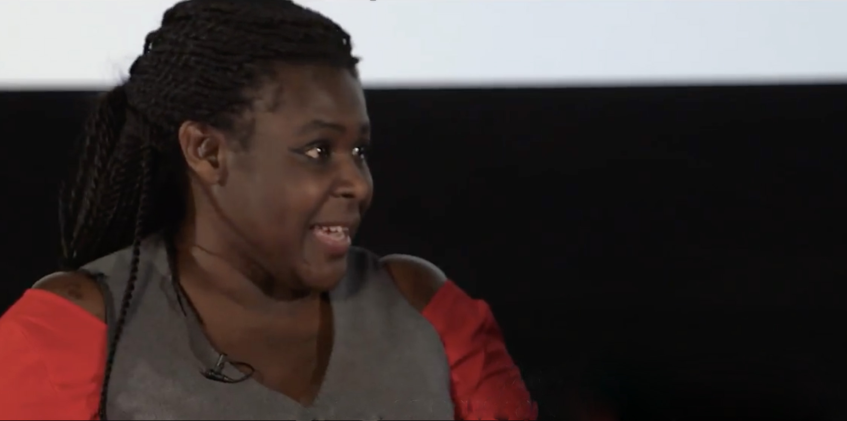
“It doesn’t matter what your stars are, everybody should be aiming high.”
Dr Maggie Aderin-Pocock
Space scientist and science educator
© Into Film 2017. All rights reserved.
Notes:
Ask the young people to reflect on the barriers that they face in achieving their goals. What learning can they take from Hidden Figures to help them to achieve it?
Encourage students to consider how they will continue to aim high in life and in what ways they can be curious, determined, innovative and focused.

Slide 11
‘Already be one’
© 2017 Twentieth Century Fox Home Entertainment LLC. All rights reserved.

