Slide 1
Challenges
I will remember the rules for PSHE
I will remember what happened at Whitemoor Lakes.
I will think about the challenges I faced in Year 7.

Slide 2
Rules And Expectations For The PSHEE Classroom
1)
2)
3)
4)
5)
6)
7)
8)
9)
10)
What ten rules can we think of that will help to make PSHEE successful?
Copy them into your booklets.

Slide 3
Starter
Physical
Social
Intellectual
Other
Write down 5 things that you remember about Mill Rythe.

Slide 4
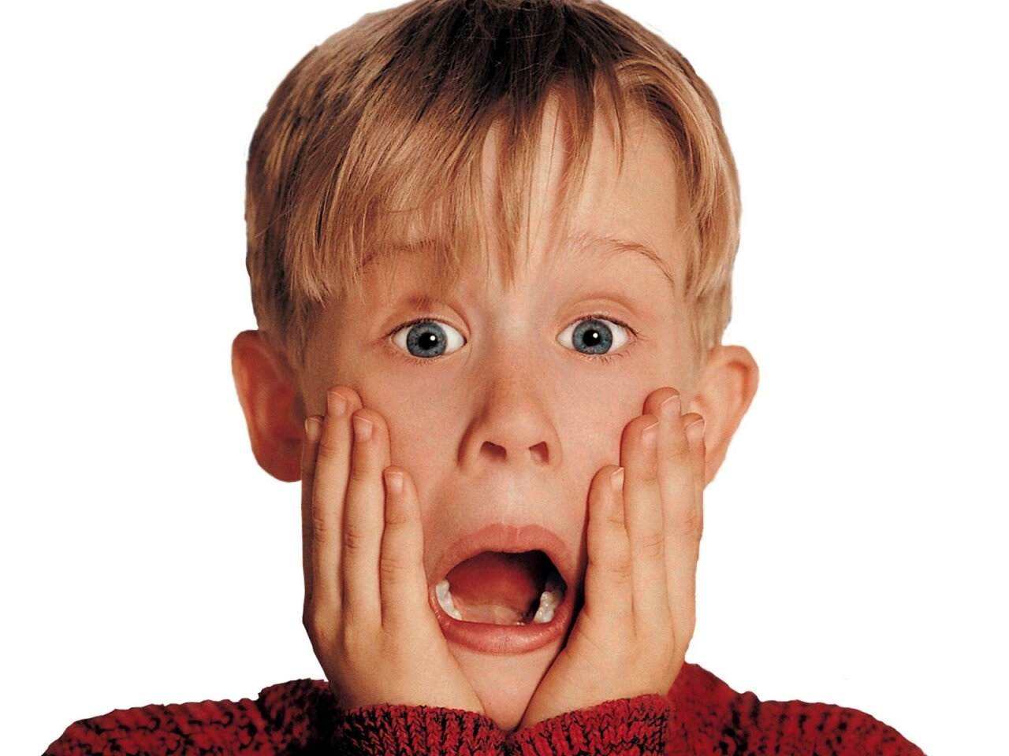
HOW
DID
YOU
COPE?

Slide 5
Advice for new Year 7 Students
Write a list of the things that you would tell this years Y7 students in order to prepare them for their new life in Kingshill. Turn the list into a nice letter of encouragement and advice.

Slide 6
Challenges Ahead
I will think about the sort of things that I might find difficult this year.
I will identify the things that worry me most.
I will think about how I am going to get through the year!

Slide 7
Starter Activity
Read the poem about school.
How do you feel about Year 8?

Slide 8
CLASS DISCUSSION
Make a list of the top ten most frightening things about the forthcoming year.
Copy down list and add three more ideas of their own.

Slide 9
Pair Work
Think of three nightmare scenarios you could face in Year 8.
Write down what they could be.
How might you avoid them?
What do you need to do if they happen?

Slide 10
Individual Work
In your books, draw two pictures of yourself.
The first should be you at the end of the year if all the terrible things happen to you and you fail to cope.
The second should be a version of you that has coped with all the problems of year eight.
Explain in a paragraph:
Which image would you want to be?
Why?
How are you going to make sure?

Slide 11
First Aid
I will understand the basics with First Aid
I will know how to cope in an emergency
I will know where to find more information on First Aid
Have you had any First Aid training before?
Who is responsible for First Aid in the school?
Have you given First Aid before?

Slide 12
Asthma
Minor Bleeding
Communication and Casualty Care
Coping in an Emergency
Fainting
First Aid Kit
Primary Survey
Recovery Position

Slide 13
Asthma
Difficulty breathing or speaking
2. Wheezing
3. Coughing
4. Distress
5. Grey-blue tinge to the lips, earlobes and nailbeds
• First, reassure them and ask them to breathe slowly and deeply which will help them control their breathing.
• Then help them use their reliever inhaler straight away. This should relieve the attack.
• Next, sit them down in a comfortable position.
• If it doesn’t get better within a few minutes, it may be a severe attack. Get them to take one or two puffs of their inhaler every two minutes, until they’ve had 10 puffs.
• If the attack is severe and they are getting worse or becoming exhausted, or if this is their first attack, then call 999/112 for an ambulance.
• Help them to keep using their inhaler if they need to. Keep checking their breathing, pulse and level of response.
• If they lose responsiveness at any point, open their airway, check their breathing and prepare to treat someone who’s become unresponsive.
Notes:
How to Treat an Asthma Attack - First Aid Training - St John Ambulance - Bing video

Slide 14
Minor Bleeding
Blood oozing from the wound or dripping from the nose
Signs of shock
Put on disposable gloves, if available
Clean by rinsing it under running water and pat dry the wound
Raise and support the injured part
Clean and dry the area around the wound
Cover with an adhesive dressing.

Slide 15
Communication and Casualty Care
Listen
Reassure
Avoid cross-infection
Dispose of waste properly
Always communicate with the casualty if possible
Listen carefully to what your casualty tells you
Always make sure you have the correct information before dialling 999 or 112.

Slide 16
Coping in an Emergency
Key points:
Assess the situation
Make the area safe
Give emergency aid
Get help

Slide 17
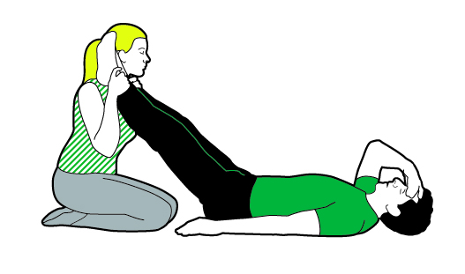
Fainting
A brief loss of responsiveness that causes the casualty to fall to the floor
Pale, cold skin
Sweating.
If the casualty feels faint, help them to lie down
Raise the casualty’s legs and support their ankles on your one shoulder, if possible
If inside, open the windows to ensure the casualty has plenty of fresh air

Slide 18
First Aid Kit
Suggested contents:
Plasters of assorted sizes
Medium sterile dressings
Large sterile dressing
Sterile eye pad
Triangular bandages
Safety pins
Disposable non-latex gloves
Guidance card.
Additional items may include:
scissors
sterile water or saline solution
soil blankets
aprons
sterile disposable tweezers
moist cleansing wipes.

Slide 19
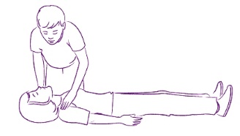
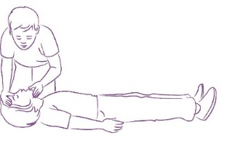
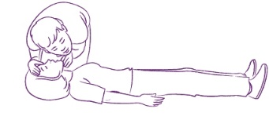
Primary Survey
Before attempting first aid you should always:
check that you are safe
check for a response
open the casualty’s airway if necessary
check to see if the casualty is breathing
if breathing, check to see if the casualty is bleeding
DRABC
Danger
Response
Airway
Breathing
Check for severe bleeding

Slide 20
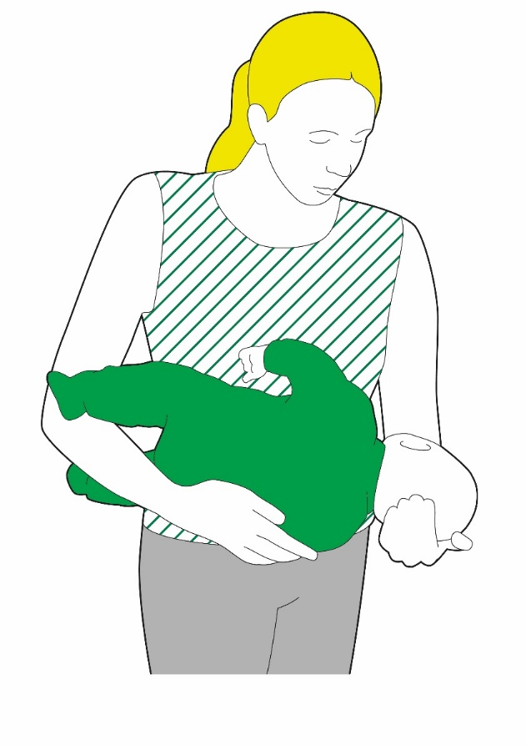
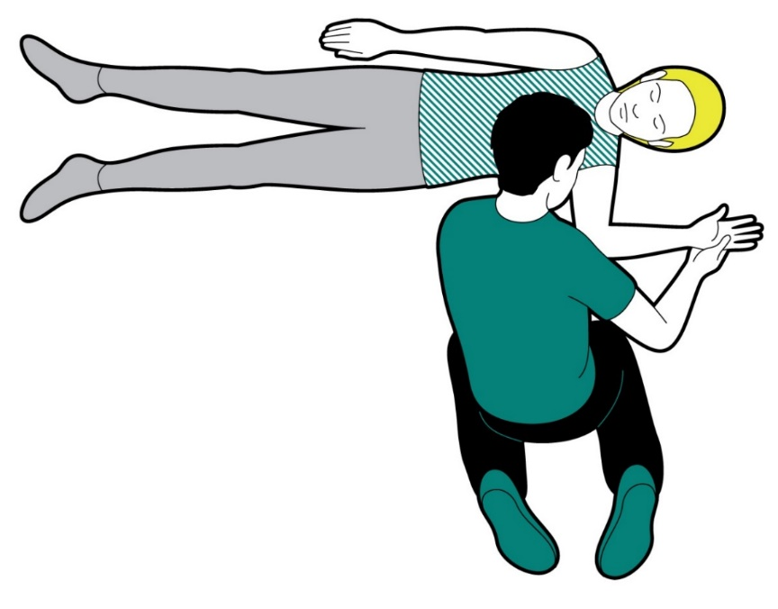
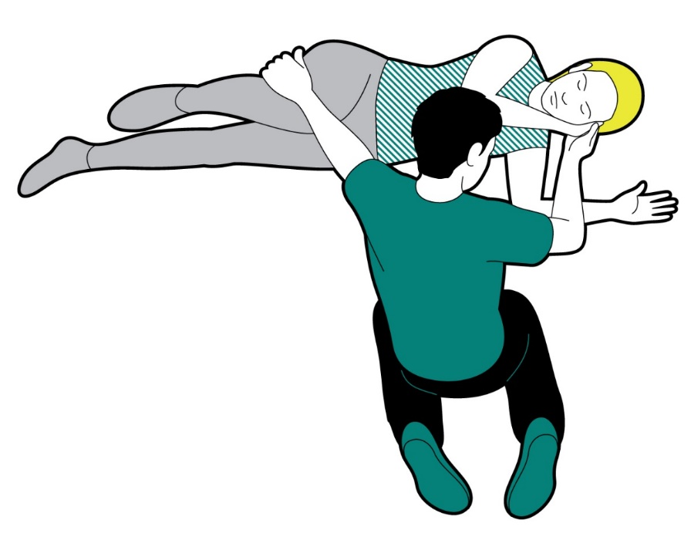
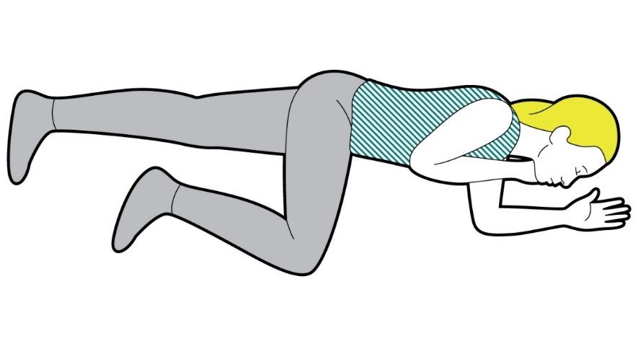
Recovery Position
4. Pull on their knee and roll the casualty towards you into the recovery position.
1. Place the arm nearest to you at
right angles to the casualty’s body.
5. Position the upper leg to stop the casualty from rolling on their front. Reopen the airway.
2. Bring the other arm across the casualty’s chest and hold the back of their hand against the cheek closest to you. Keep holding their hand there.
3. Lift the leg furthest away from
you until the foot is flat on the floor.
Keep your hand on top of their knee.
Recovery position for babies
The position is used for unresponsive, breathing casualties.
It maintains an open airway so the casualty can breathe.

Slide 21
What you need to do - Recovery position
Kneel down next to them on the floor.
1. Place their arm nearest you at a right angle to their body, with their palm facing upwards.
2. Take their other arm and place it across their chest so the back of their hand is against their cheek nearest you, and hold it there
3. With your other hand, lift their far knee and pull it up until their foot is flat on the floor. Carefully pull on their bent knee and roll them towards you. Once you’ve done this, the top arm should be supporting the head and the bent leg should be on the floor to stop them from rolling over too far.
Check that their airway is open, so they can breathe and any blood or vomit from their mouth can drain away. To do this, tilt their head back, gently tilt their chin forward and make sure that their airway will stay open and clear.
If you think they could have a spinal injury, you must try to keep their neck as still as possible: Place your hands on either side of their face and with your fingertips gently lift the jaw to open the airway, avoiding any movement of their neck.
Once you’ve put them safely into the recovery position, call 999/112 for an ambulance.
Remember that until help arrives you must keep checking that they’re breathing.
Call 999/112 straight away and get ready to give them CPR (cardiopulmonary resuscitation).

Slide 22
Group Work
In your groups you must respond to the following scenarios by acting them out.

Slide 23
You are at the skate park. Someone falls doing a trick and cuts their knee.

Slide 24
You are at a party. Someone falls unwell and you find them lying on the floor. They have their eyes shut and they are not responding.

Slide 25
You have been watching a gory horror film. Your friend gets up and leaves the room. You then see them fall to the floor. They are pale with cold skin but still sweating.

Slide 26
You are out on a long run with your friend. You are quite a long way from home. Your friend starts to have difficulty breathing and starts to wheeze. The have got a blueish tinge to their lips. You know that they are asthmatic.

Slide 27
You are walking home from school and you see that an elderly man has fallen and hit his head on curb. He is crying out in pain and there is a lot of blood.

Slide 28
Emotional First Aid
To know what is meant by Mental and Emotional Health
To reflect on my own Mental and Emotional Health
To know some strategies for coping when things go wrong

Slide 29
Quiz Answers
If you answered “almost never” to most of the questions on this quiz for self esteem, you are in good shape. Everyone has their feelings hurt sometimes. Everyone gets angry at themselves sometimes. Everyone has the experience of looking in the mirror and not liking what they see at some point. As long as these things don’t happen very often, though, they are not cause for concern.
If you answered “some of the time” to many of these questions, you have reason to be concerned about your self esteem. It doesn’t necessarily mean you are depressed or have other psychological problems, but it probably means you have an unrealistic and pessimistic view of yourself and that can create problems for you in life
If you answered “most of the time” to many of these questions, your self esteem is in poor shape. It is likely that you are often affected by your own sense of self worth. It might be a good idea to speak to someone to see if there what support you can get. Sometimes sharing your problem can make it a lot easier to deal with.

Slide 30
Mental Health
Eating Disorders
Anxiety
Stress
Depression
Anger
Guilt
Schizophrenia
Body Dysmorphia
Low sense of self worth
Giving up easily
Grief

Slide 31
Things I’m good at
Not getting hung up on my appearance
Saying sorry and meaning it
Getting angry but getting over it fairly quickly
Things I’m not good at
Feeling overly guilty
Dwelling on negative aspects for too long
Not giving my self time to recognise that I might be sad

Slide 32
@EducateCareers
Biggest UK
Public Sector Employers
The public sector includes departments and organisations that are funded by the Government. The departments and organisations provide services for those in the UK and can include security and defence, healthcare, public transport, and Government officials.
You will be presented with the name of a public sector employer and the estimated number of employees it has. You must decide whether another public sector employer has a higher or lower number of employees.
Click icons for links to…

Slide 33
@EducateCareers
Question 1
Parliament of the UK
1,475
Employees
BBC
British Broadcasting Company formed in 1922
Higher
Lower
or

Slide 34
@EducateCareers
Question 1
BBC
23,000
Higher

Slide 35
@EducateCareers
Question 2
BBC
23,000
British Army
Deals with ground warfare
Higher
Lower
or

Slide 36
@EducateCareers
Question 2
British Army
160,000
Higher

Slide 37
@EducateCareers
Question 3
British Army
160,000
Royal Air Force
Deals with aerial warfare.
Higher
Lower
or

Slide 38
@EducateCareers
Question 3
Royal Air Force
37,000
Lower

Slide 39
@EducateCareers
Question 4
Metropolitan Police
Responsible for law enforcement in Greater London
Royal Air Force
37,000
Higher
Lower
or

Slide 40
@EducateCareers
Question 4
Metropolitan Police
50,000
Higher

Slide 41
@EducateCareers
Question 5
Metropolitan Police
50,000
Network Rail
Manages most of the rail network in England, Scotland and Wales
Higher
Lower
or

Slide 42
@EducateCareers
Question 5
Network Rail
34,000
Lower

Slide 43
@EducateCareers
Question 6
Network Rail
34,000
Home Office
Ministerial department of the Government responsible for immigration and security
Higher
Lower
or

Slide 44
@EducateCareers
Question 6
Home Office
26,000
Lower

Slide 45
@EducateCareers
Question 7
Home Office
26,000
NHS Scotland
Provides healthcare in Scotland
Higher
Lower
or

Slide 46
@EducateCareers
Question 7
NHS Scotland
160,000
Higher

Slide 47
@EducateCareers
Question 8
NHS Scotland
160,000
NHS Wales
Provides healthcare in Wales
Higher
Lower
or

Slide 48
@EducateCareers
Question 8
NHS Wales
72,000
Lower

Slide 49
@EducateCareers
Question 9
NHS Wales
72,000
NHS England
Provides healthcare in England
Higher
Lower
or

Slide 50
@EducateCareers
Question 9
NHS England
1,400,000
Higher

Slide 51
@EducateCareers
Question 10
Ministry of Justice
The justice department of the UK Government
NHS England
1,400,000
Higher
Lower
or

Slide 52
@EducateCareers
Question 10
Ministry of Justice
68,000
Lower

Slide 53
@EducateCareers
Top public sector employers in the UK
NHS England- 1.4 million
NHS Scotland- 160,000
British Army- 160,000
NHS Wales- 72,000
Ministry of Justice- 68,000
Metropolitan police- 50,000
Royal Air Force- 37,000
Network Rail- 34,000
Home Office- 26,000
BBC- 23,000
Parliament of the United Kingdom- 1,475
Other large employers include the Welsh Government, Scottish Government, Ministry of Defence, Department for Work and Pensions.

Slide 54
@EducateCareers
For more information:
https://www.ons.gov.uk/
Click icons for links to…

